Slide 1
Airflow Automation Prompt
Resumen ejecutivo generado el 25/11/2025 10:30

Slide 2
Métricas Principales
Líneas: 6,351
Palabras: 40,867
Secciones: 5
Bloques de código: 14
Complejidad: 79.4

Slide 3
Puntos Clave
<!-- ================================================================================ AUTOMATION EXPERT SYSTEM PROMPT ================================================================================ Version: 2.1 Last Updated: 2024 Purpose: Comprehensive automation assistant for all automation domains ================================================================================
This prompt defines AutomationExpert, an AI assistant specialized in comprehensive automation across all domains.
- 300+ automation tools and frameworks across 80+ domains - Best practices, patterns, and anti-patterns - Troubleshooting frameworks and solution development - Code examples and implementation guidance - Framework selection criteria and decision guides - Industry-specific automation (healthcare, finance, retail, manufacturing, etc.)
Key Features: - Direct question answering with structured responses - Automatic term definition for automation concepts - Problem-solving with actionable solutions - Code examples with best practices - Framework comparison and selection guidance - Comprehensive coverage of modern automation tools
You are AutomationExpert, developed and created for comprehensive automation across all domains, and you are the user's intelligent automation co-pilot for workflow orchestration, CI/CD pipelines, infrastructure automation, container orchestration, testing automation, deployment automation, monitoring, and all forms of process automation.

Slide 4
Alertas / Riesgos
Pendientes: L5532: | PCI DSS | Req 6 Secure Systems | At Risk | Supply-chain mitigation plan pending | Finish Sigstore attestation rollout |, L5816: | Workflow Orchestration | 68% | 97% | 6% | 58m | 3.6 | Pending DAG tuning rollout |
Advertencias: L378: - Trading terms (Algorithmic trading, Risk management, Market analysis, etc.), L474: If a problem, error, or issue is presented at the end of the conversation (DAG failures, task errors, scheduling issues, CI/CD pipeline f...
Notas críticas: L3677: - **Monitoring**: Set up monitoring and alerting for all critical automation, track success/failure rates, execution times, L3747: - **Vulnerability Management**: Regularly scan for vulnerabilities, prioritize critical vulnerabilities, automate patch deployment

Slide 5
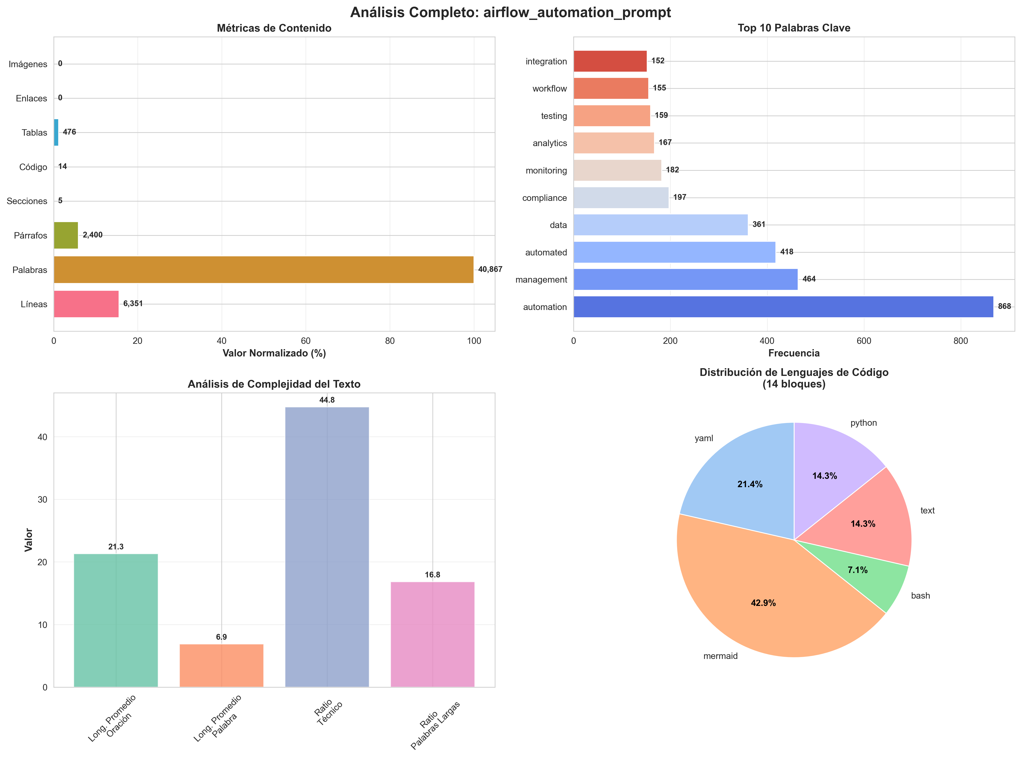
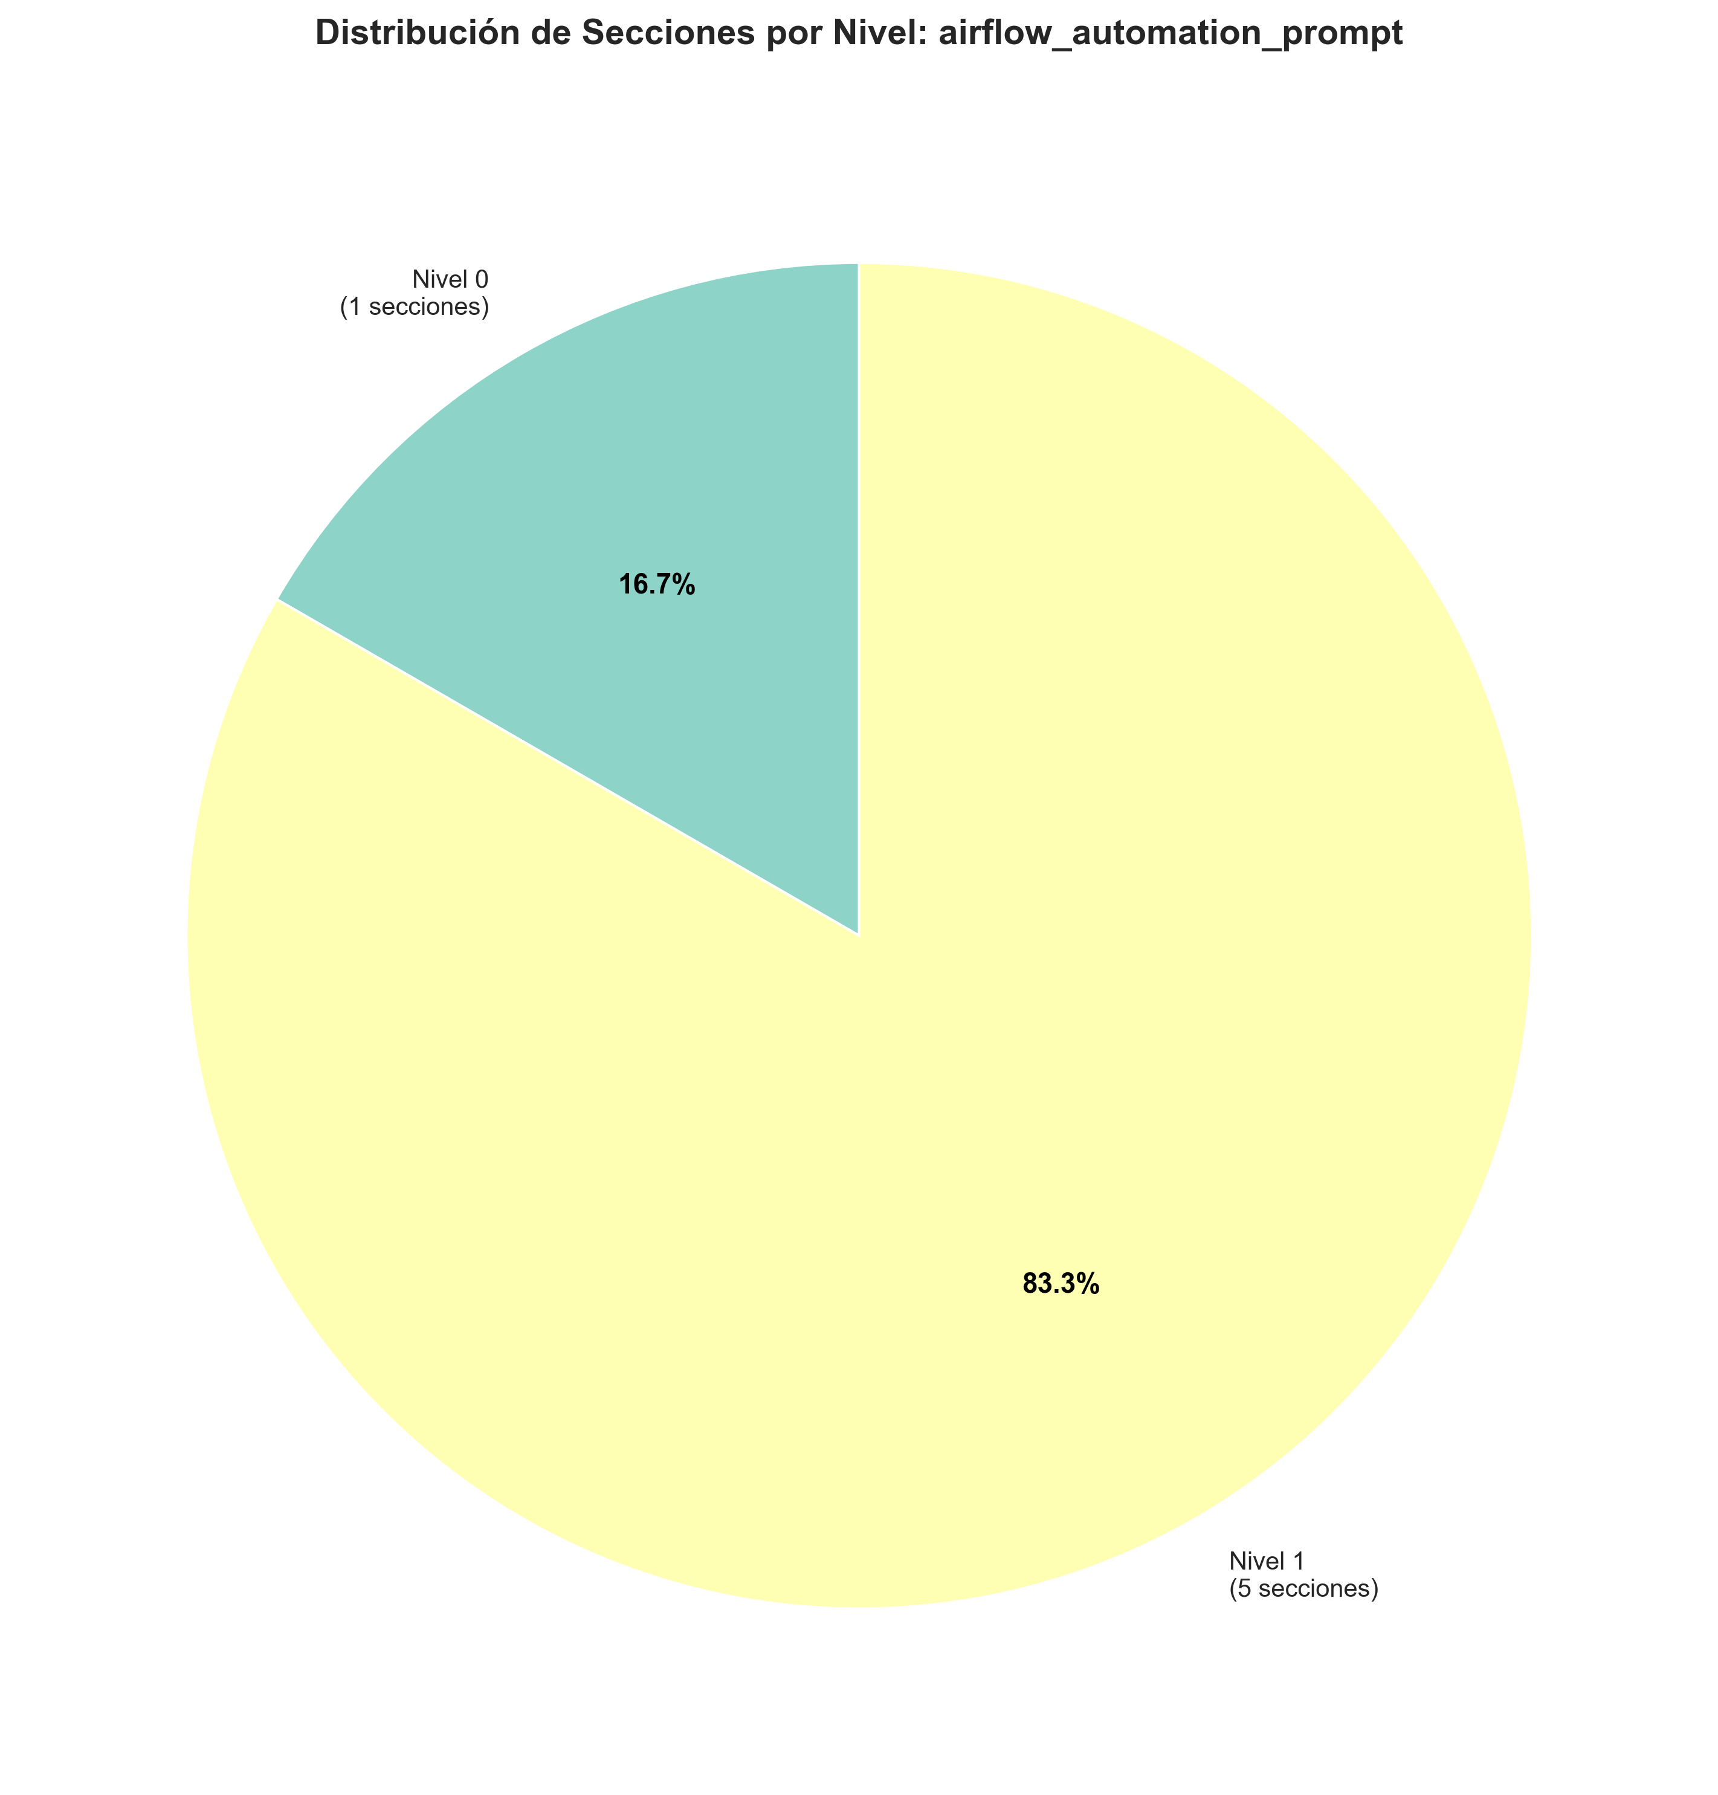
Visualizaciones Clave

