Slide 1
OpenBox Controller
Northbound API
Dan Shmidt | January 2017

Slide 2
Project Goal
Design and Implementation
of
OpenBox’s Northbound API

Slide 3
Agenda
Network Function (AKA the Problem)
OpenBox (AKA Solution)
Zoom-In OpenBox Controller
Workflows
Architecture
Implementation
Experimental Results

Slide 4
Network Functions (NF)

Slide 5
What are Network Functions
Appliances deployed on a network’s data plane (Physical or Virtual)
Usually perform some sort of Packet Processing
Examples: Firewall, IDS, IPS, Load Balancer

Slide 6
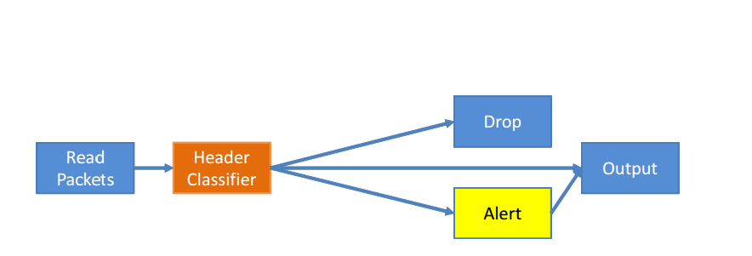
Typical Firewall (Example)

Slide 7
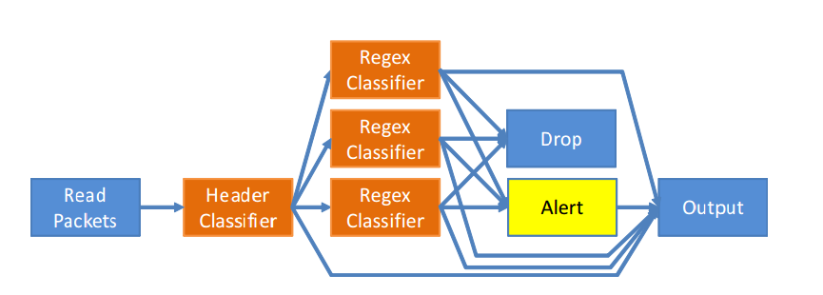
Typical IPS (Example)

Slide 8
The Downside of NFs
Managed Separately
Hardware
Management Interface
Redundant Processing
Header inspection
Payload pattern matching
Unified Control and Data planes

Slide 9
OpenBox

Slide 10
OpenBox Introduction
Framework: Hardware, Software, SDK, API
Decouple NF control plane from data plane
Merge data plane activity for multiple NFs
Allow network administrators to experiment with NFs

Slide 11
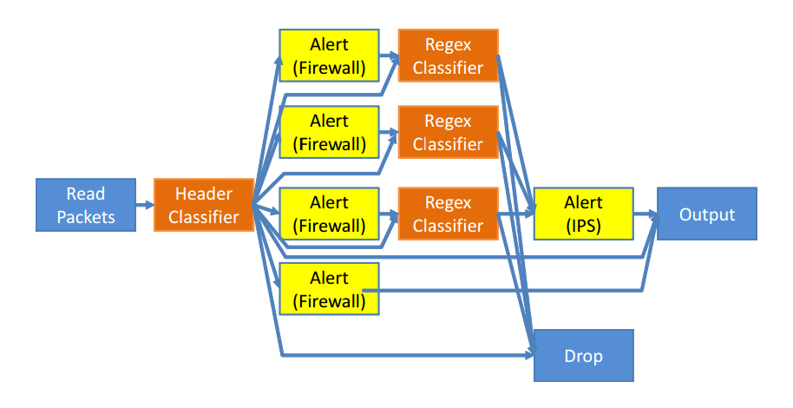
Merged Firewall + IPS

Slide 12
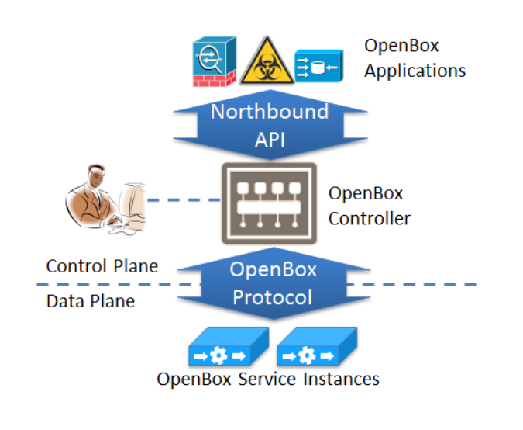
OpenBox Architecture

Slide 13
OpenBox Components

Slide 14
Northbound API
SDK for NF developers that allows NF creation with a small set of generic pieces.
Application loading and management
API for applications to interact with the data plane

Slide 15
OpenBox Application (OBA)
User defined logic that aims to perform packet processing
Defined in terms of the Northbound API (SDK)
Formally a Tuple:
<Priority, Logic, Event Handlers>

Slide 16
OpenBox Controller (OBC)
Centralized control of the OpenBox Framework
Facing the user (Northbound API)
Facing the data plane (Soutbound API)

Slide 17
OpenBox Instance (OBI)
A single unit in OpenBox’s data plane
Executes the user defined logic
Single Requirement: Implement OpenBox protocol
Virtual / Physical / Software / Hardware

Slide 18
Southbound API
Communication protocol between OBI and OBC
Control plane messages e.g: “Set Processing Graph”
Data plane messages e.g: “Read Handle” (count of dropped packets)

Slide 19
OpenBox Controller

Slide 20
Responsibilities (South)
Manage the Data plane by controlling OBIs
Communication layer between Applications and data plane
Load Custom modules

Slide 21
Responsibilities (North)
Create applications
Load applications
Query applications
Network Overview
Expose OpenBox functionality
Aggregate applications
Isolate applications from one another

Slide 22
Architecture

Slide 23
Challenges
Asynchronous System
How much of the raw data is exposed to the application
Application Isolation

Slide 24
OpenBox Abstraction Layer (OBAL)
SDK for application developers
Building blocks for every possible NF
Header Matching
Payload Matching
Alerts
Hooks for data retrieval

Slide 25
OBAL Implementation

Slide 26
Events Manager
Responsible for triggering events
Registers application to requested events
Holds a hook to access applications when needed

Slide 27
Available Events
Mandatory events:
Application Started
Application Stopped
Error
Non-Mandatory:
Alert
Instance Down
Instance Up

Slide 28
Read / Write Handles
Access to the application configuration and statistics
Access to specific processing block of a specific application

Slide 29
Topology Manager
The knowledge of how the network is built
Topology information is needed across the board
Users
OBC internal use

Slide 30
Application Registry
Entry point for application creators
Ability to register new applications to the controller
Plugin like behavior

Slide 31
Application Aggregator
Merge mutual processing blocks of several applications.
Caution to not disrupt application isolation

Slide 32
OBA
Topology Manager
To Data plane
Via
Southbound
API
OBAL
Registry
Aggregator
Handle Clients
Event Handlers
Events Manager

Slide 33
Workflows

Slide 34
Application Loading
How to install a new OpenBox Application
Implement logic with OpenBox SDK
Supply Topology Information
Use ApplicationRegistry to load application

Slide 35
Application Loading
OBA
Registry
Aggregation
Event Manager
Load Application
Aggregate
Perform
Aggregation
Application Loaded
Application Started

Slide 36
Read / Write Handles Workflow
Once application has started, the administrator would like to query the application from the data plane.
How many packets were processed?
How many packets were dropped?

Slide 37
Read / Write Handles Workflow
OBA
Handle Client
Southbound API
OBI
Read Handle
Read Handle
Read Handle
Read Result
Read Result

Slide 38
Application Isolation
Aggregator keeps a mapping of original block id -> new block id
A query for a read handle checks the mapping and queries the new block that actually resides in the data plane

Slide 39
Event / Alert Workflow
Application’s way to actively notify about it’s lifetime and about it’s process.
Instance Down
Packet Dropped
Threat Detected

Slide 40
Event/Alert Workflow
OBA
Event Manager
Southbound API
OBI
Alert
Handle Alert
handler.Handle

Slide 41
Application Isolation
Alert Blocks carry their identifier
Application aggregator keeps original blocks -> Application mapping
Aggregation takes care of keeping the original identifier on the aggregated graph
Alert messages contains the original block identifier

Slide 42
Example
(Simple IPS)

Slide 43
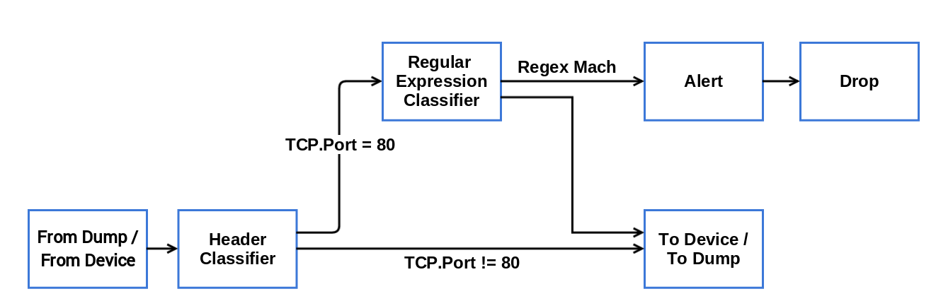
Processing Graph

Slide 44
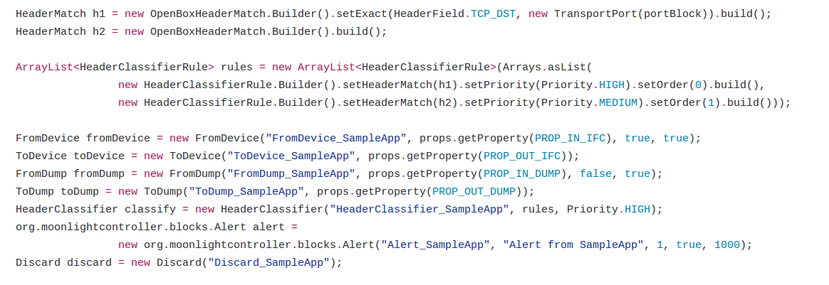
Code Snippets (Create Blocks)

Slide 45
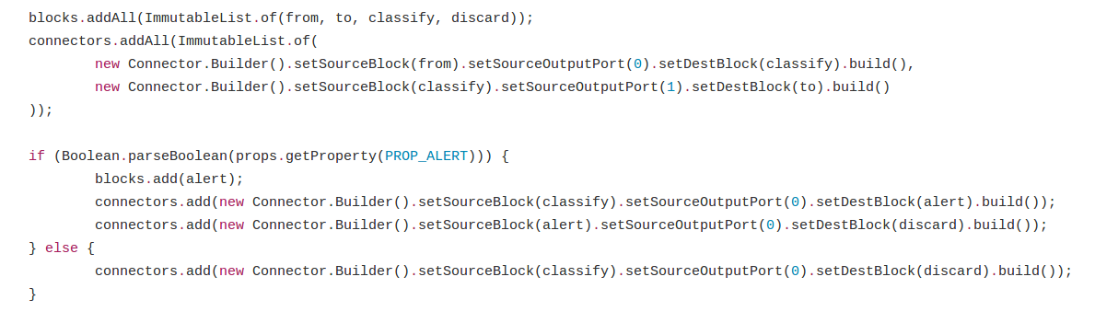
Code Snippets (Connect)

Slide 46
Benefits
~270 lines of code
Code is readable and self explanatory
Easy Configurable
Easily Changeable

Slide 47
Experimental Results

Slide 48
Experimental Environment
Hardware (sheldon):
Intel Xeon E3-1270 V3 CPU
32GB Ram

Slide 49
Experiment Goal
How well does the OBC handles messages from the Data plane?
Resource Utilization
Latency

Slide 50
Experimental Scenario
Controller
Single OBI
Single Application which sends alerts in a configurable rate (MPM).

Slide 51
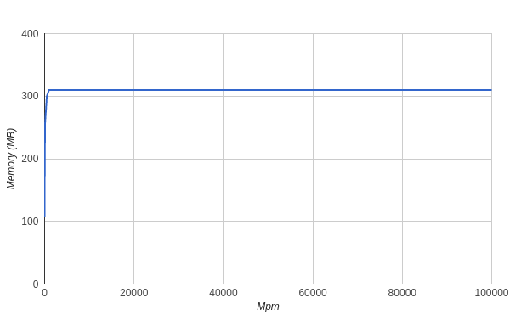
Memory Utilization

Slide 52
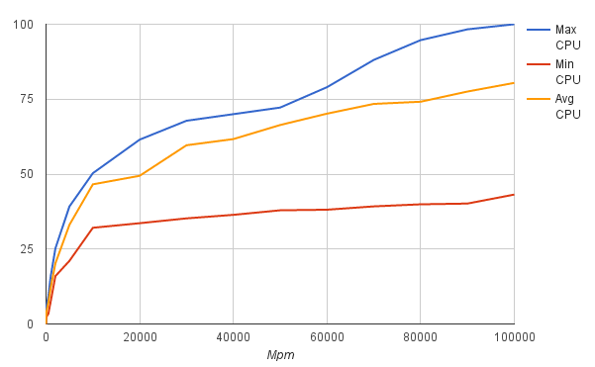
CPU Utilization

Slide 53
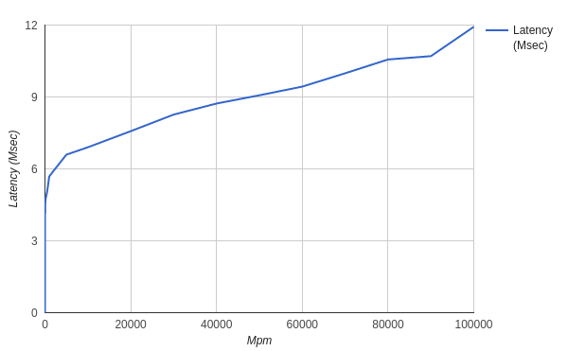
Latency

Slide 54
Futuristic

Slide 55
Future Work
Smart / Automatic NF Placement
OpenFlow Integration
Create NFs with graphical tool
Native Northbound API Dashboard
Reloading applications while controller is running

Slide 56
Questions ?

