Slide 1
OpenC2, OpenDXL, and STIX Integration
G2 Inc. Supporting National Institute of Standards and Technology (NIST)

Slide 2

The goal
Take a STIX formatted message and take action on it using the OpenC2 framework
Messages between OpenC2 nodes transported via OpenDXL
Build a simulated modern Windows domain
Add McAfee ePolicy Orchestrator, and agents on each windows system
Add McAfee Threat Intelligence Events (TIE) Server
Add OpenC2 servers
Add OpenDXL servers
Demonstrate end-to-end integration of a threat message, to transportation, to defensive action

Slide 3

What is OpenC2?
Deals with the problem of products integrating in a proprietary/unique ways
Answers the need for the synchronization of cyber defense mechanisms
Multipart and Automated actions
Dependencies
No defined transport layer
No defined authentication
Requires actuator support from devices
Messages
Tasking / Response actions ( ~30 terms)
Notifications

Slide 4

OpenDXL
Open Data Exchange Layer
Leverages McAfee Data Exchange Layer
Enables real-time communications
Supports large scale architectures via multiple “Brokers”
Transportation layer for arbitrary messages
Advantages of talking via OpenDXL
Allows strong controls via certificates and restrictions on sending or receiving communications
Supports multiple “topics”
Secure communication via TLS 1.2 and mutual PKI authentication
sends on topic
Broker
subscribes to topic
Notes:
This is a communications fabric
More info found here: http://www.mcafee.com/ca/developers/open-dxl/features.aspx

Slide 5
STIX format for structured threat data
Structured Threat Information Expression
Defines 9 key constructs and relationships between them
Used to support open exchange of data about attacks in a standard XML format
Effort is on taking a STIX indicator and mapping it to a course of action
Example: Take a STIX message about malware, and set a course of action to block it at the firewall as well as notify the antivirus to find it and delete it across the enterprise
Construct | Description
Observables | What was seen
Indicators | What patterns might been seen and what they are
Incidents | Specific adversary actions
TTPs | Attack patterns, malware, exploits, tools, and techniques
Exploit Targets | Vulnerabilities, weaknesses, and poor configurations
Courses of Actions | Response actions that may be taken to an attack, or a preventative measure
Campaigns | Sets of incidents and/or TTPs with a shared intent
Threat Actors | Identification or characterization of the adversary
Notes:
Used to prime the intelligence. Could be any other source.
More info: http://stixproject.github.io/about/

Slide 6


Setup for demonstration network - Standard Windows Domain
Build functioning, small scale network to build OpenDXL and OpenC2 environment
Windows 2012 R2 domain
Network shares
Windows 10 clients
Windows 7 clients
Standalone Linux Servers
McAfee EPO Servers
Windows 7-A
Linux3
Windows 7-B
Linux4
Windows 10-A
Windows 10-B
Domain Controller
Windows 2012R2

Slide 7

Setup for demonstration network - McAfee ePolicy Orchestrator (EPO)
Client antivirus connects periodically to the EPO Server via Polling (~hourly)
Slow updates
Client antivirus maintains connection to DXL Server
Fast updates
TIE Server
Repository of threat intelligence
McAfee EPO
Windows 10-B
OpenDXL Server
Threat Intelligence Events Server (TIE)

Slide 8
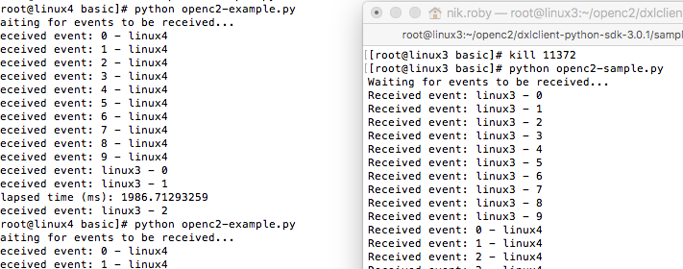
Successful Implementation of OpenDXL
Screenshot of servers communicating via OpenDXL Fabric
Leveraging Mutual TLS 1.2 certificates
Authorization to publish on a topic handled by EPO Server
Used a custom topics channel
Requires successful setup of a custom Certificate Authority, trusts, and a local OpenDXL Broker
sends on topic
linux3
Broker
linux4
Custom (local) Broker

Slide 9
Setting a file reputation via OpenC2 using OpenDXL as the messaging fabric
Read in a standard file describing a malicious file with hashes
Convert the file to an OpenC2 message
Send the message to an actuator (EPO) using OpenDXL
Provides Auth/Security
Provides reliable messaging
Actuator (EPO) takes appropriate actions
(subscribes to channel)
Remediate this Malware Signature
McAfee EPO
Windows Network
Linux3
(send to TIE channel)
Publish a custom reputation for this file
(publishes to channel)
Remediate this Malware Signature
OpenDXL Server
Threat Intelligence Events Server (TIE)
Linux4

Slide 10
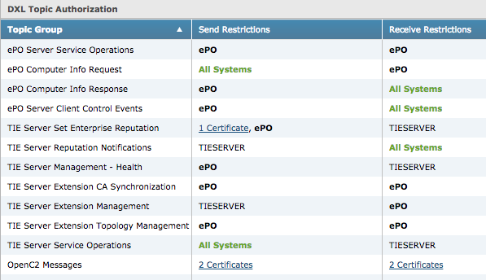
DXL Topic Authorization / Authentication
Built Custom Certificate Authority (CA) and issued certificates to each OpenC2 server
Only clients with valid and authorized certificates can talk
OpenDXL handles the authentication and restrictions

Slide 11
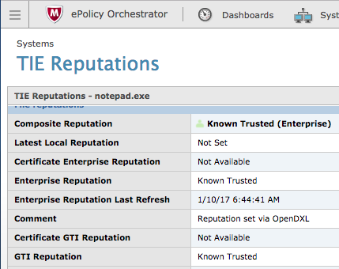
Setting enterprise reputations in TIE
Demonstrate using Threat Intelligence Enterprise Server (TIE) as an Actuator
TIE allows various types of enterprise reputations associated to files
File reputations will elicit different behaviors by the host based client
These behaviors are tied to policy described in the EPO
A file reputation of “Known Malicious” will elicit three behaviors
Kill the process
Delete the file
Disallow further attempts to run process

Slide 12
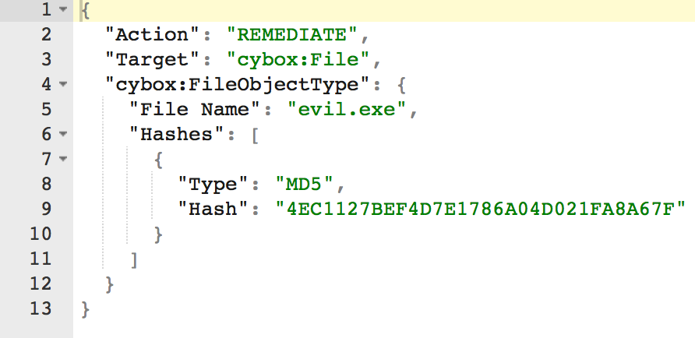
Setup for OpenC2 via OpenDXL demo
For this demo we wrote 2 pieces of shim code
stix_shim.py (Publisher)
Ingests STIX message
Derives and creates OpenC2 message
Sends OpenC2 message via OpenDXL
Utilizes Topic: /openc2/action
tie_shim.py (Subscriber)
Receives OpenC2 message via OpenDXL
Utilizes Topic: /openc2/action
Inspects OpenC2 message for actions
Sends TIE reputation update
Describing a malicious file by hash

Slide 13
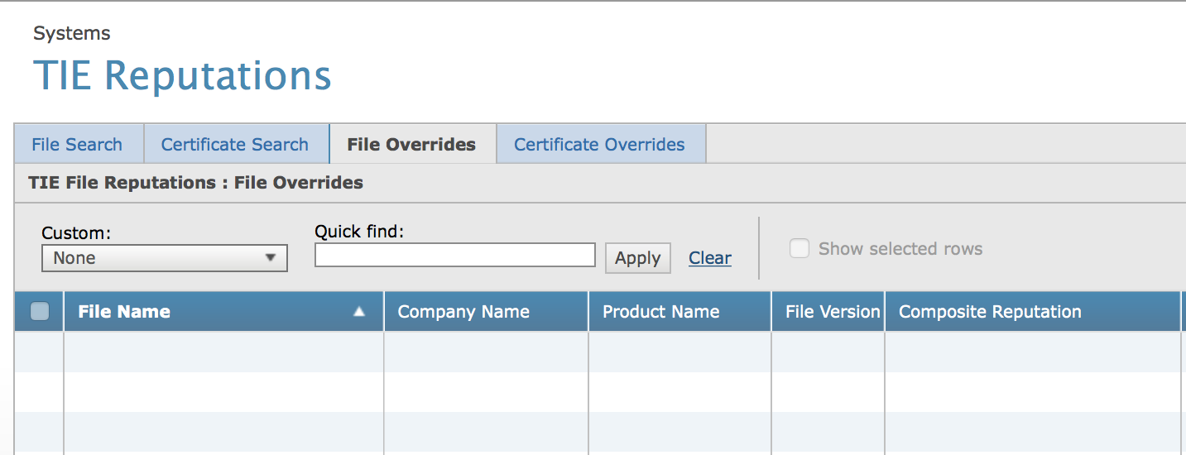
OpenC2 via OpenDXL demo (explained)
TIE reputations start as unset
We will set it via an OpenC2 message via OpenDXL message fabric
No reputations are set yet

Slide 14
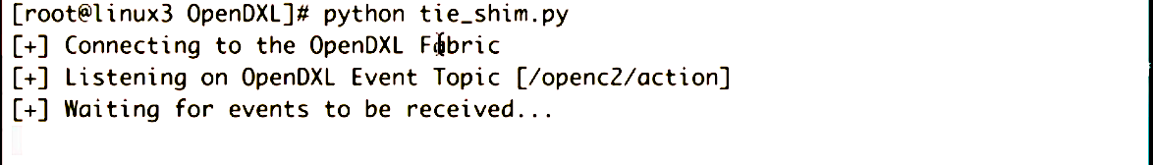
OpenC2 via OpenDXL demo (explained)
tie_shim.py is currently waiting for events to be received
This is a process that will wait for an OpenC2 message on the right topic
When it receives a message, it will set the file reputation via the TIE actuator

Slide 15
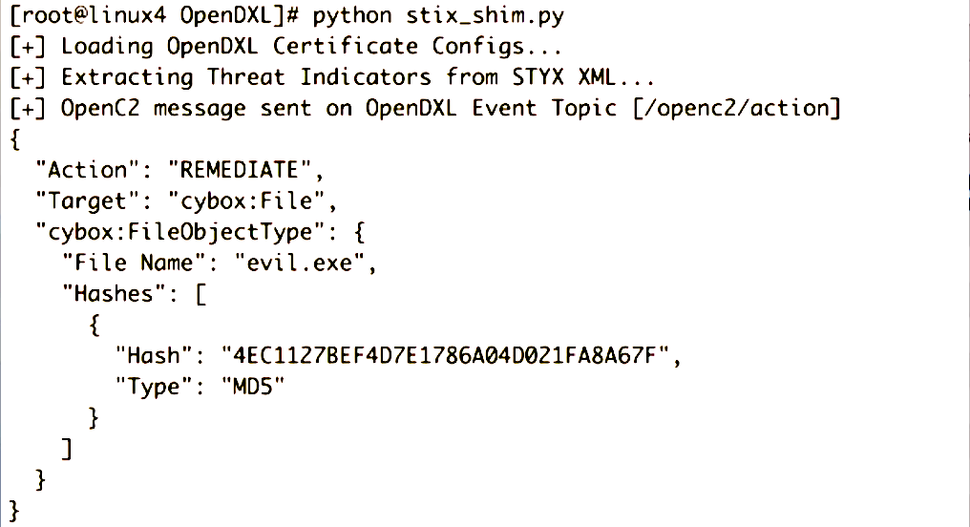
OpenC2 via OpenDXL demo (explained)
stix_shim.py sends OpenC2 message via OpenDXL after ingesting STIX file example.xml
Reads the STIX message
Creates and OpenC2 action of “REMEDIATE”
Sends message via OpenDXL to all systems subscribed to the OpenC2 topic
Sending an OpenC2 message via DXL

Slide 16
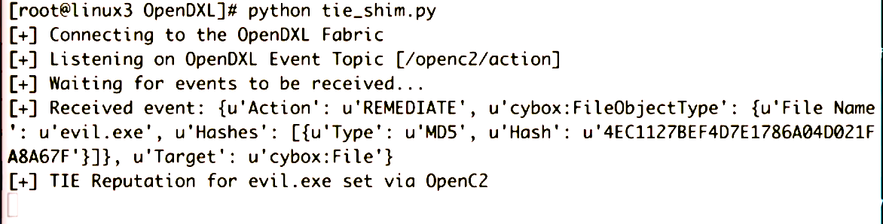
OpenC2 via OpenDXL demo (explained)
Tie_shim.py updates TIE reputations after receiving OpenC2 message
Message went thru OpenDXL broker
Encryption and authentication is invisible when using OpenDXL

Slide 17
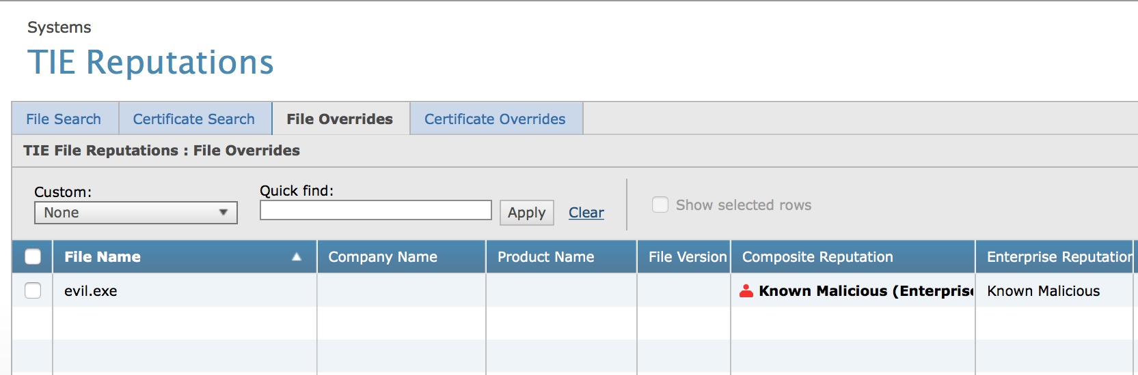

OpenC2 via OpenDXL demo (explained)
TIE reputation for evil.exe is set to “Known Malicious”
This allows EPO to determine appropriate actions for “REMEDIATE”

Slide 18
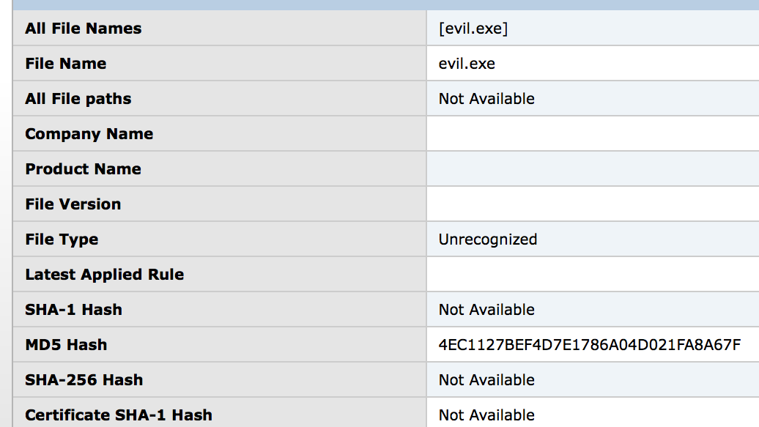
OpenC2 via OpenDXL demo (explained)
TIE reputation the contains MD5 Hash of evil.exe

Slide 19
Video Demonstration
Demonstrate setting actions via live demonstration

Slide 20
VIDEO REMOVED

Slide 21
Questions? Thanks for your time!
Further questions, comments, or slides copies
openc2@g2-inc.com
Nik Roby
Nik.roby@g2-inc.com
Danny Martinez
danny.martinez@g2-inc.com

