Slide 1

Biweekly forum meeting
02 Mar 2017

Slide 2
Agenda
RSA Debrief (Brule)
OASIS Transition (Ensign)
LDD Updates (Romano)
Actuator Profile Subgroup Report (Romano)
STIX/OpenC2 Subgroup Report (Verma)

Slide 3
RSA Debrief

Slide 4
TC Launch Timeline
Draft Charter
Statement of work, scope, and other requirements defined in TC Process
Submitted by Convener to OASIS
Call for Comment
14-day review by OASIS membership at-large
Comments are submitted to OASIS-hosted mailing list
Convener Call
Convener, TC Proposers review member comments, finalize charter
OASIS convenes within 2 to 5 days of close
Comment Log & Final Charter
Due to TC Admin by 28th day after charter submission
Call for Participation
Announcement from OASIS minimum 30-day before first meeting (teleconference) or 45-days (face-to-face)
1st TC Meeting
Official TC launch; first order of business is election of chair/co-chairs

Slide 5
TC Launch Timeline
Timeline for OASIS actions:
Call for participation sent
Reminder of deadline to join with voting rights (approx. 10 days before first mtg)
Call for nominations for chair (approx. 8 days before)
Last day to join with voting rights (7 days before 1st meeting)
List of eligible voters to mailing list
Inaugural meeting

Slide 6
TC Resources when C4P is sent
Members-only TC web site / collaboration tools (“Kavi”)
Only OASIS members may view
Public TC web site (subset of Members-only)
TC mailing list
Publicly archived
Only TC Members may post
Only TC Members and Observers are subscribed (automatically)
TC comment list (non-member feedback to TC)
TC wiki*
JIRA issue tracking system*
Version control system (SVN or GitHub)*
*Created upon request

Slide 7
Language Description Document
Updated the Target Data Model
Removed and updated Actions (33)
Incorporated many suggested changes
Reorganized Section 3: OpenC2 Language
OpenC2 Command
OpenC2 Response
OpenC2 Alert

Slide 8
RESPONSE Format
(
RESPONSE (
SOURCE (
type = <data-model>:<ACTUATOR_TYPE>,
<actuator-specifier>
),
[CMDREF = <COMMAND_REFERENCE>,]
STATUS = <STATUS_CODE>,
[STATUS_TEXT = <STATUS_TEXT>,]
RESULTS (
<DEFINED_VALUE>
)
)
)

Slide 9
Actuator Profile Subgroup Report

Slide 10
STIX/OpenC2 Subgroup Report

Slide 11
Attendees
General Dynamics – Jason Romano, Joyce Fai
NSA – Joeph Brule, Dave Kemp, Kevin Miller, Joan Peterson
Cisco – Jyoti Verma
Symantec – Bret Jordan
Looking Glass – Allan Thomson, Todd Beine
Cyber Phantom – Sourabh
sFractal – Duncan Sparrel
DHS - Juan Gonzales
JHAPL – Mark Moss
Mitre – Sean Barnum, Applebaum
Soltra – Aharon Chernin
…

Slide 12
History
Formed a couple of months ago to develop reference implementations for OpenC2 in STIX
Started off with XML - developed STIX COA in XML for 1.2
Moved to JSON following STIX 2.0

Slide 13
What we have achieved
Influenced OpenC2 with decisions from CTI-TC
JSON MTI, Cyber Observables etc.
Socialized and influenced CTI-TC about using OpenC2

Slide 14
Next Steps
Short term - Complete STIX COA representation for STIX 2.1
Ongoing work here - to be done before OpenC2 becomes a TC
Longer term - Interoperability topics between STIX and OpenC2 – example Playbook

Slide 15
Takeaways from CTI-TC F2F
Playbook
A Playbook represents a workflow for incident response. Following are the characteristics of a playbook:
Each step of the playbook can either be manual or automated.
Playbook has synchronous or asynchronous steps
Every step in the playbook may depend on the response of the earlier step - for sequential steps
Playbooks can be very long lived
The steps of a playbook could be related to each other out of order

Slide 16
Playbook definitions
“Playbook is a named sequence of coa that can be referred to by one or more SDOs (campaign, sighting, ....etc) where the playbook is a top-level SDO that has its own object lifecyle like other objects”
“Playbooks will contain a series of COAs (manual, process, automated) that have conditional logic and temporal logical associated with each one. Do X then if result Y do Z followed by A and B within 1 day”

Slide 17
Examples
Ransomware

Slide 18
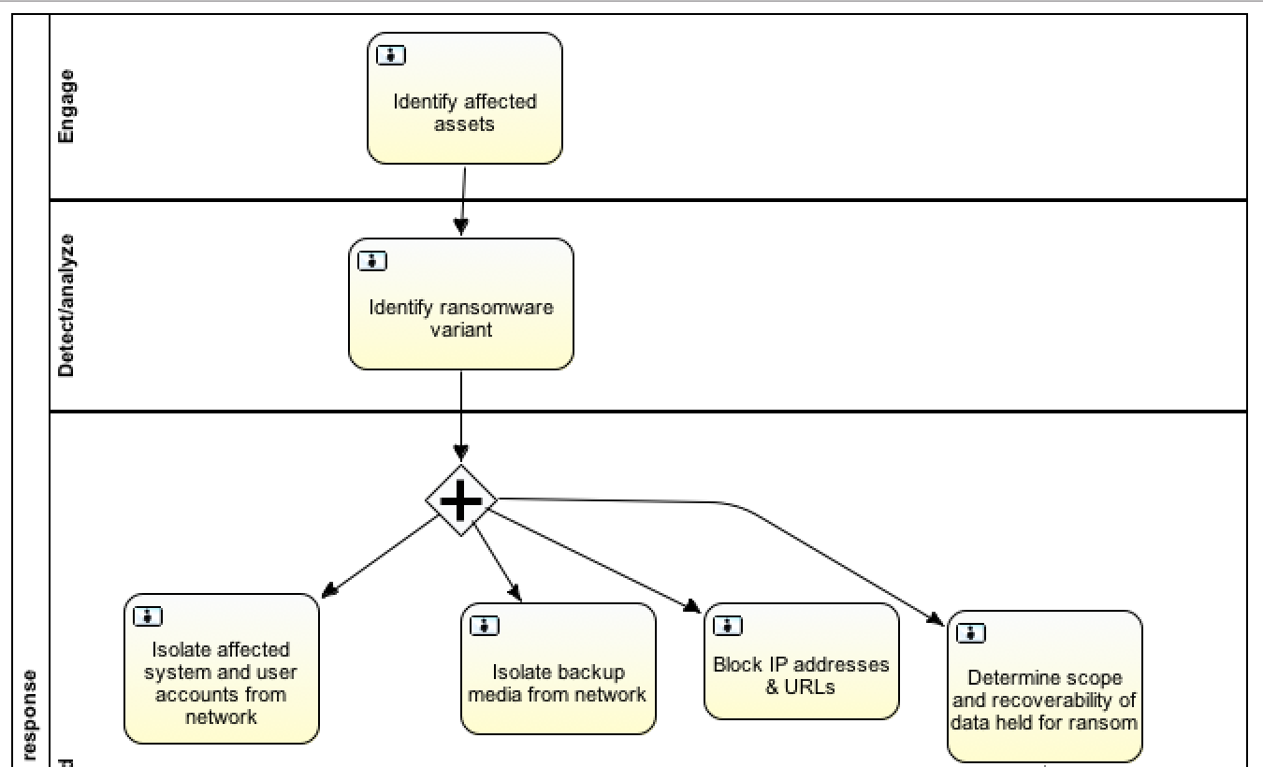
OpenC2?
OpenC2?
Contain
Contain
Deny

Slide 19
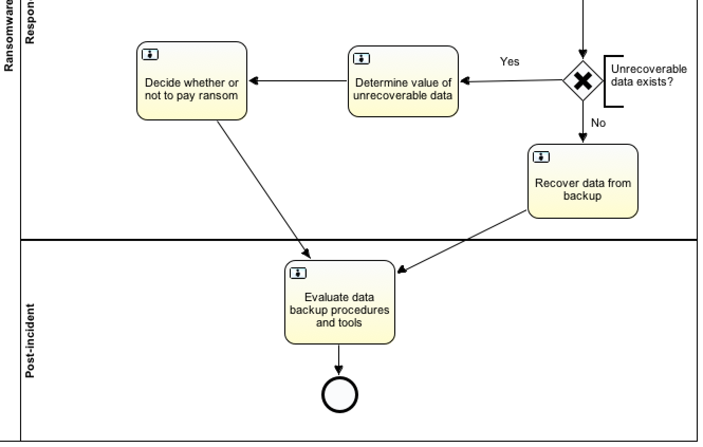

Slide 20
Open Questions
How to handle interoperability
Participate in mini groups of CTI-TC – Example Playbook
Handled by CTI-TC interoperability sub-committee – headed by Allan
As part of OpenC2 TC?
Liaison group in OASIS?

