Slide 1

External dependencies
Or ‘What is the next REALLY hard problem?’
Joe Brule
NSA IAD Active Cyber Defense
March 31, 2016
07 Jan 2016

Slide 2
Agenda
Tasks at Hand
Define within protocol
Create Overlay
Leave to Implementer
The Models & Environments
Design Principles
Next Steps?

Slide 3
External Dependencies and Considerations (Partial list)
Identifier (or UUID)
Connection management
Packet order
Missing packets
Latency management
Information Assurance Considerations
Authentication
Integrity
Confidentiality
Priority
TTL (i.e., duration that the command is valid)
Acknowledgement (receipt and/or execution of command)
Order of execution (for stream of commands)
Data Model for Targets, Sensors and Actuators
Should We Define as Overlay or Within Standard?

Slide 4
ACD Command and Control Model

Slide 5
Command and Control Model (examples)
Upper Tier to Lower Tier (hierarchical)
Peer to Peer
Enclave Level
Publish-Subscribe
Point to Point, unicast or multicast

Slide 6
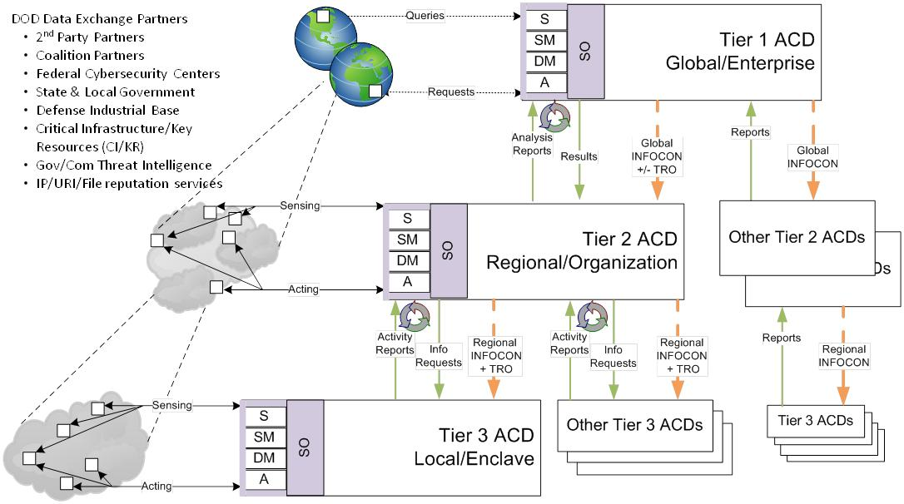
Hierarchical Model (an example)

Slide 7
Transport Model
Pub-Sub
Authentication/ Data at rest protection
Asynchronous
Acknowledgement
Missing packets
Jitter/ Delay
Full Mesh of https Sessions
Key Management
Full Mesh of PVC connections
Scalability concerns
Out of Band Command and Control Channel
Cost Concerns

Slide 8
OpenC2 Design Principles
Lightweight
Efficient Machine to Machine communications
Minimize the set of ‘core’ actions
Abstract
Focuses on ‘What’ to do vice ‘How’ to do it
Permits different levels of abstraction
Extensible
Address requirements for operational environment
Extensions enable additional precision and flexibility
Agnostic
Transport, Authentication , Integrity controls etc.
Enables flexibility w.r.t. implementation
Enable Unambiguous Machine to Machine
Command and Control Messages
Notes:
The end state is to enable unambiguous messages for machine to machine C2.
The language needs to provide sufficient detail so that it is clear, but at a high enough level so it does not become obsolete or be device specific.
We want to accommodate different levels of abstraction so that we can convey the effects based commands across domains, but extensible so that we can provide context specific details to execute the tasks
We do not want to be bound by any particular protocols to ensure that the language will adapt to niche or future environments.

Slide 9
OpenC2 ‘Philosophy’
Pre-existing standards will be leveraged to the greatest extent practical
Minimize Complexity Of Command
Minimize Overhead on Sensor/Actuator
Infrastructure, architecture and vendor agnostic
Extensible to support different levels of detail and future technologies
Notes:
The end state is to enable unambiguous messages for machine to machine C2.
The language needs to provide sufficient detail so that it is clear, but at a high enough level so it does not become obsolete or be device specific.
We want to accommodate different levels of abstraction so that we can convey the effects based commands across domains, but extensible so that we can provide context specific details to execute the tasks
We do not want to be bound by any particular protocols to ensure that the language will adapt to niche or future environments.

Slide 10
Acknowledgement
Inherit from Transport Layer
Simple to implement
Limited functionality/ flexibility
Define within header of Command
Can be optimized for C2 purposes
May introduce constraints
Concatenate Command
Introduces overhead only where needed
Introduces Language Requirements
Must not separate commands
Inhibits Asynchronous Execution of Commands

Slide 11
Command Identifier/ Time to Live
Leverage RFC 4122 (UUID) ?
Does the ingress and egress define new commands?
[=] of TTL?
Milliseconds?
Hop count?
Create a header to manage TTL and Identifier?

Slide 12
Connection Management
Connection Management
Packet order
Rely on Transport Layer or incorporate Command Count in the OpenC2 header?
Missing packets
Latency management
Priority
Is the entire C2 channel ‘Priority’?
Order of Execution
Asynchronous or Serial by Default?
Specify in frame or transfer Execution management to Orchestrator/ Decision Engine?

Slide 13
Data Models
Current Strategy
Actions are defined by OpenC2
‘Plug in’ for Target and Actuator Data Models
Alternative Strategy
OpenC2 defined Data Model?
Define OpenC2 ‘Profiles’ from Existing Data Models
Cybox, ISCM, CDM, Others?
User specified Data Models

Slide 14
Information Assurance
Availability
Define Minimum Specifications or leave to Owner?
Integrity
Inherit from Message Fabric or implement CRC?
Confidentiality
Do all links need Confidentiality?
Authentication
Explicitly Define or derive from C and I?
Mutual authentication?
Non Repudiation
Explicit or derive from Availability and Authentication?
Authorization
Define in the Language or Create IA Overlay?

Slide 15
Thank you! Questions?

