Slide 1
STIX™ COA Extension
USING OPENC2 for automated response
July 15th, 2016

Slide 2
7/15 Agenda
Recap
New Design proposal
Discuss open items and GitHub issues
Reference implementation

Slide 3
Recap
Design considerations
Fairly typed flexible schema
Validation logic on client side (orchestrator/actuator)
Deliverable – XML schema for STIX 1.2 validated by one reference implementation at least

Slide 4
OpenC2 ACTION SYNTAX
<ACTION> ([TARGET, specifiers], [ACTOR, specifiers], [modifiers])
verb object subject
ACTION gathers and conveys information, controls devices and processes
TARGET is the object of the ACTION
e.g., device, person, process, network, data
ACTOR is performing the ACTION
specifiers identify individual ACTOR or group of ACTORs
accommodates hierarchies, inheritance, lists
modifiers provide additional contextual information
e.g., time, frequency, degree/extent, priority, location

Slide 5
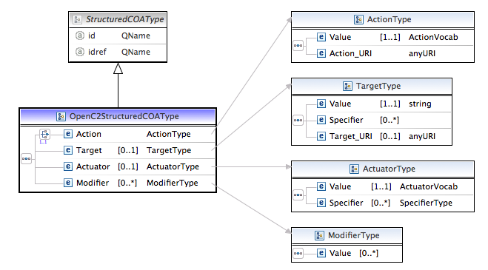
Schema so far

Slide 6
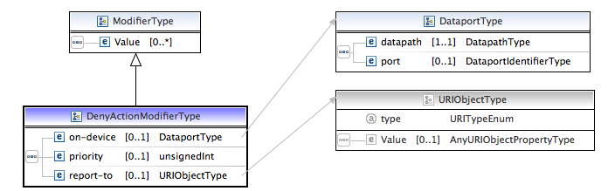
Actuator Specific modifiers as extensions

Slide 7
Pros and Cons of this approach
PROS
Actuator specific modifiers defined and maintained in their own schemas
CONS
Nested hierarchy
COA -> StructuredCOA(OpenC2StrucutedCOA) -> Modifier -> Actuator specific modifier
Validation needs to be applied at different levels
Validate that the action in COA matches OpenC2StructuredCOA matches Modifier

Slide 8
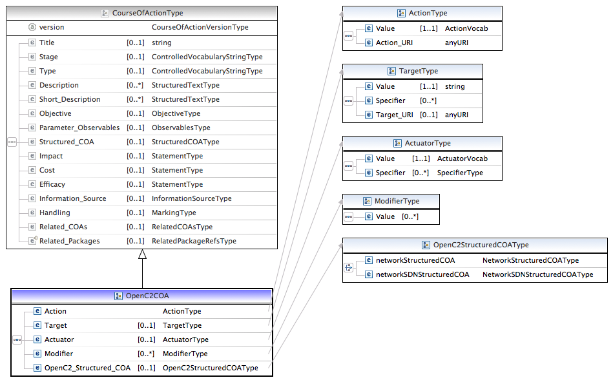
Alternate approach – OpenC2 COA as a CourseOfActionType extension

Slide 9
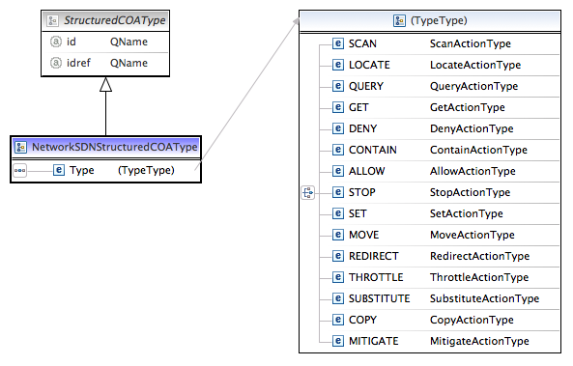
Alternate approach continued…

Slide 10
Pros and Cons of this approach
PROS
Reduced Nesting
Easy to collapse OpenC2 action under main COA in the future
No need for modifier extensions – StructuredCOA captures the actuator specific details
Validation logic easier
Actuator vendors can define and maintain their own StructuredCOA extensions that would easily fit into this model
CONS
Not the recommended STIX way for defining extensions.

Slide 11
Open Issues
Embedding JSON within XML

Slide 12
Near Term Reference Implementations
Phase 1:
Phase 2:
Orchestrator 2
Orchestrator 1
OpenC2 [JSON] (deny)
OpenC2 Proxy
Consumer
Generator
Consumer
Generator
Consumer
A
OpenC2 [JSON] (mitigate)
OpenC2 STIX COA [XML, STIX 1.2] (mitigate)
Parallel Efforts
Mitigation Manager (Firewall Manager)
Consumer
A
Provide OpenC2 generator and consumer building blocks
Phase 1: Develop OpenC2 Orchestrator App (new, generator)
Not tied to specific actuator
Open an http socket, push out openC2 in JSON over the socket
Support OpenC2 in STIX COA
Implement OpenC2 Actions: Deny, Mitigate, Allow
Phase 2: Develop OpenC2 Consumer App (new, consumer)
Consume OpenC2 commands in JSON format
Implement OpenC2 Actions: Deny, Allow
Parallel Efforts:
Develop OpenC2 Mitigation Manager for Traditional Firewall (new, consumer)
Develop SDN Mitigation Manager (new, consumer)
Mitigation Manager (SDN Controller)
OpenFlow
Consumer
A

