Slide 1
STIX™ COA Extension
USING OPENC2 for automated response
July 28th, 2016

Slide 2
7/28 Agenda
Recap
Discuss open items and GitHub issues
Reference implementation

Slide 3
OpenC2 ACTION SYNTAX
<ACTION> ([TARGET, specifiers], [ACTOR, specifiers], [modifiers])
verb object subject
ACTION gathers and conveys information, controls devices and processes
TARGET is the object of the ACTION
e.g., device, person, process, network, data
ACTOR is performing the ACTION
specifiers identify individual ACTOR or group of ACTORs
accommodates hierarchies, inheritance, lists
modifiers provide additional contextual information
e.g., time, frequency, degree/extent, priority, location

Slide 4
Actions
"DENY"
"CONTAIN"
"ALLOW"
"START"
"STOP"
"RESTART"
"PAUSE"
"RESUME"
"SET"
"UPDATE"
"MOVE"
"REDIRECT"
"DELETE"
"SNAPSHOT"
"DETONATE"
"RESTORE"
"SAVE"
"MODIFY"
"THROTTLE"
"DELAY"
"SUBSTITUTE"
"COPY"
"SYNC"
"Other"

Slide 5
Actuators
"network"
"network.bridge"
"network.firewall"
"network.gateway"
"network.guard"
"network.hips"
"network.hub"
"network.ids"
"network.ips"
"network.modem"
"network.nic"
"network.proxy"
"network.router"
"network.security_manager"
"network.sense_making"
"network.sensor"
"network.switch"
"network.vpn"
"network.wap"
"network.sdn"
"process"
"process.aaa-server"
"process.anti-virus-scanner"
"process.connection-scanner"
"process.directory-service"
"process.dns-server"
"process.email-service"
"process.file-scanner"
"process.location-service"
"process.network-scanner"
"process.remediation-service"
"process.reputation-service"
"process.sandbox"
"process.virtualization-service"
"process.vulnerability-scanner"
"endpoint"
"endpoint.digital-telephone-handset"
"endpoint.laptop"
"endpoint.pos-terminal"
"endpoint.printer"
"endpoint.sensor"
"endpoint.server"
"endpoint.smart-meter"
"endpoint.smart-phone"
"endpoint.tablet"
"endpoint.workstation"

Slide 6
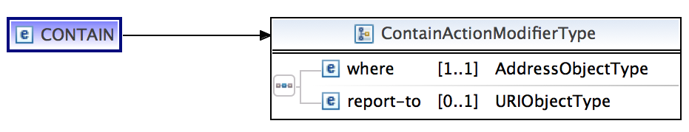
Modifiers
Universal modifiers
"delay”
"duration”
"frequency”
"response”
"time"
Actuator specific modifiers – every actuator class could have its
own list of specifiers for every action type
Example: network.sdn

Slide 7
Recap
Design considerations
Fairly typed flexible schema
Validation logic on client side (orchestrator/actuator)
Deliverable – XML schema for STIX 1.2 validated by one reference implementation at least

Slide 8
Schema Options
1. OpenC2 COA as an extension of StructuredCOA with actuator modifiers as further extensions
2. OpenC2 COA as an extension of CourseOfAction with actuator modifiers being the StructuredCOA extensions
3. OpenC2 message embedded as a JSON blob in the Specification field of GenericStructuredCOA

Slide 9
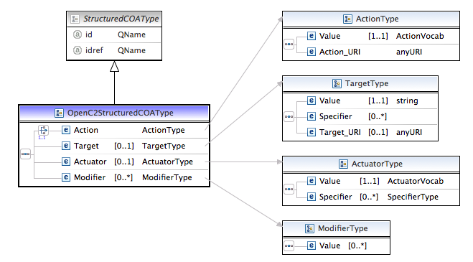
Schema 1: OpenC2 COA as a StructuredCOA extension

Slide 10
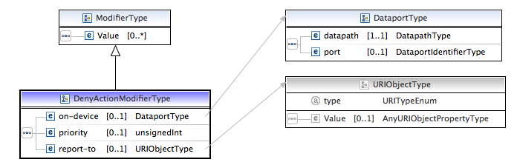
Actuator Specific modifiers as extensions

Slide 11
Pros and Cons of this approach
PROS
Actuator specific modifiers defined and maintained in their own schemas
CONS
Nested hierarchy
COA -> StructuredCOA(OpenC2StrucutedCOA) -> Modifier -> Actuator specific modifier
Validation needs to be applied at different levels
Validate that the action in COA matches OpenC2StructuredCOA matches Modifier

Slide 12
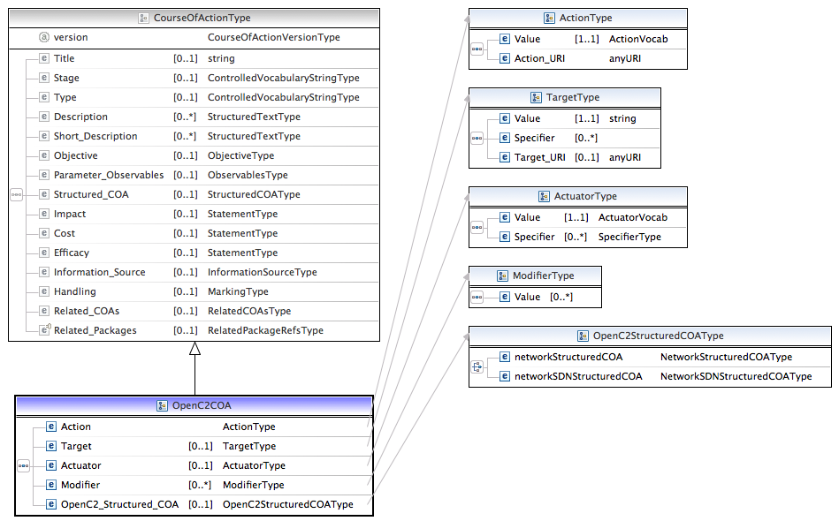
Schema 2 – OpenC2 COA as a CourseOfActionType extension

Slide 13
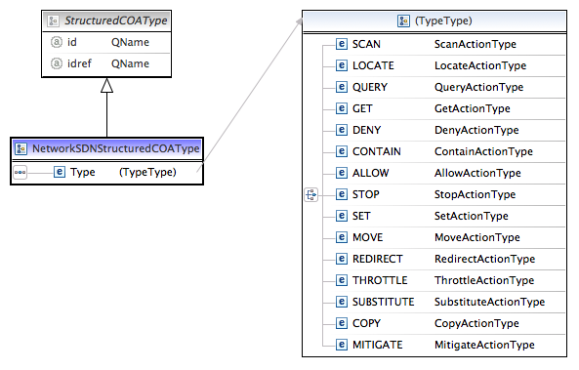
Actuator modifiers as StructuredCOA extensions

Slide 14
Pros and Cons of this approach
PROS
Reduced Nesting
Easy to collapse OpenC2 action under main COA in the future
No need for modifier extensions – StructuredCOA captures the actuator specific details
Validation logic easier
Actuator vendors can define and maintain their own StructuredCOA extensions that would easily fit into this model
CONS
Not the recommended STIX way for defining extensions.

Slide 15
Schema 3 – Embedded OpenC2 JSON message
OpenC2 JSON schema embedded inside the specification object of GenericStructuredCOA

Slide 16
JSON Syntax
Abstract Syntax
JSON Representation
<ACTION> (
TARGET (
type = <TARGET_TYPE>,
[<target-specifier>]
),
[ACTUATOR (
type = <ACTUATOR_TYPE>,
[<actuator-specifier>]
)],
[<modifiers>]
)
{
"DENY": {
"TARGET": {
"type": "cybox:Network_Connection",
"specifiers": [
{
"NetworkConnectionObj:Layer3_Protocol": "IPv4",
"NetworkConnectionObj:Source_Socket_Address": {
…
}
]
},
"ACTUATOR": {
"type": "openc2:network.firewall",
"specifiers": [
{ "ip_address": "10.18.2.2" }
]
},
“MODIFIER": {
"context": "87"
}
}
}

Slide 17
Near Term Reference Implementations
Phase 1:
Phase 2:
Orchestrator 2
Orchestrator 1
OpenC2 [JSON] (deny)
OpenC2 Proxy
Consumer
Generator
Consumer
Generator
Consumer
A
OpenC2 [JSON] (mitigate)
OpenC2 STIX COA [XML, STIX 1.2] (mitigate)
Parallel Efforts
Mitigation Manager (Firewall Manager)
Consumer
A
Provide OpenC2 generator and consumer building blocks
Phase 1: Develop OpenC2 Orchestrator App (new, generator)
Not tied to specific actuator
Open an http socket, push out openC2 in JSON over the socket
Support OpenC2 in STIX COA
Implement OpenC2 Actions: Deny, Mitigate, Allow
Phase 2: Develop OpenC2 Consumer App (new, consumer)
Consume OpenC2 commands in JSON format
Implement OpenC2 Actions: Deny, Allow
Parallel Efforts:
Develop OpenC2 Mitigation Manager for Traditional Firewall (new, consumer)
Develop SDN Mitigation Manager (new, consumer)
Mitigation Manager (SDN Controller)
OpenFlow
Consumer
A

