Slide 1
STIX™ COA Extension
USING OPENC2 for automated response
May 6 2016

Slide 2
Recap
We discussed safe vs. flexible options for schema implementation – The group voted for flexibility
Validation logic will live on the client side (orchestrator/actuator)
Should the schema be strongly typed ? - NO
Should modifier be extended to represent actuator specific modifiers ?
We should define a set of standard and virtual modifiers that could be extended
Since the schema will not be strongly typed, we should document clearly which modifiers belong to which actions
Suggestion – Schematron rules could be part of the schema. With this the consumers of the action would be able to optionally validate the rules
Should action be extended to represent actuator specific modifiers ?
Complex to define and maintain

Slide 3
Path forward
Define a fairly typed JSON schema that documents the different options.
Model overall structure and define bindings
Sean’s proposal
<modifier>
<name>foo</name>
<value>bar</value>
<contain-action-modifier-extension>
<property1>xxx</property1>
</contain-action-modifier-extension>
<gcp-actuator-modifier-extension>
<property1>xxx</property1>
</gcp-actuator-modifier-extension>
</modifier>

Slide 4
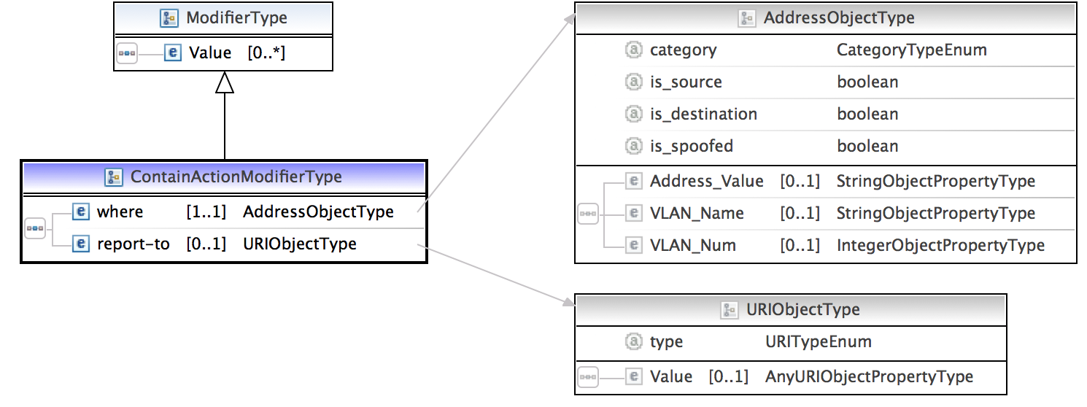
Universal Modifiers
Action specific Modifiers

Slide 5
JSON

Slide 6
OpenC2 ACTION SYNTAX
<ACTION> ([TARGET, specifiers], [ACTOR, specifiers], [modifiers])
verb object subject
ACTION gathers and conveys information, controls devices and processes
TARGET is the object of the ACTION
e.g., device, person, process, network, data
ACTOR is performing the ACTION
specifiers identify individual ACTOR or group of ACTORs
accommodates hierarchies, inheritance, lists
modifiers provide additional contextual information
e.g., time, frequency, degree/extent, priority, location

Slide 7
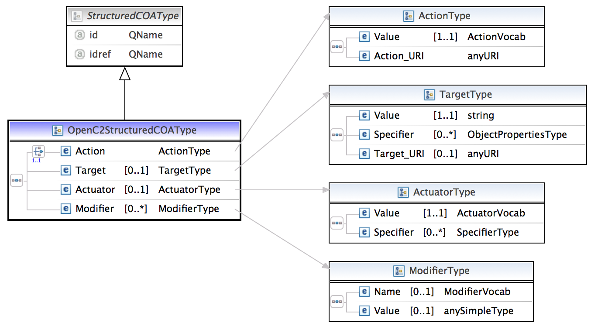



Schema so far
Extend StructuredCOAType to define all the fields of the OpenC2 action construct - action, target, target-specifier, actuator, actuator-specifier and modifier

Slide 8
Actions
"DENY"
"CONTAIN"
"ALLOW"
"START"
"STOP"
"RESTART"
"PAUSE"
"RESUME"
"SET"
"UPDATE"
"MOVE"
"REDIRECT"
"DELETE"
"SNAPSHOT"
"DETONATE"
"RESTORE"
"SAVE"
"MODIFY"
"THROTTLE"
"DELAY"
"SUBSTITUTE"
"COPY"
"SYNC"
"Other"

Slide 9
Actuators
"process"
"process.aaa-server"
"process.anti-virus-scanner"
"process.connection-scanner"
"process.directory-service"
"process.dns-server"
"process.email-service"
"process.file-scanner"
"process.location-service"
"process.network-scanner"
"process.remediation-service"
"process.reputation-service"
"process.sandbox"
"process.virtualization-service"
"process.vulnerability-scanner"
"endpoint"
"endpoint.digital-telephone-handset"
"endpoint.laptop"
"endpoint.pos-terminal"
"endpoint.printer"
"endpoint.sensor"
"endpoint.server"
"endpoint.smart-meter"
"endpoint.smart-phone"
"endpoint.tablet"
"endpoint.workstation"
"network"
"network.bridge"
"network.firewall"
"network.gateway"
"network.guard"
"network.hips"
"network.hub"
"network.ids"
"network.ips"
"network.modem"
"network.nic"
"network.proxy"
"network.router"
"network.security_manager"
"network.sense_making"
"network.sensor"
"network.switch"
"network.vpn"
"network.wap"
"network.sdn"

Slide 10
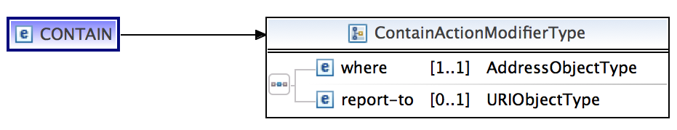
Modifiers
Universal modifiers
"delay”
"duration”
"frequency”
"response”
"time"
Actuator specific modifiers – every actuator class could have its
own list of specifiers for every action type
Example: network.sdn

Slide 11
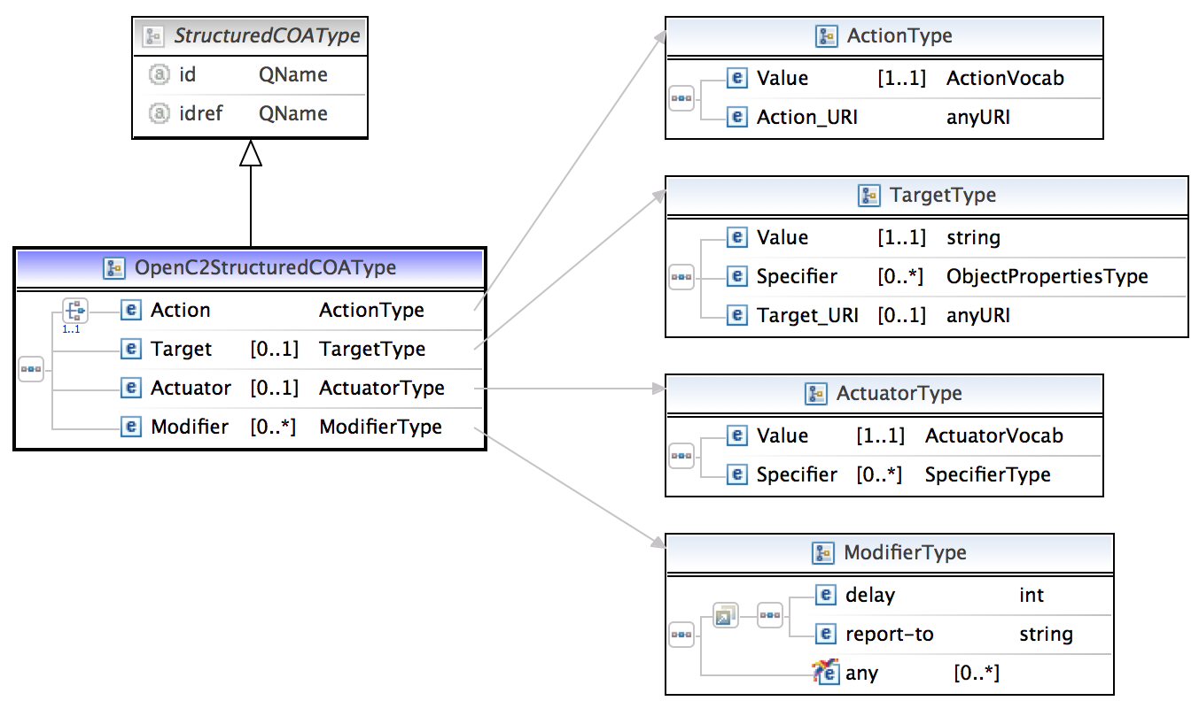
Implementation options
Universal modifiers as group

Slide 12
Strong typed sample
<!-- coa:ActionType →
<ActionType>
<target> </target>
<actuator> </actuator>
<delay/>
<report-to/>
<!--- ANYTHING allowed to go here! --->
</ActionType>
sdn:ALLOW which extends coa:ActionType:
Extension with on-device
<allow_intermediate_type> <!-- restriction on ... above></!-->
<target></target>
<actuator> </actuator>
<delay/>
<report-to/>
<!--- NOTHING allowed to go here! -→
</intermediate>
<network_sdn:ALLOW> <!-- extend intermediate_type></!→
<target></target>
<actuator> </actuator>
<delay/>
<report-to/>
<on-device/>
<!--- NOTHING allowed to go here! --->
</sdn:ALLOW>
<network_firewall:ALLOW>
<target></target>
<actuator> </actuator>
<delay/>
<report-to/>
<priority/>
<!--- nothing allowed to go here! -→
</network_firewall:ALLOW>

Slide 13
Restriction vs. Extension
Restriction
https://github.com/OpenC2-org/subgroup-stix/tree/experimental_schemas/proposal-restriction_interface
Extension
https://github.com/OpenC2-org/subgroup-stix/tree/experimental_schemas/proposal-extension_interface

Slide 14
Data Model

Slide 15
JSON

