Slide 1
STIX™ COA Extension
USING OPENC2 for automated response
May 6 2016

Slide 2
OpenC2 ACTION SYNTAX
<ACTION> ([TARGET, specifiers], [ACTOR, specifiers], [modifiers])
verb object subject
ACTION gathers and conveys information, controls devices and processes
TARGET is the object of the ACTION
e.g., device, person, process, network, data
ACTOR is performing the ACTION
specifiers identify individual ACTOR or group of ACTORs
accommodates hierarchies, inheritance, lists
modifiers provide additional contextual information
e.g., time, frequency, degree/extent, priority, location

Slide 3
STIX Extension options

Slide 4
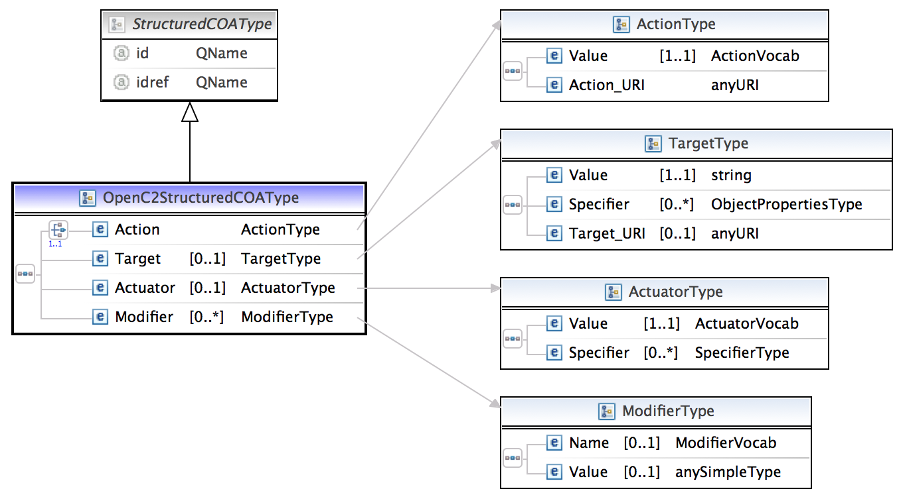



Schema so far
Extend StructuredCOAType to define all the fields of the OpenC2 action construct - action, target, target-specifier, actuator, actuator-specifier and modifier

Slide 5
Actions
"DENY"
"CONTAIN"
"ALLOW"
"START"
"STOP"
"RESTART"
"PAUSE"
"RESUME"
"SET"
"UPDATE"
"MOVE"
"REDIRECT"
"DELETE"
"SNAPSHOT"
"DETONATE"
"RESTORE"
"SAVE"
"MODIFY"
"THROTTLE"
"DELAY"
"SUBSTITUTE"
"COPY"
"SYNC"
"Other"

Slide 6
Actuators
"process"
"process.aaa-server"
"process.anti-virus-scanner"
"process.connection-scanner"
"process.directory-service"
"process.dns-server"
"process.email-service"
"process.file-scanner"
"process.location-service"
"process.network-scanner"
"process.remediation-service"
"process.reputation-service"
"process.sandbox"
"process.virtualization-service"
"process.vulnerability-scanner"
"endpoint"
"endpoint.digital-telephone-handset"
"endpoint.laptop"
"endpoint.pos-terminal"
"endpoint.printer"
"endpoint.sensor"
"endpoint.server"
"endpoint.smart-meter"
"endpoint.smart-phone"
"endpoint.tablet"
"endpoint.workstation"
"network"
"network.bridge"
"network.firewall"
"network.gateway"
"network.guard"
"network.hips"
"network.hub"
"network.ids"
"network.ips"
"network.modem"
"network.nic"
"network.proxy"
"network.router"
"network.security_manager"
"network.sense_making"
"network.sensor"
"network.switch"
"network.vpn"
"network.wap"
"network.sdn"

Slide 7
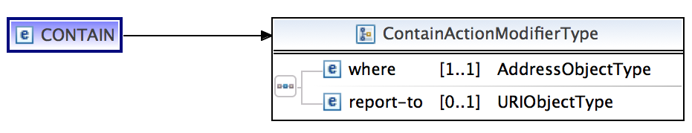
Modifiers
Universal modifiers
"delay”
"duration”
"frequency”
"response”
"time"
Actuator specific modifiers – every actuator class could have its
own list of specifiers for every action type
Example: network.sdn

Slide 8
Open Questions
Where does the validation logic for the schema live ?
Should the schema be strongly typed ?
Should modifier be extended to represent actuator specific modifiers ?
Should action be extended to represent actuator specific modifiers ?

Slide 9
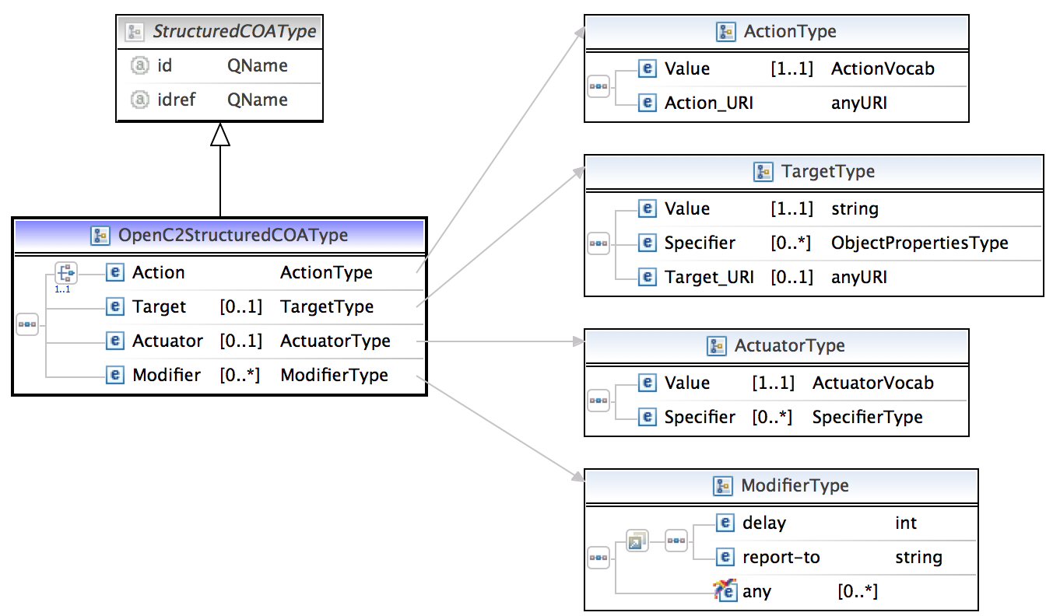
Implementation options
Universal modifiers as group

Slide 10
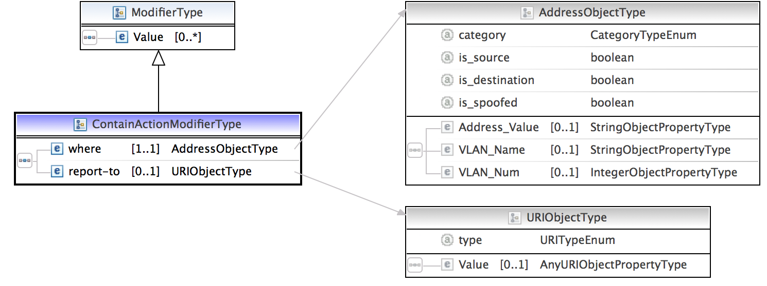
Implementation options
Universal Modifiers
Action specific modifier as extension
Action specific Modifiers
Pros | Cons
Implementation fairly simple | Schema cannot be validated easily. Example: no way to determine if a deny modifier was added to an allow action

Slide 11
Strong typed sample
<!-- coa:ActionType →
<ActionType>
<target> </target>
<actuator> </actuator>
<delay/>
<report-to/>
<!--- ANYTHING allowed to go here! --->
</ActionType>
sdn:ALLOW which extends coa:ActionType:
Extension with on-device
<allow_intermediate_type> <!-- restriction on ... above></!-->
<target></target>
<actuator> </actuator>
<delay/>
<report-to/>
<!--- NOTHING allowed to go here! -→
</intermediate>
<network_sdn:ALLOW> <!-- extend intermediate_type></!→
<target></target>
<actuator> </actuator>
<delay/>
<report-to/>
<on-device/>
<!--- NOTHING allowed to go here! --->
</sdn:ALLOW>
<network_firewall:ALLOW>
<target></target>
<actuator> </actuator>
<delay/>
<report-to/>
<priority/>
<!--- nothing allowed to go here! -→
</network_firewall:ALLOW>

Slide 12
Restriction vs. Extension
Restriction
https://github.com/OpenC2-org/subgroup-stix/tree/experimental_schemas/proposal-restriction_interface
Extension
https://github.com/OpenC2-org/subgroup-stix/tree/experimental_schemas/proposal-extension_interface

Slide 13
Data Model

Slide 14
JSON

