Slide 1
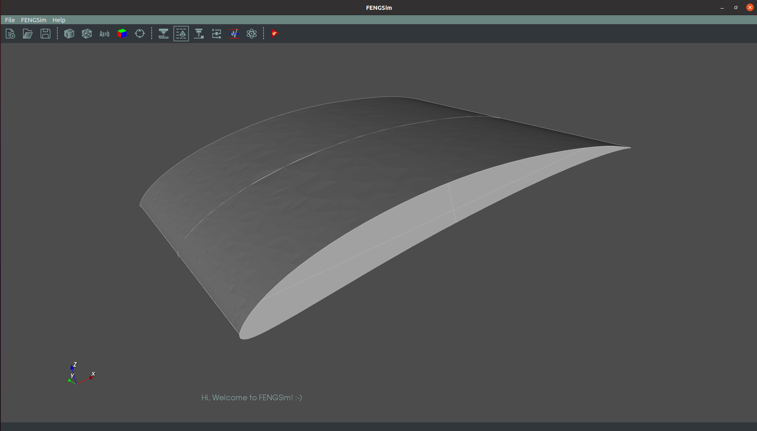
Digital Twin for Airfoil
Product Design
fluid structure coupling
system simulation
Manufacturing
addative manufacturing
3d scanner
Operation
Educational Wind Tunnel
ARM cluster

Slide 2
OpenCAEPoro
FASP

Slide 3




