Slide 1
These images are used in the following command reference documentation:
ReadCropPatternTSFromHydroBase
ReadIrrigationPracticeTSFromHydroBase

Slide 2
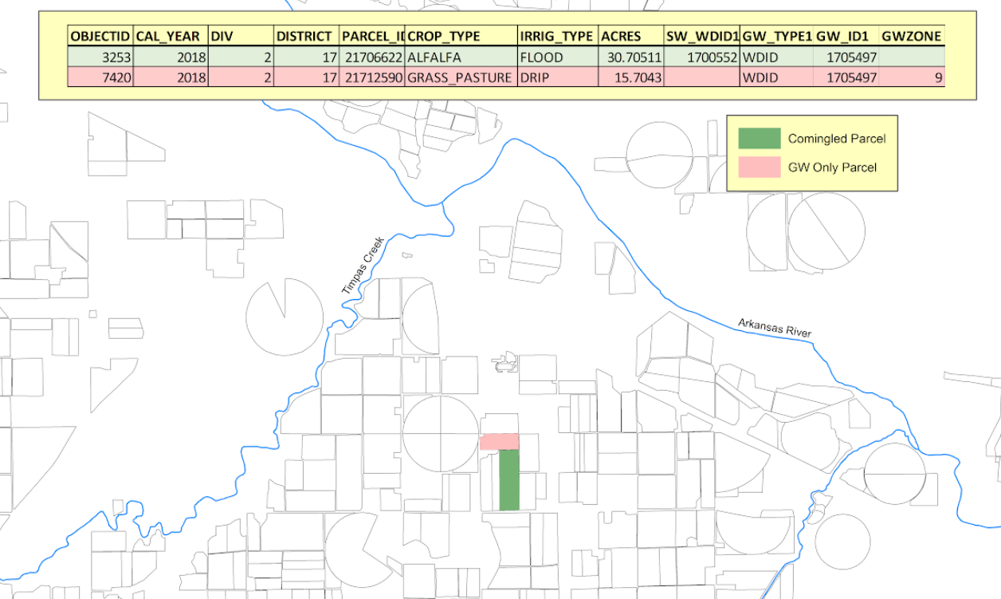
Irrigated Acreage Example – Well as Supplemental Supply to Ditch and Serves a Groundwater Only Parcel
G
GWZone9
Parcel 21712590, 15.7043 acres
Well WDID 1705497
Parcel 21706622, 30.70511 acres
“DW” Ditch 1700552
Graphic is modified version of image from “Acreage Assignment”, Wilson Water Group

Slide 3
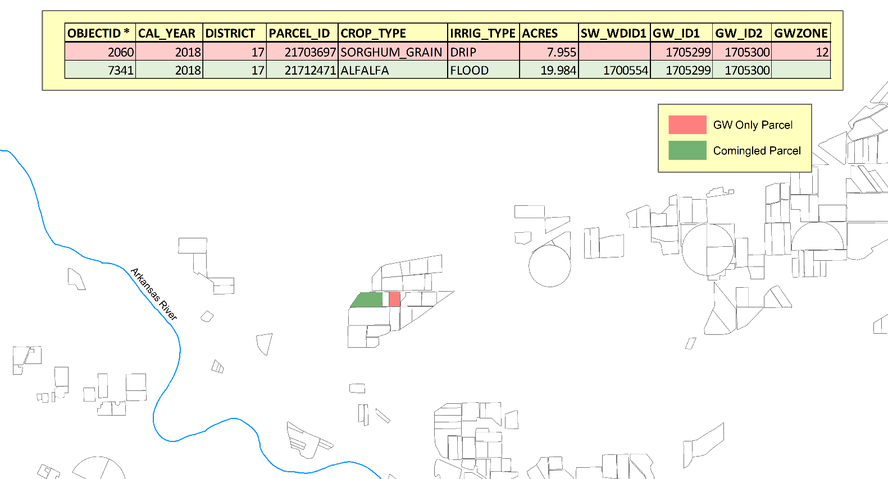
Irrigated Acreage Example – Well as Supplemental Supply to Ditch and Serves a Groundwater Only Parcel
Parcel 21712471, 19.984 acres
Parcel 21703697, 7.955 acres
G
Well WDID 1705299
Well WDID 1705300
GWZone12
“DW” Ditch 1700552
Graphic is modified version of image from “Acreage Assignment”, Wilson Water Group

