Slide 1
StateMod
Maintenance Training Session #1
April 24-25, 2014

Slide 2
Development History
Version | Year | Areas of Key Enhancements
1. | 1986 | Program developed for the Green Mountain Pump Back and Exchange Project
2. – 4. | 1995 | Baseflow module enhancement New reporting capabilities
5. | 1996 | Allow multiple replacement reservoirs Reoperate for non downstream return flows
6. | 1996 | Enhanced binary file reporting. New reporting capabilities
7. | 1997 | Treat Instream flows as a Reach Linked model capability
8. | 1998 | Daily simulation capability
9. | 1999 | Well simulation capability
10. | 2001 | Variable efficiency capability
11. | 2006 | Plan structure type added. New operating rule data that allow carrier losses, annual limits and on/off dates
12. | 2007-2008 | Irrigation Practice File is allowed to contain 4 water supply and irrigation method combinations (Expanded the ability to divert to and from plans.
13 | 2012 | Finalized plan implementation and application to South Plate

Slide 3
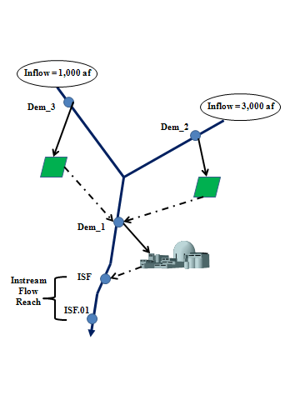
Structure | Priority | Location | Demand | Ave. Eff | Immediate Return (%)
Dem_1 | 1 | Dem_1 | 2,000 af | 20 | 40
Dem_2 | 2 | Dem_2 | 3,000 af | 50 | 50
Dem_3 | 3 | Dem_3 | 1,000 af | 50 | 50
ISF_1 | 4 | ISF_1 to ISF.01 | 65 cfs | 0 (1) | 100

Slide 4
Development Philosophy
Keep it simple
Complexity is there if required
Help the user
Check input data
Backward compatible
Ability to construct input data in steps
Stream,
Diversions,
Reservoirs,
…
Simplify data input
Quality in = quality out
Data groups
Structure
Water rights
Time series

Slide 5
MODEL COMPONENTS

Slide 6
Key Components
Network System
Looks like the stream itself
Prior Appropriation Doctrine
Modified Direct Solution Algorithm
Structure Types
Diversion,
Instream flows,
Reservoirs,
Wells,
Plans

Slide 7
Operating Modes
Baseflows
Create streamflow without man’s impact
100% is natural, <100% is baseflow
Simulate
Calibrate to history
Simulate future conditions
Report
Standard reports
Detailed as needed
Data check
Verify input data

Slide 8
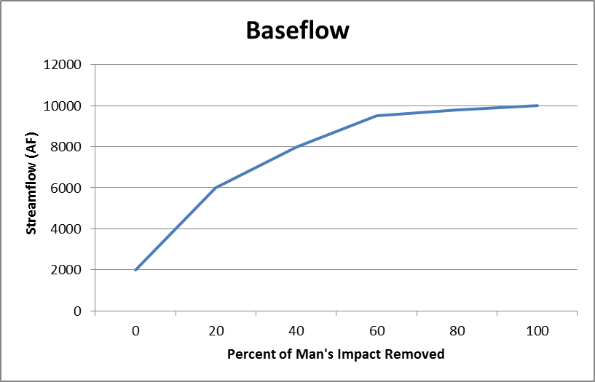
Baseflow
Create streamflow without man’s impact
100% is natural, <100% is baseflow
Can operate with missing data
100% Removed is Natural flow

Slide 9
Gaged Baseflow
Gaged (Qg) = Qg + D – R – S + E
Baseflow Calculation
Item | Ex 1 | Ex 2 | Ex 3
Gaged | 1,000 | 1,000 | 1,000
Diversion (-) | 500 | 500 | 500
Return Flow (-) | 200 | 0 | 400
Storage Increase (-) | 210 | -490 | 1490
Evaporation Loss (+) | 10 | 10 | 10
Baseflow | 1,100 | 2,000 | -380

Slide 10
Un-gaged Baseflow
FlowX = gaged portion + ungaged portion
Gaged = (FlowB(1)*coefB(1) + FlowB(2)*coefB(2)+ ....)
Ungaged = pf * (FlowG(1)*coefG(1) + FlowG(2)*coefG(2)+ ..
FlowX = 1,000*1.0 + 3,000*1.0 + 0.70*(6,000*1 – 1,000*1-3000*1)

Slide 11
Simulate (Stream Allocation)
Water availability is determined for network
The most senior water right is identified
Allocate diversion using the MDSA
Min (available flow, demand, water right, capacity, other)
Downstream flows are adjusted
Return flows for future time periods are stored
Well depletions for future time periods are stored
Check for need to need to reoperate
If yes, go back to step 2 and repeat with the most senior water right
Repeated by priority for each successive direct, instream, storage, well and operational water right.
The process is repeated for each month or day of the study period

Slide 12
Report
Standard
Network *.xdd
Diversion & well *.xss
Reservoir output: *.xre
Well output: *.xwe
Plan output: *.xpl
Operating Rule Info: *.xop
Instream Reach Info: *.xir
Structure Summary: *.xss
Call (Control) Summary: *.xca
Detailed
Water Balance *.xwb
Diversion comparison *.xdc
CU summary *.xcu
…

Slide 13
Data Check
Read input data
Standard Reports
Base flow (*.xbc)
Compare gaged to ungaged flow
Direct demand (*.xcd)
Instream Demand (*.xci)
Well Demand (*.xcw)
Water Right List (*.xwr)
Output Request (*.xou)

Slide 14
FEATURES

Slide 15
Features
Modified Direct Solution Algorithm MDSA)
Include immediate return flows w/o iteration
Reoperates if new water is added to system
Daily or Monthly
Variable efficiency
Soil accounting
Wells
Plans
Operating rules

Slide 16
Modified Direct Solution Algorithm
In summary:
Direct Solution Algorithm (see handout):
For every node downstream:
Divert = min(demand, water right, capacity, available flow
If available flow limits:
Divert = Available Flow / (1.00-efficiency) * (return (0))
Modified Direct Solution Algorithm (see handout)
Allow variable efficiency and soil accounting
Requires Consumptive Water Requirement (CIR) data
Requires maximum efficiency data

Slide 17
Reoperation
Check for new water
Reservoir releases
Non downstream returns
Reoperate
Determine if a senior right
can benefit from new water
by repeating the water
right loop
Control
Off (testing)
On (simulate)
Reoperate when the sum of reservoir releases and non-downstream return flows exceed a specified value

Slide 18
Daily Operations
Build upon a monthly model
System understanding
Daily input options
Provide daily data for only those component where it is necessary or justified (e.g. streamflow but not reservoir targets)
Options
Daily data provided
Use a monthly average
Similar to another station
Connect monthly midpoints (demand)
Connect monthly end points (reservoir target)
No routing

Slide 19
Variable Efficiency
Major component to MDSA
Allows the efficiency of water use to vary from 0 to a maximum.
Soil moisture accounting may be included
Does not apply to reservoir releases
Data requirements
Consumptive water requirement
Maximum efficiency
Sprinkler or
Flood

Slide 20
Soil Accounting
Requires the variable efficiency option
Capacity = depth * area * capacity
Max diversion to storage is the minimum of soil capacity and diversion * efficiency
If area is reduced in a time step and soil capacity is exceeded the difference is a loss
Amount to Storage for various maximum efficiency values
Given: Storage Capacity | 200
Item | Ex 1 | Ex 2 | Ex 3
Divert | 1000 | 1000 | 1000
Max efficiency | 40% | 60% | 70%
CIR | 500 | 500 | 500
CU | 400 | 500 | 500
Final soil storage | 0 | 100 | 200

Slide 21
Wells
May be independent or tied to a diversion
Do not need to be in network
Demands
If independent, they are provided in the well demand file
If tied to a diversion, provided as a well demand (calibration) or as part of a diversion demand (simulate)
Well operations can cause the system to reoperate
If depletions exceed streamflow
Water is taken from groundwater storage
Groundwater storage is paid back in next time step
Can be tied to augmentation plans
Reported in two pieces:
From well (pumping this time step) and
Well Depletion (prior pumping)

Slide 22
Plans
Originated for wells
Expanded to include many complex features (see section 3.9 of documentation for descriptions)
Accounting
Reservoir reuse
Non reservoir reuse
Transmountain imports
Terms and conditions
Well augmentation
Recharge plan
Out of priority diversions
Release limit
Special well augmentation (designated basin, coffin wells, etc)

Slide 23
Operating Rules
Allow complex owner and water rights to be simulated
Began with 12 and have grown to 50
See section 4.13 of documentation
In general must know 3 things
Source of Water
Water right, reservoir, well, water right , plan
Destination of water
Diversion, reservoir, well, instream flow or plan
Delivery method
Stream or carrier
With or without losses
Special operating rules
Compacts, soil moisture, storage

Slide 24
Soil Accounting
Requires the variable efficiency option
Capacity = depth * area * capacity
Max diversion to storage is the minimum of soil capacity and diversion * efficiency
Water use efficiency includes soil storage
If area is reduced in a time step and soil capacity is exceeded the difference is a loss
Amount to Storage for various maximum efficiency values
Given: Storage Capacity | 200
Item | Ex 1 | Ex 2 | Ex 3
Divert | 1000 | 1000 | 1000
Max efficiency | 40% | 60% | 70%
CIR | 500 | 500 | 500
CU | 400 | 500 | 500
Final soil storage | 0 | 100 | 200

Slide 25
Water Balance
Stream Inflow
Return
To/From GW Storage
Total In
Stream Outflow
From river by well
Well Depletion
Reservoir Evaporatoin
Stream Output
Total Out
Delta (In – Out)
Other
CU
Loss
Pumping
Salvage

Slide 26
Documentation
Acknowledgment
Introduction
Model description
Input data
Output data
Model operation
Technical notes
Describes various technical issues
Frequently asked questions
Supporting utilities
Discontinued but supported files

