Slide 1
StateMod GUI Training
Getting Started
Version: 7.04.00, 2012-04-25
Duration: Approximately 45 minutes
Level: Introduction

Slide 2
This Presentation
Provides an introduction to the StateMod graphical user interface (StateMod GUI) for new users
Assumes some familiarity with the StateMod model and water allocation modeling
Is designed for self-paced training
Is accompanied by a sample StateMod dataset
  See the doc/Training/data-cm2009 folder under the software installation
  This is the Colorado main stem dataset

Slide 3
StateMod Model
Developed for Colorado’s Decision Support Systems (CDSS)
Is the water allocation model, which simulates water deliveries, use, and return flows considering demands, water rights, physical data, and operating rules
Is a command-line FORTRAN executable program that reads text input files and produces text and binary output files

Slide 4
StateMod GUI
Is a graphical user interface (GUI) program that:
  Provides visualization of StateMod data (input and output)
  Runs StateMod
  Provides the ability to edit data sets, with limitations
  Enforces modeling conventions

Slide 5
CDSS Data-Centered Approach
Open access to data
Share data for multiple uses
Applications focus on analysis and generating results/products
Data Collection
Data-Centered Management:
GIS/HydroBase
Data Management Interfaces (DMIs)/Access Tools:
TSTool, StateDMI, StateDGI, etc.
StateView, Website
Applications/Models:
Consumptive Use (StateCU)
Water Allocation (StateMod)
Groundwater (MODFLOW)
Other

Slide 6
StateMod
Water Allocation Model
Software and baseline data sets are provided by the State of Colorado (http://cdss.state.co.us – see Modeling Data…Surface Water)
Refer to data set documentation
StateMod software documentation describes model files
StateDMI documentation describes data-centered approach to create model files

Slide 7
CDSS Automated Data Processing
HydroBase
Model Network
Raw Data Files
Process Data
Run Model
Process Results
Create StateMod input files by
using StateDMI, TSTool, etc. to edit and run command files
StateMod Input Files
from processing
StateMod response (*.rsp) and control (.ctl) files
Run StateMod
StateMod Output Files
Text reports and binary results files
View/Process/Publish Output
Using Editor, TSTool, StateMod GUI, etc.
To modify model input files, adjust command files and rerun DMI programs
Indicates activities that can be controlled by the StateMod GUI

Slide 8
Benefits of Automation
“Touches” on data are more visible
Logic is documented by command files
Troubleshooting is facilitated by sequential processing, logging, and checks
Processing is repeatable, and automated tests can be implemented
Overall processing time can be much faster than non-automated processing
Quality control can be automated

Slide 9
Limitations of Automation
Automation does not eliminate the need for human insight and review
Modelers still need to understand model software, representation of the system, and input files
Modelers still need to understand data processing and limitations of data

Slide 10
Role of the StateMod GUI
The GUI provides features to navigate data sets, run StateMod, and visualize input and output
Editing performed in the GUI should normally be limited to minor changes because the automated data-centered process will not be aware of such “one off” edits
Future enhancements to the GUI will improve integration of automated processing and subsequent edits in the GUI

Slide 11
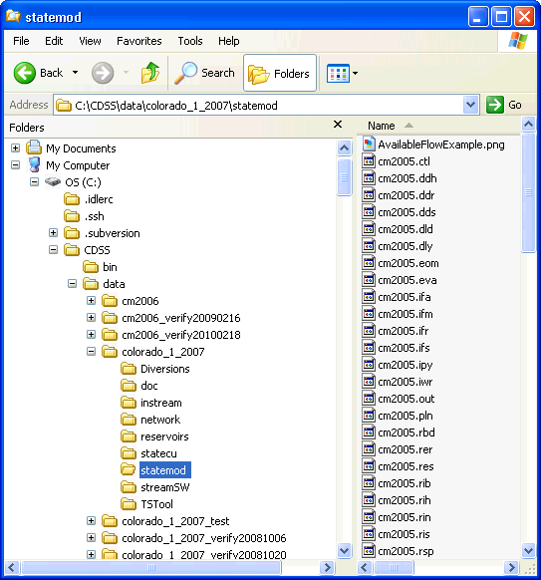
StateMod Dataset Files
The “statemod” folder contains final model input files and results (can be distributed without other work files)
Subfolders may be used for different scenarios (historical, calculated demands, etc.)

Slide 12
Notes on File Organization
Does change over time, but has become relatively standardized
Allows modelers to focus on specific files (e.g., diversions) in sub-folders to “divide and conquer” when preparing data files
Working files in sub-folders ultimately result in files that are copied into the main “statemod” folder for distribution and model runs

Slide 13
StateMod Model and GUI Interaction
The GUI is written in Java, whereas the StateMod software is FORTRAN
The StateMod executable is run using a “system call” with command line parameters
Screen output from StateMod is captured and displayed by the GUI
The exit code and screen output from StateMod are interpreted by the GUI to determine whether an error occurred during the StateMod run
All data exchange between StateMod and the GUI is via input and output files

Slide 14
Running the StateMod GUI
To run the GUI:
Start…All Programs…CDSS…StateModGUI-Version
(where Version is the installed version)

Slide 15
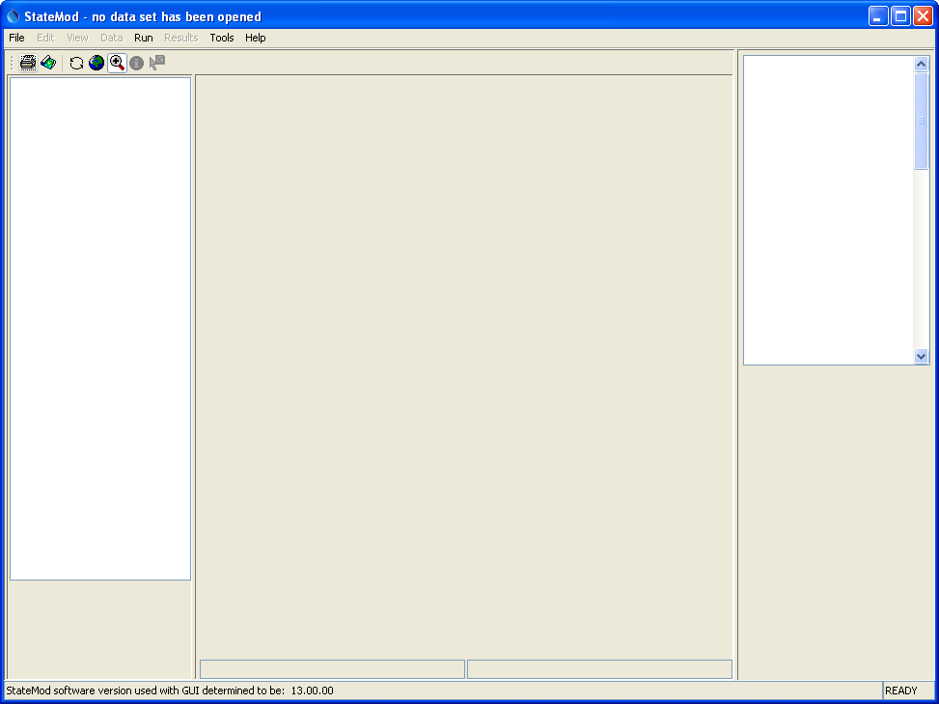
After starting the StateMod GUI
No data set has been opened.
“statemod –version” is run to determine the configured StateMod executable version, which indicates file format versions

Slide 16
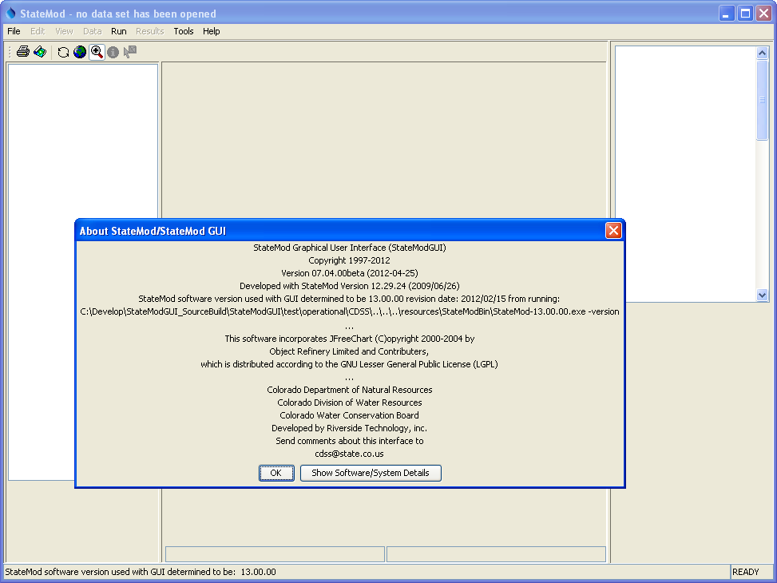
Help…About StateMod/StateMod GUI also displays the StateMod version

Slide 17
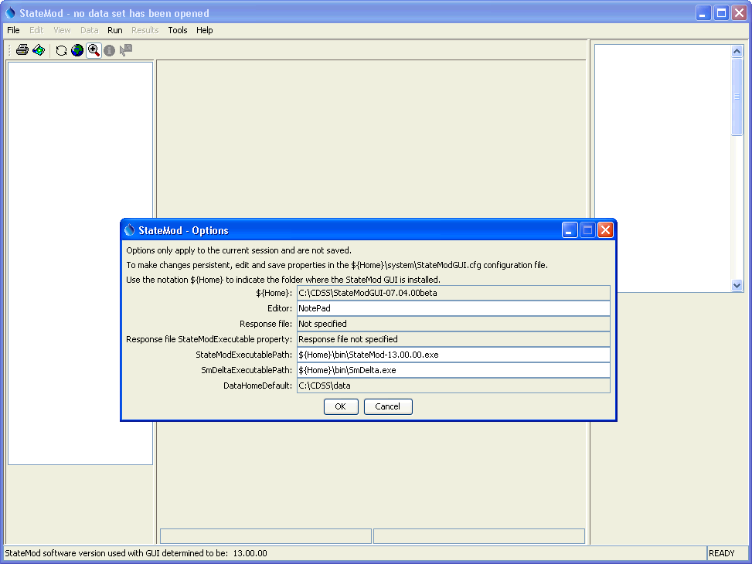
Main configuration information
Tools…Options will display main configuration properties. In particular, the GUI needs to know which StateMod executable program to run.
The default StateMod executable will be the version distributed with the GUI.

Slide 18
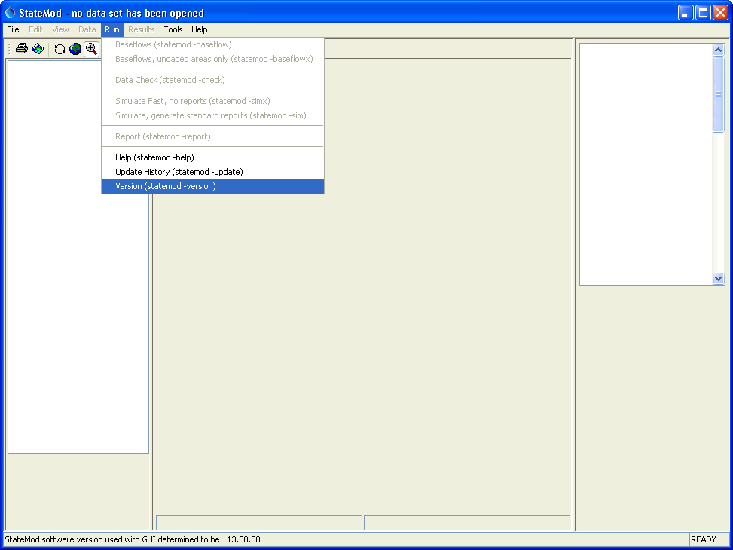
Running StateMod to view program information
Run…Version (statemod –version)
will display StateMod version information and confirm that the GUI is able to locate the StateMod executable program.

Slide 19
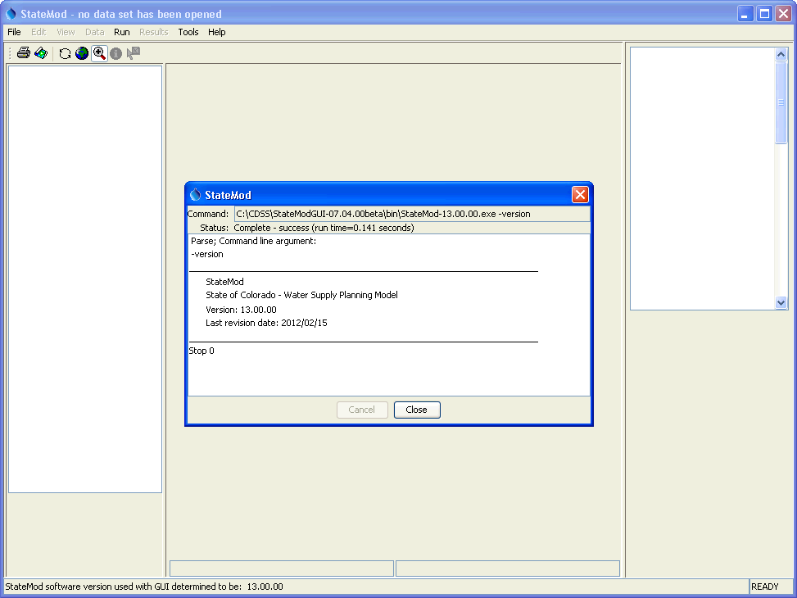
Running StateMod to view program information
Displayed output is the same as screen output when StateMod is run in a command shell (when the GUI is not used).
This dialog must be closed before other GUI features can be accessed.

Slide 20
Opening an Existing Dataset
File…Open…
Select a *.rsp file in the “statemod” folder of the dataset
For this example, choose the following (assuming defaults for installation):
  C:\CDSS\StateModGUI-Version\doc\Training\data-cm2009\statemod\cm2009.rsp

Slide 21
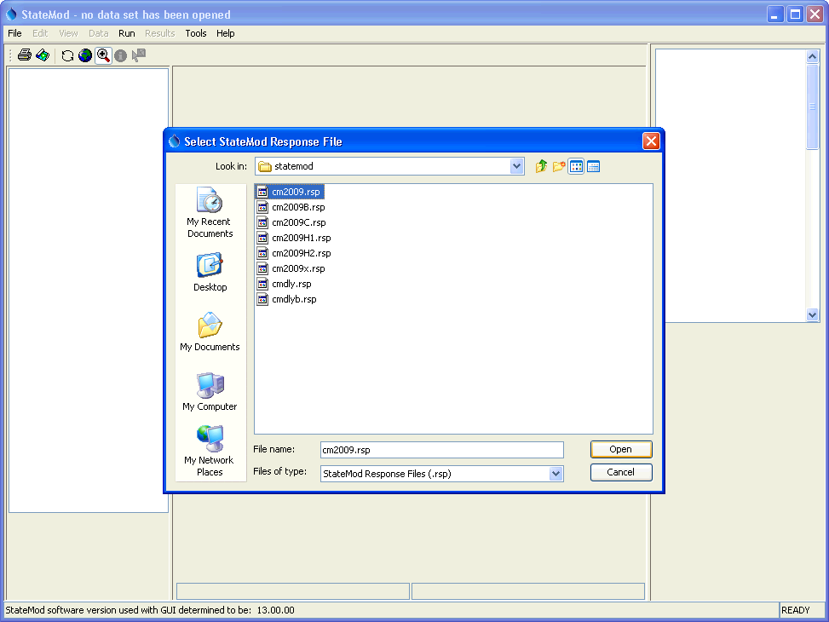
Opening a StateMod dataset
“Response files” are used to configure multiple variations of the dataset, including historical, baseline, and calculated planning demands. Refer to dataset documentation for an explanation.

Slide 22
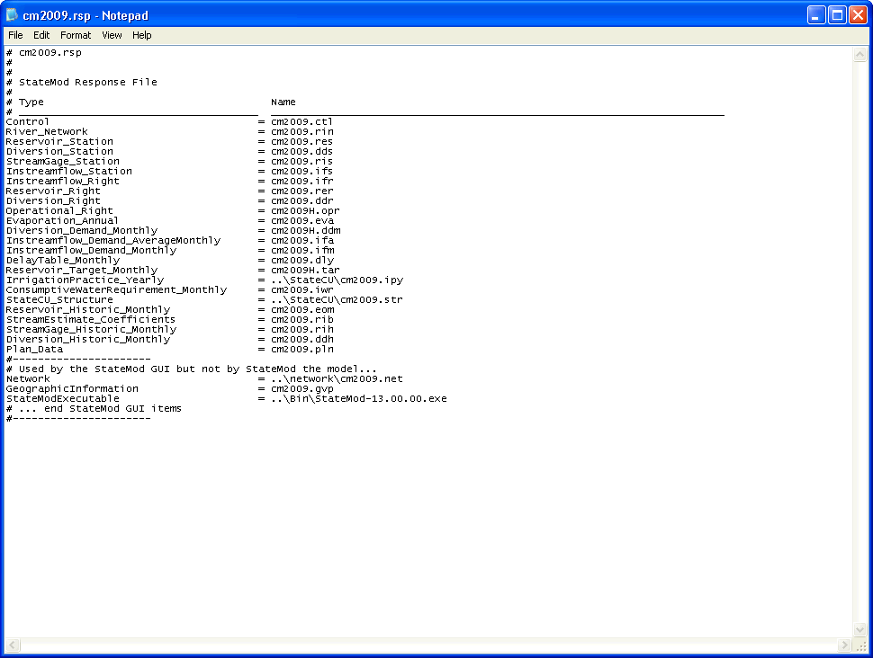
Response file
Comment lines start with #
StateMod files with file type and path relative to the response file – some files, such as those primary to the StateCU model, may exist in another folder
Several files and properties are used by the GUI but not the StateMod program

Slide 23
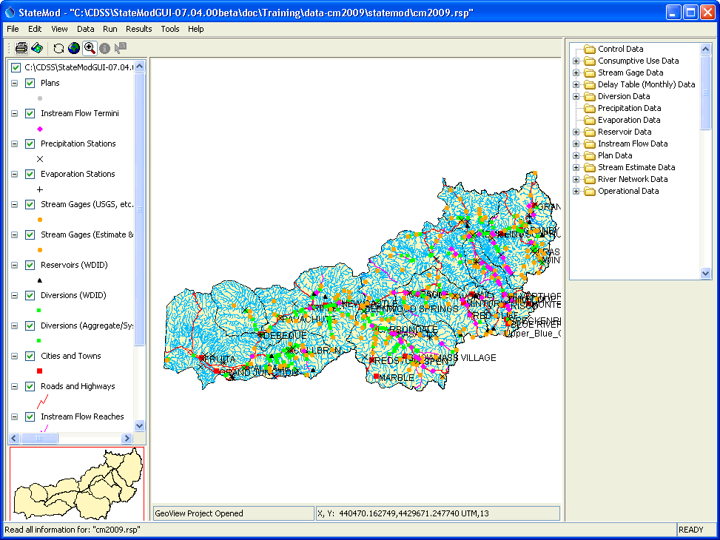
StateMod GUI after opening dataset
Response file name
Tree navigator for dataset components
Interactive map to navigate dataset and view data (if dataset has been configured with map).

Slide 24
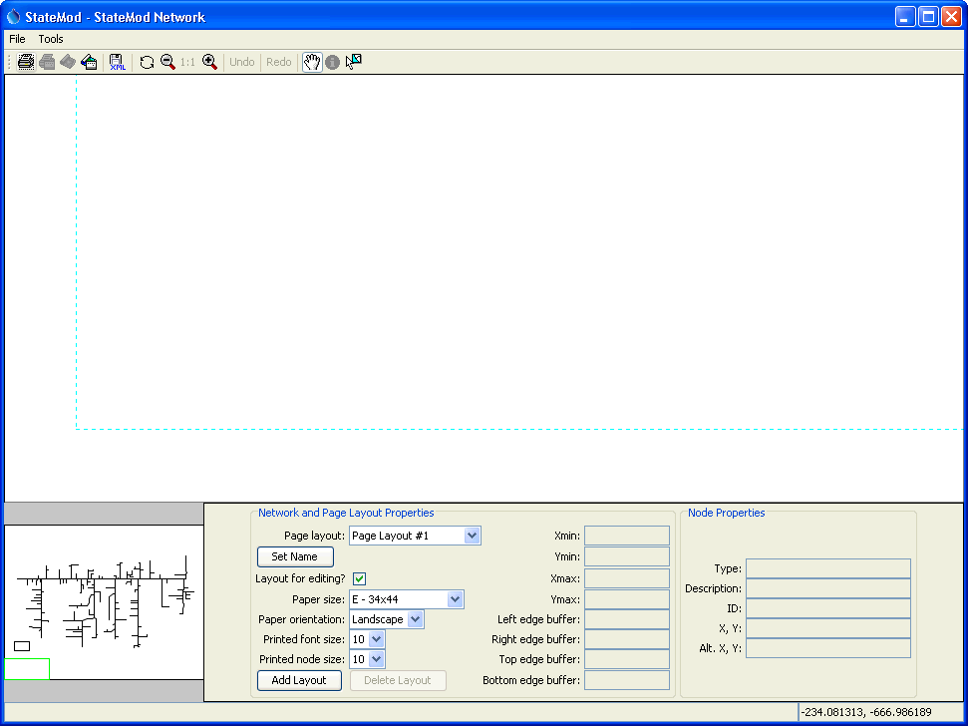
StateMod GUI network window after opening dataset
Use the zoom buttons to change scale.
The network is a schematic view of the physical river basin. The network typically is created in StateDMI when creating a dataset using the “data-centered” approach.
Drag overview box or drag the mouse in the main network window (when the pan tool is selected) to view parts of the network.

Slide 25
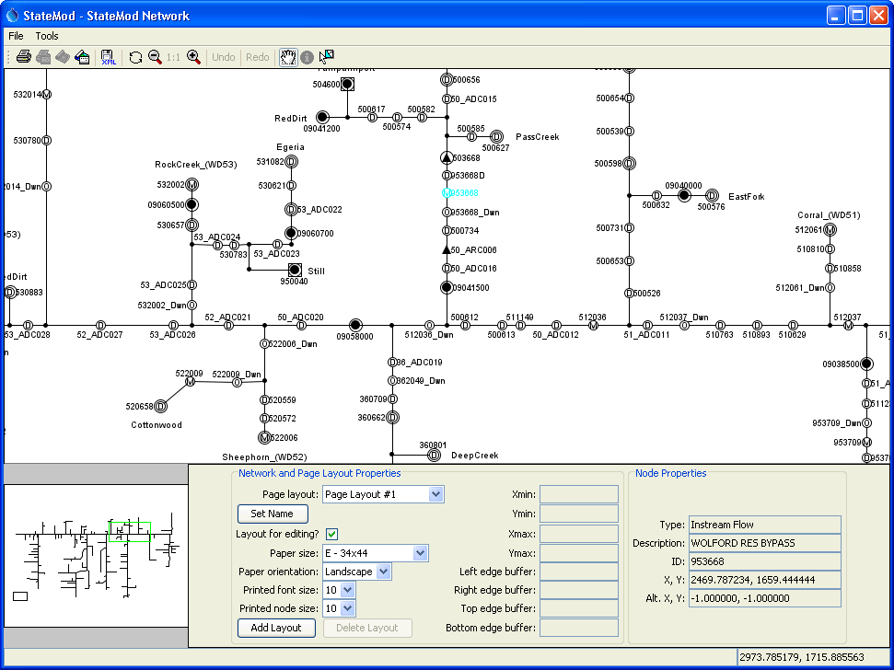
StateMod GUI network window after scrolling
Click on a model node to select and see properties below.

Slide 26
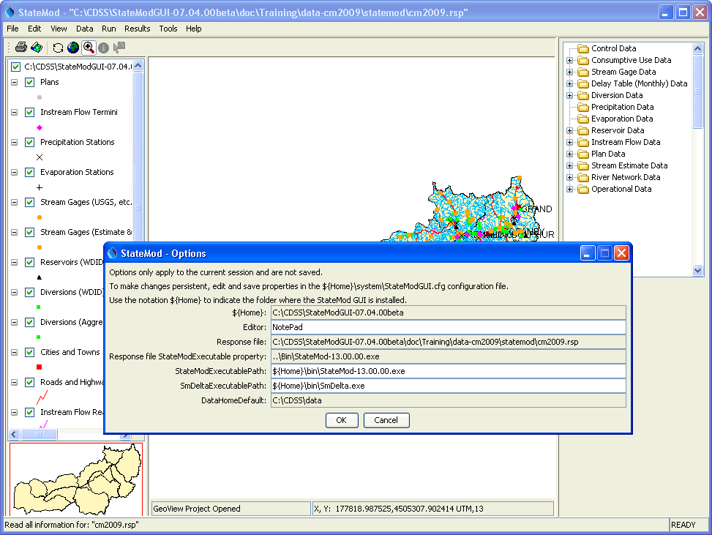
Main configuration information after selecting response file
The StateMod executable will be the version distributed with the dataset.

Slide 27
Recommendations for Modelers
Use CDSS best practices for modeling, including data-centered approach for preparing StateMod data files.
Use the StateMod GUI for visualizing data, running StateMod, and visualizing results.
Limit the editing performed in the GUI if such editing will negatively impact data-centered processes.
Provide feedback on software, data sets, and documentation to foster continued improvement.

Slide 28
More Information
Help…View Documentation to view the StateMod and StateMod GUI documentation.
Help…View Training Materials to view additional StateMod GUI training materials.
Basin model documentation describes in detail the sources of data, estimates, and processes that were used to create the data sets, and summarizes results.
Numerous task memoranda, reports, software documentation, and other documents provide technical information and are available on the CDSS web site:
http://cdss.state.co.us

