Slide 1
StateMod GUI Training
Running StateMod
Version: 7.04.00, 2012-04-25
Duration: Approximately 45 minutes
Level: Introduction

Slide 2
This Presentation
Describes how to run the StateMod program on the command line and from the StateMod GUI
Assumes some familiarity with the StateMod model and water allocation modeling
Assumes that the StateMod GUI “Getting Started” training slideshow has been reviewed
Is designed for self-paced training
Is accompanied by a sample StateMod dataset
  See the doc/Training/data-cm2009 folder under the software installation
  This is the Colorado main stem dataset

Slide 3
StateMod Dataset File Location
StateMod datasets installed from the CDSS website typically live in folder C:\CDSS\Data, for example “C:\CDSS\Data\cm2009” for the Colorado mainstem dataset.
The Colorado dataset also is distributed with the StateMod GUI training materials and by default is installed in “C:\CDSS\StateModGUI-Version\doc\Training\data-cm2009” (where Version is the StateMod GUI version)
Training examples focus on the dataset distributed with the GUI

Slide 4
StateMod Model and GUI Interaction
The GUI is written in Java, whereas the StateMod software is FORTRAN
The StateMod executable is run using a “system call” with command line parameters
Screen output from StateMod is captured and displayed by the GUI
The exit code and screen output from StateMod are interpreted by the GUI to determine whether an error occurred during the StateMod run
All data exchange between StateMod and the GUI is via input and output files

Slide 5
Multiple Ways to Run StateMod
Using the command line
From within the StateMod GUI
From other software (e.g., the StateDMI RunProgram() command)

Slide 6
Running StateMod from the
Command Line – Why?
During dataset development, a “data-centered” approach is used where StateMod input files are created in an automated way
Running StateMod on the command line during this process is generally more efficient because opening a dataset in the GUI reads all input files, which takes time
StateMod executation and processing of output can be automated if StateMod GUI features are not needed
Modeler preference

Slide 7
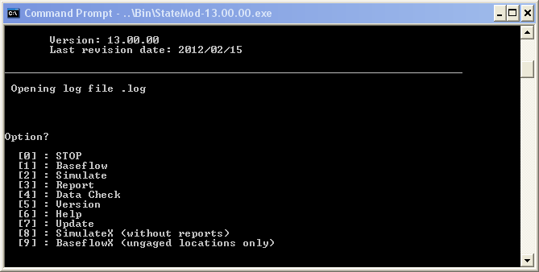
Running StateMod from the
Command Line – How?
Open a command shell – Start…Accessories…Command Shell
Change directories to dataset folder – “cd \CDSS\StateModGUI-Version\doc\Training\data-cm2009\statemod”
Run StateMod that is distributed with the dataset – “../Bin/StateMod-13.00.00”

Slide 8
StateMod Modeling Steps
(Refer to StateMod Documentation)
Data Check – checks input for problems
Baseflow/BaseflowX – estimates natural flow
Simulate/SimulateX – run simulation
Report – create reports from binary output files

Slide 9
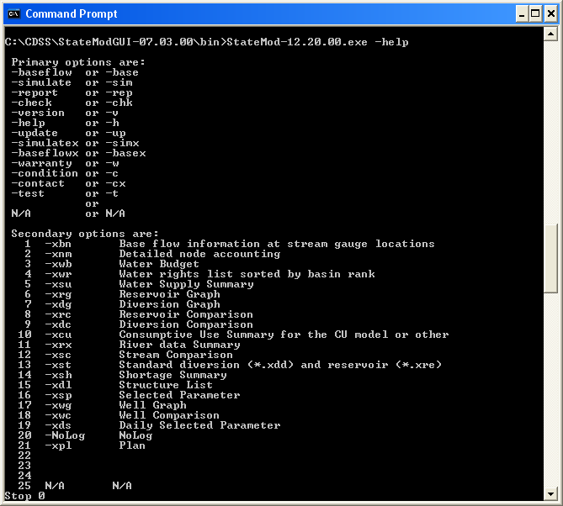
Running StateMod
From Command Line
Using the command line directly is more streamlined and can be automated
Menu will be shown if command line is in error
Syntax is:
StateMod-Version.exe
responseFile.rsp
–primaryOption
–secondaryOption

Slide 10
Running StateMod Data Check on the Command Line
Open a command shell – Start…Accessories…Command Shell
Change directories to dataset folder – “cd \CDSS\StateModGUI-Version\doc\Training\data-cm2009\statemod”
Run StateMod that is distributed with the dataset – “../Bin/StateMod-13.00.00”

Slide 11
Running the StateMod GUI
To run the GUI:
Start…All Programs…CDSS…StateModGUI-Version
(where Version is the installed version)

Slide 12
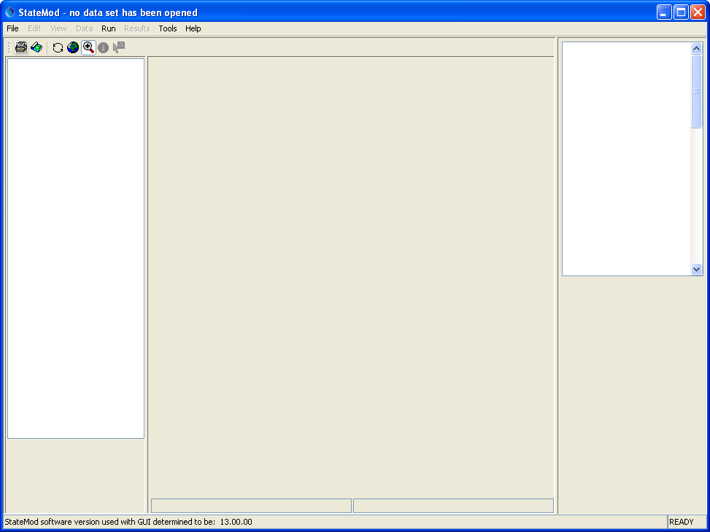
After starting the StateMod GUI
No data set has been opened.
“statemod –version” is run to determine the configured StateMod executable version, which indicates file format versions

Slide 13
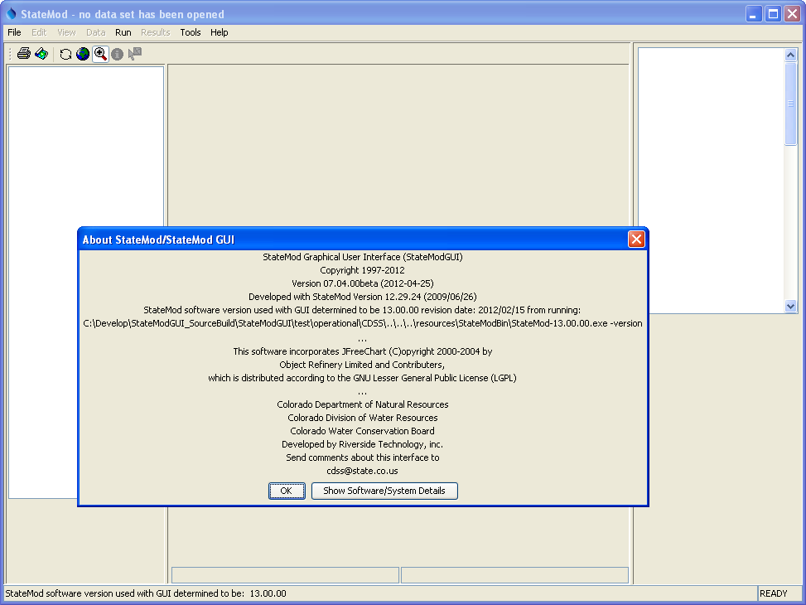
Help…About StateMod/StateMod GUI also displays the StateMod version

Slide 14
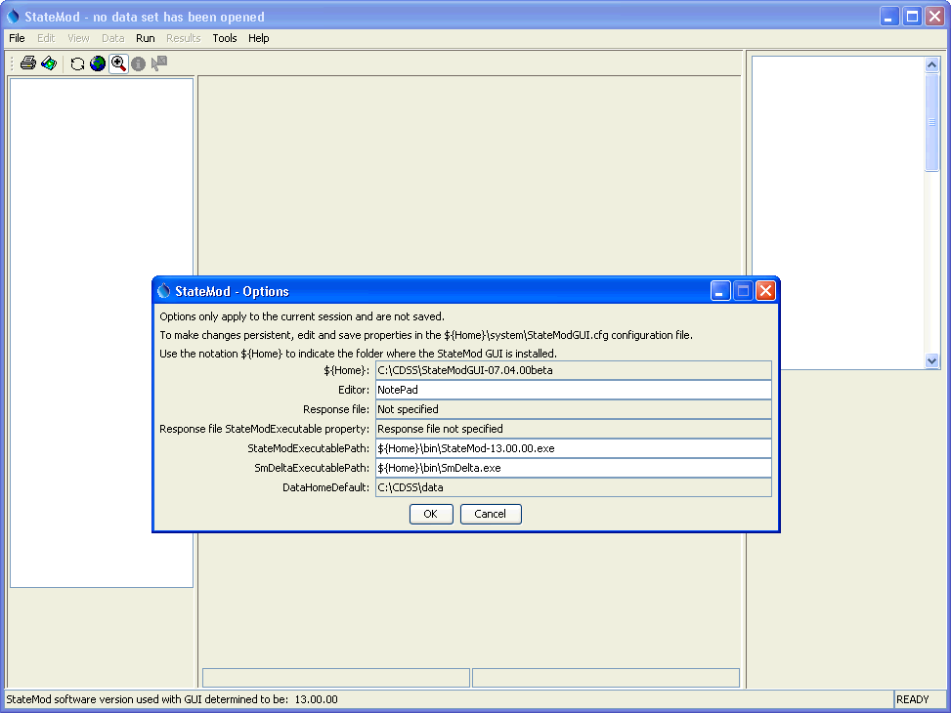
Main configuration information
Tools…Options will display main configuration properties. In particular, the GUI needs to know which StateMod executable program to run.
The default StateMod executable will be the version distributed with the GUI.

Slide 15
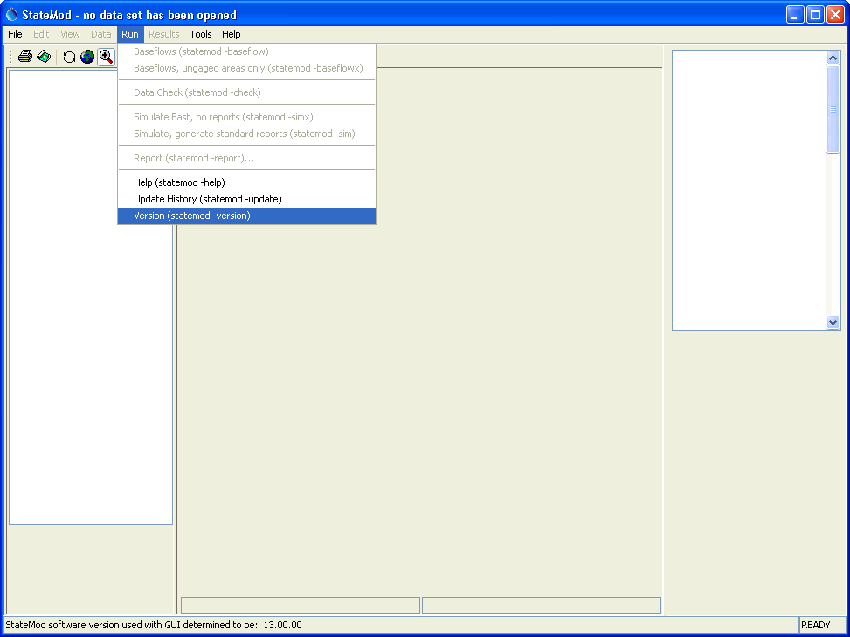
Running StateMod to view program information
Run…Version (statemod –version)
will display StateMod version information and confirm that the GUI is able to locate the StateMod executable program.

Slide 16
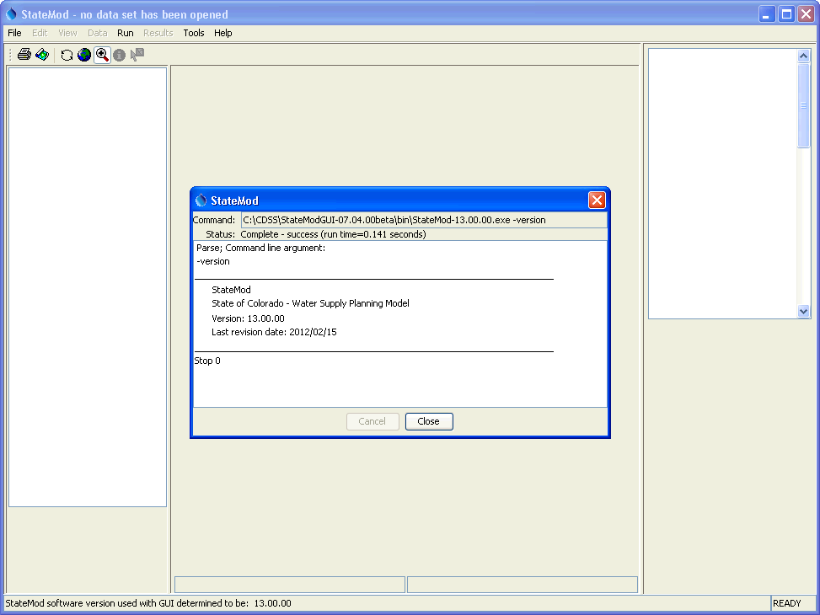
Running StateMod to view program information
Displayed output is the same as screen output when StateMod is run in a command shell (when the GUI is not used).
This dialog must be closed before other GUI features can be accessed.

Slide 17
Opening an Existing Dataset
File…Open…
Select a *.rsp file in the “statemod” folder of the dataset
For this example, choose the following (assuming defaults for installation):
  C:\CDSS\StateModGUI-Version\doc\Training\data-cm2009\statemod\cm2009.rsp

Slide 18
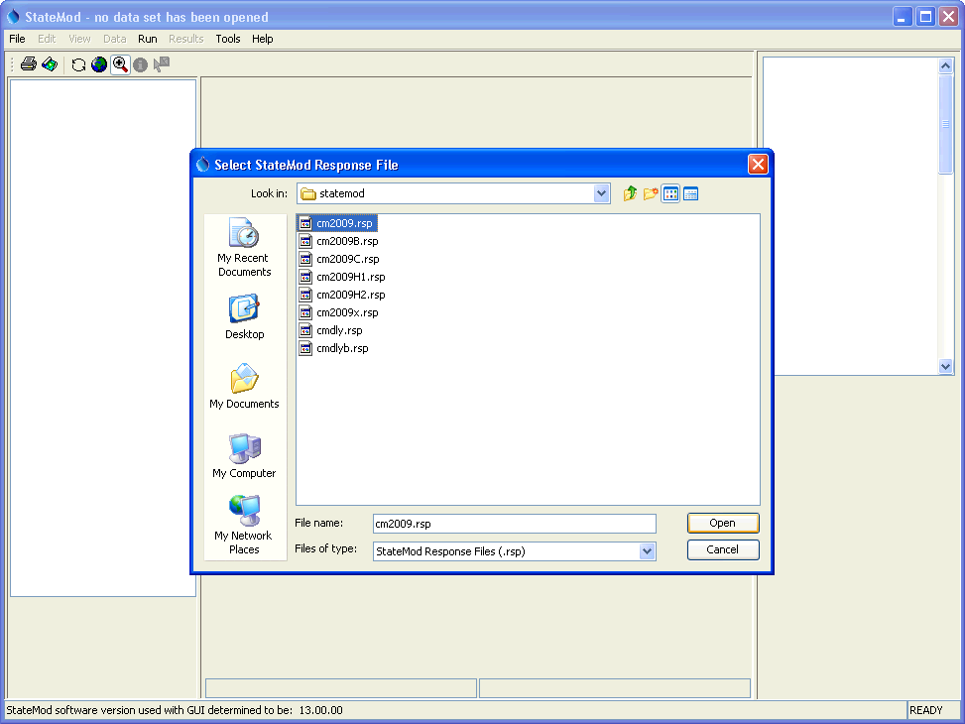
Opening a StateMod dataset
“Response files” are used to configure multiple variations of the dataset, including historical, baseline, and calculated planning demands. Refer to dataset documentation for an explanation.

Slide 19
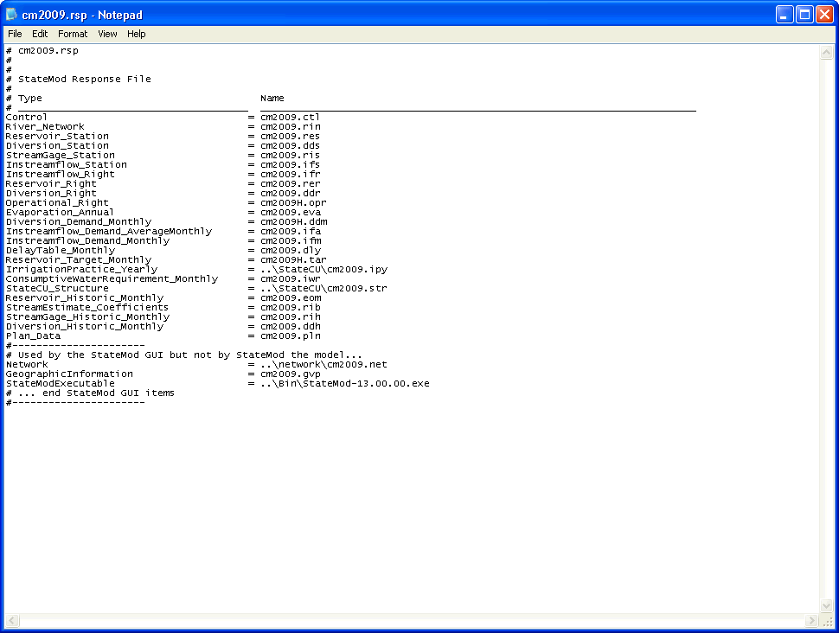
Response file
Comment lines start with #
StateMod files with file type and path relative to the response file – some files, such as those primary to the StateCU model, may exist in another folder
Several files and properties are used by the GUI but not the StateMod program

Slide 20
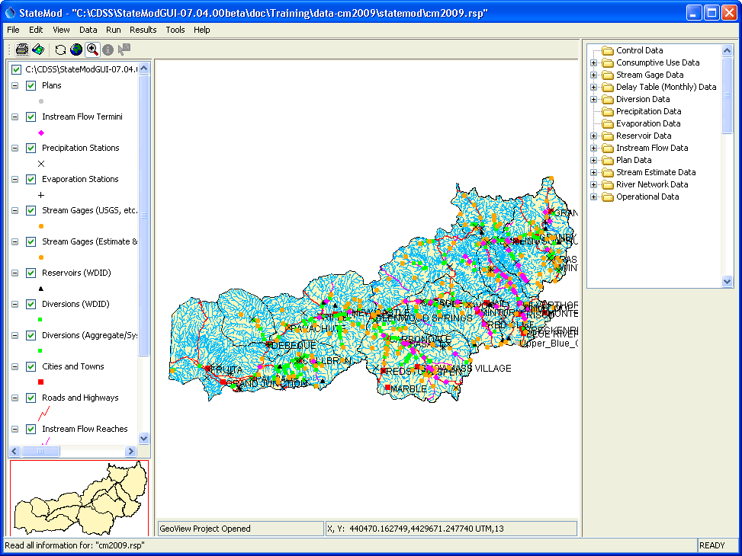
StateMod GUI after opening dataset
Response file name
Tree navigator for dataset components
Interactive map to navigate dataset and view data (if dataset has been configured with map).

Slide 21
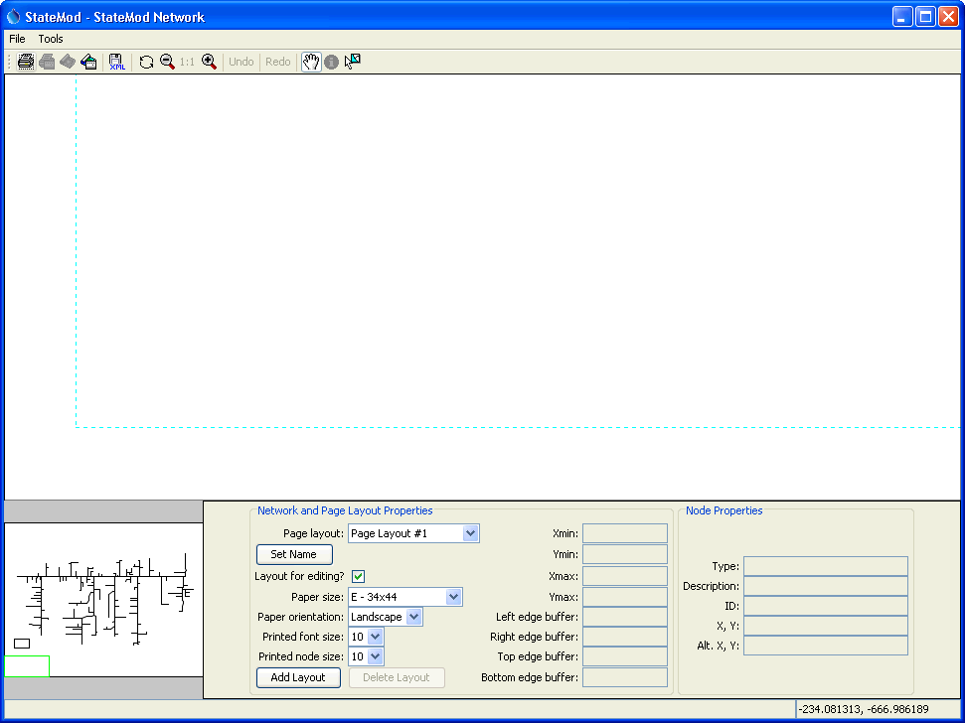
StateMod GUI network window after opening dataset
Use the zoom buttons to change scale.
The network is a schematic view of the physical river basin. The network typically is created in StateDMI when creating a dataset using the “data-centered” approach.
Drag overview box or drag the mouse in the main network window (when the pan tool is selected) to view parts of the network.

Slide 22
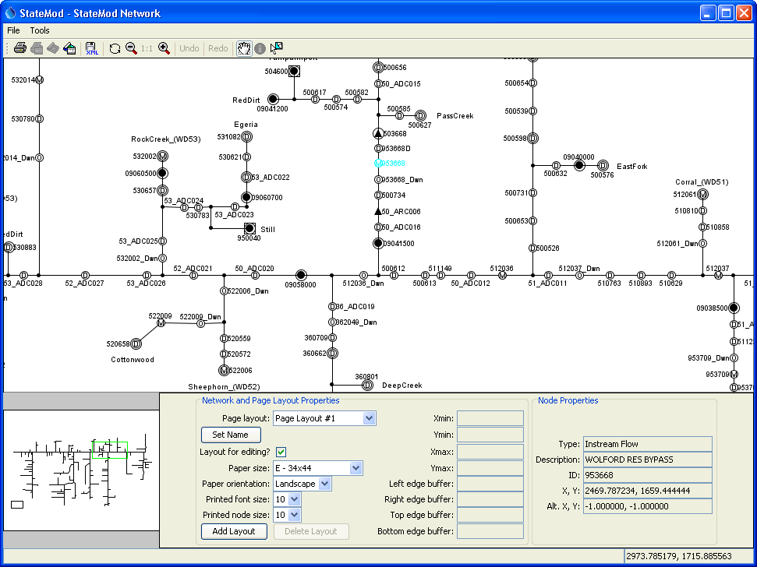
StateMod GUI network window after scrolling
Click on a model node to select and see properties below.

Slide 23
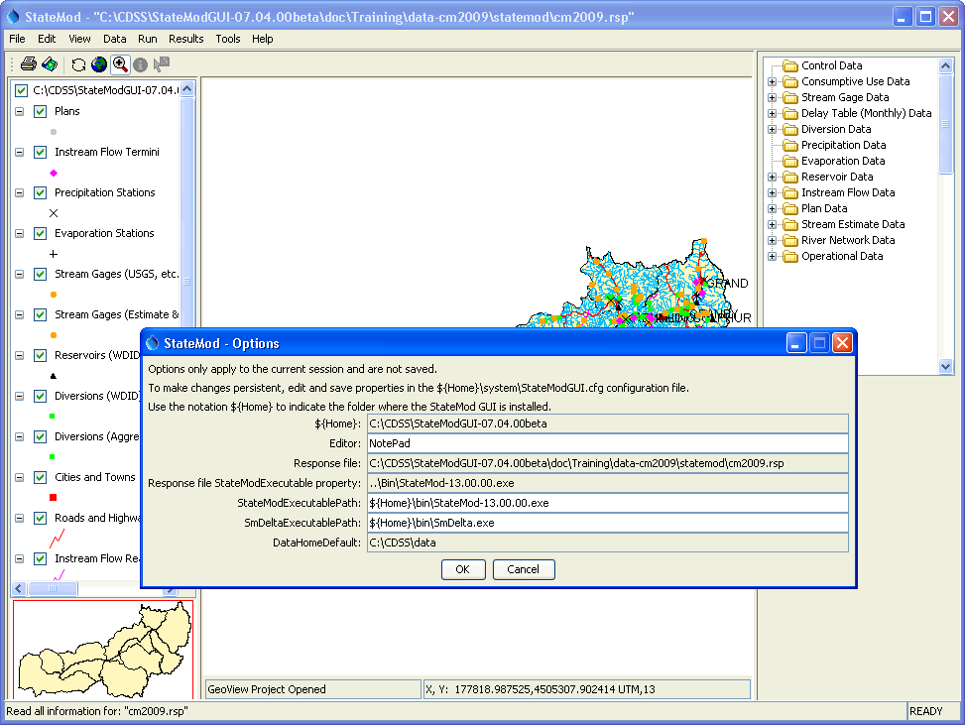
Main configuration information after selecting response file
The StateMod executable will be the version distributed with the dataset.

Slide 24
Recommendations for Modelers
Use CDSS best practices for modeling, including data-centered approach for preparing StateMod data files.
Use the StateMod GUI for visualizing data, running StateMod, and visualizing results.
Limit the editing performed in the GUI if such editing will negatively impact data-centered processes.
Provide feedback on software, data sets, and documentation to foster continued improvement.

Slide 25
More Information
Help…View Documentation to view the StateMod and StateMod GUI documentation.
Help…View Training Materials to view additional StateMod GUI training materials.
Basin model documentation describes in detail the sources of data, estimates, and processes that were used to create the data sets, and summarizes results.
Numerous task memoranda, reports, software documentation, and other documents provide technical information and are available on the CDSS web site:
http://cdss.state.co.us

