Slide 1
TSTool Training
Getting Started
Colorado’s Decision Support Systems (CDSS)
Version: 10.00.01, 2011-05-05
Duration: Less than 30 minutes
Level: Introduction
Colorado Water Conservation Board and Division of Water Resources

Slide 2
This Presentation
Provides an introduction to TSTool for new users
Is designed for self-paced training
Is accompanied by examples, each of which reside in a folder distributed with this presentation
  See the doc/Training folder under the software installation
  Full use of TSTool requires access to databases and internet (some examples will not work without such access)

Slide 3
TSTool Feature Summary
Read and write time series in various formats
Automate processing using a command language
Fill/manipulate data
Quality control
Analyze data and generate products

Slide 4
TSTool Origins in CDSS
Originally developed for Colorado’s Decision Support Systems (CDSS)
  Read time series data from HydroBase database and files
  Fill missing data
  Create input files for StateCU and StateMod models
  Process model results into products
Within CDSS, complements other software
  TSTool processes time series
  StateDMI processes some time series but focuses on other data files

Slide 5
TSTool …Beyond CDSS
Read/write CADSWES RiverWare files
Read MODSIM time series files
Read/write Army Corps HEC-DSS files
Read/write National Weather Service River Forecast System files
Process ensembles of time series
Retrieve files using FTP and URLs
Run on Windows and Linux/UNIX
Run external programs and Python Scripts
…many enhancements beyond CDSS core

Slide 6
CDSS Data-Centered Approach
Open access to data
Share data for multiple uses
Applications focus on analysis and generating results/products
Concepts are applicable beyond CDSS
Data Collection
Data-Centered Management:
GIS/HydroBase Database
Data Management Interfaces (DMIs)/Access Tools:
TSTool, StateDMI,etc.
StateView, Website
Applications/Models:
Consumptive Use (StateCU)
Water Allocation (StateMod)
Groundwater (MODFLOW)
Other

Slide 7
Starting TSTool
If not already installed, download and install the software from http://cdss.state.co.us (see the Products…DMI Utilities link).
To run, for example:
Start…All Programs…CDSS…TSTool-09.07.02
Multiple versions can be installed and will be listed in the CDSS menu.

Slide 8
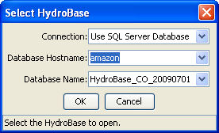
Select HydroBase
Select HydroBase server (can be local computer)
Select available HydroBase version
Reading data from HydroBase will not be possible if HydroBase is not available (but web services and other options are available if internet access is available).

Slide 9
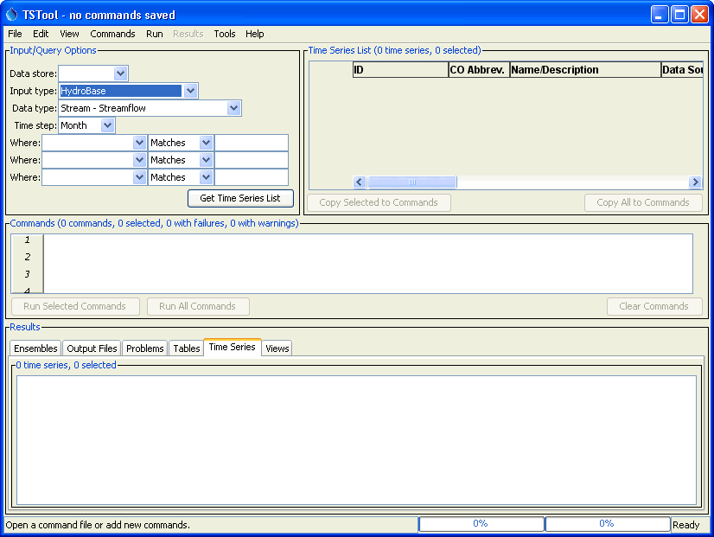
After starting TSTool
Query area to browse data
Commands area to automate processing
Results area to view results

Slide 10
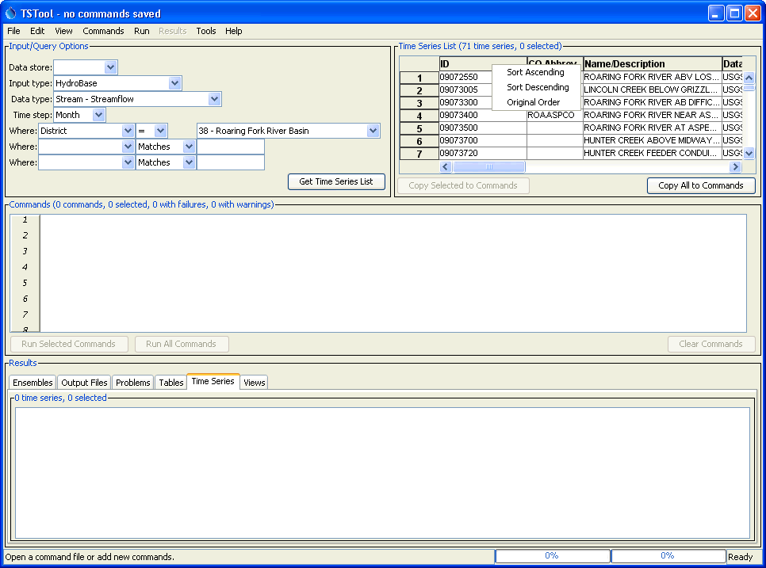
Listing available time series (HydroBase example)
1. Specify input and query options
2. “Get Time Series List”
3. View the time series list – right click on headings for sort options.
Each input type has choices and limitations based on the data

Slide 11
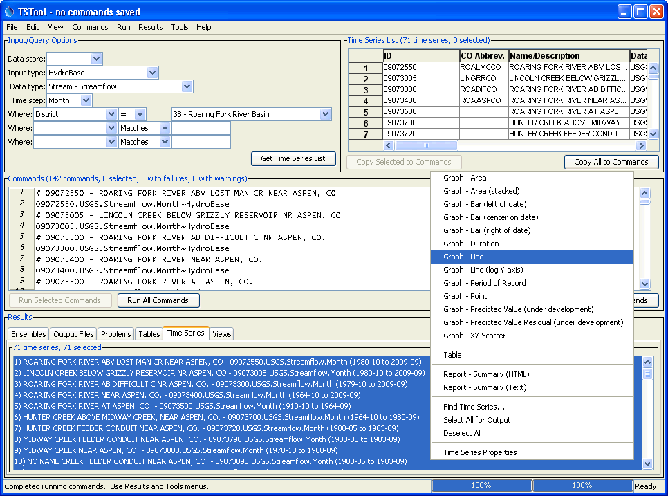
Graphing time series
1. Copy time series identifiers (TSIDs) to commands
2. Run commands
3. Select time series and right click to graph

Slide 12
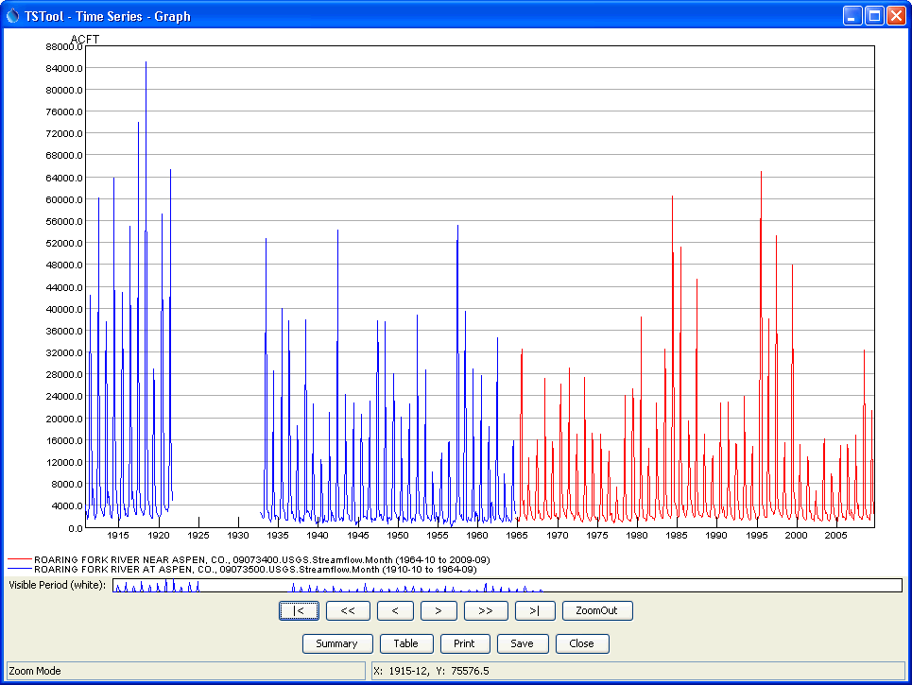
Graph Features
The graph is interactive!
Can mix data intervals
Time axis automatically reformats
Mouse coordinates are displayed at bottom
Overview window is shown below main graph
Use mouse to draw box to zoom in time
Use buttons to page through data
Alternate views and other actions

Slide 13
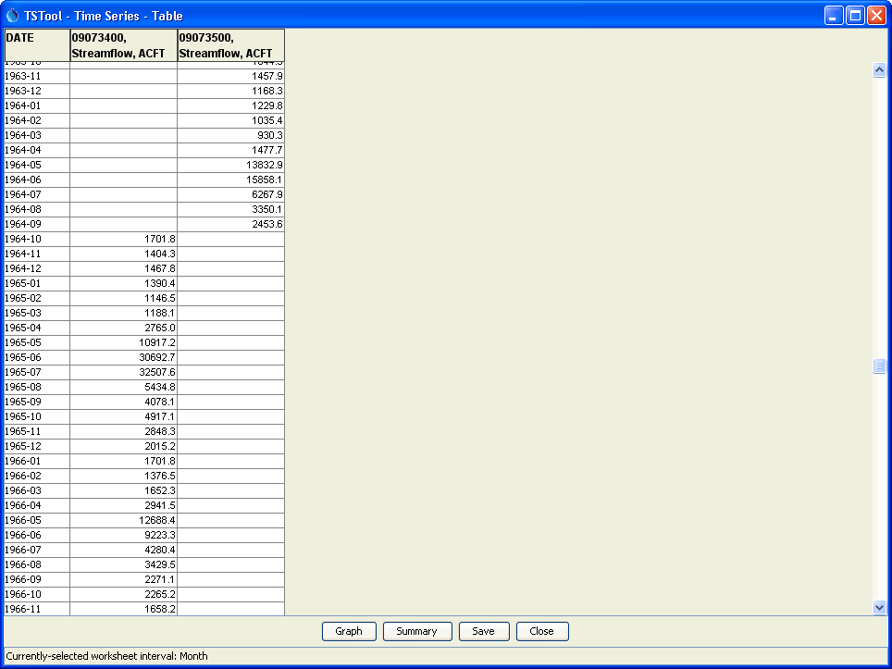
Table Features
Column headings default to information from time series
Table scrolling, with rows and columns limited only by computer memory
Select cells, right-click for clipboard and export options
Alternate views and other actions

Slide 14
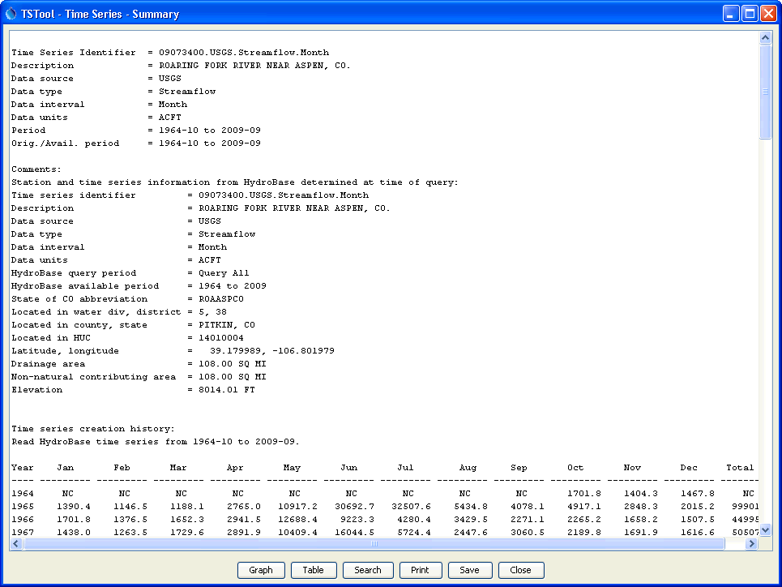
Summary Features
General time series metadata
Additional information if available (e.g., from HydroBase)
Default report format for data interval
Alternate views and other actions

Slide 15
Time Series Identifier (TSID)
LocID.Source.DataType.Interval
LocID.Source.DataType.Interval~InputType
LocID.Source.DataType.Interval~InputType~Filename
LocID.Source.DataType.Interval~DataStore
The TSID uniquely identifies the time series and allows TSTool to find the time series in a database, files, or website.
The DataStore concept is being phased in and allows more flexibility in configuring input and output.
An alias also can be used to identify time series and can be set in some commands that create time series. Aliases are in many cases interchangeable with TSIDs and allow users to identify time series using metadata that is more relevant for a specific application.

Slide 16
Opening and Running an
Existing Command File
File…Open…Command File
Select a *.TSTool file (in this case choose example1-StreamflowCommands\ StreamflowCommands.TSTool)
Press the Run All Commands button under the command list
View the results

Slide 17
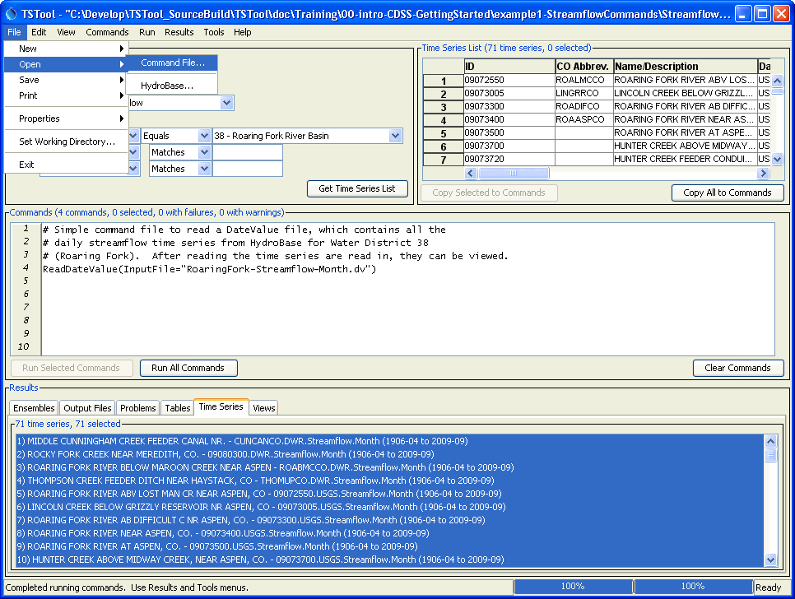
Opening and Running a Command File
Open an existing command file
Commands have a readable text form, with comments used to describe processing
Run commands to generate results

Slide 18
More Information
Help…View Documentation to view the TSTool documentation

