Slide 1
TSTool Training
Introduction to
Regional Climate Center (RCC)
Applied Climate Information System (ACIS)
Web Service Data
Version: 10.00.01, 2011-05-09
Duration: 15 minutes
Level: Introduction

Slide 2
This Presentation
Provides an introduction using TSTool with RCC ACIS data
Is designed for self-paced training
Is accompanied by examples, each of which reside in a folder distributed with this presentation
  See the doc/Training folder under the software installation
  Full use of RCC ACIS web services with TSTool requires internet access

Slide 3
RCC ACIS Web Service Data
Provides access to National Climatic Data Center (NCDC) data archives and real-time data
Data are “best estimate” based on multiple data feeds
Requires internet access
Currently limited to daily data and mainly has been tested with core data types (precipitation, temperature, etc.), but additional data types will be supported in the future
Performance is impacted by network speed (may be best to harvest data, save locally, and then use local data for further processing)
See example1-Precipitation\daily-precip.TSTool
(the following slide illustrates how to create this command file)

Slide 4
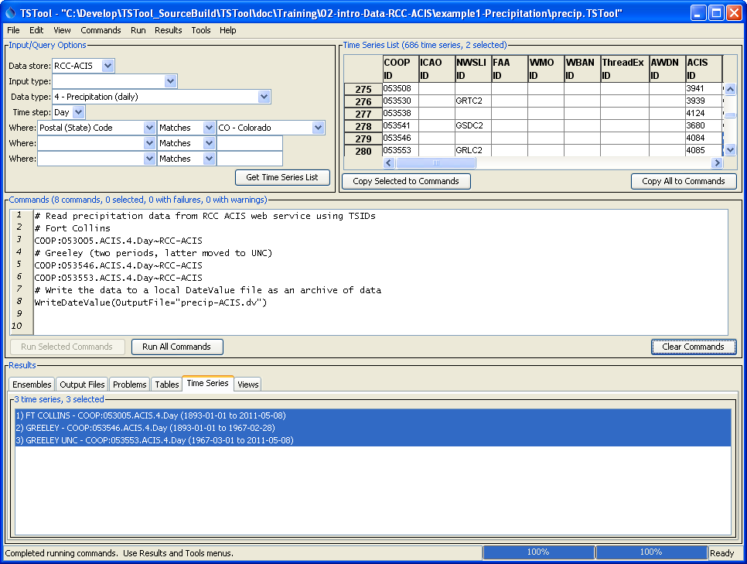
RCC ACIS Web Service Data
1) Specify data type and location criteria and press “Get Time Series”
2) Select time series above and press “Copy Selected to Commands” or “Copy All to Commands” – multiple location identifiers may be available and are used in the order preferred by ACIS
3) “Run All Commands”
4) Right-click on results and “Graph…”

Slide 5
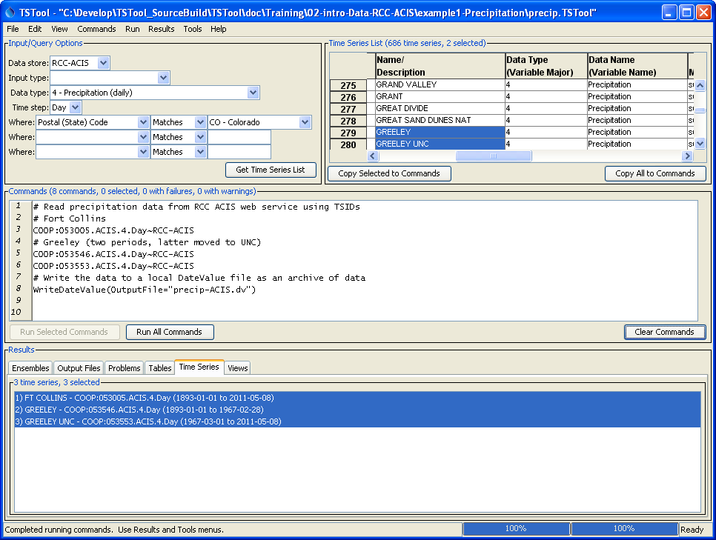
RCS ACIS Web Service Data
Scroll to right to see additional station and time series properties, including station name
Time series identifiers use numerical data type, as per ACIS conventions

Slide 6
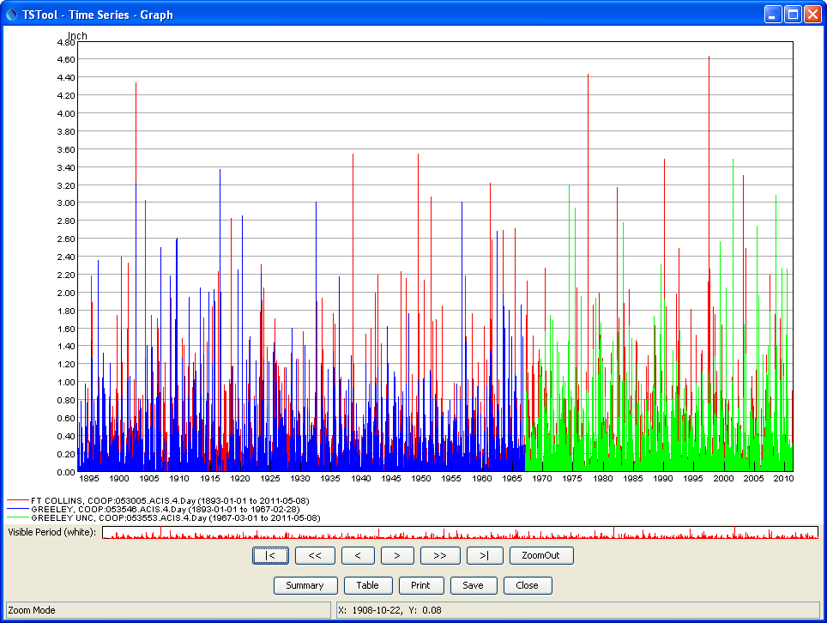
RCS ACIS Web Service Data
Right click on graph to change graph properties – see other training materials for more information
Use graph controls to zoom in and display other data views

Slide 7
More Information
Help…View Documentation to view the TSTool documentation

