Slide 1
TSTool Training
Introduction to CDSS Data
Colorado’s Decision Support Systems (CDSS)
Version: 10.00.01, 2011-05-09
Duration: 60+ minutes
Level: Introduction
Colorado Water Conservation Board and Division of Water Resources

Slide 2
This Presentation
Provides an introduction using TSTool with CDSS data
Is designed for self-paced training
Is accompanied by examples, each of which reside in a folder distributed with this presentation
  See the doc/Training folder under the software installation
  Full use of TSTool requires access to a HydroBase database and internet (ColoradoWaterHBGuest and ColoradoWaterSMS web services)

Slide 3
ColoradoWaterHBGuest Web Service
Diversion Data
Requires internet access
Currently limited to total diversion through structure (DivTotal) data type, but additional data types will be supported in the future
Performance is impacted by network speed
See example1-ColoradoWaterHBGuest\ ColoradoWaterHBGuest.TSTool
(the following slide illustrates how to create this command file)

Slide 4
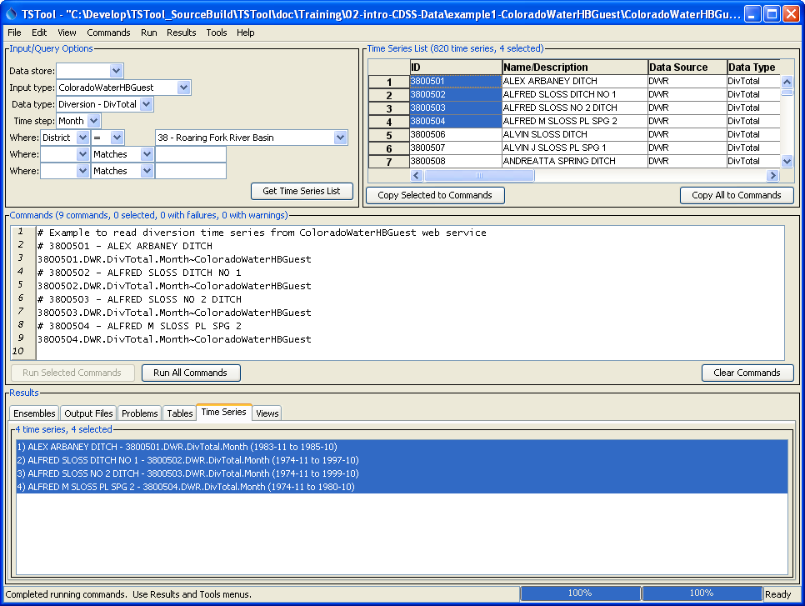
ColoradoWaterHBGuest Diversions
1. Specify district and press “Get Time Series List”
2. Select time series above and press “Copy Selected to Commands” or “Copy All to Commands”
3. “Run All Commands”
4. Right-click on results and “Graph…”

Slide 5
ColoradoWaterHBGuest Web Service
Diversion Data
Day, Month, and Irrigation Year (November to October) data available
Can convert monthly data to calendar year using the ChangeInterval() command
See example1-ColoradoWaterHBGuest\ ColoradoWaterHBGuest-3800502.TSTool

Slide 6
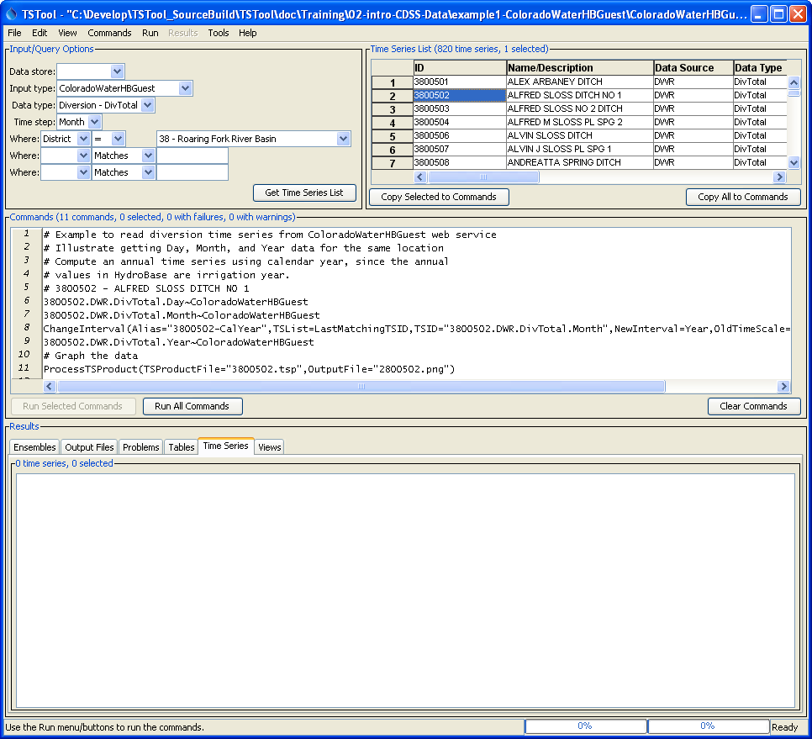
ColoradoWaterHBGuest Diversions
Repeat query with different time step and copy selected Day, Month, and Year TSIDs to commands
Create calendar year annual time series and assign alias
HydroBase annual time series is in irrigation year
Automate graph generation

Slide 7
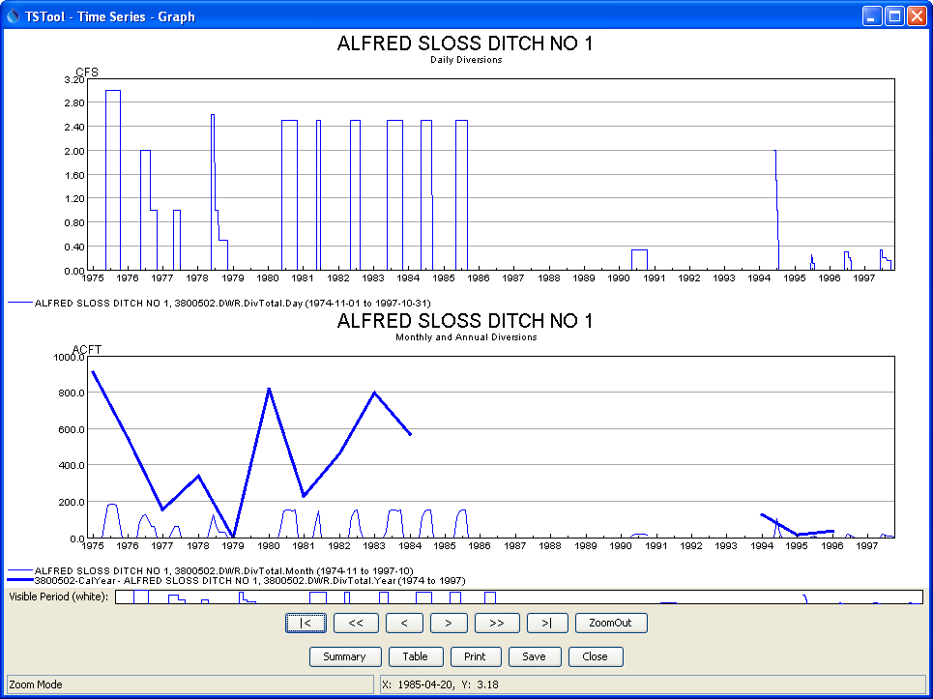
Example Time Series Product
Separate graphs for different data units
Can display different time steps on the same graph
Graph zooming is linked

Slide 8
ColoradoWaterSMS Web Service
Real-Time Data
Requires internet access
Preliminary implementation (there are some rough edges and additional optimization is needed)
Performance is impacted by network speed
See example2-ColoradoWaterSMS\ ColoradoBelowGranby.TSTool

Slide 9
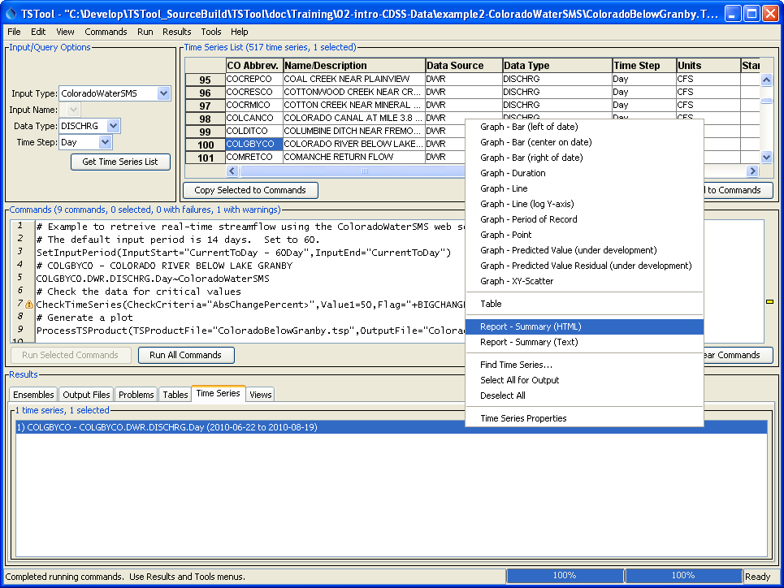
ColoradoWaterSMS Streamflow
DISCHRG data type = streamflow
Right-click and view HTML summary
Check for critical values

Slide 10
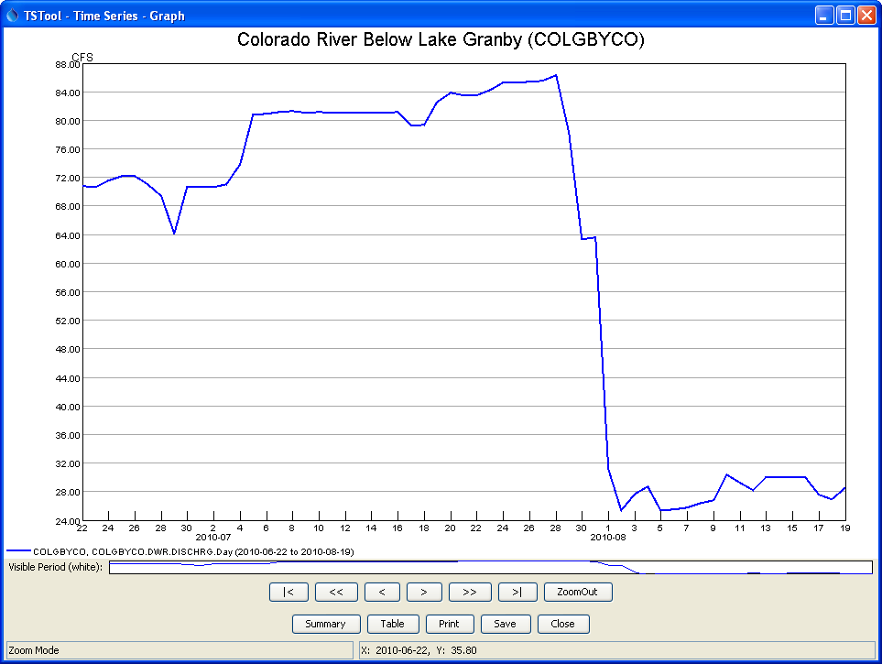
Example Real-Time Product

Slide 11
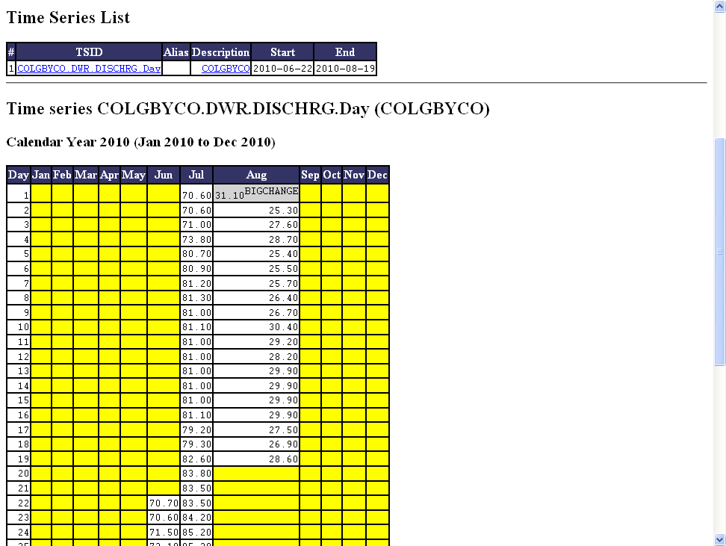
Example Time Series HTML Summary
Annotation from CheckTimeSeries()
See also notes in the legend at the bottom of the page

Slide 12
HydroBase
Contains many time series data types
Requires a local installation of the database (available on DVD) or server installation at bigger organizations like the State
Provides fastest access to the State’s data
Can have different versions of the database
See example3-HydroBase\ SPlatteStreamflow.TSTool

Slide 13
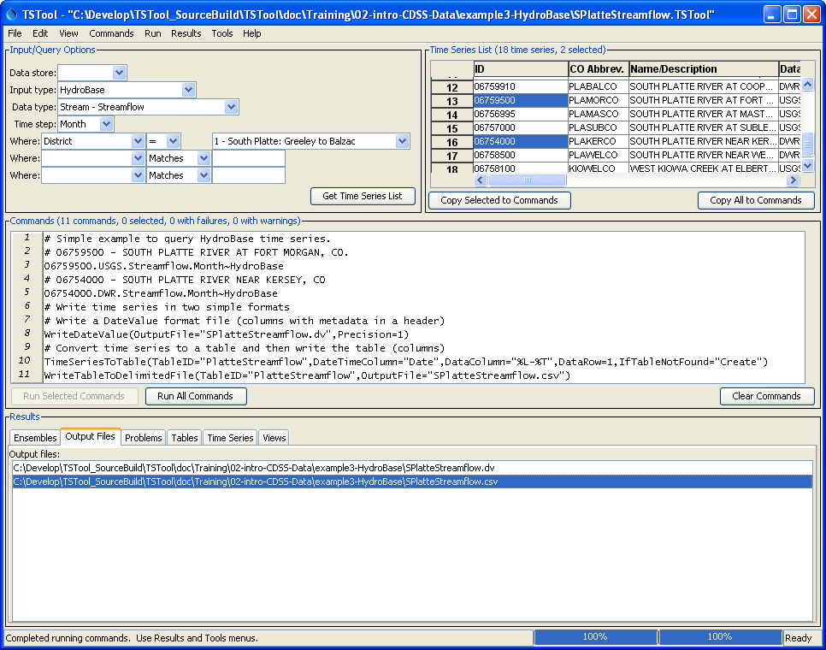
HydroBase Streamflow
Can limit queries with “Where” choices
Example of writing data in simple formats, for use in Excel
Click on output file name (in Output Files tab) to view in program configured for file extension

Slide 14
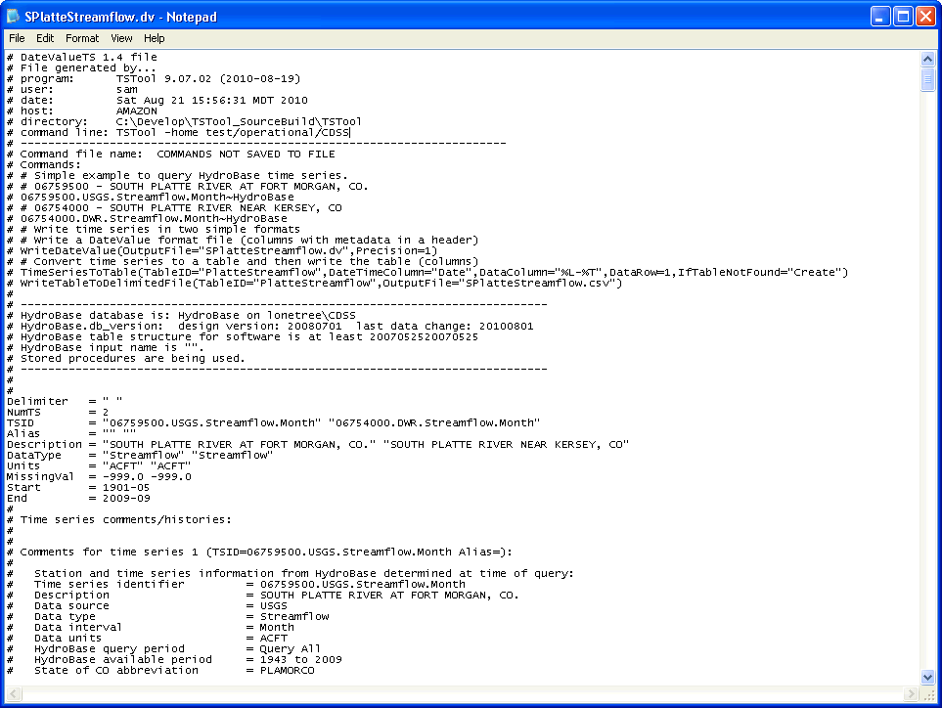
DateValue (*.dv) Format
Notes about software version and user that created file
Commands that created file
HydroBase version information
Time series metadata
Comments about each time series from HydroBase
Data listed in columns below

Slide 15
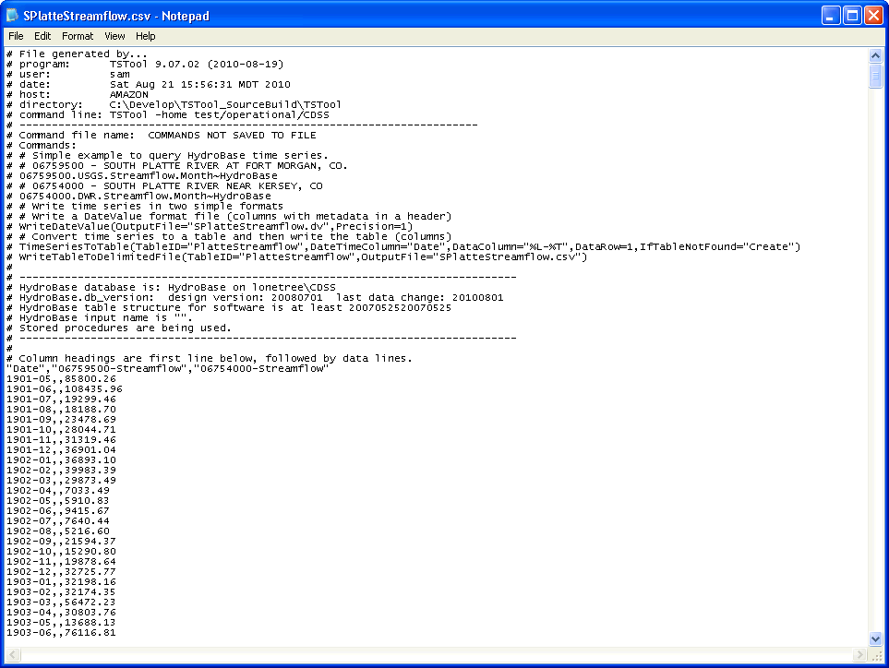
Delimited (*.csv) Format
Notes about software version and user that created file
Commands that created file
HydroBase version information
Columns defined by command parameter
Data listed in columns with blanks for missing values

Slide 16
HydroBase – Diversion Records
Total diversions (DivTotal) or classes (SFUT=Source, From, Use, Type)
Infrequent diversions
Day, Month, and Year interval
See example3-HydroBase\ 5000518.TSTool

Slide 17
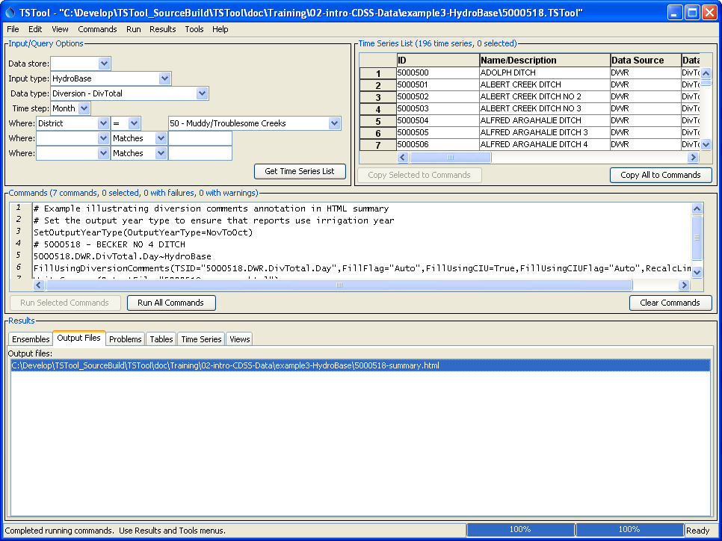
HydroBase Diversions
See “Diversion” data type choices
Example of filling with diversion comments and writing HTML summary file
Click on output file name (in Output Files tab) to view in web browser

Slide 18
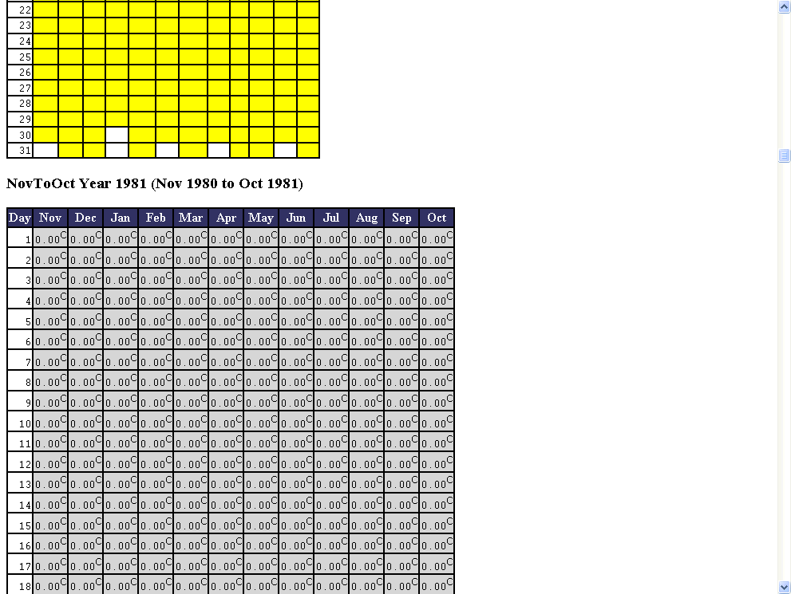
HydroBase Daily Diversions
Irrigation year (NovToOct) 1980 has no daily data or diversion comments.
Irrigation Year 1981 is all zeros because the HydroBase “not_used” flag is “C”, meaning “Water available but not taken”
Notes at bottom of report summarize how many values are flagged.

Slide 19
StateCU Input Files
StateCU is the CDSS consumptive use model
StateCU input files are created by TSTool and StateDMI software, which also can read the files
StateCU processes data by calendar year and the timestep for input depends on analysis method (e.g., Blaney-Criddle, Penman-Monteith)
Simple time series (e.g., precipitation, temperature) use StateMod time series file format
Complex time series (e.g., crop patterns) use a StateCU format
Crop pattern time series:
See example4-StateCU\ CropPatterns.TSTool

Slide 20
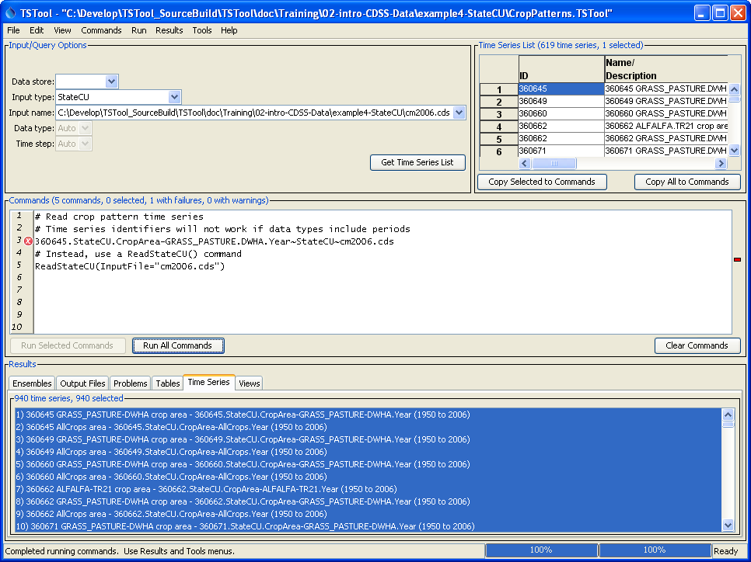
StateCU Crop Pattern Time Series
Select input file when “Get Time Series” is pressed
Time series identifiers have errors because data types use periods
Instead, use a ReadStateCU() command
Dataset totals also are computed

Slide 21
StateCU Irrigation Practice
Time Series
See example4-StateCU\ IrrigationPractice.TSTool

Slide 22
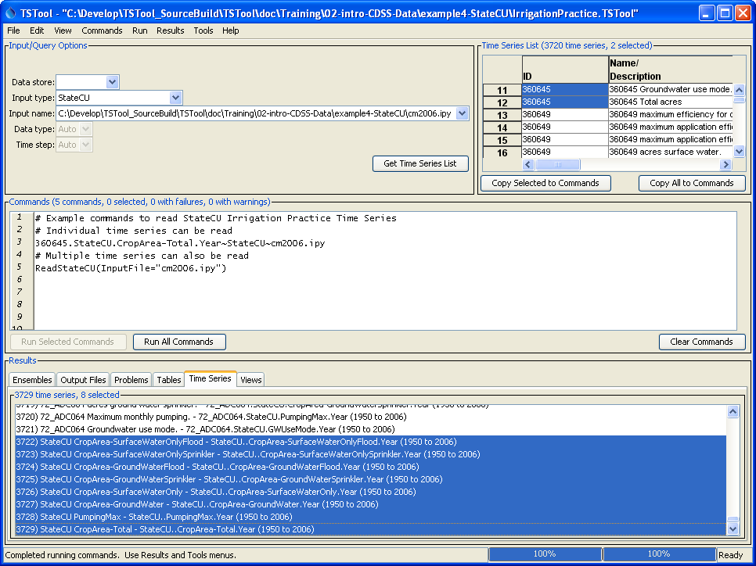
StateCU Irrigation Practice Time Series
Select input file when “Get Time Series” is pressed
Individual time series can be read using time series identifiers
Also can use a ReadStateCU() command
Dataset totals also are computed

Slide 23
StateCU Precipitation
Time Series
See example4-StateCU\ Precipitation.TSTool

Slide 24
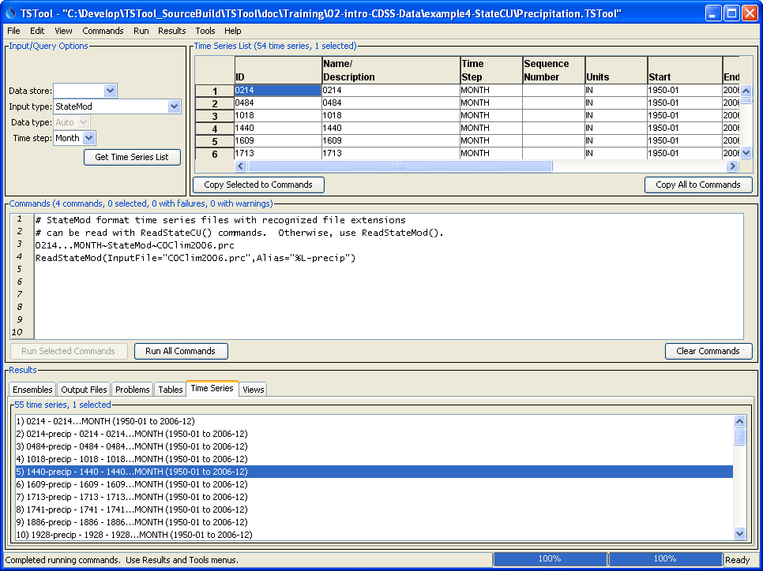
StateCU Precipitation Time Series
are in StateMod format
Select input file when “Get Time Series” is pressed
Can read using individual time series identifiers
Also can use a ReadStateMod() command

Slide 25
StateCUB (StateCU Binary Output)
Consumptive Use Estimates
Binary file is consistent with reports and facilitates optimized data extraction
Use TSTool to read from binary file and export to different formats
See example5-StateCUB\ Farmers.TSTool

Slide 26
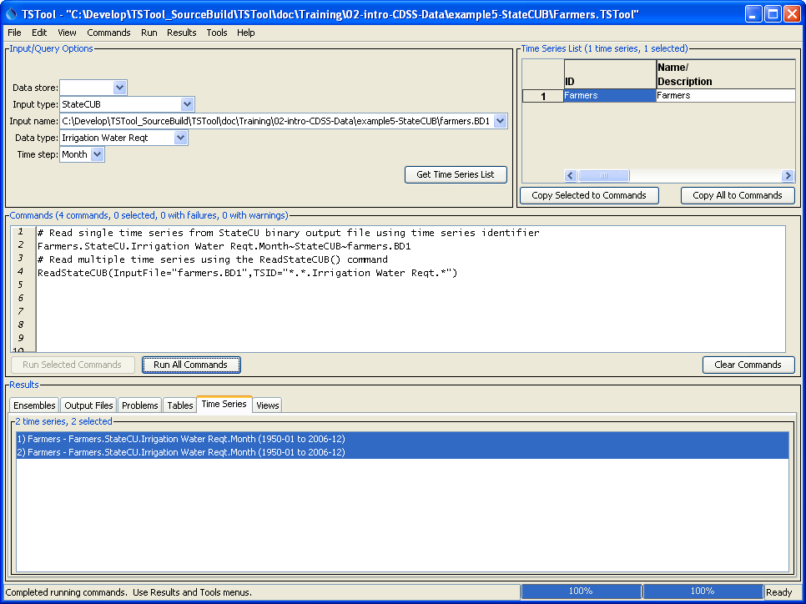
StateCU Binary Output Time Series
Data types are defined by StateCU
Can read using individual time series identifiers
Also can use a ReadStateCUB() command to read one or more time series

Slide 27
StateMod Input Files
StateMod is the CDSS water allocation model
Most time series use the same format
A few (e.g., reservoir targets, which have maximum and minimum) are different
Daily and monthly formats
See example6-StateMod\ HistoricalDiversions.TSTool

Slide 28
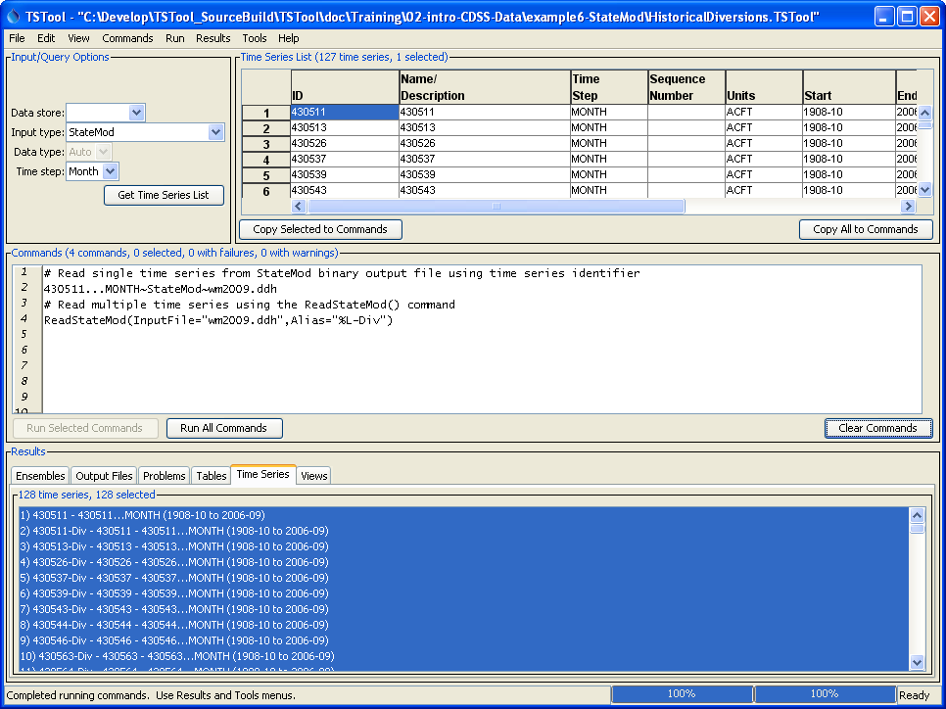
StateMod Diversion Time Series
TSTool prompts for filename when “Get Time Series List” is pressed
Can read using individual time series identifiers
Also can use a ReadStateMod() command to read one or more time series

Slide 29
StateMod Input Files
Water Rights as Time Series
Water rights are defined by a priority date (administration number) and decree
HydroBase net amounts (sum of transactions) are used in StateMod modeling
Time series of rights are used in some data processing tasks, such as limiting groundwater pumping to times when rights existed
See example6-StateMod\ DiversionRights.TSTool

Slide 30
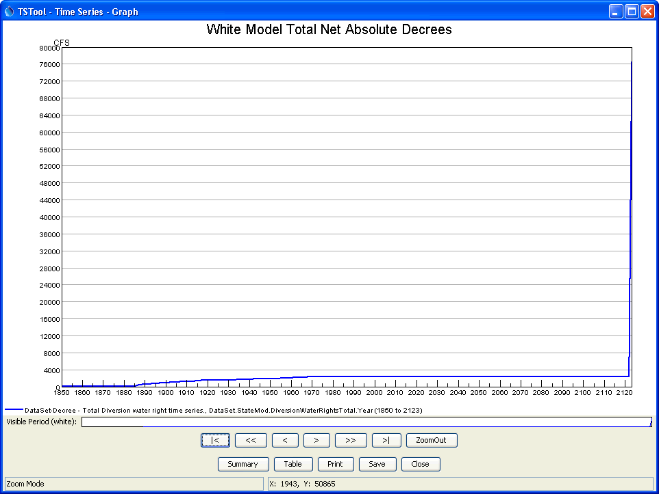
StateMod Diversion Right Time Series Graph
Free river rights.
Starts with administration number equivalent of 00000.00000

Slide 31
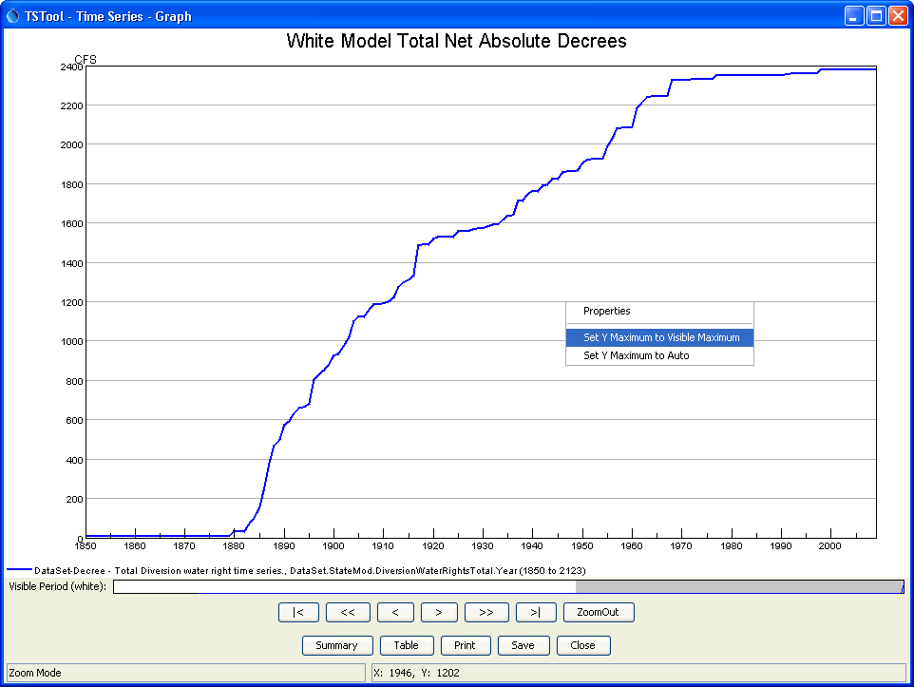
StateMod Diversion Right Time Series Graph
1) Draw box on main or overview graph to zoom into 1850 to 2010
2) Right click on graph and select “Set Y Maximum to Visible Maximum”

Slide 32
StateModB (StateMod Binary Output)
Water Allocation Results
Binary file is consistent with reports and facilitates optimized data extraction
Use TSTool to read and export to different formats
Different binary files store time series for different model node types.
See example7-StateModB\ TotalAndAvailableFlow.TSTool

Slide 33
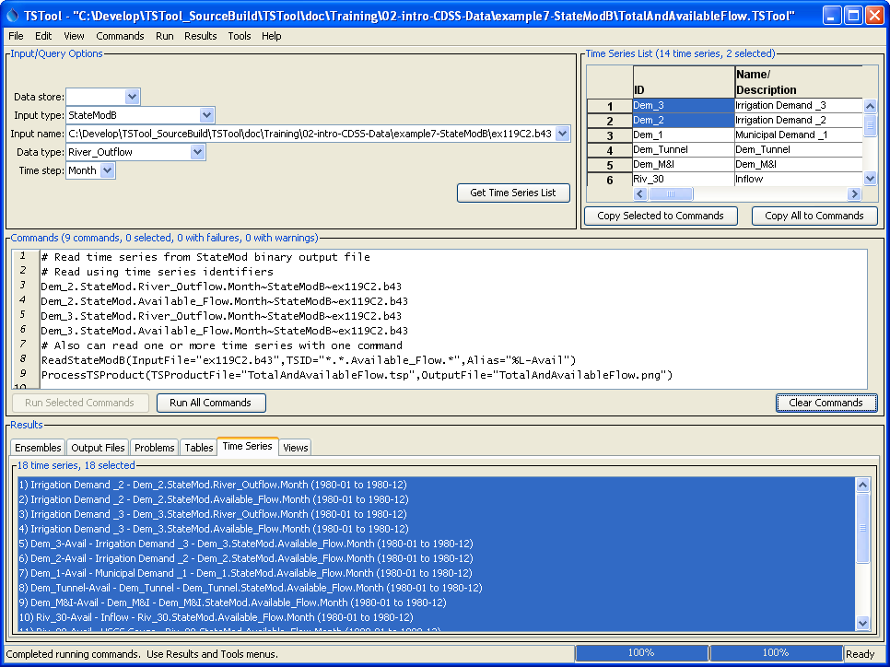
StateMod Binary Output File Time Series
TSTool prompts for filename when “StateModB” is selected – data types are defined by StateMod
Can read using individual time series identifiers
Also can use a ReadStateModB() command to read one or more time series
It is useful to automate creation of graph and other products after model runs

Slide 34
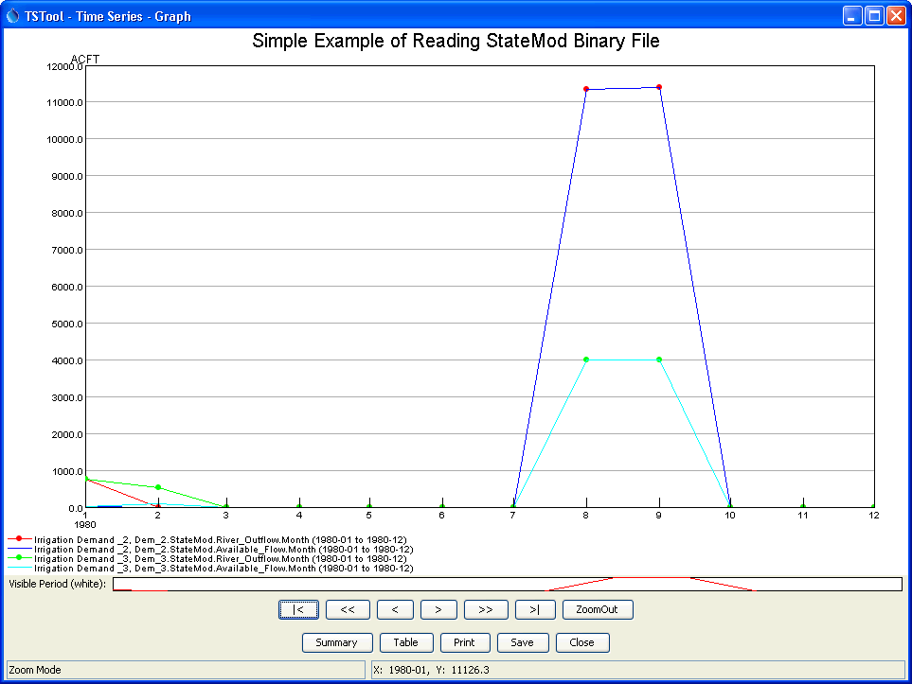
StateMod Binary Output Time Series Graph
(from small StateMod Test Example)
River available flow equals river outflow (free river)
Available flow is less than river outflow (other structures/rights are more senior)
See data types in legend

Slide 35
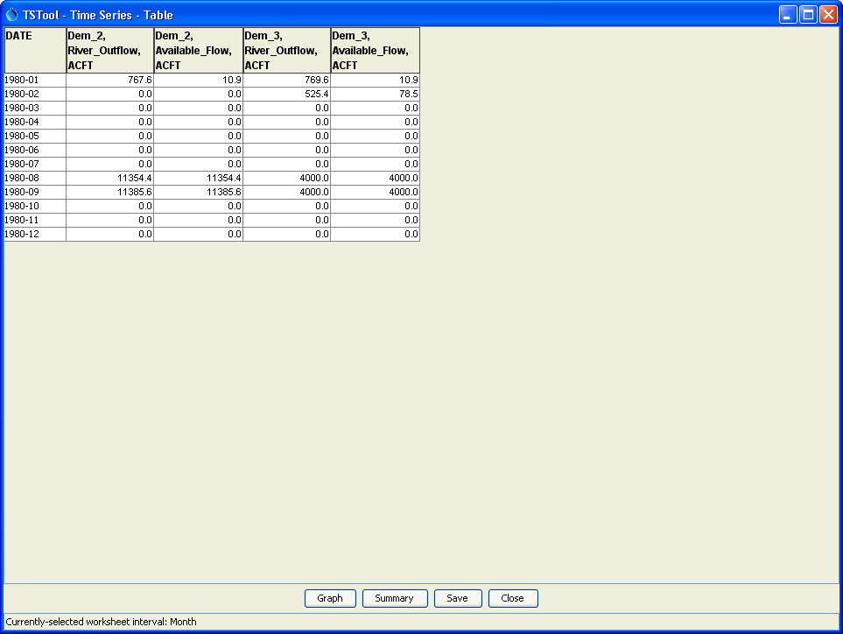
StateMod Binary Output Time Series Table
Available flow is less than river outflow (other structures/rights are more senior)
River available flow equals river outflow (free river)

Slide 36
More Information
Help…View Documentation to view the TSTool documentation

