Slide 1
Colorado’s Decision Support Systems (CDSS)
Training
TSTool
Version: 2006-02-13
Duration: Approximately 1.5 hours

Slide 2
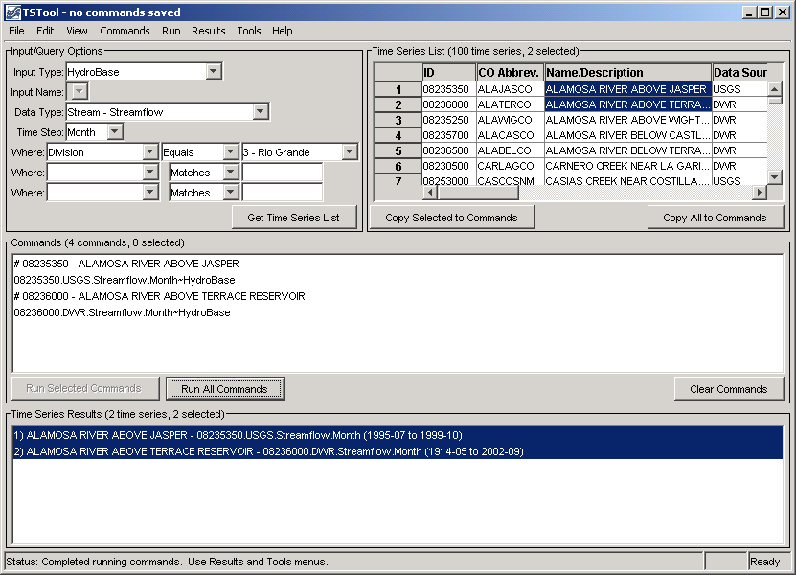
Module 1
TSTool Overview
Notes:
Graphic: GUI_MainWithTS

Slide 3
What is TSTool?
TSTool is a “power user” software tool that:
Reads time series from various input formats
Displays time series data
Analyzes and manipulates time series
Writes time series to various formats
Provides commands for automated processing
Can be used for one-time processing or as part of a larger solution

Slide 4
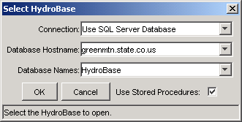
Lab 1.1: Starting TSTool
Start…CDSS… TSTool or desktop shortcut. Ignore the command prompt window (it can be minimized).
Select the HydroBase to use (usually the defaults).
HydroBase properties can be displayed: File… Properties… HydroBase

Slide 5
Lab 1.2: Viewing TSTool Documentation
TSTool documentation is provided as a PDF and is typically saved in \cdss\doc\TSTool\UserManual. Appendices provide useful information, including describing time series that are available in HydroBase.
TSTool training materials and examples are typically saved in \cdss\doc\TSTool\Training.

Slide 6
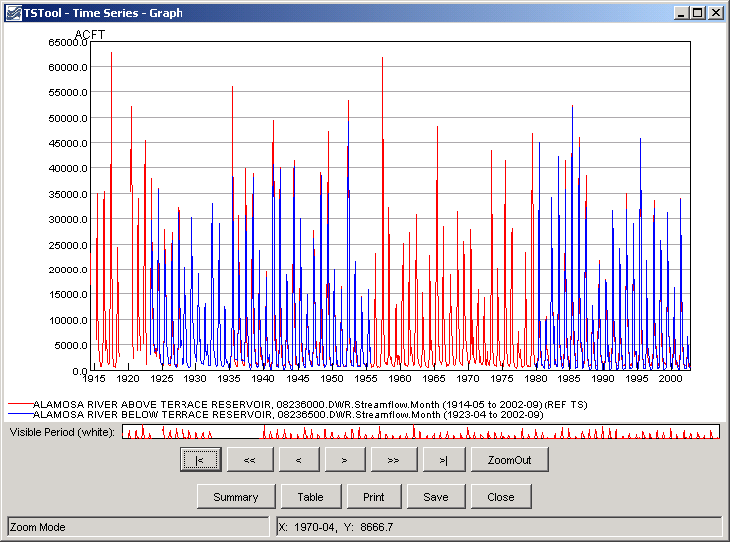
Module 2
Time Series Concepts

Slide 7
Time Series Concepts Regular/Irregular Time Series
A time series is defined as:
A list of date/value pairs.
Regular time series:
Have data values at regular time intervals.
Have data values at every interval in a period (even if the value is a missing value placeholder).
Are managed with a start and end date/time.
Are faster to process.
Irregular time series:
Typically occur at irregular intervals.
Are managed as date/value pairs.
Are slower to process.
Why is this important? Data structure impacts processing.

Slide 8
Time Series Concepts
Date/time
A date/time:
Has one or more string representations (e.g., “2006-01-23”, “2003-01-23 07:55”).
Has precision (e.g., to month, to day, to minute).
Is used to iterate through time series.
Is used to request data values from all time series.
TSTool uses 0 to 23 hours. Hour 24 is converted to hour 0 of the next day.
Why is this important? Date/time controls how time series data are accessed.

Slide 9
Time Series Concepts
Data
Time series data:
Have a type (e.g., “Streamflow”, “Precip”, “Volts”)
Have a missing data value indicator (e.g., -999).
Have precision, typically defined by the data provider – displays and reports may or may not be aware of this precision.
Have units (e.g., “CFS”, “FT”)
Why is this important? Data must be treated consistently by the software.

Slide 10
Time Series Concepts
Statistics
A statistic:
Is a value determined from a sample (one or more values).
Can be determined from a time series (e.g., MaxValue).
Can be determined from a part of a time series (e.g., MaxValue in each month).
Can be a time series (e.g., data type MaxValue with interval Month).
Why is this important? Statistics can be powerful (and may be confusing) when analyzing time series data.

Slide 11
Time Series Concepts
Time Scale
A time scale defines how a time series value is recorded:
Instantaneous (INST) – value was observed at the indicated date/time.
Mean (MEAN) – average value occurred during the interval ending at the recording date/time.
Accumulated (ACCM) – a total is recorded for the interval ending at the indicated date/time
Why is this important? Time scales can be interpreted differently and must be considered with the data interval for the time series data to be understood. For example, consider the following monthly data: ACFT (ACCM for month), AF/M (INST month?). Users must understand the data.

Slide 12
Time Series Concepts
Time Series Identifier
A time series (TS) has a unique time series identifier (TSID):
Location.DataSource.DataType.Interval.Scenario~InputType~InputName
Location = usually a station or location ID
DataSource = usually an agency
DataType = for example “Streamflow”
Interval = for example “Month”, “Day”, “6Hour”
Scenario = optional, for uniqueness
InputType = indicates input format (e.g., “HydroBase”)
InputName = to locate data on system (e.g., filename)

Slide 13
Time Series Concepts
Time Series Identifier (cont)
A time series identifier (TSID) allows TSTool and other software to uniquely identify the time series, allowing:
Repetition/automation of tasks.
Portability of data.
Comparison of different versions of data.
Comparison of different sources of data.

Slide 14
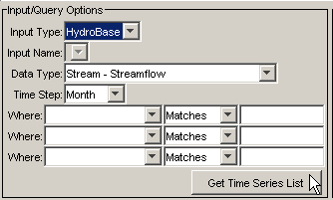
Lab 2.1: Listing Time Series
List monthly streamflow:
Input Type: HydroBase
Input Name not needed
Data Type: Streamflow
Time Step (interval): Month
Press Get Time Series List

Slide 15
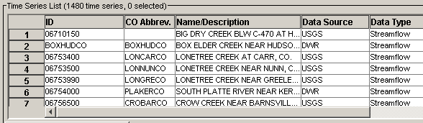
Lab 2.1: Listing Time Series (continued)
The Time Series List provides:
A list of matching time series (but no data values).
“Header” information used to identify the time series, and which provides very basic statistics such as the period of record and number of data values.
A table that can be copied/pasted to other software.

Slide 16
Listing Time Series
More on Input Type
The Input Type:
Uniquely identifies a database or file type that supplies time series data (e.g., HydroBase, USGSNWIS).
May or may not require an input name, which are typically filenames.
Causes a cascade effect in other choices.

Slide 17
Listing Time Series
More on Input Name
The Input Name:
May be used to identify a file or database connection.
Is automatically prompted for some input types. For others it is prompted for after pressing Get Time Series List.
If a file, should be made a relative path to promote portability.

Slide 18
Listing Time Series
More on Data Type
The Data Type choices:
Are determined automatically based on Input Type…OR… may not be determined until data are read (e.g., from a file).
May match a string in a database or file…OR… may be assigned by TSTool (because a data type is not found in the database or file).
May be shown with additional notes, to facilitate use.

Slide 19
Listing Time Series
More on Time Step
The Time Step choices:
Are determined automatically based on Input Type and Data Type…OR… may not be determined until data are read (e.g., from a file).
Are standardized in TSTool (i.e., “Month” instead of “Monthly”).
DO NOT use “real time”. “Irregular” or “Nminute” are used for real-time data.

Slide 20

Listing Time Series
Input Filters
Input filters:
Are shown based on the Input Type and Data Type.
Facilitate querying/reading time series.
DO NOT filter on time series data values, unless a statistic is available for an input type.

Slide 21
Lab 2.2: Listing Time Series
Experiment with Query Options
List HydroBase streamflow time series for various combinations of:
Data Type (see “Stream –” data types).
Time Step
Input filters (try entire database, or regions).

Slide 22
Questions about…
Time Series Concepts?

Slide 23
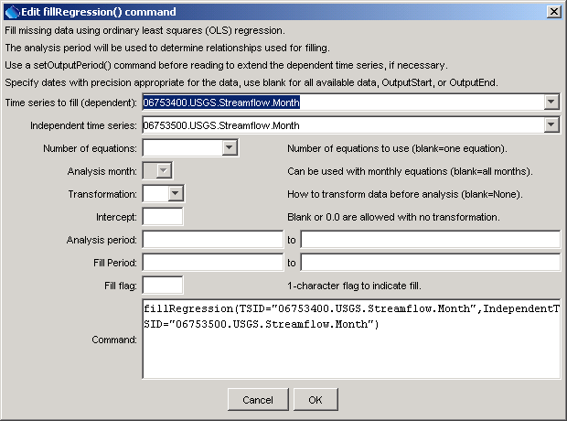
Module 3
Command Concepts

Slide 24
Command Concepts
A command:
Is a software component that performs an “atomic” unit of processing.
Can process one time series, many time series, or no time series, depending on the command.
Uses TSIDs to locate time series for processing.
Has a string representation.
Typically has parameters that control the command.
Allows processes to be tested, automated, and scaled.

Slide 25
Command Concepts
TSID as a Command
A TSID is a special command that:
When processed, causes the time series to be read (the input type is used to determine the input format).
Allows TSTool to scan through commands, in order to list time series that can be parameters to commands.
Can be cumbersome to work with, and is therefore optionally replaced with an alias (discussed later).

Slide 26
Command Concepts
The Commands List
The Commands List:
Is displayed in the middle of the TSTool main window.
Will be processed sequentially from the top to the bottom.
Has a right-click popup menu.
If no commands are selected, new commands will be inserted at the end.
If one or more commands are selected, new commands will be inserted before the first selected command.
Double-clicking on a command will display the command editor dialog for the command (or right-click and Edit…).
A label above the commands list displays the number of commands and indicates how many are selected.

Slide 27
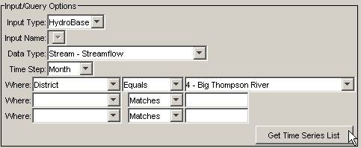
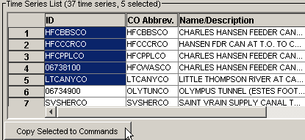
Lab 3.1: Running TSID Commands to Read Time Series
To read time series:
Generate a list of time series as in the previous lab.
Select time series in the list and use Copy Selected to Commands or use Copy All to Commands. Select one to five time series.
Press the Run All Commands button in middle of the TSTool main window.
In the lower window, right-click and press Graph – Line (more on this soon!). Close the window when done viewing the graph.

Slide 28
Command Concepts
Typical Command Syntax
A “named parameter” command has the syntax:
commandName(param1=value1,param2=“value2”,…)
Command names and parameters are not case-sensitive.
Parameters can be specified in any order.
Parameter names are verbose to promote readability.
Parameter values that contain whitespace, delimiter, or other special characters are double-quoted.
This design allows new parameters to be added in the future.
Commands are documented in the TSTool Command Reference.

Slide 29
Command Concepts
Old Command Syntax
Old commands have the syntax:
commandName(value1,”value2”,…)
Command names and parameter values are not case-sensitive.
Parameters names are NOT included in the command.
Parameters must be specified in the documented order.
Parameter values that contain whitespace, delimiter, or other special characters are double-quoted.
This design is being phased out in favor of the named parameter design.
Commands are documented in the TSTool Command Reference.

Slide 30
Command Concepts
Command Editor Dialog
A command editor dialog:
Provides a graphical user interface for command parameters.
Provides choices to minimize user error.
Checks command parameters before the command is inserted/updated.
Facilitates software enhancements by automatically updating commands.

Slide 31
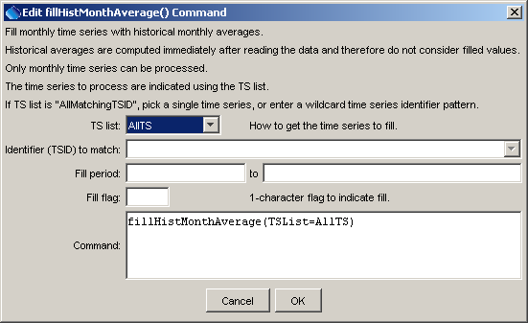
Command Concepts
Inserting a New Command
To insert a new command:
Indicate where to insert the command (insert will be before the first selected command or at end if none are selected).
Use the Commands menu to select a new command – this will display a command editor dialog for the command.
Edit the command parameters in the command editor dialog.
Press OK in the dialog to insert the command in the commands list.

Slide 32

Command Concepts
Editing an Existing Command
To edit an existing command:
Double-click on the command or right-click and then Edit. Commands can be edited with error checks (the default) or without.
In the command editor dialog, edit parameters as appropriate.
Press OK to update the command in the commands list.

Slide 33
Command Concepts
Deleting Commands
To delete one or more commands:
Select one or more commands in the commands list.
Press the Clear Commands button, or right-click and Delete.
Warning: There is currently not an UNDO. However commands that have been deleted can be pasted with the Edit…Paste menu or right-click Paste menu.

Slide 34
Command Concepts
Copying and Pasting Commands
To cut/copy/paste one or more commands:
Select one or more commands in the commands list.
Press right-click and Cut (or Copy).
Select another command (or deselect all).
Press right-click and Paste to insert AFTER the selected command(s).
Note: Currently copy/paste from other software is not fully enabled, although Ctrl-C, Ctrl-X, Ctrl-V do work in many text fields.

Slide 35
Lab 3.2: Running Commands to Fill Time Series
To fill historical streamflow time series:
Generate a list of TSID commands as in the previous lab (Streamflow, Month). Use one to five time series.
Make sure that no commands are selected and press Commands…Fill Time Series Data…fillHistMonthAverage().
In the command editor dialog, simply press OK. The command will be added at the end of the commands list.
Press the Run All Commands button in middle of the TSTool main window. Time series results will be listed at the bottom.
In the lower window, right-click and press Graph – Line (more on this soon!).

Slide 36
Command Concepts
More about Commands
Commands:
Are processed sequentially.
Do not look forward (can only operate on results from previous commands).
Can be applied to supplement each other (e.g., fill with one technique and then fill with a second technique).
Add information to the time series to document processing.
Can be saved and reloaded, to repeat processing at a later time.

Slide 37
Lab 3.3: Saving and Opening a Commands File
To demonstrate saving a commands file:
Generate a list of commands as in the previous lab.
Select File…Save…Commands and save the file to a folder of your preference.
In the middle of the TSTool main window, press Clear Commands (twice if any commands were selected).
Select File…Open…Commands File and load the file that was previously saved.
Press the Run All Commands button in middle of the TSTool main window.
In the lower window, right-click and press Graph – Line.
By saving TSTool commands, data processing steps can be saved and can be rerun later, either using the graphical user interface or in command-line batch mode.

Slide 38
Command Concepts
Command Categories Summary
Command menus are organized into the following categories, listed generally in the order that they would be used:
Creating new time series.
Converting TSID to read*() commands (allows custom parameters).
Reading time series.
Filling time series data.
Setting (not filling) time series contents.
Manipulating time series (e.g., adding, cumulating).
Analyzing time series (e.g., for patterns, comparing).
Models (e.g., hydrologic, hydraulic models).
Outputting time series.
Commands specific to input types (e.g., HydroBase).
General commands.

Slide 39
Command Concepts
Troubleshooting
Troubleshooting command processing involves:
Use Tools…Diagnostics – View Log File to display details about warnings, to evaluate corrective actions.
Use Tools…Diagnostics to turn on debug to print more information.
Gaining familiarity with TSTool to be able to recognize user errors.
Providing feedback to TSTool developers so that additional checks and features can be put in place.

Slide 40
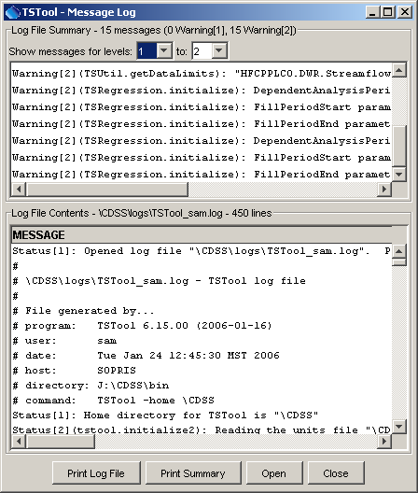
Lab 3.4: View Log File
To view the log file:
Run any commands.
Select Tools…Diagnostics – View Log File...
Scroll through messages in the bottom part of the window.
If warnings are listed at the top, right-click on a warning and select Go to log message.

Slide 41
Time Series Aliases
A time series alias may be assigned to a time series by some commands, using the syntax:
TS Alias = someCommand(…)
The alias:
Is typically a short string.
Can be used in place of a TSID, to facilitate processing.
Will be listed by later commands, when selecting time series to process.
Is useful when two time series might otherwise have the same TSID (e.g., same location ID but different input files).

Slide 42
Questions about…
Command Concepts?

Slide 43
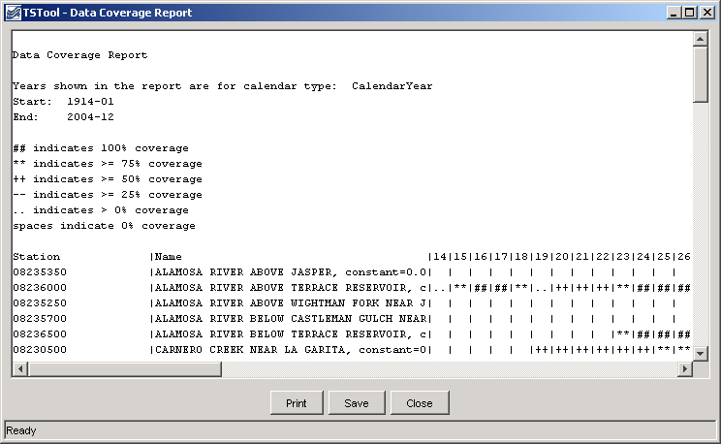
Module 4
Time Series Results Concepts

Slide 44
Time Series Results Concepts
Each time series resulting from commands:
Has a unique identifier.
Has header information consisting of data units, period of record, history, etc.
Has data values.
Can be further processed into specific data products including graphs and reports.
Can be output in various formats that are appropriate for the data type, interval, etc.

Slide 45
Time Series Results Concepts
Time Series Results List
The Time Series Results list:
Is at the bottom of the main TSTool window.
Lists all time series that result from processing, in the order that they were generated.
Provides general information like the time series name/description, TSID, and period of record.
Allows selection of one or more time series for further processing into data products.
Provides a right-click popup menu with useful features.

Slide 46
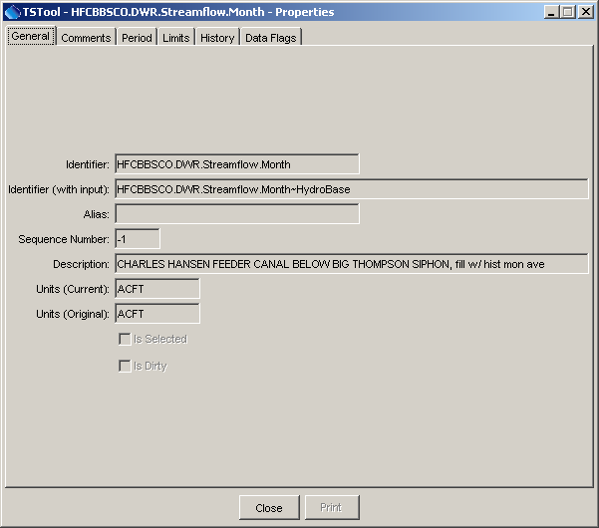
Lab 4.1: Display Time Series Properties
To display time series properties:
Generate a list of time series by running commands, as in previous labs.
In the time series list, select one time series, right-click, and select Time Series Properties.
View the properties tabs and then press Close.

Slide 47
Time Series Results Concepts
Time Series Graph
The time series graphing tool:
Attempts to display all time series that were selected.
Allows time series of different interval to be displayed on the same graph.
Allows zoom-in, zoom-out, and paging.
Provides generic defaults for labeling and symbols and allows changing the graph appearance.
Allows graphs to be printed or saved as an image.
Allows time series to be saved in various formats.
Provides access to the table and summary views.

Slide 48
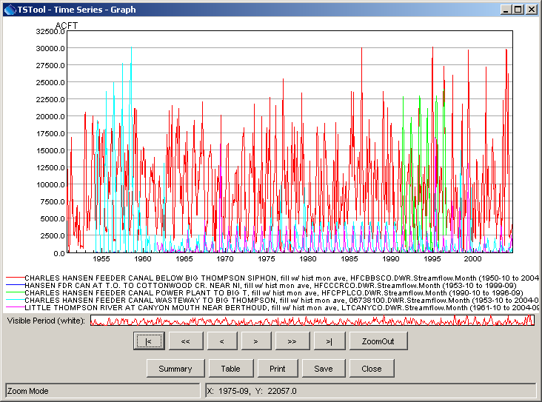
Lab 4.2: Display Time Series Graph
To display a time series graph:
Generate a list of time series by running commands, as in previous labs.
In the time series list, select one or more time series, right-click, and select Graph - Line. If the data type is appropriate for bars (e.g., precipitation data), select Graph - Bar. The main Results menu can also be used.

Slide 49
Time Series Results Concepts
Time Series Table
The time series table tool:
Attempts to display all time series that were selected.
Allows time series of different interval to be displayed on the window, using multiple tables if necessary.
Allows scrolling of data, with no limit on the number of columns or rows.
Allows copy/paste of data to other applications.
Allows time series data to be saved in various formats.
Provides access to the graph and summary views.

Slide 50
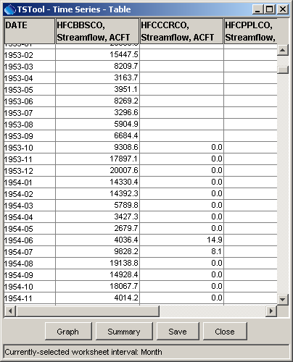
Lab 4.3: Display Time Series Table
To display a time series table:
Generate a list of time series by running commands, as in previous labs. Skip this step if already completed.
In the time series list, select one or more time series, right-click, and select Table. Alternatively, select the Table button on a graph window. The main Results menu can also be used.

Slide 51
Time Series Results Concepts
Time Series Summary
The time series summary:
Attempts to display all time series that were selected, using generic formats for the data interval.
Allows time series of different interval to be displayed in the report.
Allows scrolling of data, with no limit on the report size.
Allows searching the report.
Allows copy/paste of text to other applications.
Allows time series data to be saved in various formats.
Allows printing the report.
Provides access to the graph and table views.

Slide 52
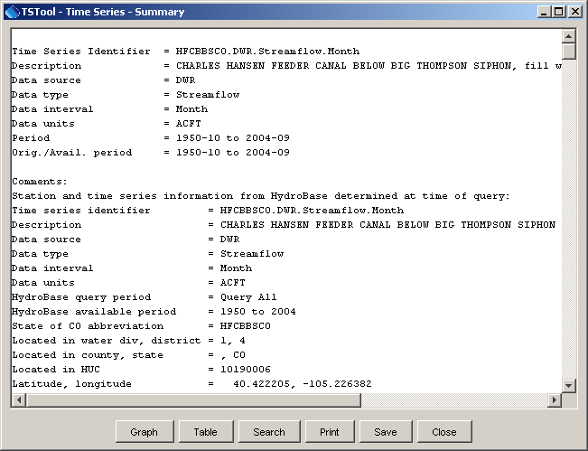
Lab 4.4: Display Time Series Summary
To display a time series summary:
Generate a list of time series by running commands, as in previous labs. Skip this step if already completed.
In the time series list, select one or more time series, right-click, and select Report - Summary. Alternatively, select the Summary button on a graph or table window. The main Results menu can also be used.

Slide 53
Lab 4.5: Open Session
Use skills gained in previous labs to query time series lists, process commands, and display time series.
The following modules will provide specific examples of using commands.

Slide 54
Questions about…
Time Series Results Concepts?

Slide 55
Module 5
Example TSTool Applications

Slide 56
Lab 5.1 Review Data Availability
To review data availability by data type and interval:
Query a list of time series for a region, data type, and interval of interest. For example, query Streamflow, Month for a water division or district.
Copy All to Commands under the time series list.
Run All Commands under the commands list.
Select Tools…Report…Data Coverage by Year.
If desired, save the report to a file for later review or for inclusion in a document or spreadsheet.
If printing the report, it is recommended that landscape and possibly oversize paper be used.

Slide 57
Lab 5.2 Add Time Series
Adding time series is a common activity, for example to compute totals in a basin. The following example illustrates how to add all HydroBase diversion time series in a water district. Note that this is a simple total and does not analyze return flows or reservoir releases (this requires more engineering work).
Clear all commands.
Query DivTotal (Diversion – DivTotal data type choice), Month for a water district (e.g., 4).
Copy All to Commands under the time series list to copy the TSIDs to the commands list.
Select Commands…Create Time Series… TS Alias = newTimeSeries() and enter information similar to the following (this creates a time series to receive the total).

Slide 58
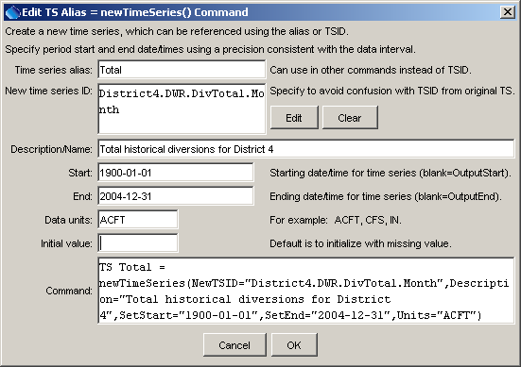
Lab 5.2 Add Time Series
(continued)
See next page for how to use the Edit button.

Slide 59
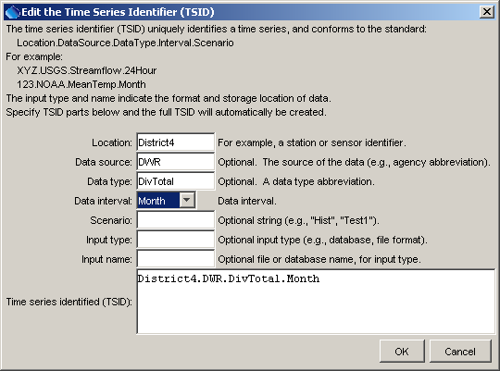
Lab 5.2 Add Time Series
(continued)
Use this dialog to edit a TSID:

Slide 60
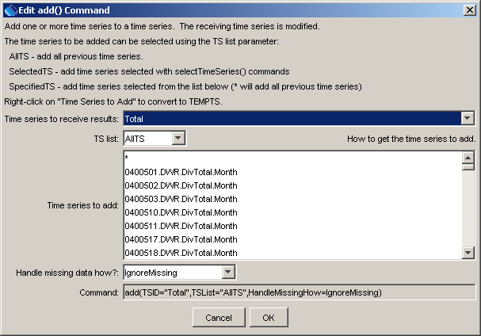
Lab 5.2 Add Time Series
(continued)
Select Commands… Manipulate…add() and complete the dialog similar to that on the right.
Select Run All Commands to generate results. The individual time series and total will be available for graphing or output.

Slide 61
Lab 5.3 Query Diversion Class Time Series
Diversion class time series provide detailed water accounting data. The source/from/use/type SFUT codes provide the detail (see the Water Commissioner Manual). The following example illustrates how to query all daily diversion time series with a transbasin water source (source 4).
Clear all commands.
Select Commands…Read Time Series… readHydroBase() and enter information similar to that on the following page.

Slide 62
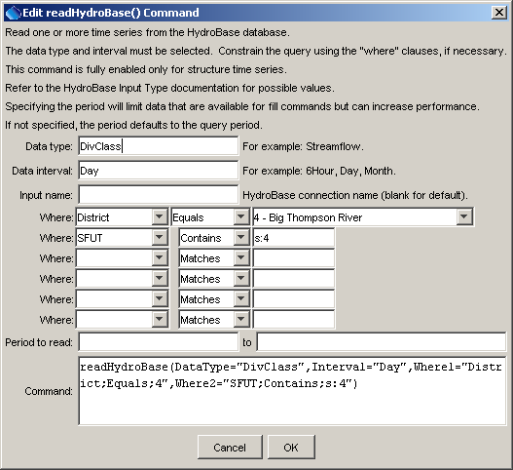
Lab 5.3 Query Diversion Class Time Series (continued)
Select Run All Commands under the commands list. The time series will be available for graphing and additional processing.

Slide 63
Lab 5.4 Create a Statistic Year Time Series
Annual statistic time series are useful for historical data analysis and planning. The following example creates a time series of “the day to maximum flow” for a daily streamflow time series.
Clear all commands.
Query Streamflow, Day for a water district (e.g., 4).
Select a time series with a relatively long period (e.g., HFCBBSCO) and Copy Selected to Commands under the time series list to copy the TSID to the commands list. Only one TSID will be shown in the commands.
Select Commands…Create Time Series… TS Alias = newStatisticYearTS() and enter information similar to the following.

Slide 64
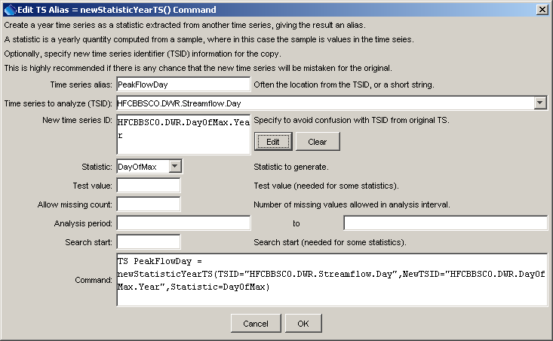
Lab 5.4 Create a Statistic Year Time Series (continued)
See the next page for how to use the Edit button.

Slide 65
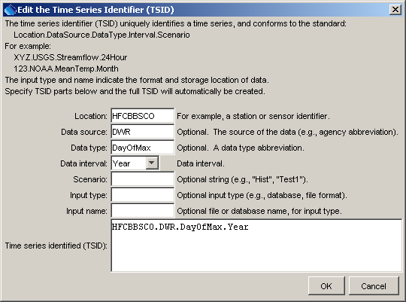
Lab 5.4 Create a Statistic Year Time Series (continued)
Use this dialog to edit a TSID:

Slide 66
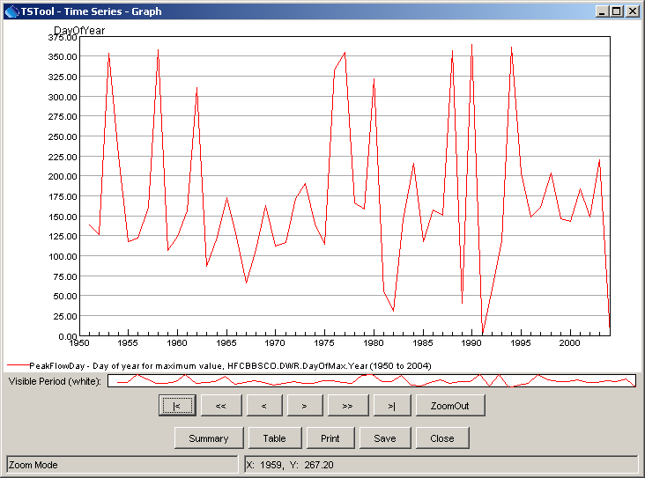
Lab 5.4 Create Statistics Year Time Series (continued)
Select Run All Commands under the commands list. The input and statistic time series will be available for graphing and additional processing.

Slide 67
Lab 5.5 Fill Time Series Data Using Regression
Filling time series is a common activity for modeling. The following example illustrates how to fill monthly streamflow data using ordinary least squares regression. Note that this is a limited example – filling should normally occur on unregulated flows with long overlapping periods.
Clear all commands.
Select Commands…Output…setOutputPeriod() and set to a period to be filled (e.g., 1940-01 to 2004-12).
Query Streamflow, Month for a water district (e.g., 4).
Copy All to Commands under the time series list to copy the TSIDs to the commands list.
Run All Commands under the commands list.
Select the time series to be filled and a candidate time series with overlapping period, right-click and Graph – XY-Scatter.
Review the line of best fit and right-click on the graph and select Analysis Details. Review the R value.

Slide 68
Lab 5.5 Fill Time Series Data Using Regression (continued)
When a good fit is determined (e.g., for Glacier Creek near Estes Park and Beaver Brook near Estes Park), delete all other TSID commands, leaving only the two time series of interest.
Select Commands…Fill Time Series Data… fillRegression() and edit the parameters similar to the following figure.

Slide 69
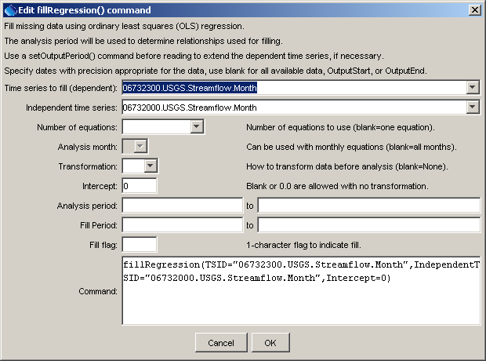
Lab 5.5 Fill Time Series Data Using Regression (continued)
Notes:
Skim

Slide 70
Lab 5.5 Fill Time Series Data Using Regression (continued)
Run All Commands under the commands list. The independent and dependent (filled) time series will be available for graphing and additional processing.

Slide 71
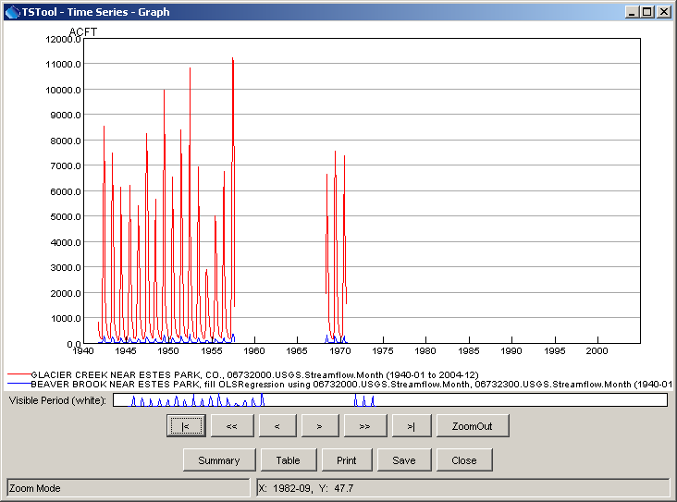
Lab 5.5 Fill Time Series Data Using Regression (continued)
Filled Period

Slide 72
Lab 5.6 Output Time Series to a Generic Format
The following example illustrates how to query streamflow time series from HydroBase and write to a generic DateValue file.
Clear all commands.
Query Streamflow, Month for a water district (e.g., 4).
Copy All to Commands under the time series list to copy the TSIDs to the commands list.
Select Commands…Output Time Series… writeDateValue(). Browse to specify an output file name.
Run All Commands under the commands list. The time series will be written to the file and can be imported into Excel or other applications.

Slide 73
Module 6
Time Series Products

Slide 74
Time Series Products
A time series product:
Is a text representation that concisely describes a time series data product (e.g., graph).
Does not store the time series data, only the configuration.
Can be processed to generate a data product.
Is useful for repetitive data processing.

Slide 75
Lab 6.1 Precipitation & Flow Graph
A precipitation and flow graph illustrates hydrology input and output. The following example illustrates how to plot both on a graph page.
Clear all commands.
Query Precip (Climate – Precip data type choice), Month for a water district (e.g., 4).
Select a time series with a reasonably long period of record (e.g., Estes Park) and Copy Selected to Commands under the time series list to copy the TSID to the commands list.
Query Streamflow, Month for a water district (e.g., 4).
Select a time series with a reasonably long period of record (e.g., Big Thompson River above Estes Park) and Copy Selected to Commands under the time series list to copy the TSID to the commands list.
Run All Commands under the commands list.
Right-click on the time series and select Graph – Line. A warning will be displayed about units. Continue with the graph.

Slide 76
Lab 6.2 Precipitation & Flow Graph
(continued)
Right-click on the graph and select Properties.
Right-click on the small layout window and select Add Graph Below Selected. The graph window will split.
In the Graph Properties section in the middle of the properties window, select “1” (the first graph). This will list the time series for the first graph in the bottom third of the properties window.
Select the streamflow time series in the Time Series Properties section of the properties window and drag it onto graph 2 in the layout window. The graph window will redraw.
In the Graph Properties section using graph “1”, select the Graph Type tab and change the graph type to Bar, Left of Date. Press the Apply button. The precipitation will be drawn as bars.
Set other properties like titles, using Apply as appropriate before switching between graphs on the page.

Slide 77
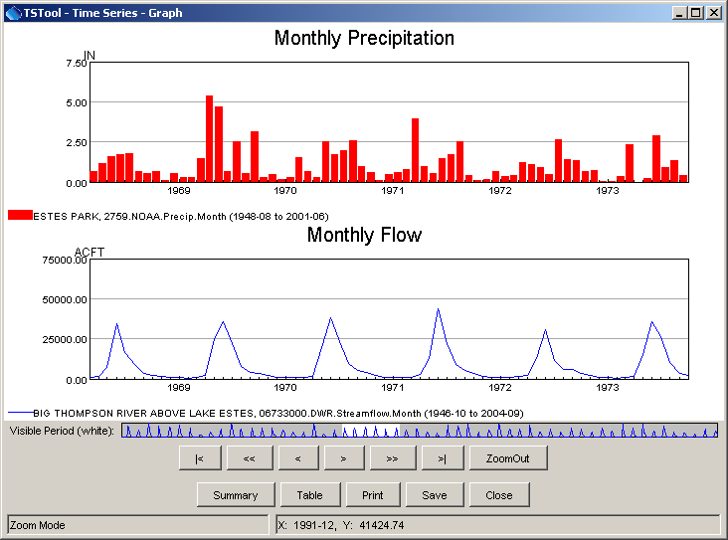
Lab 6.2 Precipitation & Flow Graph
(continued)

Slide 78
Lab 6.2 Precipitation & Flow Graph
(continued)
On the graph window, select Save and save as a Time Series Product File (.tsp).
Close the graph window (and graph properties window).
In the main window, select Run…Process TSProduct File (preview) and select the .tsp file that was saved. A graph will be shown.
Clear all commands if necessary.
Select Commands…Output Time Series…processTSProduct() and select the file.
Select Run All Commands under the commands list. The time series will be queried as necessary to process the product, and a graph will be shown.

Slide 79
Final Questions About TSTool?

