Slide 1
TSTool Training: Introduction to Commands
Duration: ~30 minutes
Level: introduction
TSTool version used: 14.0.4
Updated: 2021-12-19

Slide 2
Presentation Goals
Provide an introduction to TSTool commands.
Run working examples, each of which reside in a folder distributed with presentation:
See the doc/training folder under the software installation folder
Full use of TSTool requires access to the internet and may require installing databases and other software

Slide 3
Prerequisites
TSTool software must be installed and must have internet access.
See the “Getting Started” training lesson for TSTool installation instructions and general information about TSTool features.

Slide 4
Command Files are Workflows to Support Decisions
Command Workflow
TSTool Command Processor
Information Products
Command list
Time series list
- look up using TSID and alias
Data files
Reports
Visualizations
Databases
Table list
- look up using table identifier
Datastore list
- look up using datastore name
Other data
- properties, etc.

Slide 5
Opening and Running an Existing Command File
Command files can be saved and rerun, shared between users, and managed with version control systems.
This helps to document and automate workflows, which increases transparency and efficiency.
Select an existing TSTool command file using the File / Open / Command File… menu.
Then press the Run All Commands button under the command list to run the commands.
Then view the results.

Slide 6
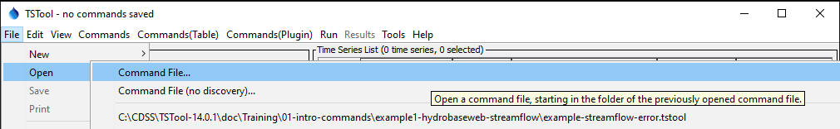
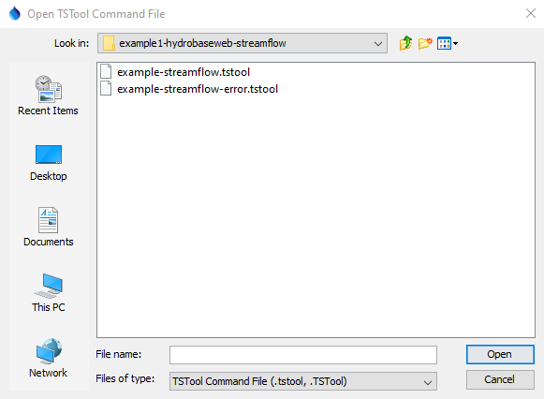
example1: Open an Existing Command File
Browse to a command file (above and then right).
Or, pick from the list of previously opened files.
Open the file: example1-hydrobaseweb-streamflow/example-streamflow.tstool

Slide 7
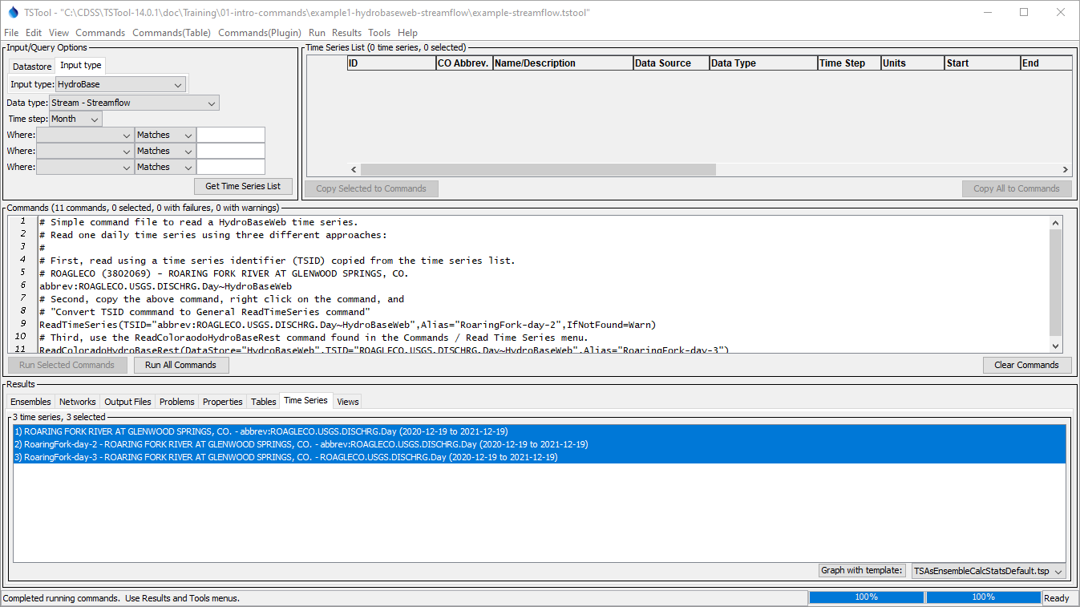
Command file is shown in the title bar, with “modified” if changes have been made
There is no need to browse for time series since the commands will query time series
The contents of the selected command file is shown in the Commands area
1. Press “Run All Commands”
2. Select time series and then right-click to view data

Slide 8
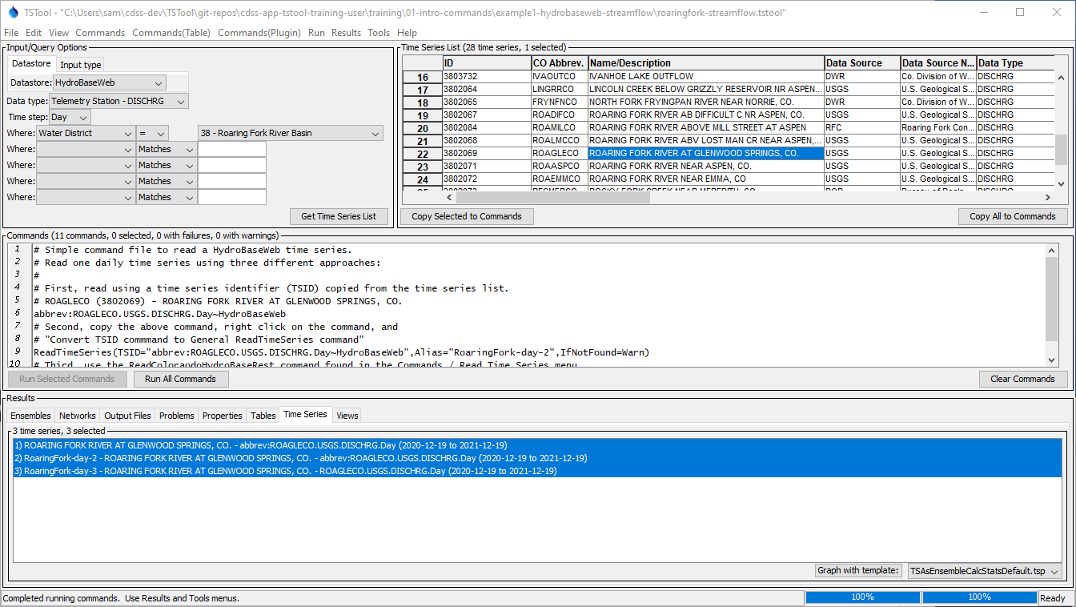
Review of how to Create TSID Commands…
3. Right click on headings
for sort options.
Specify input
and query options
2. Press “Get Time Series List”
4. Click to select time series from list
5. Press “Copy Selected to Commands”
6. Press “Run All Commands”
7. Select time series and then right-click to view data.

Slide 9
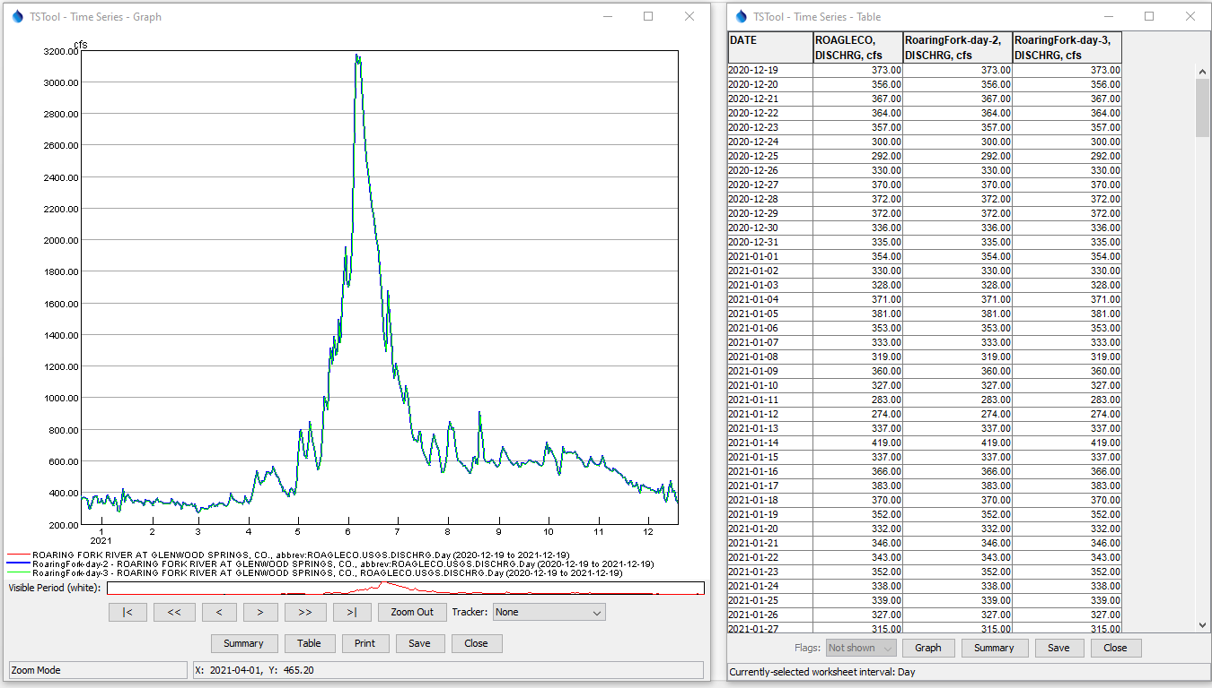
Three copies of the same time series
Click on the legend to toggle selecting a time series and increase its line width

Slide 10
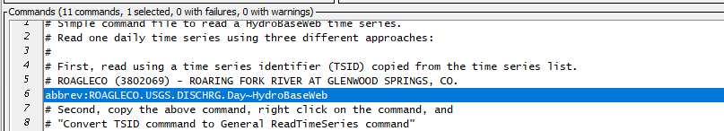
All or Selected Commands Can Be Run
All commands are run each time that the Run All Commands button is pressed.
The Run Selected Commands button will run all commands if none are selected, or will run only the selected commands. See the note above the command list to confirm how many commands are selected.
If necessary, right-click on commands and use the Deselect All Commands menu. Then select one or more commands to run.
The results are (re)generated each time that commands run.

Slide 11
Command Syntax
Example command (line breaks inserted for readability):
ReadTimeSeries(
TSID="abbrev:ROAGLECO.USGS.DISCHRG.Day~HydroBaseWeb",
Alias="RoaringFork-day-2",IfNotFound=Warn)
The command name is followed by a list of parameters in parentheses.
Each parameter has a name, equal sign, and value.
Quotes around parameter values help ensure correct parsing.
Parameters can be in any order; however, TSTool command editors will enforce a default order consistent with documentation.

Slide 12
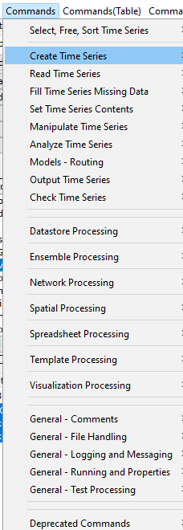
Insert and Edit a New Command
Use the Commands menu to insert a command at the end of the command file or before the first selected command. The menu is organized by logical order at the top, and then grouped by categories of commands.
If necessary, right-click on commands and use the Deselect All Commands menu. Then select a command to insert before.
See the documentation command reference or use the Help button on command editors to view the documentation for a specific command.
There are about 300 commands to process time series, tables, and other data.

Slide 13
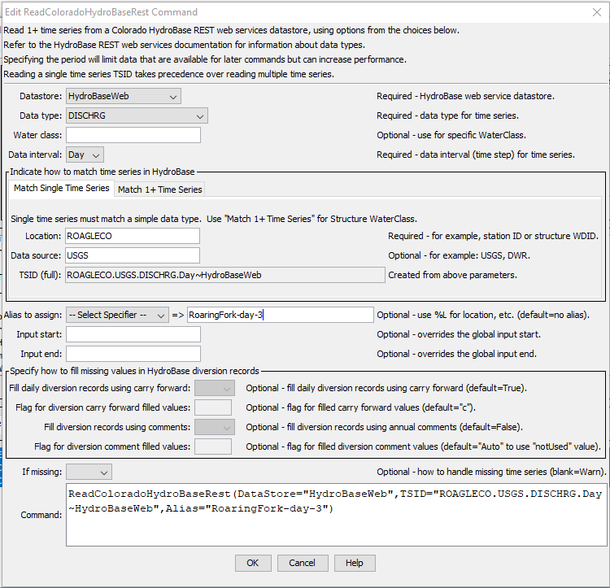
Read a single time series from the HydroBaseWeb datastore
Commands provide more granular control than general TSID commands when reading time series.
Read commands are available for many data sources, which have appendices in the documentation to help understand data.
The main TSTool time series list can help identify time series of interest and properties such as period of record.
The command formatted as text is shown at the bottom of the editor and is useful when command files are edited with a text editor.
Use the Help button to view command documentation for the current TSTool version (or “latest” if version-specific documentation is not available).

Slide 14
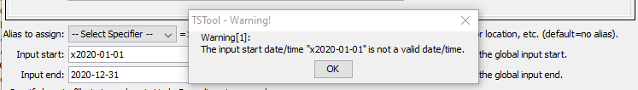
Command Editor Input Validation
Commands editors attempt to verify input and will display a warning when editing changes are saved.
Invalid command parameter values must be corrected before saving the command edits.
To facilitate editing, commands that read or create time series run in “discovery” mode when a command file is opened or a new command is added with an editor. This allows later commands to select time series identifiers from previous commands.

Slide 15
Edit an Existing Command
Double-click on a command to edit.
Or, right-click on a command and use the popup Edit menu.
Command files can also be edited with a text editor and can be created by other software, but be careful when mixing editing tools during an editing session because changes will reflect the tool that saves the changes.

Slide 16
Copy / Paste / Delete Commands
Commands can be copied and pasted using the main Edit menu, or right-click popup menu in the Commands list.
Delete commands by selecting (highlighting) commands to be deleted and then use the Delete Command(s) item from the Edit menu, press the Delete key or use the Clear Commands button below the command list.
Use the View / Command File Diff menu to review unsaved changes, but this requires installing KDiff3 or other software to compare files.

Slide 17
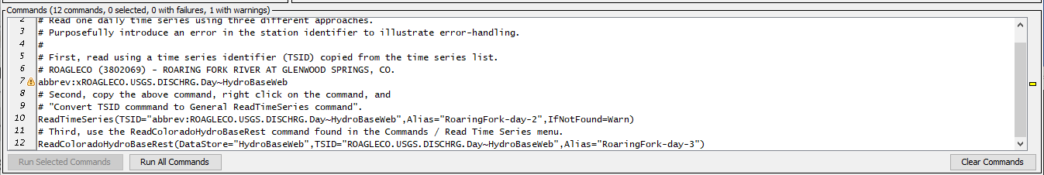
example2: Troubleshooting Using the Command Status
Open and run the example2-error/example-streamflow-error.tstool command file.
A warning or failure (error) will be indicated by yellow markers on left and right of the command list.
The Commands list title will also indicate the number of commands with failures and warnings.
Mouse over the symbol on the left to view the command log.
Right-click on the command and use the Show Command Status (Success/Warning/Failure) menu (see the next slide).

Slide 18
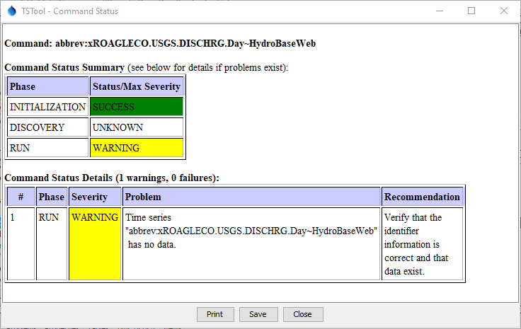
Troubleshooting Using the Command Status
Show the status for a command by right-clicking on the command and use the Show Command Status (Success/Warning/Failure) menu.
Each command may be processed using three phases, with a status for each phase.
Command log messages are generated when a problem occurs, describe the problem and provide recommendations to fix the problem.

Slide 19
Troubleshooting Using the TSTool Log File
The TSTool log file may need to be checked during troubleshooting.
The log file may need to be provided to support.
Use the Tools / Diagnostics – View Log File (Startup)… menu to view startup messages, including information about configuration.
The StartLog command can be used to start a new log file, which can be viewed with the Tools / Diagnostics – View Log File… menu.

Slide 20
example3: Running Average
Open and run the example3-running-average/example-running-average.tstool command file.
This example builds on example1 by adding several new commands.
The following slides show how to use other commands to process and output time series.

Slide 21
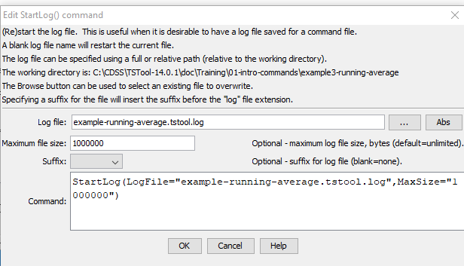
Use a StartLog Command for Troubleshooting
Use as the first command to track all commands in a workflow.
See the Commands / Logging and Messaging menu.
Use a filename that is the same as the command file with “.log” at end to avoid confusion.
Can limit the log file size.
Use the Tools / Diagnostics - View Log File… menu to view the log file contents.

Slide 22
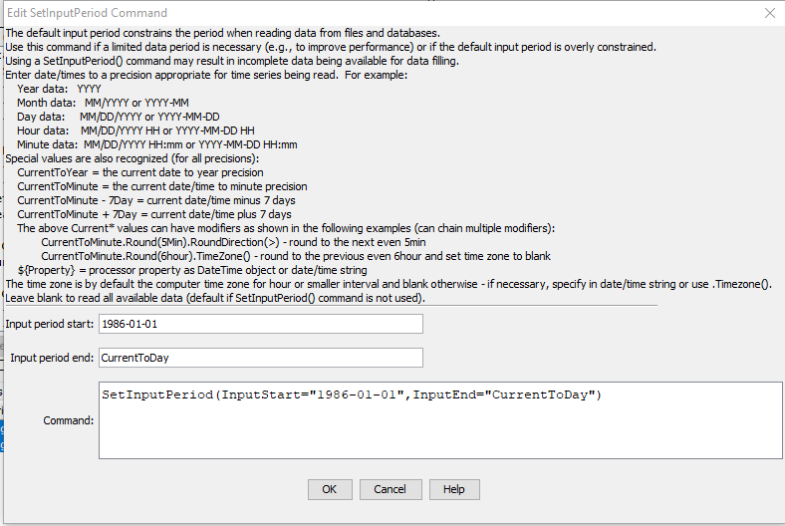
Use a SetInputPeriod Command to Control Reading
Use the SetInputPeriod command to set a global read period.
See the Commands / Read Time Series menu.
Some read commands return all available data by default. However, HydroBase web services return a short recent period by default.
Use the TSTool main window browser to view the available data period for time series and pick a period that is suitable.
Some commands allow the period to be set only for that command.
Once data are viewed, additional commands can be used to fill missing data.

Slide 23
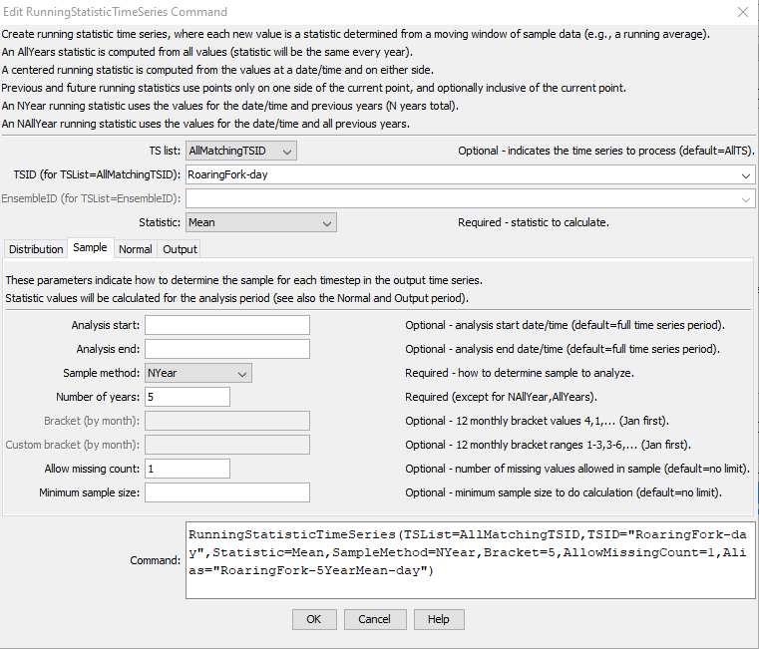
Use the RunningStatisticTimeSeries Command for Analysis
See the Commands / Create Time Series menu.
The “TS list” indicates which time series should be processed.
The “Statistic” is calculated for each sample.
The Sample tab indicates how to determine the sample for each calculated statistic. In this case, each value from the same day for the last 5 years is used.
Also use the Output tab to specify the alias of the output time series.
See the command documentation for a full explanation.

Slide 24
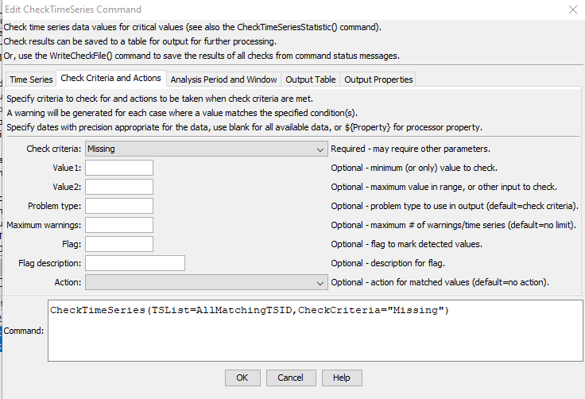
Use the CheckTimeSeries Command for Quality Control
See the Commands / Check Time Series menu.
Use the Time Series tab to indicate which time series to check.
Use the Check Criteria and Actions tab to specify the criteria, in this case check for missing values.
Optionally, use the Analysis Period and Window tab to specify analysis window such as seasons.
Optionally, use the Output Table tab to save output to a table, which can be viewed and output.
See also the CheckTimeSeriesStatistic command.
Comment out the command if issues are known and don’t want to see a warning.

Slide 25
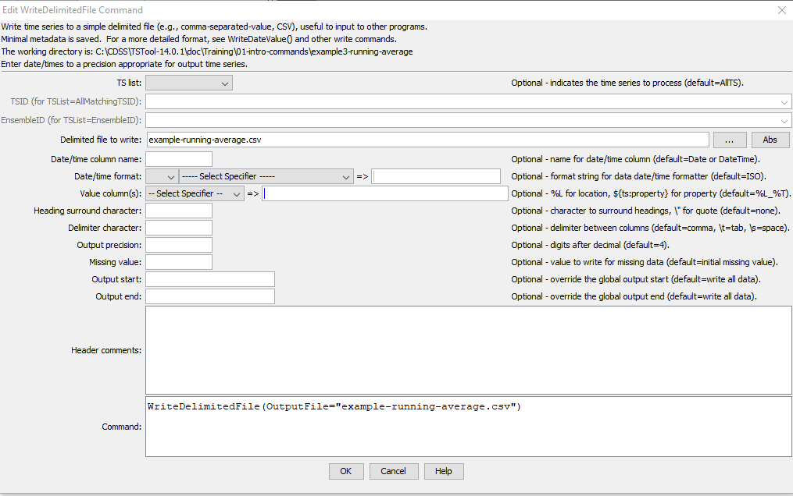
Output Results Using WriteDelimitedFile or other Command
Output files allow other software to use the results.
Many commands are available for different file formats, databases, Excel, etc.

Slide 26
Command File Best Practices
Use comments to describe the command workflow.
Use a StartLog command as the first command, to help with troubleshooting. Comment out if not required for troubleshooting.
Use relative paths for file names to allow files to be easily moved and shared, without dependency on a specific computer.
Use CheckTimeSeries and other commands to check for missing data and other problems.
Use time series, table, and file naming conventions that are consistent and allow a workflow to be modified.
For more complex workflows, use a folder for log and output files to separate results from input files.

Slide 27
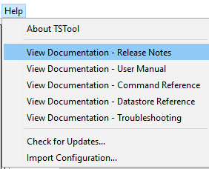
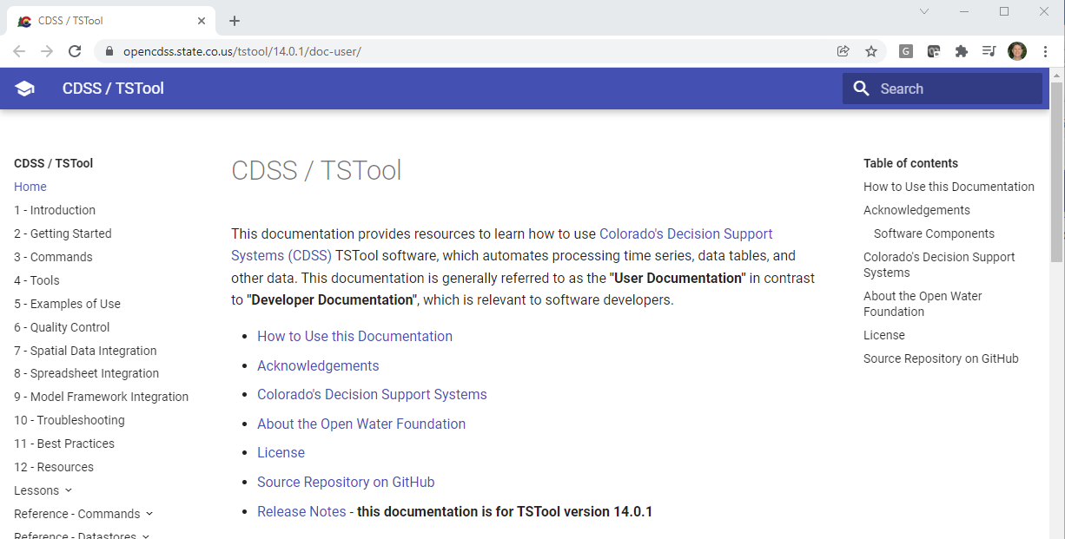
More Information
See the TSTool Help menu for links to online documentation.

Slide 28
Next Steps
Review the TSTool documentation to gain an appreciation for processing that can be done. The Examples section of each command’s documentation includes a link to command files that are used to test the software.
Create command files to automate processing.

