Slide 1
TSTool Training: Getting Started
Duration: ~30 minutes
Level: introduction
TSTool version used: 14.0.4
Updated: 2021-12-09

Slide 2
Presentation Goals
Explain how to download, install, and configure TSTool
Provide an introduction to TSTool for new users
Allow self-paced training
Run working examples, each of which reside in a folder distributed with presentation:
See the doc/training folder under the software installation folder
Full use of TSTool requires access to the internet and may require installing databases and other software

Slide 3
TSTool Feature Summary
Reading and writing time series, tables, and other data using various data sources and formats
Automating processing using a workflow command language
Filling and manipulating data
Analyzing and visualizing data
Implementing workflows for business processes, modeling, and decision-making

Slide 4
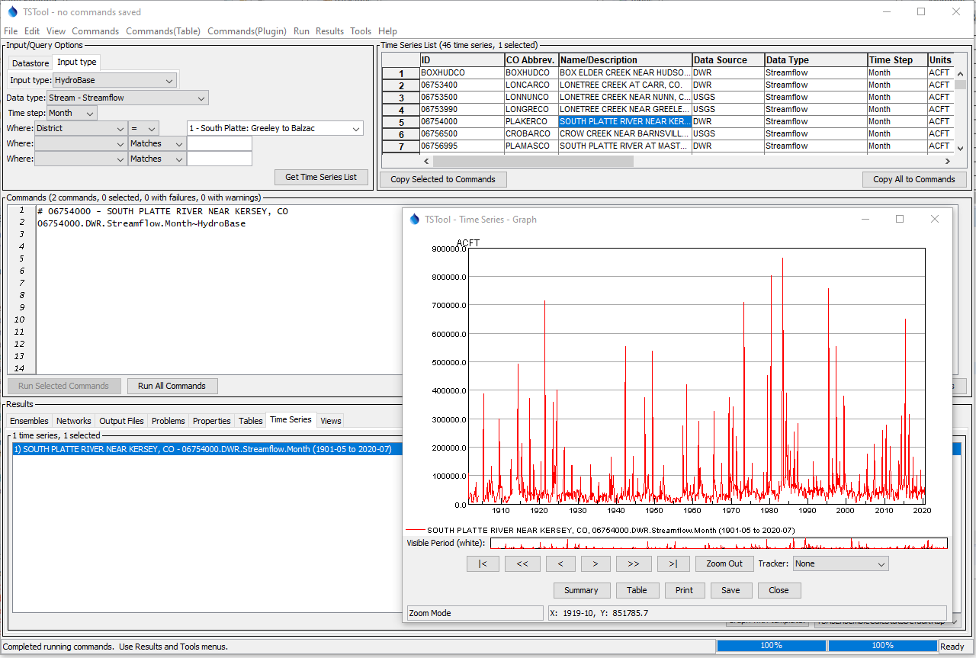
Example of browsing, reading, and visualizing data.

Slide 5
TSTool Role in CDSS
Reads time series from State of Colorado’s HydroBase database and other sources
Fills missing data and manipulates data
Creates input files for CDSS models including StateCU and StateMod
Processes model results into information products
Performs software testing and quality control
Complements StateDMI software, which processes specific model data files
Automates workflows, which increases efficiency and reproducibility

Slide 6
Installation and Configuration
The following slides describe how to install and configure TSTool.
If the default configuration is OK, skip forward to examples of using TSTool.
See also the Troubleshooting chapter of the documentation for additional guidance, available from the TSTool Help menu.

Slide 7
Download the TSTool Installer
CDSS website (used for CDSS work): https://cdss.colorado.gov/software/tstool
OpenCDSS website with newer versions and history of releases: https://opencdss.state.co.us/tstool/
Download the installer to the C:\Users\user\Downloads folder (where “user” is a specific user).
Multiple versions of TSTool can be installed on a computer, which allows software to be updated without overwriting old versions.

Slide 8
Install TSTool
Run the installer as Administrator (future updates may remove this requirement)
Typically accept all the defaults
See the documentation installation appendix for more information: https://opencdss.state.co.us/tstool/latest/doc-user/appendix-install/install/

Slide 9
Run TSTool
Start / CDSS / TSTool-14.0.1 menu (or similar)
If installed for the first time, the user’s files will be automatically created during the first session
If a previous version has been installed with the same major number (e.g., 14), the user’s configuration files will be shared between installations
If a previous version has been installed with a different major number (e.g., updating from 13 to 14), the user’s configuration files will be copied to the new version
Additional configuration may be needed as explained in the following slides
The configuration will depend on the type of work being done, such as modeling, data analysis, research, etc.

Slide 10
TSTool Log File
The TSTool log file may need to be checked during troubleshooting
The log file may need to be provided to support
Use the Tools / Diagnostics – View Log File (Startup)… menu to view startup messages, including information about configuration
The StartLog command can be used to start a new log file, which can be viewed with the Tools / Diagnostics – View Log File… menu (commands in the Commands menu are discussed in other training lessons)

Slide 11
TSTool Installation and User Files
TSTool software installation configuration files are used by default, for example in: C:\CDSS\TSTool-14.0.1\...
Additional user configuration files are shared between TSTool installations with the same major version, for example: C:\Users\user\.tstool\14\...
User configuration files add to and override the software installation configuration settings

Slide 12
HydroBase Database Configuration
HydroBase is the State of Colorado’s database for water data
TSTool is distributed with a default HydroBase configuration to facilitate use of a local HydroBase database; however, HydroBase must be installed separately
One or more HydroBase databases can be downloaded and installed: https://opencdss.state.co.us/opencdss/hydrobase/
Or, HydroBase database features can be disabled and HydroBase web services can be used (described in following slides)

Slide 13
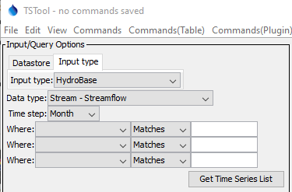
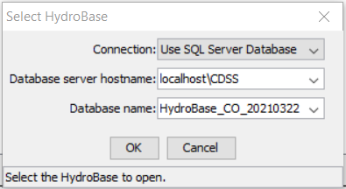
HydroBase Database Selection (as Input Type)
If HydroBase is installed on the computer, the default configuration will cause TSTool to prompt for the HydroBase to use in the current session
After selection, HydroBase will be listed in the Input Type tab in the upper left TSTool main window
Note the version, which is needed in following examples

Slide 14
Enable HydroBase Database Datastore
Datastores are a general feature, are newer than input types, and allow databases and web services to be configured, which enable useful software features such as ability to run SQL statements
Take note of the HydroBase version that is listed in the previous slide to use in the configuration file below
Copy file C:\CDSS\TSTool-14.0.1\datastores\HydroBase.cfg (using the correct software version) to C:\Users\user\.tstool\14\DataStores\HydroBase.cfg
Update the HydroBase version in the file (e.g. HydroBase_CO_20210322) and confirm that Enabled = True
Restart TSTool to see the datastore listed in the Datastore tab in the upper left of the main TSTool window
A datastore named HydroBase will be used before the input type named HydroBase when processing commands
Use the View / Datastores menu and TSTool log file to troubleshoot database connections
Update the datastore configuration file if a new HydroBase version is installed

Slide 15
Disabling HydroBase Database Features
A HydroBase database is not installed with TSTool by default
TSTool by default does attempt to list HydroBase databases when it starts
This will cause the HydroBase selector to display each time that TSTool starts and will be slow as TSTool searches for HydroBase on the network
To disable HydroBase because no local database has been installed, create the file C:\Users\user\.tstool\14\system\TSTool.cfg and include the content shown below
Restart TSTool to confirm that no HydroBase selector is shown
[TSTool]
HydroBaseEnabled = False

Slide 16
HydroBase Web Service Datastore
The HydroBaseWeb web service datastore is enabled by default and allows HydroBase to be accessed over the internet
This is slower than a local database but avoids having to install a HydroBase database on the local computer
Historical data are updated whereas data in a local database version are a snapshot in time
Not all HydroBase data are available in TSTool via web services and new features are added over time
Examples in this training presentation use HydroBase web services to avoid the need for a local database
Examples can be run with a HydroBase database by substituting the HydroBase datastore for HydroBaseWeb

Slide 17
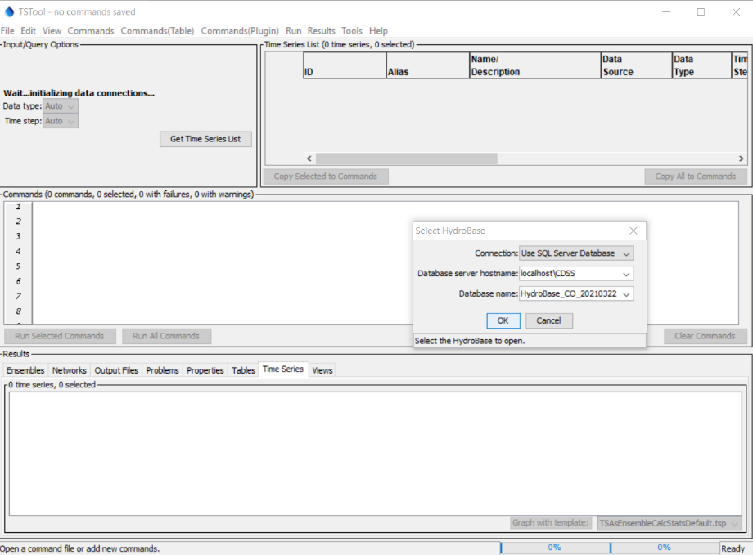
After starting TSTool
Select HydroBase

Slide 18
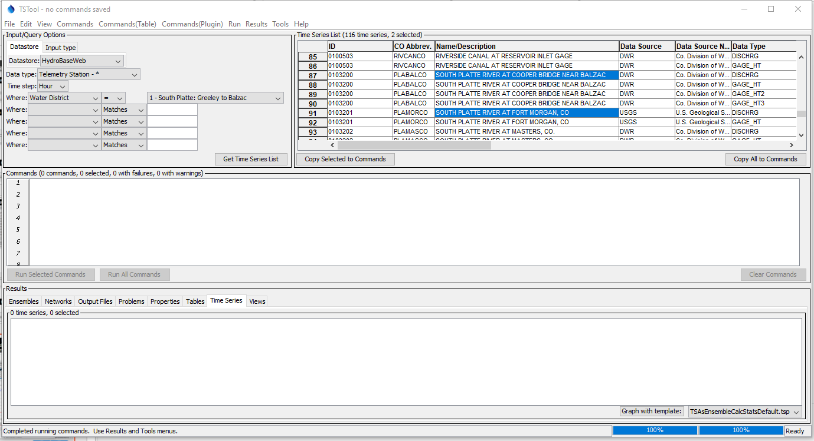
Listing real-time streamflow station time series
Specify input
and query options
2. Press “Get Time Series List”
3. View the time series list.
Right click on headings
for sort options.
4. Click, Shift-click, and Ctrl-click to select
single rows or groups

Slide 19
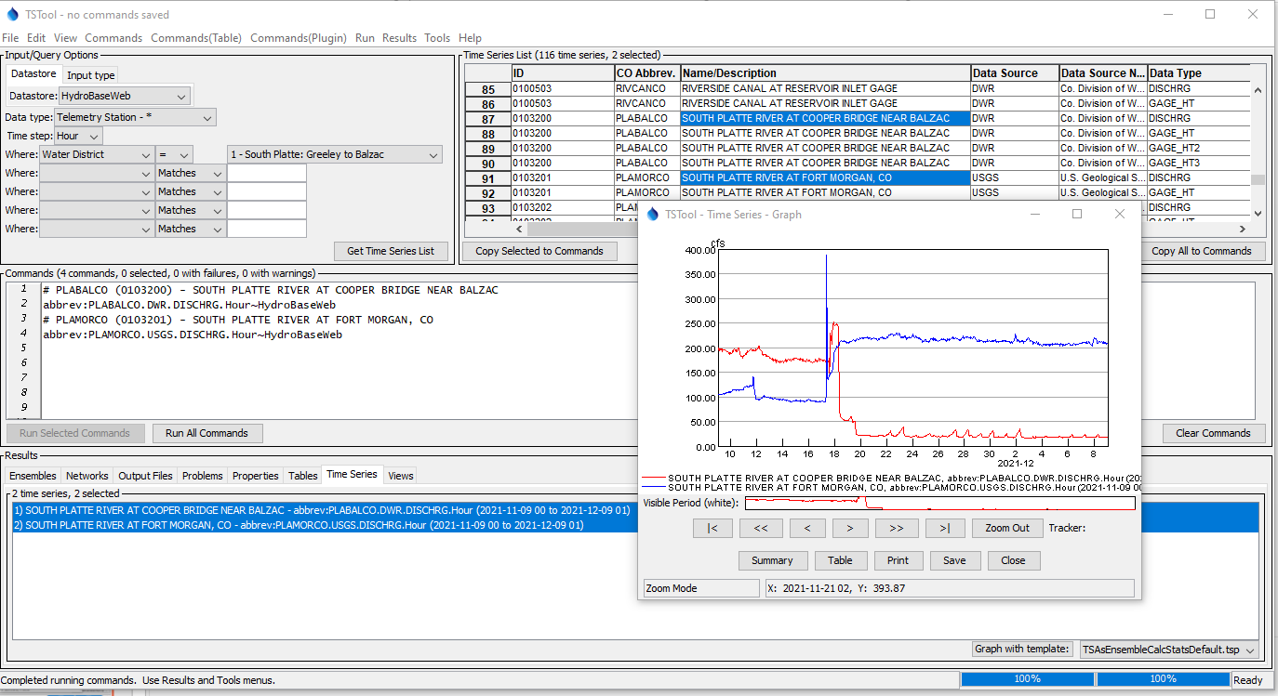
Select one or more time series and copy
time series identifiers (TSIDs) to commands
Graph time series
2. Run commands
4. Graph is displayed
3. Select time series to view in Results,
right-click, and Select “Graph – Line”

Slide 20
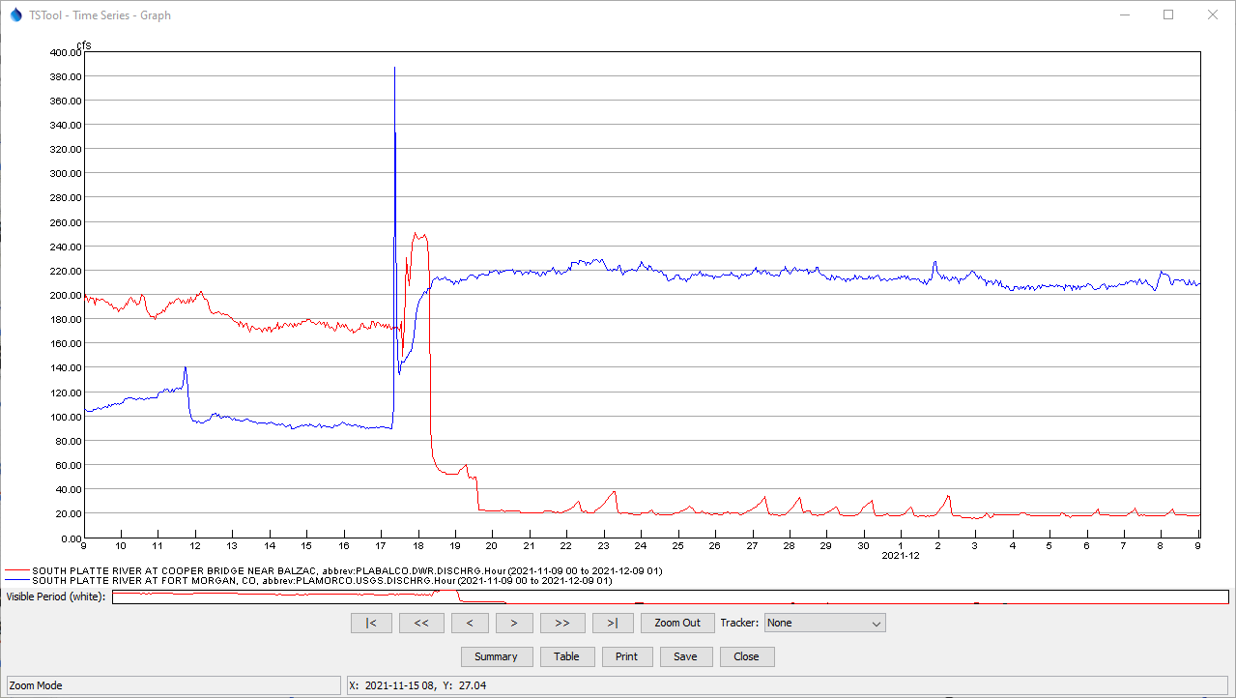
Time Series Graph Features
The graph is interactive
Can mix data intervals
Time axis automatically reformats
Mouse coordinates are displayed at bottom
Overview window is shown below main graph
Use the mouse to draw a box to zoom the time axis
Use buttons to page through data.
Alternate views and other actions
Mouse position

Slide 21
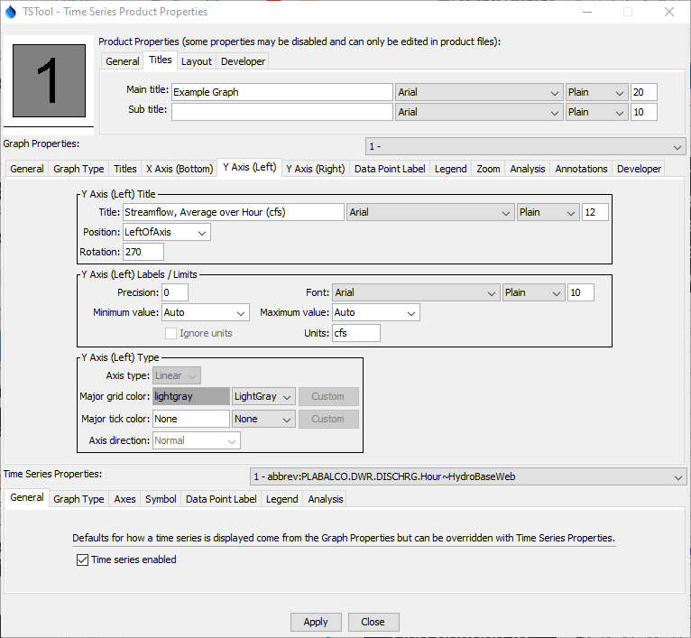
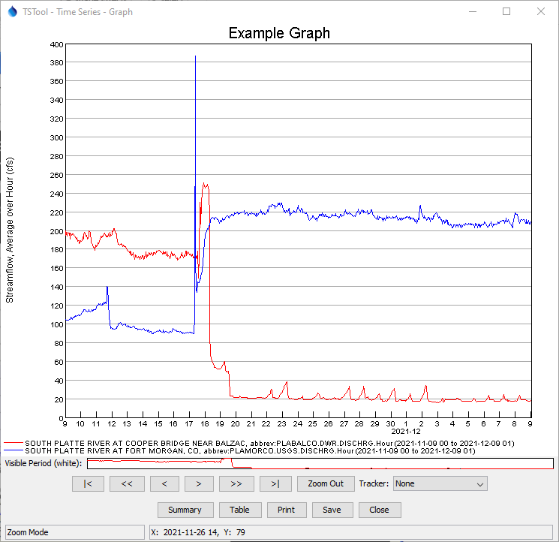
Time Series Graph Properties
Many graph properties can be edited.
Right-click on the graph to edit its properties
The ProcessTSProduct command is used to automate graph processing.
Use “Apply” to update the graph.

Slide 22
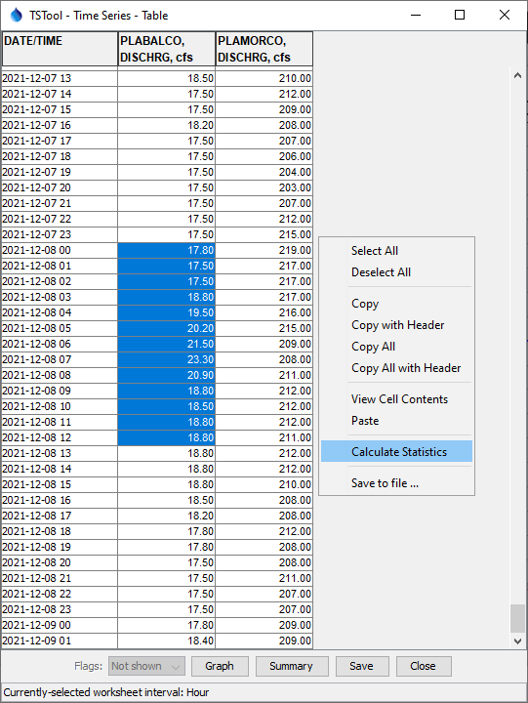
Time Series Table
The table shows a column for each time series that was selected
Right-click on a column header to sort
Click, Shift-click, and Ctrl-click to select single cells and groups of cells (similar to Microsoft Excel)
Multiple tables will be shown if the time intervals are different
If time series have irregular time interval, date/times are added for all data with blanks shown when data do not align
Missing values are shown as empty cells
If data flags are used in time series, they can be shown next to the data value
Table contents can be saved to a file

Slide 23
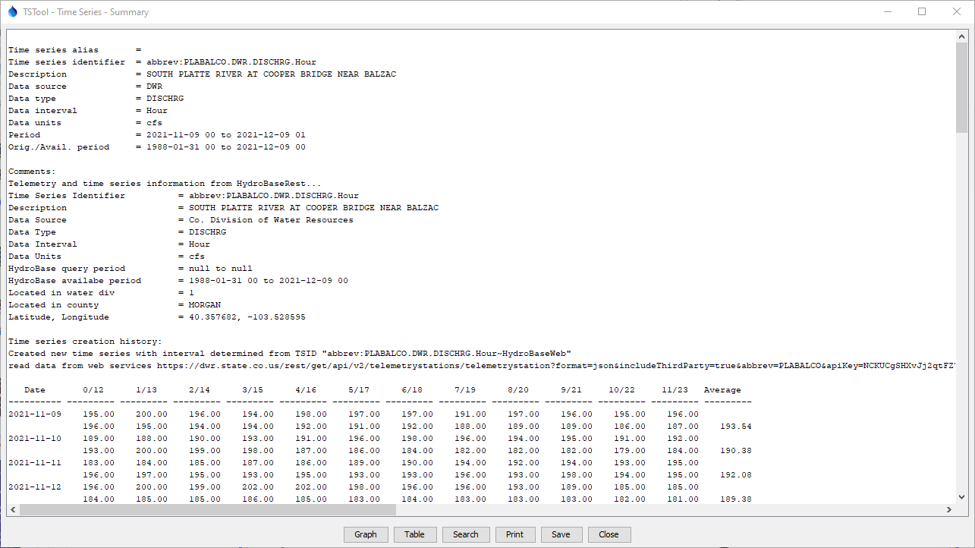
Time Series Summary
General time series metadata
Additional information if available (e.g., from HydroBase)
Default report format for the data interval

Slide 24
Time Series Identifier (TSID)
LocID.DataSource.DataType.Interval
LocID.DataSource.DataType.Interval~InputType
LocID.DataSource.DataType.Interval~InputType~Filename
LocID.DataSource.DataType.Interval~DataStore
LocID.DataSource.DataType.Interval.Scenario~DataStore
LocID.DataSource.DataType.Interval.Scenario[Trace]~DataStore
TSID commands are used when selecting specific time series
The above illustrates typical TSID syntax
The TSID uniquely identifies the time series and allows TSTool to find the time series in databases, files, and web services
The . (period), [ ], and ~ (tilde) characters have special meaning
A Datastore has properties such as database name (see View / Datastores)
TSIDs vary by data source, as documented in datastore appendices

Slide 25
TSIDs and Time Series Alias
TSIDs can be long and complex, but are necessary to uniquely identify time series, especially when reading and writing time series
Each TSID must provide unique identification across all data sources handled by TSTool
A time series “alias” can optionally be defined for each time series to facilitate identifying the time series during workflow processing
The alias can be short, for example using the location identifier and data type (e.g. 123456-Streamflow)
TSIDs and alias are used in commands

Slide 26
Command Files
The commands in the Commands area can be saved to a file, opened later, and rerun
Command files automate data processing and can be run in batch mode without using the user interface
See the File / Save / Commands and File / Open / Command File… menu
Command files can be maintained with datasets to automate data processing
Command files can be managed in a version control system such as GitHub to track changes over time, support collaboration, and provide examples of workflows
Use the Commands / General – Comments … menu to insert comments in command files to document workflows

Slide 27
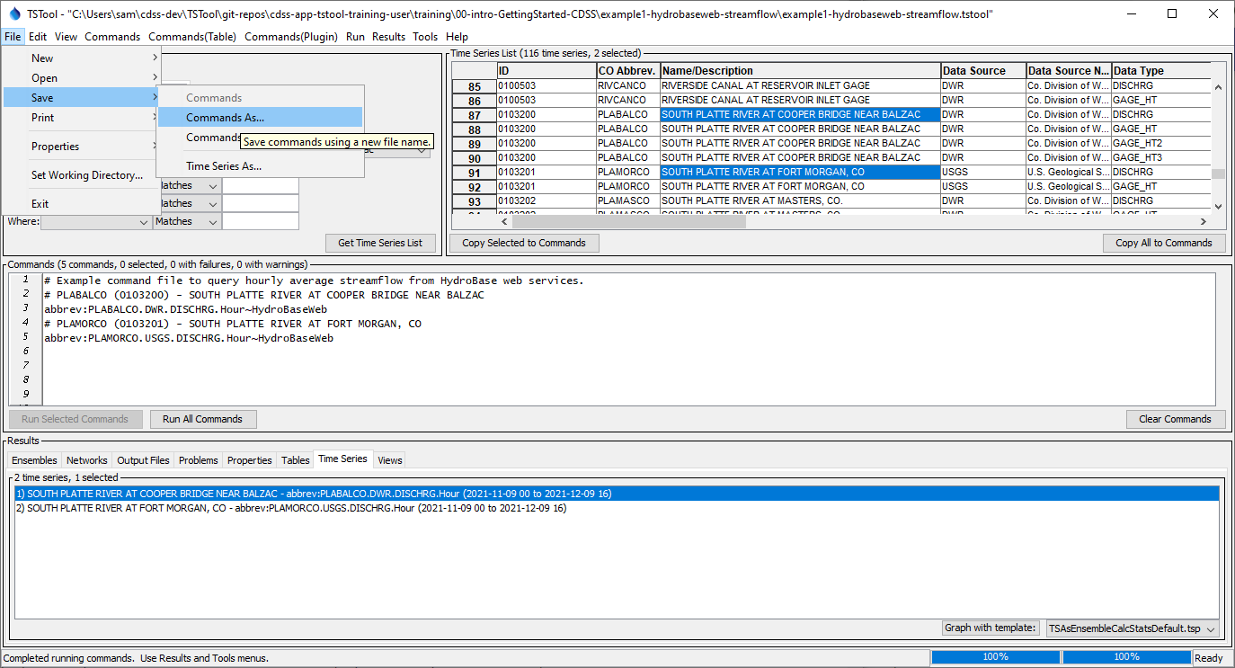
Saving a command file
2. Use the File / Save / Commands menu
3. Command file name is indicated in the window title after saving
1. Add comments to document the command file

Slide 28
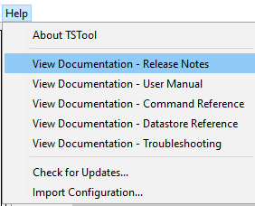
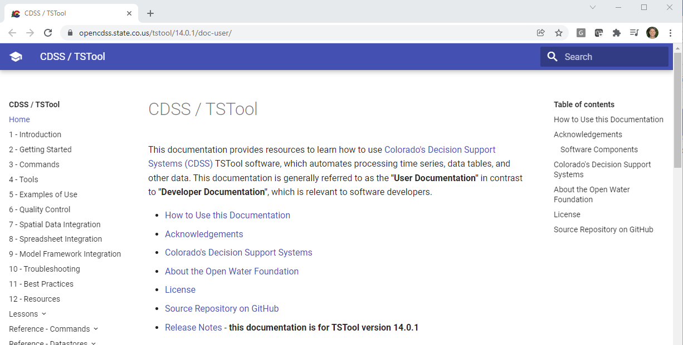
More Information
See the TSTool Help menu for links to online documentation.

