Slide 1
TSTool Training: Getting Started
Duration: ~30 minutes
Level: introduction
TSTool version used: 14.0.4
Updated: 2021-12-19

Slide 2
Presentation Goals
Explain how to download, install, and configure TSTool.
Provide an introduction to TSTool for new users.
Run working examples, each of which reside in a folder distributed with this presentation:
See the doc/training folder under the software installation folder.
Full use of TSTool requires access to the internet and may require installing databases and other software.

Slide 3
TSTool Feature Summary
Read and write time series, tables, and other data using various data sources and formats.
Automate processing using a workflow command language.
Fill and manipulate data.
Analyze and visualize data.
Implement workflows for business processes, modeling, and decision-making.

Slide 4
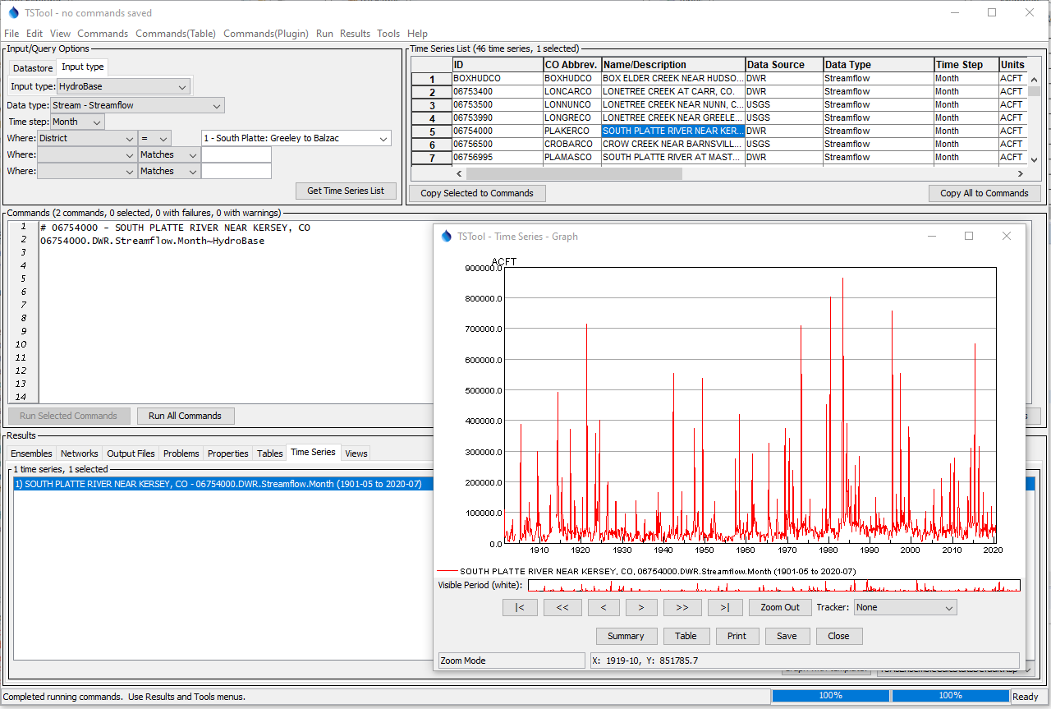
Example of browsing, reading, and visualizing data.

Slide 5
TSTool Role in CDSS
Read time series from State of Colorado’s HydroBase database and other sources.
Fill missing data and manipulate data.
Create input files for CDSS models including StateCU and StateMod.
Process model results into information products.
Perform software testing and quality control.
Automate workflows, which increases efficiency and reproducibility.
TSTool complements StateDMI software, which processes specific model data files.

Slide 6
Installation and Configuration
The following slides describe how to install and configure TSTool.
If the default configuration is OK, skip forward to examples of using TSTool.
See the Troubleshooting chapter of the documentation for additional guidance, available from the TSTool Help menu.

Slide 7
Download the TSTool Installer
CDSS website (used for CDSS work): https://cdss.colorado.gov/software/tstool
OpenCDSS website with newer versions and history of releases: https://opencdss.state.co.us/tstool/
Download the installer to the C:\Users\user\Downloads folder (where “user” is a specific user).
Multiple versions of TSTool can be installed on a computer, which allows software to be updated without overwriting old versions.

Slide 8
Install TSTool
Run the installer as Administrator (future updates may remove this requirement).
Typically accept all the defaults.
See the documentation installation appendix for more information: https://opencdss.state.co.us/tstool/latest/doc-user/appendix-install/install/

Slide 9
Run TSTool
Use the Start / CDSS / TSTool-14.0.4 menu (or similar) to start TSTool.
If installing for the first time, the user’s files will be automatically created during the first session.
If a previous version has been installed with the same major number (e.g., 14), the user’s configuration files will be shared between installations.
If a previous version has been installed with a different major number (e.g., updating from 13 to 14), the user’s configuration files will be copied to the new version.
Additional configuration may be needed as explained in the following slides.
The configuration will depend on the type of work being done, such as modeling, data analysis, research, etc.

Slide 10
TSTool Log File
The TSTool log file may need to be checked during troubleshooting.
The log file may need to be provided to support.
Use the Tools / Diagnostics – View Log File (Startup)… menu to view startup messages, including information about configuration.
The StartLog command can be used to start a new log file for the command file, which can be viewed with the Tools / Diagnostics – View Log File… menu (commands in the Commands menu are discussed in other training lessons).

Slide 11
TSTool Installation and User Files
TSTool files exist in the software installation folder and user files.
TSTool software installation configuration files are used by default, for example in: C:\CDSS\TSTool-14.0.4\...
Additional user configuration files are shared between TSTool installations with the same major version, for example: C:\Users\user\.tstool\14\...
User configuration files add to and override the software installation configuration settings.

Slide 12
HydroBase Database Configuration
HydroBase is the State of Colorado’s database for water resources data.
TSTool is distributed with a default HydroBase configuration to facilitate use of a local HydroBase database; however, a HydroBase database must be installed separately.
One or more HydroBase databases and the HydroBase Database Manager software can be downloaded and installed: https://opencdss.state.co.us/opencdss/hydrobase/
Or, HydroBase database features can be disabled and HydroBase web services can be used (described in following slides).

Slide 13
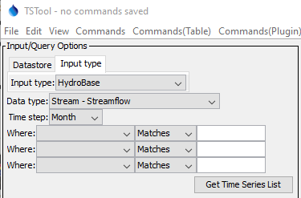
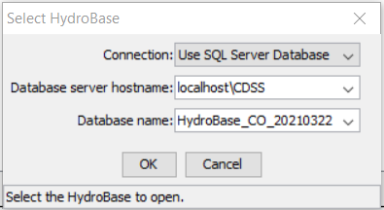
HydroBase Database Selection (as Input Type)
If HydroBase is installed on the computer, the default configuration will cause TSTool to prompt for the HydroBase to use in the current session (left image below).
After selection, HydroBase will be listed in the Input Type tab in the upper left TSTool main window (right image below).
Note the version, which is needed in following examples

Slide 14
Enable HydroBase Database Datastore
A HydroBase datastore can be enabled if HydroBase database is available.
Datastores are a general feature, are newer than input types, and allow databases and web services to be configured, which enable useful software features such as ability to run SQL statements.
Take note of the HydroBase version that is listed in the previous slide to use in the configuration file below.
Copy file C:\CDSS\TSTool-14.0.4\datastores\HydroBase.cfg (using the correct software version) to C:\Users\user\.tstool\14\datastores\HydroBase.cfg
With a text editor, update the HydroBase version in the file (e.g. HydroBase_CO_20210322) and confirm that: Enabled = True
Restart TSTool to see the datastore listed in the Datastore tab in the upper left of the main TSTool window.
Selecting a HydroBase database at startup will use a database input type named HydroBase. If a datastore named HydroBase is also defined, the datastore will take precedence in time series identifiers used in commands. Time series identifiers are discussed later in this presentation.
Use the View / Datastores menu and TSTool log file to troubleshoot database connections.
Update the datastore configuration file if a new HydroBase version is installed.

Slide 15
Disabling HydroBase Database Features
A HydroBase database is not installed with TSTool by default.
TSTool by default does attempt to list HydroBase databases when it starts.
This will cause the HydroBase selector to display each time that TSTool starts and will be slow as TSTool searches for HydroBase on the network.
To disable HydroBase because no local database has been installed, use a text editor to create the file C:\Users\user\.tstool\14\system\TSTool.cfg and include the content shown below:
[TSTool]
HydroBaseEnabled = False
Restart TSTool to confirm that no HydroBase selector is shown.

Slide 16
HydroBase Web Service Datastore
The HydroBaseWeb web service datastore is enabled by default and allows HydroBase to be accessed over the internet.
This is slower than a local database but avoids having to install a HydroBase database on the local computer.
Historical data are updated whereas data in a local database version are a snapshot in time.
Not all HydroBase data are available in TSTool via web services and new features are added over time.
Examples in this training presentation use HydroBase web services to avoid the need for a local database.
Examples that use a datastore named HydroBaseWeb can be run with a HydroBase database by replacing HydroBaseWeb with HydroBase.

Slide 17
Examples
The following example TSTool session illustrates basic software functionality.
Notes:
In the 6th bullet, do you mean “Examples can be run with the HydroBase Web Service database by substituting…”?

Slide 18
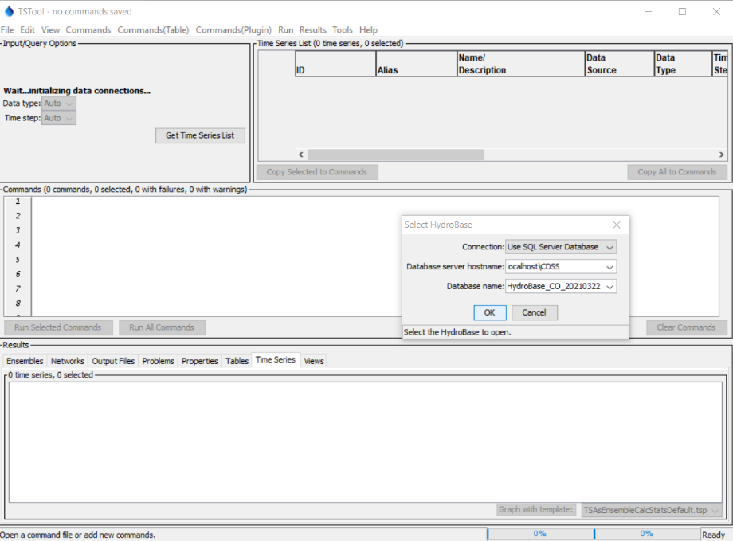
After starting TSTool when
the HydroBase database
is enabled and
has been installed
Select HydroBase database
Only shown if HydroBase
database features
are enabled

Slide 19
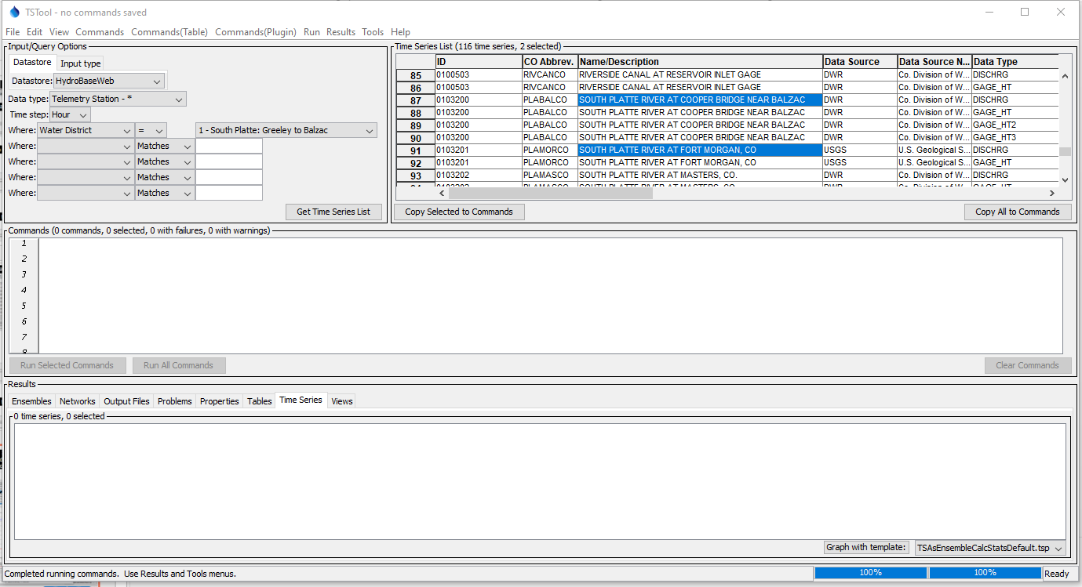
Listing real-time streamflow station time series
Specify input and query
options. Use the Input Type tab to select a local HydroBase or Datastore tab to select HydroBaseWeb or a HydroBase database datastore.
2. Press “Get Time Series List”
3. View the time series list.
Right click on headings
for sort options.
4. Click, Shift-click, and Ctrl-click to select
single rows or groups

Slide 20
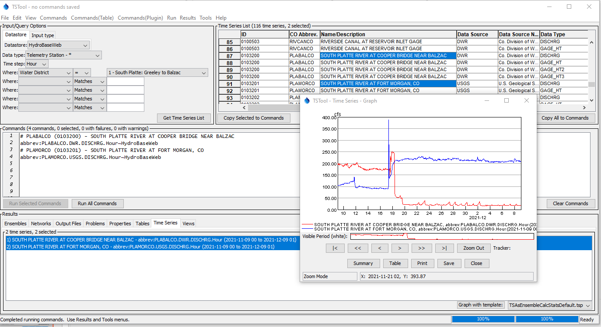
Select one or more time series and copy
time series identifiers (TSIDs) to commands
Graph time series
2. Run commands
4. Graph is displayed
3. Select time series to view in Results,
right-click, and Select “Graph – Line”

Slide 21
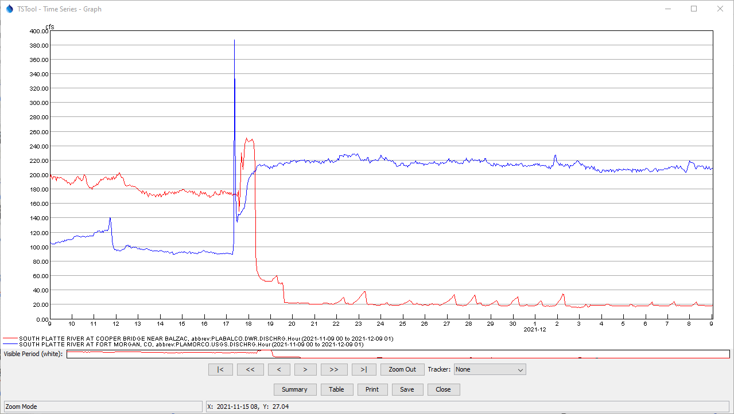
Time Series Graph Features
The graph is interactive
Can mix data intervals
The data axis scales to the overall time series limits
The time axis automatically reformats
Mouse coordinates are displayed at bottom
An overview window is shown below main graph
Use the mouse to draw a box to zoom the time axis
Use buttons to page through data.
Alternate views and other actions
Mouse position

Slide 22
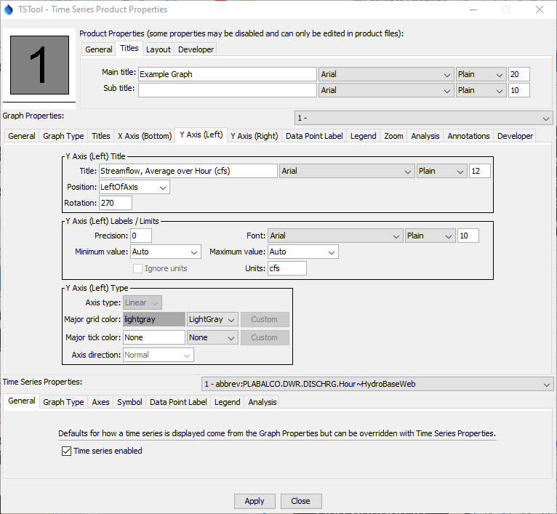
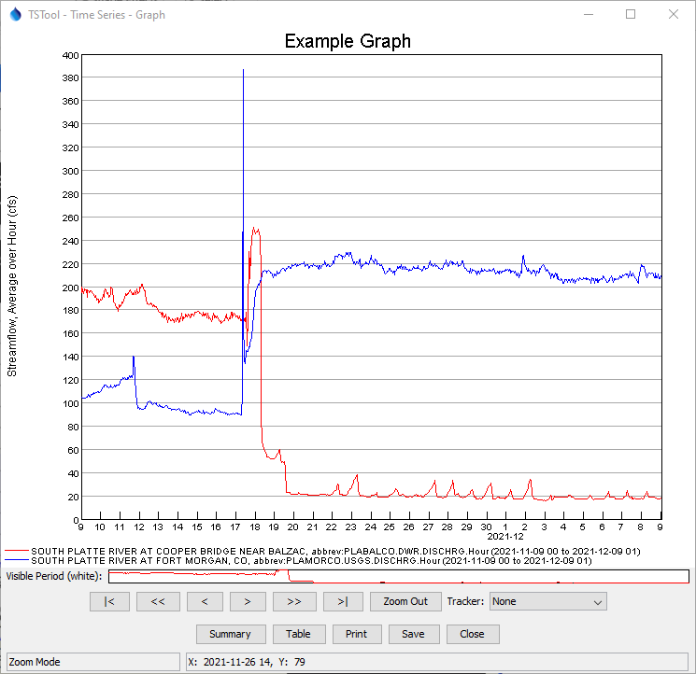
Time Series Graph Properties
Many graph properties can be edited.
Right-click on the graph to edit its properties
The ProcessTSProduct command is used to automate graph processing.
Use “Apply” to update the graph.

Slide 23
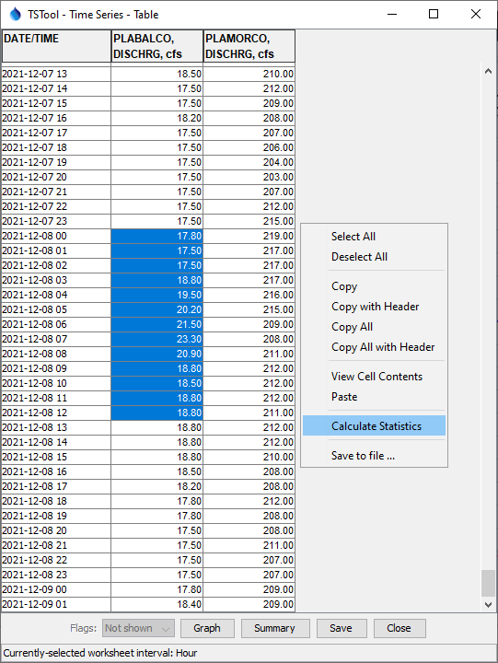
Time Series Table
The table shows a column for each time series that was selected.
Right-click on a column header to sort.
Click, Shift-click, and Ctrl-click to select single cells and groups of cells (similar to Microsoft Excel).
Multiple tables will be shown if the time intervals are different.
If time series have irregular time interval, date/times are added for all data with blanks shown when data do not align.
Missing values are shown as empty cells.
If data flags are used in time series, they can be shown next to the data value by using the Flags choice in the lower left.
Table contents can be saved to a file.

Slide 24
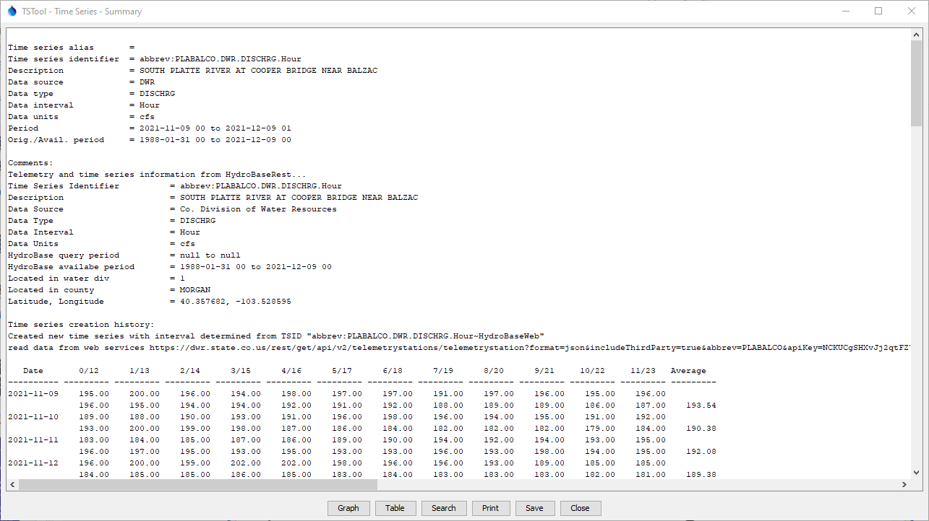
Time Series Summary
General time series metadata
Additional information if available (e.g., from HydroBase)
Default report format for the data interval

Slide 25
Time Series Identifier (TSID)
Example time series identifiers:
LocID.DataSource.DataType.Interval
LocID.DataSource.DataType.Interval~InputType
LocID.DataSource.DataType.Interval~InputType~Filename
LocID.DataSource.DataType.Interval~DataStore
LocID.DataSource.DataType.Interval.Scenario~DataStore
LocID.DataSource.DataType.Interval.Scenario[Trace]~DataStore
TSID commands are used when selecting specific time series.
The above illustrates typical TSID syntax.
The TSID uniquely identifies the time series and allows TSTool to find the time series in databases, files, and web services.
The . (period), [ ], (square brackets), and ~ (tilde) characters have special meaning and cannot be used in TSID parts.
A Datastore has properties such as database name (see View / Datastores).
TSIDs vary by data source, as documented in datastore appendices.

Slide 26
TSIDs and Time Series Alias
TSIDs can be long and complex, but are necessary to uniquely identify time series, especially when reading and writing time series.
Each TSID must provide unique identification across all data sources handled by TSTool.
A time series “alias” can optionally be defined for each time series to facilitate identifying the time series during workflow processing.
The alias can be short, for example using the location identifier and data type (e.g. 123456-Streamflow).
TSIDs and alias are used in commands.

Slide 27
Command Files
The commands in the Commands area can be saved to a file, opened later, and rerun.
Command files automate data processing and can be run in batch mode without using the user interface.
See the File / Save / Commands menu and File / Open / Command File… menu.
Command files can be maintained with datasets to automate data processing.
Command files can be managed in a version control system such as GitHub to track changes over time, support collaboration, and provide examples of workflows.
Use the Commands / General – Comments … menu to insert comments in command files to document workflows.

Slide 28
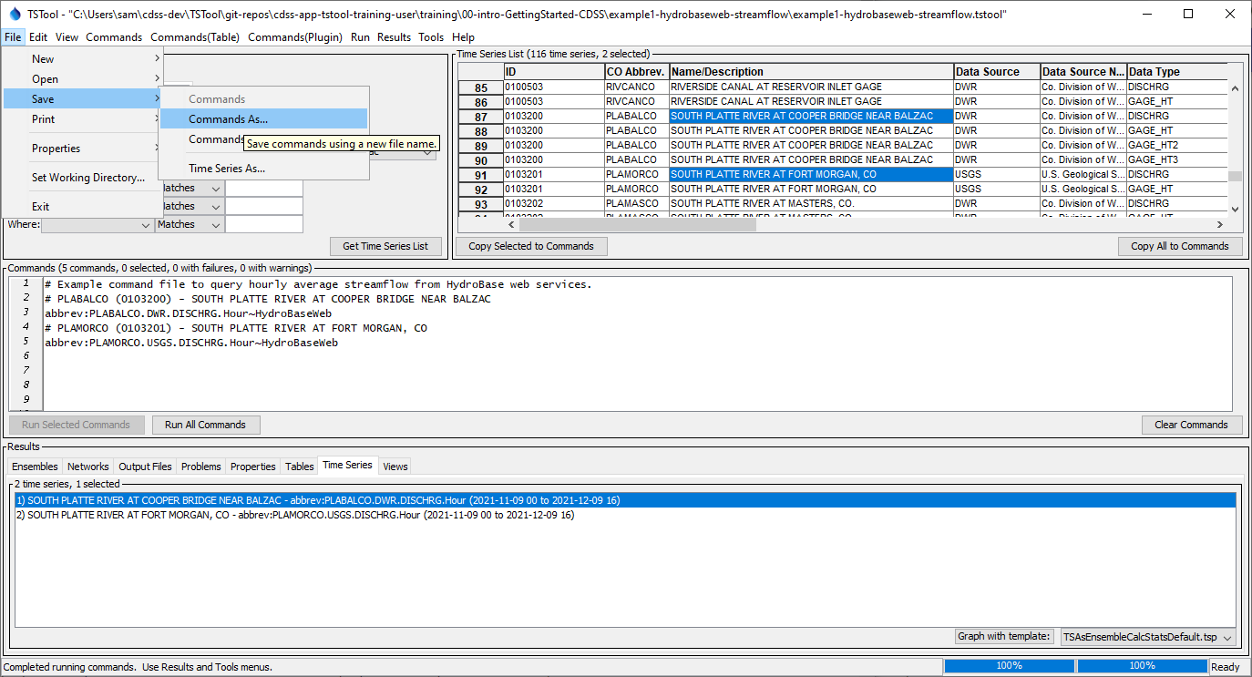
Saving a command file
2. Use the File / Save / Commands menu
3. Command file name is indicated in the window title after saving
Add comments to document the command file, using Commands / General – Comments menu

Slide 29
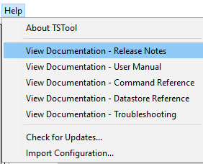
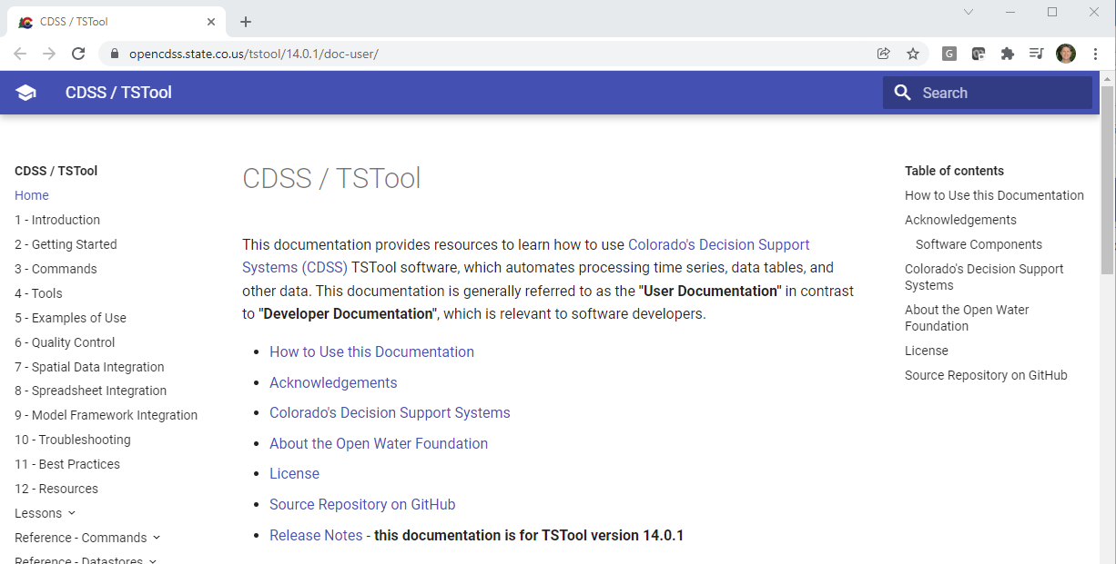
More Information
See the TSTool Help menu for links to online documentation.

Slide 30
Next Steps
Other training presentations are available.
For example, see the “Introduction to Commands”.

