Slide 1
OpenChain Monthly Meeting: Spec, Education + More
Europe / Asia - 2025-10-15 @ 08:30 UTC

Slide 2
Anti-Trust Policy Notice
Linux Foundation meetings involve participation by industry competitors, and it is the intention of the Linux Foundation to conduct all of its activities in accordance with applicable antitrust and competition laws. It is therefore extremely important that attendees adhere to meeting agendas, and be aware of, and not participate in, any activities that are prohibited under applicable US state, federal or foreign antitrust and competition laws.
Examples of types of actions that are prohibited at Linux Foundation meetings and in connection with Linux Foundation activities are described in the Linux Foundation Antitrust Policy available at http://www.linuxfoundation.org/antitrust-policy. If you have questions about these matters, please contact your company counsel, or if you are a member of the Linux Foundation, feel free to contact Andrew Updegrove of the firm of Gesmer Updegrove LLP, which provides legal counsel to the Linux Foundation.

Slide 3
Agenda
OpenChain Project News
Specification Work Group – CRA, other regulations and our standards
Education Work Group – Update on Status and Community Work Items
Any Other Business?

Slide 4
OpenChain Project News

Slide 5

General Project News
Welcoming the OpenChain Ambassador Program – we have over 20!: https://openchainproject.org/news/2025/09/18/welcoming-the-openchain-ambassador-program
OpenChain ISO/IEC 18974 was referenced in the CRA standards development: https://openchainproject.org/news/2025/09/18/update-on-openchain-iso-iec-18974-and-the-cra
OpenChain SBOM Work Group – driving forward SBOM quality discussion: https://openchainproject.org/news/2025/09/25/sbom-work-group-2025-09-24

Slide 6
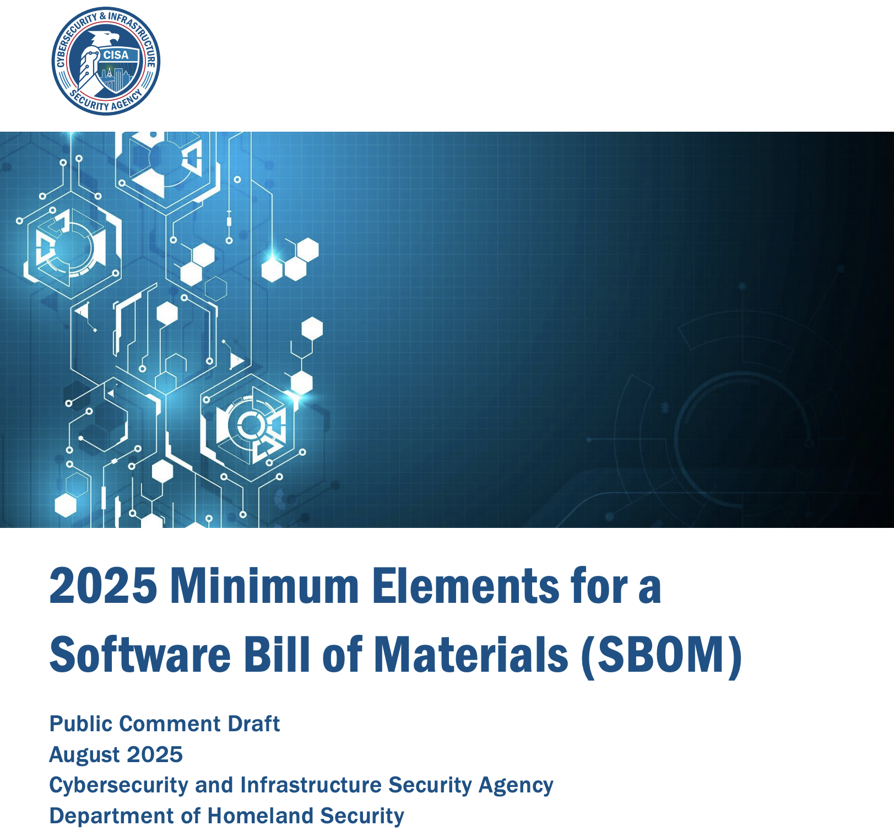
SBOM News
The updated 2025 CISA SBOM Guidelines (Draft) are available: https://www.cisa.gov/sites/default/files/2025-08/2025_CISA_SBOM_Minimum_Elements.pdf
We will be following this process closely for the SBOM Quality Guide(s).
We (SBOM and Telco) already collaborated with sister projects to prepare comments for the deadline.

Slide 7
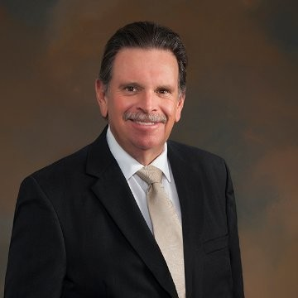
Specification Work Group

Slide 8
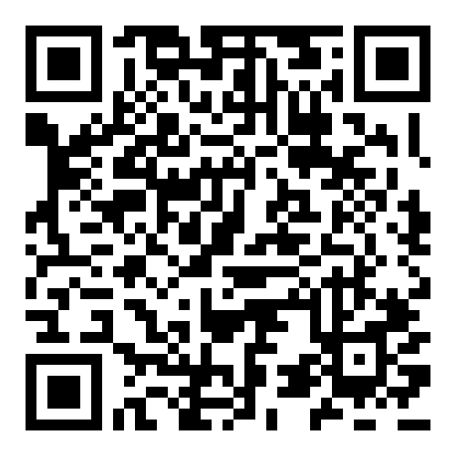
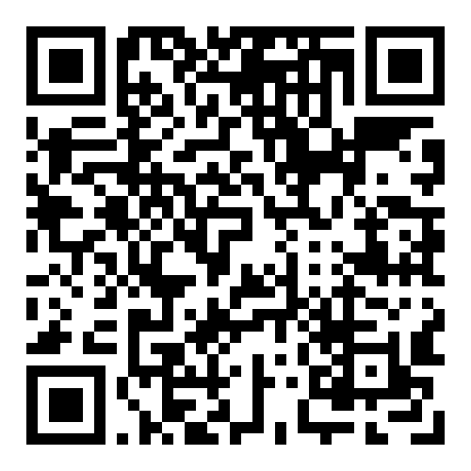
Sister Standards - Processes for Programs
ISO/IEC 5230 (License Compliance)
ISO/IEC 18974 (Security Assurance)
Flexible program size
Covering:
Inbound processes
Internal processes
Outbound processes
Standards about process points
Not about process content
https://bit.ly/3JUnEh8
http://bit.ly/4mbmOd8

Slide 9
Further Development of the Specs
An open question for our community is whether we should continue to expand the scope and coverage of our two standards.
Perhaps the most immediate example is the Security Specification, ISO/IEC 18974, with the incoming CRA regulation in December 2026 (see next slide).
tl;dr: at the North America / Europe meeting earlier this month, we had emerging consensus that the most important thing was a global focus, and to explore commonalities of regulations…but not favor specific geographies.

Slide 10
Area | Citation | Requirement | TL/DR
Cyber Policy | Article 24 | 1. Open-source software stewards shall put in place and document in a verifiable manner a cybersecurity policy to foster the development of a secure product with digital elements as well as an effective handling of vulnerabilities by the developers of that product. That policy shall also foster the voluntary reporting of vulnerabilities as laid down in Article 15 by the developers of that product and take into account the specific nature of the open-source software steward and the legal and organisational arrangements to which it is subject. That policy shall, in particular, include aspects related to documenting, addressing and remediating vulnerabilities and promote the sharing of information concerning discovered vulnerabilities within the open-source community. | security.md +vuln handling process/link +detailed secure development practices
Cooperation | Article 24 | 2. Open-source software stewards shall cooperate with the market surveillance authorities, at their request, with a view to mitigating the cybersecurity risks posed by a product with digital elements qualifying as free and open-source software. | cooperate with M.S.A. to mitigate risks
 |  | Further to a reasoned request from a market surveillance authority, open-source software stewards shall provide that authority, in a language which can be easily understood by that authority, with the documentation referred to in paragraph 1, in paper or electronic form. | policy posted electronically, translated on request
Vuln Reporting | Article 24 | 3. The reporting obligations laid down in Article 14(1) shall apply to open-source software stewards to the extent that they are involved in the development of the products with digital elements. The reporting obligations laid down in Article 14(3) and (8) shall apply to open-source software stewards to the extent that severe incidents having an impact on the security of products with digital elements affect network and information systems provided by the open-source software stewards for the development of such products. | Report vulns and known exploits to the dedicated Union’s officials
For reference only. There is no need to read this material in-depth in this meeting
CRA Steward Obligations
The table is taken from the text of the CRA:
In plain language, the Steward’s obligations come down to:
Have a vulnerability reporting process and publicly posted policy.
Have a single point of contact for reporting and inquiring about vulnerabilities (e.g. https://www.linuxfoundation.org/security)
If approached by EU officials (Market Surveillance Authority (MSA), ENISA, National CSIRT, etc.) provide requested information.
If a project is known to be actively exploited or if underlying Foundation infrastructure (e.g. CI/CD systems, websites, etc.) has suffered a cybersecurity incident, report to the ENISA Single Reporting Platform (SRP). Notes from CRob over at OpenSSF

Slide 11
Meanwhile, Over At FINOS
We have a request from FINOS (bank open source) to help them consider ways to turn a governance framework into an ISO standard. Let’s walk through this: https://air-governance-framework.finos.org
First thoughts: there is a lot of work to do to turn this series of information and solution ideas into a specification, but it seems like an interesting journey, and it would be interesting to see if we could collaborate if the community agrees.
Key thing: mapping problem > requirements to solve > solution

Slide 12

Education Work Group

Slide 13
Update and Next Steps – Training Material
Example Policy template
Reference training links (as shown last call) committed to master
"Require a procedure to create a SBOM" text updated, see: https://github.com/OpenChain-Project/Reference-Material/issues/112
LFC193 Training
Proposed updated Ch4 diagrams - intention is that for the LF Training hosted course an AI presenter can talk the text with accompanying video animated diagrams. See latest version : https://github.com/OpenChain-Project/Reference-Material/tree/master/OpenChain-Training/en/Online-Training-Courses/LFC193%20Course%20Content

Slide 14
Any other business?

Slide 15
Close of meeting

Slide 16
See you next time!

