Slide 1
OpenChain SBOM Study Group
2025-07-23

Slide 2
Anti-Trust Policy Notice
Linux Foundation meetings involve participation by industry competitors, and it is the intention of the Linux Foundation to conduct all of its activities in accordance with applicable antitrust and competition laws. It is therefore extremely important that attendees adhere to meeting agendas, and be aware of, and not participate in, any activities that are prohibited under applicable US state, federal or foreign antitrust and competition laws.
Examples of types of actions that are prohibited at Linux Foundation meetings and in connection with Linux Foundation activities are described in the Linux Foundation Antitrust Policy available at http://www.linuxfoundation.org/antitrust-policy. If you have questions about these matters, please contact your company counsel, or if you are a member of the Linux Foundation, feel free to contact Andrew Updegrove of the firm of Gesmer Updegrove LLP, which provides legal counsel to the Linux Foundation.

Slide 3
Agenda
News - Contributions of New Documents for SBOM Quality
News - OpenChain @ Debian Conf 25
Comments on the term "SBOM Document”
Who should create SBOMs and how they can be created
Key points regarding security considerations

Slide 4
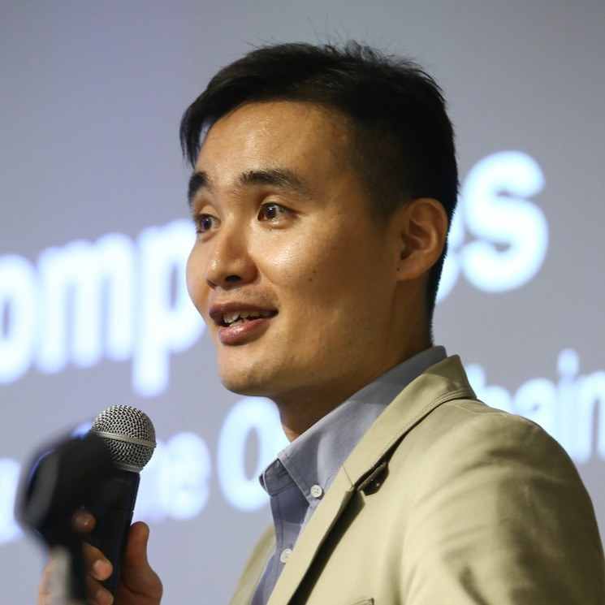
News – New Documents for SBOM Quality
Haksung Jang, Chair of the OpenChain Korea Work Group, has contributed two major documents to help with SBOM Quality!
The Telco SBOM Guide 1.1 in Korean: https://github.com/OpenChain-Project/Telco-WG/blob/main/OpenChain-Telco-SBOM-Guide_KR.md
A Handbook for Software Supply Chain Security in the Telco Industry: https://openchain-project.github.io/OpenChain-KWG/en/guide/telco_sbom/

Slide 5

News – OpenChain @ Debian Conf 25
Debian Conf 25 in Brest, France, Yamane-san from SIOS technology and Namae-san from Sony gave presentations about Project ESSTRA. In the introduction, Namae-san referenced the OpenChain Standard: https://debconf25.debconf.org/talks/118-project-esstra-a-software-suite-to-enhance-software-transparency-and-traceability-in-the-software-supply-chain/
There is a recording here: https://chuangtzu.ftp.acc.umu.se/pub/debian-meetings/2025/DebConf25/debconf25-156-project-esstra-a-software-suite-to-enhance-software-transparency-and-traceability-in-the-software-supply-chain.lq.webm

Slide 6
News – New Documents for SBOM Quality
Haksung Jang, Chair of the OpenChain Korea Work Group, has contributed two major documents to help with SBOM Quality!
The Telco SBOM Guide 1.1 in Korean: https://github.com/OpenChain-Project/Telco-WG/blob/main/OpenChain-Telco-SBOM-Guide_KR.md
A Handbook for Software Supply Chain Security in the Telco Industry: https://openchain-project.github.io/OpenChain-KWG/en/guide/telco_sbom/

Slide 7
Comments on the term "SBOM Document”
Jari San provided some comments on the term "SBOM Document," and I am currently organizing my thoughts on this.
I have summarized what it means to focus on SBOM Document Quality and would like to hear the participants' opinions on it.
(Please refer to "1. Scope" below)
https://docs.google.com/document/d/1iuXX8j10N70dfce1-CZFWhW6S2jEqc--flcCgXMMdjg/edit?usp=sharing

Slide 8
Who should create SBOMs and how they can be created
Owada San will introduce who should create SBOMs and how they can be created within the software supply chain.
https://docs.google.com/presentation/d/1T0mifMjTbiOoxPMv-04rHV42mcRw9SSQocAq1USgEZg/edit?usp=sharing

Slide 9
Key points regarding security considerations
Hosomi San has summarized key points regarding security considerations, which will also be presented.
https://openchain-japanwg.slack.com/files/UDCGE1C92/F097E8XP6QZ/issues_on_vuln_mgmt.pptx

Slide 10
Any Other Business?

Slide 11
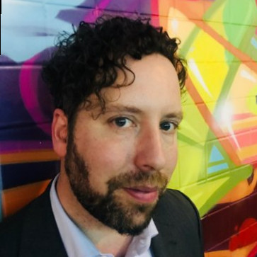
Allan Friedman Leaving CISA
At the most recent CISA bi-weekly call, it was announced that Allan Friedman is leaving at the end of July.
This will not have any direct impact on US Government Policy and on matters like the NTIA Minimum Requirements for SBOM in Federal Procurement, but it does mean we are losing an important liaison between the US Government and the open source community on SBOM topics.

Slide 12
See You Next Time!

