Slide 1
OpenChain Monthly Meeting: Spec, Education + More
North America and Europe - 2025-08-13 @ 16:30 UTC

Slide 2
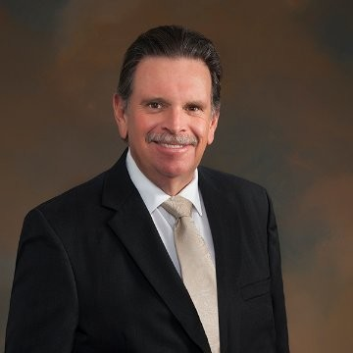

Call Hosted By:
Specification Chair: Chris Wood, Lockheed Martin
Education Chair: Martin Yagi, First Light Fusion

Slide 3
Anti-Trust Policy Notice
Linux Foundation meetings involve participation by industry competitors, and it is the intention of the Linux Foundation to conduct all of its activities in accordance with applicable antitrust and competition laws. It is therefore extremely important that attendees adhere to meeting agendas, and be aware of, and not participate in, any activities that are prohibited under applicable US state, federal or foreign antitrust and competition laws.
Examples of types of actions that are prohibited at Linux Foundation meetings and in connection with Linux Foundation activities are described in the Linux Foundation Antitrust Policy available at http://www.linuxfoundation.org/antitrust-policy. If you have questions about these matters, please contact your company counsel, or if you are a member of the Linux Foundation, feel free to contact Andrew Updegrove of the firm of Gesmer Updegrove LLP, which provides legal counsel to the Linux Foundation.

Slide 4
Agenda
OpenChain Project News
Open Compliance Summit – Call for Papers
Specification Work Group – Some Questions for the Community
Education Work Group – Update on Status and Community Work Items
Any Other Business?

Slide 5
OpenChain Project News

Slide 6
Five Key Items
CJ CGV (Korea’s largest Cinema Company) Announces An ISO/IEC 5230 Conformant Program: https://openchainproject.org/news/2025/07/30/cj-cgv-iso5230-conformant
Webinar: Unlocking Potential – Case Study on ZF’s ISO/IEC 5230 Certification: https://openchainproject.org/news/2025/07/31/zf-webinar
Recording: OpenChain Mini-Summit @ Open Source Summit North America: https://openchainproject.org/news/2025/07/31/openchain-ossna-2025
OpenChain Tooling Work Group – The 2025 Video Series: https://openchainproject.org/news/2025/07/18/openchain-tooling-work-group-the-2025-video-series
New Handbook for Software Supply Chain Security in the Telco Industry: https://openchainproject.org/news/2025/07/23/telco-handbook

Slide 7
Open Compliance Summit

Slide 8

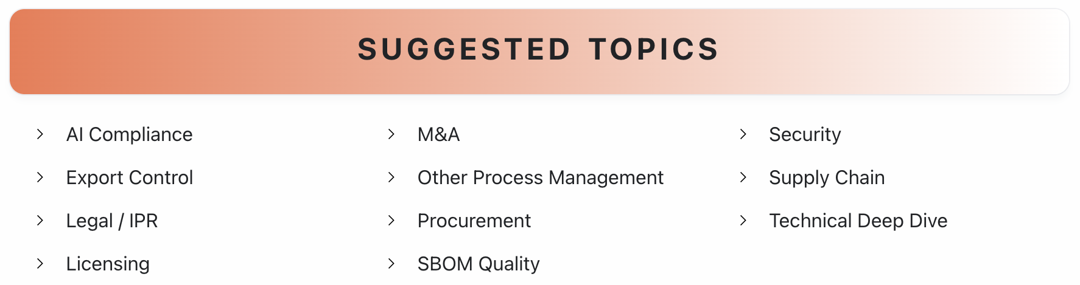
Call For Papers Close: Sunday, August 17 at 23:59 JST (UTC+9)
Submit a talk:
https://events.linuxfoundation.org/open-compliance-summit/program/cfp/

Slide 9
Specification Work Group

Slide 10
Questions for the Community
Proposed questions for a survey – do you have any suggestions for improvement?
Q1: Have you found shortfalls in ISO/IEC 5230 regarding how it addresses open source license compliance process management? Q2: Have you found shortfalls in ISO/IEC 18974 regarding how it addresses open source security assurance process management? Q3: Have you found any disconnect between the requirements of ISO/IEC 5230 and ISO/IEC 18974 that caused confusion? Q4: Have you found any disconnect between the requirements of ISO/IEC 5230 and ISO/IEC 18974 that hindered cross-adoption?

Slide 11
Education Work Group

Slide 12
Update and Next Steps
I have engaged with Linux Foundation Training to update our training material
LFC193 review started (not many comments / improvements suggested so far): https://lists.openchainproject.org/g/education/topic/114410124#msg844
LFC193 md GitHub version created: https://github.com/OpenChain-Project/Reference-Material/blob/master/OpenChain-Training/en/Online-Training-Courses/LFC193%20Course%20Content/Introduction%20to%20Open%20Source%20License%20Compliance%20Management%20(LFC193).md
Started adding relevant training resource information / links to the Sample Policy: https://lists.openchainproject.org/g/education/topic/sample_policy_training_matrix/114662906
TBD: LFC194 word document replaced by the one used by Linux Foundation Training – the proposed text changes were already implemented in the online course.
GitHub Improvement to training material suggestion from Jari: https://github.com/OpenChain-Project/Reference-Material/issues/103

Slide 13
Any other business?

Slide 14
Close of meeting

Slide 15
See you next time!

