Slide 1
OpenChain Monthly Meeting: Spec, Education + More
North America / Europe - 2025-09-10 @ 16:30 UTC

Slide 2
Anti-Trust Policy Notice
Linux Foundation meetings involve participation by industry competitors, and it is the intention of the Linux Foundation to conduct all of its activities in accordance with applicable antitrust and competition laws. It is therefore extremely important that attendees adhere to meeting agendas, and be aware of, and not participate in, any activities that are prohibited under applicable US state, federal or foreign antitrust and competition laws.
Examples of types of actions that are prohibited at Linux Foundation meetings and in connection with Linux Foundation activities are described in the Linux Foundation Antitrust Policy available at http://www.linuxfoundation.org/antitrust-policy. If you have questions about these matters, please contact your company counsel, or if you are a member of the Linux Foundation, feel free to contact Andrew Updegrove of the firm of Gesmer Updegrove LLP, which provides legal counsel to the Linux Foundation.

Slide 3
Agenda
OpenChain Project News
Specification Work Group – Some Questions for the Community
Education Work Group – Update on Status and Community Work Items
Any Other Business?

Slide 4
OpenChain Project News

Slide 5
General Project News (excitable version)
AMAZING OPENCHAIN MINI-SUMMIT AT OSS EU!
AI GUIDE IS APPROVED TO RELEASE! https://github.com/OpenChain-Project/Reference-Material/blob/master/AI-SBOM-Compliance/en/Artificial-Intelligence-System-Bill-of-Materials-Compliance-Management-Guide.md
SBOM STUDY GROUP IS BECOMING SBOM WORK GROUP
SBOM CROSS-INDUSTRY GUIDE NEARLY READY FOR RELEASE! https://docs.google.com/document/d/1iuXX8j10N70dfce1-CZFWhW6S2jEqc--flcCgXMMdjg/edit?tab=t.0#heading=h.xtogtsbrin0p

Slide 6
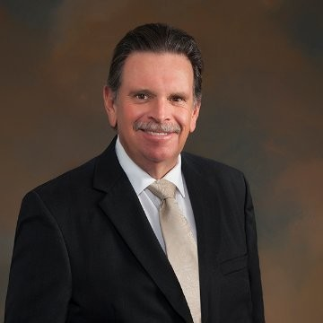
Specification Work Group

Slide 7
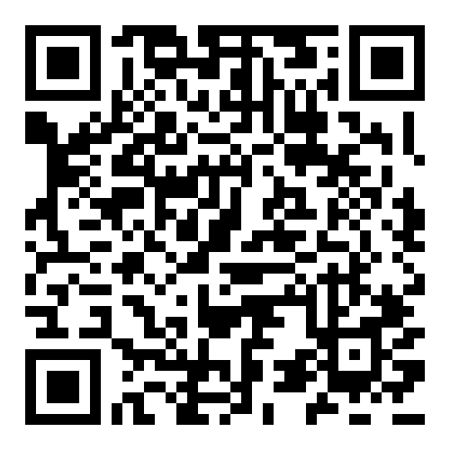
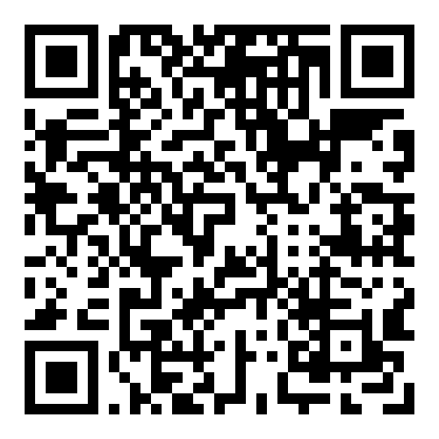
Sister Standards - Processes for Programs
ISO/IEC 5230 (License Compliance)
ISO/IEC 18974 (Security Assurance)
Flexible program size
Covering:
Inbound processes
Internal processes
Outbound processes
Standards about process points
Not about process content
https://bit.ly/3JUnEh8
http://bit.ly/4mbmOd8

Slide 8
Questions for the Community
https://openchainproject.org/openchain-iso-standard-survey-2025
Q&A:
(1) What does this mean for the edits we already have queued for 2026?
Nothing. Those are still going live.
(2) So this is a new chance to review and change the standards?
Yes.
(3) Do we have constraints?
No, brainstorm freely.

Slide 9
Results So Far : informal, and company names are not tied to the results listed
Has your organization adopted ISO/IEC 5230 and/or ISO/IEC 18974? Yes = 5, No = 1
Have you found shortfalls in ISO/IEC 5230 regarding how it addresses open source license compliance process management? Yes = 1, No = 5
Have you found shortfalls in ISO/IEC 18974 regarding how it addresses open source security assurance process management? Yes = 1, No = 1, N/A = 4
Have you found any disconnect between the requirements of ISO/IEC 5230 and ISO/IEC 18974 that caused confusion? No = 5, N/A = 1
Have you found any disconnect between the requirements of ISO/IEC 5230 and ISO/IEC 18974 that hindered cross-adoption? No = 4, N/A = 2

Slide 10
Companies Involved And Comment(s)
CAICT, Sony, CSI Piemonte, First Light Fusion, CJ CGV, Erlang/OTP (Ericsson AB) (not in order)
Comment from Company X: “We have not fully adopted ISO/IEC 5230 as such but our process/policy is aligned with it meaning that it would be minimal effort to fully adopt and become compliant if/when the business requires it. We do not currently typically distribute software (we are end of chain for the software we use!) so being a little ad-hoc in places is a good cost/benefit balance for us. The ISO/IEC 18974 specification is effectively irrelevant to us at the moment but I'm aware of it in case it does become relevant.”

Slide 11

Education Work Group

Slide 12
Update and Next Steps – Training Material
LFC193 review continuing
One bug fixed in github: https://github.com/OpenChain-Project/Reference-Material/issues/103
Sample Policy Training tab added links to relevant information:
https://lists.openchainproject.org/g/education/topic/fw_education_sample_policy/115060609

Slide 13
Any other business?

Slide 14
Close of meeting

Slide 15
See you next time!

