Slide 1
OpenChain Monthly Meeting
2022-11-15

Slide 2
Anti-Trust Policy Notice
Linux Foundation meetings involve participation by industry competitors, and it is the intention of the Linux Foundation to conduct all of its activities in accordance with applicable antitrust and competition laws. It is therefore extremely important that attendees adhere to meeting agendas, and be aware of, and not participate in, any activities that are prohibited under applicable US state, federal or foreign antitrust and competition laws.
Examples of types of actions that are prohibited at Linux Foundation meetings and in connection with Linux Foundation activities are described in the Linux Foundation Antitrust Policy available at http://www.linuxfoundation.org/antitrust-policy. If you have questions about these matters, please contact your company counsel, or if you are a member of the Linux Foundation, feel free to contact Andrew Updegrove of the firm of Gesmer Updegrove LLP, which provides legal counsel to the Linux Foundation.

Slide 3
Regular Agenda
Introductions
Specification news
SBOM news
OSPO news
Automation news
Work on standards and core material
Work on reference and supporting material
Work to support other projects
Any other business
Close of meeting

Slide 4
Introductions

Slide 5
Specification news

Slide 6
Specification Chair Rotation Underway
Mark Gisi, our founding chair of the OpenChain Specification Work Group (leading the creation of ISO/IEC 5230), will formally pass the leadership torch before end of year.
Because of this we are seeking two people to act as OpenChain Specification Chairs. The idea is to allow chairs to split the work and/or alternate between editing around License Compliance (ISO/IEC 5230) and Security (OpenChain Security Assurance Specification).

Slide 7
Specification Chair Rotation Underway
Being a chair around our specifications does not require specialized experience, but of course we do have some preferences:
(1) Be from a company using open source in products or services;
(2) Have domain knowledge in either license compliance or security assurance;
(3) Be detail-focused and unbiased;
(4) Have experience building consensus in community discussions.

Slide 8
Specification Chair Rotation Underway
(a) Participate in our monthly community calls;
(b) Help lead the segment reviewing open issues or accepting new issues around the specifications;
(c) Make judgement calls around what is included in the edit cycle and what is not (subject to Steering Committee approval for final decisions);
(d) Coordinate with the General Manager to finalize editing around the specifications;
(e) Participate in future Steering Committee meetings (4 per year from 2023) to vote on final versions of our specifications.

Slide 9
Specification Chair Rotation Underway
How do I nominate myself?
Just say so via our specification mailing list:
https://lists.openchainproject.org/g/specification
Is anyone else currently nominated?
Yes, Steve Kilbane from Analogue Devices, Jacob Wilson from Gemini, Chris Wood from Lockheed Martin and Helio Chissini de Castro from CARIAD.

Slide 10
Specification Chair Rotation Underway
(1) We have two spaces in total available (co-chairs);
(2) If two or fewer people are nominated before November 15th, they will become co-chairs of the specification activity around OpenChain with a one year term;
(3) If more than two people are nominated before November 15th, an election will be triggered;
(4) The election will take place via email between 15th and 22nd November and will be “first past the post;”
(5) Current chairs may be re-elected in the next cycle in the same manner as this time.
We may, of course, adjust this process for future years depending on lessons learned from this first election cycle.

Slide 11
And…

Slide 12
Specification Editing Cycle Begins This Month
Updating OpenChain ISO/IEC 5230:2020 (License Compliance)
Also known as OpenChain 2.1
Editing on new version – third generation – starts today
ISO update ETA 2024
Updating OpenChain Security Assurance Specification 1.1
Reminder: generation one is going into the ISO/IEC process via JTC-1 ETA mid-2023
Adjacent to this, editing on new version – second generation – starts today
ISO update ETA 2024

Slide 13
SBOM news

Slide 14
Update from SPDX Project (thanks Kate)
SPDX 2.3 is out, we're still working on getting the default version showing up on the web site (help welcome!) but the version is https://spdx.github.io/spdx-spec/v2.3/
Join in the monthly call on Thursday Nov 3, at 8am PST for details on the 3.0 model and subgroup progress
Active work is ongoing on Build profile, AI profile, Dataset profile, (as well as security & licensing) for inclusion in 3.0.
New license list coming soon.
SPDX Python library rework (sponsored by OpenSSF) is progressing well.
Open Call on Thursdays for 30 minutes, anyone wanting to join in for progress details, issue discussion, etc. is welcome
New test suite for checking libraries is being incorporated into the SPDX repo

Slide 15
OSPO news

Slide 16
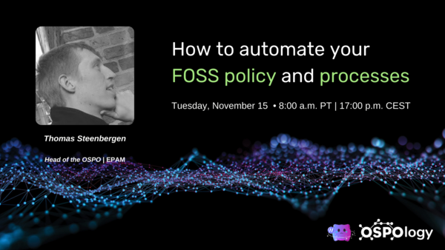
TODO Project News (thanks Ana)
TODO and CHAOSS working together on the new OSPO Metrics Working Group
TODO Community Survey 2022
OSPOlogy.live Netherlands for the Public Sector & Energy Industry (January 2023)
Next community call: How to automate your FOSS policy and processes

Slide 17
Security news

Slide 18
Update from OpenSSF Project (thanks David)
Sigstore Announces General Availability at SigstoreCon https://openssf.org/press-release/2022/10/25/sigstore-announces-general-availability-at-sigstorecon/
OpenSSF Project Alpha-Omega Invests in the OpenJS Foundation and jQuery to Help Secure the Consumer Web https://openssf.org/blog/2022/10/24/openssf-project-alpha-omega-invests-in-the-openjs-foundation-and-jquery-to-help-secure-the-consumer-web/
Report Finds OpenSSF Scorecards Are Highly Effective Measures to Assess Project Security https://openssf.org/blog/2022/10/20/report-finds-openssf-scorecards-are-highly-effective-measures-to-assess-project-security/
How OSPOs Can Be a Key Lever for Open Source Sustainability and Security https://openssf.org/blog/2022/09/29/how-ospos-can-be-a-key-lever-for-open-source-sustainability-and-security/
Also: Sonatype's 8th annual "State of the Software Supply Chain Report" (2022): https://www.sonatype.com/state-of-the-software-supply-chain/introduction

Slide 19
Automation news

Slide 20
OpenChain Automation Work Group
Capability Map 1.5.7:
A way to understand what is needed (and what is available) around open source tooling for open source license compliance
OpenAPI 0.2.2:
This API specification describes the minimum requirements any API should follow to comply with the OpenChain Capability Model
Both here: https://github.com/Open-Source-Compliance/Sharing-creates-value/tree/master/Tooling-Landscape/CapabilityMap

Slide 21
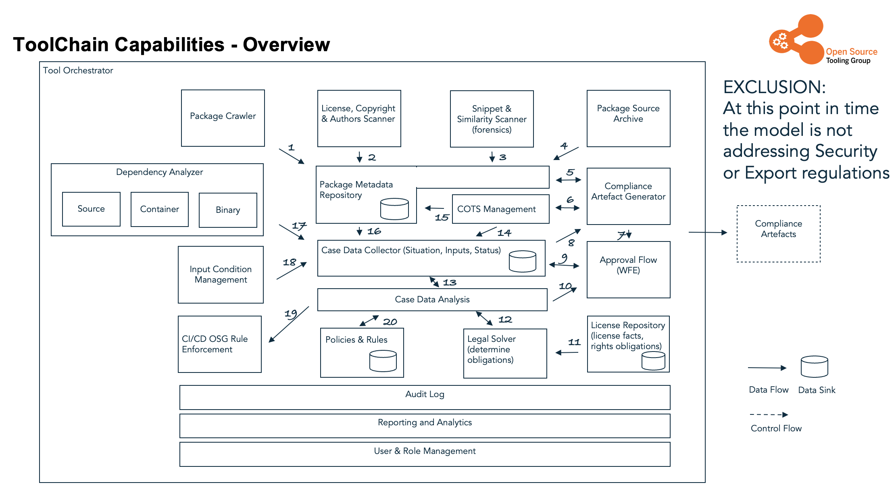
Capability Map 1.5.7

Slide 22
Get involved via our Automation Work Group
First Wednesday Meeting in November @ 09:00 UTC+1
Third Wednesday Meeting in November @ 15:00 UTC+1
https://conf.fsfe.org/b/compliance-tooling
Access Code: 199143
And join our mailing list:
https://groups.io/g/oss-based-compliance-tooling

Slide 23
Work on standards and core material

Slide 24
We are going to work on updating our standards
This does not mean the current standards are outdated. Our ISO standard for license compliance and our de facto standard for security assurance can and should continue to be included in procurement and other negotiations.
However, we are formally looking for future ideas and suggestions.
We want to ensure people are stakeholders in developing the next generation of our work.
You can expect the editing starting today to result in formal updates in 2024 for both the ISO standard for license compliance and the (forthcoming ISO standard for security assurance.

Slide 25
Our License Compliance Specification
We are formally opening an editing cycle for this specification. It is intended to provide a forum for ideas, suggestions and corrections. It will result in an update to ISO/IEC 5230:2020 circa 2024. Current specification here:
https://github.com/OpenChain-Project/License-Compliance-Specification/blob/master/Official/en/2.1/openchainspec-2.1.md
Spot an issue? Have a suggestion? Submit your notes here:
https://github.com/OpenChain-Project/License-Compliance-Specification/issues/new/choose
Check currently open issues here:
https://github.com/OpenChain-Project/License-Compliance-Specification/issues

Slide 26
Our Security Assurance Specification
We are formally opening an editing cycle for this specification. It is intended to provide a forum for ideas, suggestions and corrections. It will result in an update to the OpenChain Security Assurance Specification (expected to be an ISO standard in mid-2023) for around mid-2024. Current specification here:
https://github.com/OpenChain-Project/Security-Assurance-Specification/blob/main/Security-Assurance-Specification/1.1/en/openchain-security-specification-1.1.md
Spot an issue? Have a suggestion? Submit your notes here:
https://github.com/OpenChain-Project/Security-Assurance-Specification/issues/new/choose
Check currently open issues here:
https://github.com/OpenChain-Project/Security-Assurance-Specification/issues

Slide 27
Next call… live editing of issues!

Slide 28
Work on reference and supporting material

Slide 29
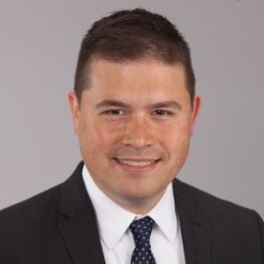
Welcome Nathan, our new chairperson!
🎊
🎊

Slide 30
Recently Released – Path to Conformance
A resource previous located on our website is the Path to Conformance. The old iteration was significantly outdated due to material and our project evolving. A new iteration has been started in GitHub in MarkDown to make editing and translation a lot easier:
https://github.com/OpenChain-Project/Reference-Material/blob/master/Path-to-Conformance/Official/en/path-to-conformance-version-1.md
Open issues for improvement:
https://github.com/OpenChain-Project/Reference-Material/issues/new/choose

Slide 31
Recently Released – FAQ (needs work)
The FAQ on our website has been collected as a MarkDown resource and is ready for editing and expansion. A suggested priority item for the Education Work Group is to help adjust this to properly include the new OpenChain Security Assurance Specification:
https://github.com/OpenChain-Project/Reference-Material/blob/master/FAQ/2.0/en/faq.md
Open issues for improvement:
https://github.com/OpenChain-Project/Reference-Material/issues/new/choose

Slide 32
Recently Released – Supplier Education Leaflet
Taking the MarkDown text of the supplier education leaflet, Shane began to prepare a Version 2 draft that will include things like the Security Assurance Specification. He suggests we edit this on the monthly calls (and of course elsewhere) to try and ensure we have solid material for the supply chain that covers both our license compliance and security work.
https://github.com/OpenChain-Project/Reference-Material/blob/master/Suppliers/Leaflet/Official/MarkDown/en/supply-chain-education-leaflet-version-2.md
Open issues for improvement:
https://github.com/OpenChain-Project/Reference-Material/issues/new/choose

Slide 33
Recently Released – Small Company Playbook
The OpenChain small company playbook (version 1) has been updated as part of our ongoing effort to make it easier to edit and translate OpenChain reference material. You can get it here:
https://github.com/OpenChain-Project/Reference-Material/blob/master/PlayBooks/Official/Version-1/Small-Company/en/OpenChain%20PlayBook%20-%20Small%20Company.md
Do you have ideas for improving this playbook? You can submit them in this email thread or by opening an issue on GitHub:
https://github.com/OpenChain-Project/Reference-Material/issues/new/choose

Slide 34
Needing Work – Medium Company Playbook
The OpenChain small company playbook (version 1) has seen solid revisions that make things easier:
https://github.com/OpenChain-Project/Reference-Material/blob/master/PlayBooks/Official/Version-1/Small-Company/en/OpenChain%20PlayBook%20-%20Small%20Company.md
Perhaps we can include them in a future iteration of the medium company playbook?
https://github.com/OpenChain-Project/Reference-Material/blob/master/PlayBooks/Official/Version-1/Medium-Company/en/OpenChain%20PlayBook%20-%20Medium%20Company.md

Slide 35
Next call… live editing of issues!

Slide 36
Work to support other projects

Slide 37
Deferring to next call due to time
Open questions:
How do we interlink with OpenSSF more effectively?
How do we interlink with ACT Project more effectively?
How do we interlink with SPDX Project more effectively?
How do we interlink with TODO Group more effectively?

Slide 38

Events coming up
Our next big event is Open Compliance Summit, December 7th and 8th in Yokohama, Japan
This event will cover license, security and export control compliance
We also expect to host OpenChain, TODO and SPDX Mini-Summit adjacent
Learn more: https://events.linuxfoundation.org/open-compliance-summit/

Slide 39
Any other business

Slide 40

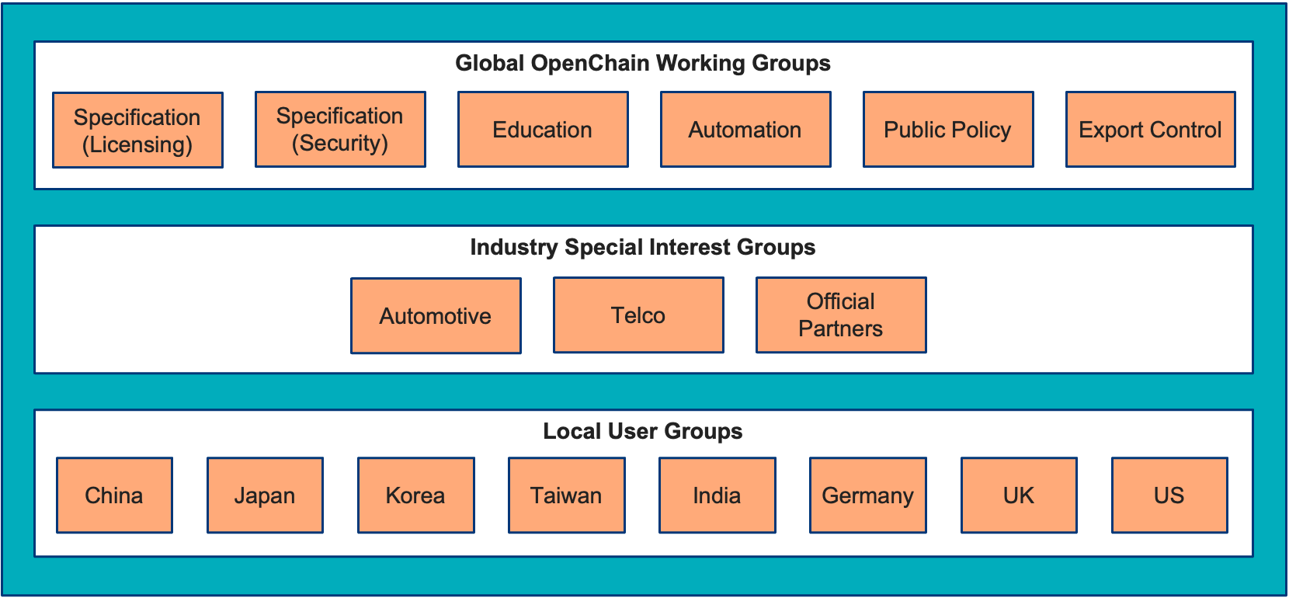


Slide 41



Different groups within OpenChain
Working Groups (WG) Works on key OpenChain related topics of Global interest
Working Groups Global in scope
Special Interest Groups Global in scope but limited to a specific industry
User Groups (UG) Global issues with a local scope
Special Interest Groups (SIG) Sector or industry specific groups for sharing experiences or work on sector/industry specific challenges
User Groups (UG) Groups for OpenChain adopters, users, and partners to share experience and challenges in their local language with the lo

Slide 42

Different groups within OpenChain
Working
Group
Working Group
Works on key OpenChain related topics of Global interest
Develops and maintains specifications old and new
Develops materials to help spread and implement OpenChain
Special Interest
Group
Special Interest Group
Industry specific groups focusing on:
Exchanging experience and challenges with industry peers.
Work on solving specific industry challenges
User Group
User Group
Anchored in the local community
Allowing everyone the opportunity to discuss and exchange experience in the language and cultural setting most familiar to them
Creating the basis of broadening the local OpenChain community

Slide 43
Close of meeting

Slide 44
See you next time!

