Slide 1
OpenChain Monthly Meeting
2023-01-17

Slide 2
Anti-Trust Policy Notice
Linux Foundation meetings involve participation by industry competitors, and it is the intention of the Linux Foundation to conduct all of its activities in accordance with applicable antitrust and competition laws. It is therefore extremely important that attendees adhere to meeting agendas, and be aware of, and not participate in, any activities that are prohibited under applicable US state, federal or foreign antitrust and competition laws.
Examples of types of actions that are prohibited at Linux Foundation meetings and in connection with Linux Foundation activities are described in the Linux Foundation Antitrust Policy available at http://www.linuxfoundation.org/antitrust-policy. If you have questions about these matters, please contact your company counsel, or if you are a member of the Linux Foundation, feel free to contact Andrew Updegrove of the firm of Gesmer Updegrove LLP, which provides legal counsel to the Linux Foundation.

Slide 3
Regular Agenda
Introductions
Specification (our process standards) news
SBOM news
Security News
OSPO news
Automation news
Community feedback and comments - issues for standards and core supporting material
Community feedback and comments - issues for reference and supporting material
Any other business
Close of meeting

Slide 4
Introductions

Slide 5
Specification news

Slide 6

Global Support Announcements: Security Spec
In December, Six partner organizations have announced services to support adoption of the OpenChain Security Assurance Specification 1.1. Three of these organizations are OpenChain Project official third-party certifiers, and all of these companies provide onboarding, adoption and review services across the global supply chain. https://www.openchainproject.org/news/2022/12/14/security-assurance-global-support

Slide 7

Global Support Announcements: Security Spec
In January, Bitsea in Germany also announced OpenChain Security Assurance Specification services: https://www.openchainproject.org/news/2023/01/12/bitsea-security-assurance-services

Slide 8

First Security Assurance Spec Conformance
Interneuron completed their self-certification in collaboration with Source Code Control and announced their conformant program in January: https://www.openchainproject.org/featured/2023/01/03/interneuron-security-assurance-conformance

Slide 9

Last Security Spec Item
We handed the OpenChain Security Assurance Specification 1.1 over to Joint Development Foundation (JDF) in Q4 2022.
It will be guided through the ISO/IEC JTC-1 PAS Transposition Process by JDF.
We expect to see graduation (all being well) mid-to-late 2023.

Slide 10
SBOM news

Slide 11
SPDX Announces Updated Python Tools
“As the Python tools were only nominally maintained for about a year, a lot of “backlog” had piled up, both in open pull requests (short: PRs) and open issues. While not the most exciting part of working on the Python tools, finishing PRs and triaging issues was still an essential first step to bringing the Python tools up to speed. […] Over the past two months, 48 PRs were closed, out of which 21 had been open for up to several years.” Read more: https://spdx.dev/an-update-on-the-spdx-python-tools/

Slide 12
Security news

Slide 13
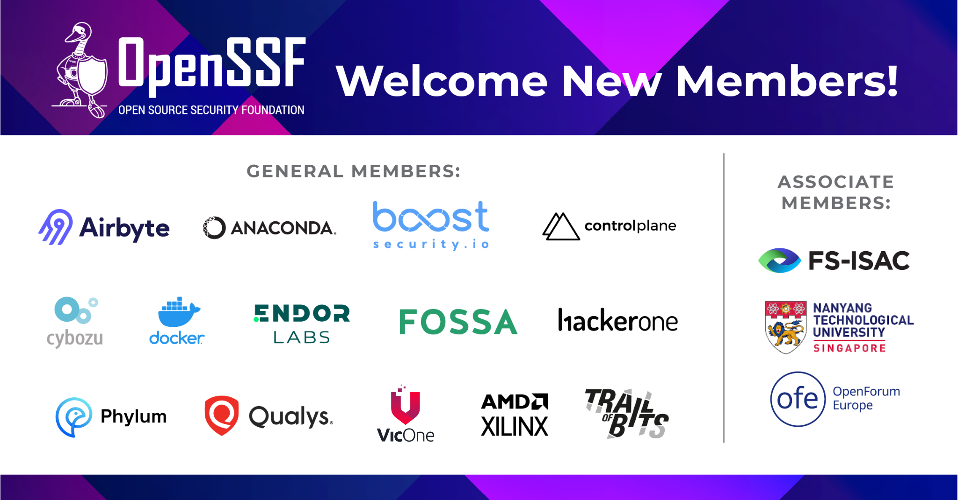

Slide 14
OSPO news

Slide 15

OSPOlogy.live Netherlands Coming Up
Learn more: https://community.linuxfoundation.org/events/details/lfhq-ospology-european-chapter-presents-ospologylive-share-learn-netherlands

Slide 16
Automation news

Slide 17
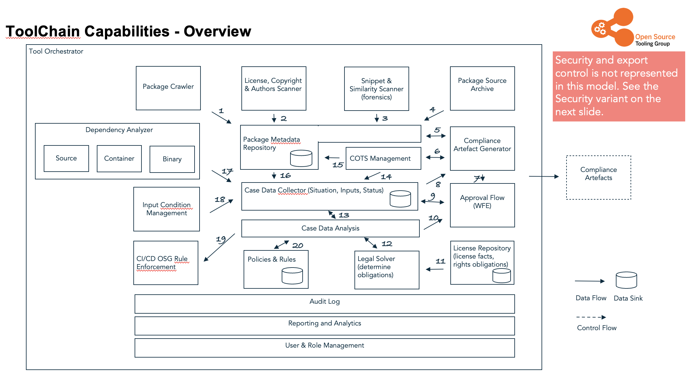
OpenChain Automation Work Group
The Capability Map is now available in MarkDown (as a Pull Request): https://github.com/Open-Source-Compliance/Sharing-creates-value/pull/95
Get the “normal” (or old) version as PPTX: https://github.com/Open-Source-Compliance/Sharing-creates-value/raw/master/Tooling-Landscape/CapabilityMap/OC_ToolingChain_v1.6.0.pptx

Slide 18

OSSelot - The Open Source Curation Database
At the end of 2022 OSADL launched a project to provide reliable compliance information for commonly used open source called OSSelot: https://www.osselot.org/
The database they are creating is available under CC-0 via Github: https://github.com/Open-Source-Compliance/package-analysis Compliance artifacts for more than 100 packages are already available and SPDX is supported: https://www.osselot.org/index.php?s=data&action=gotoplot

Slide 19
Work on standards and core material

Slide 20
License Compliance Spec
[Improvement] Should we revisit contribution - pointers to elsewhere or more than generic policy request? https://github.com/OpenChain-Project/License-Compliance-Specification/issues/62
[Improvement] Revisit Definitions 2.4 - Open Source https://github.com/OpenChain-Project/License-Compliance-Specification/issues/63

Slide 21
Security Assurance Spec
[Improvement] Revisit Definitions 2.7 - Open Source https://github.com/OpenChain-Project/Security-Assurance-Specification/issues/20

Slide 22
Work on reference and supporting material

Slide 23
Education Work Group Priorities
Nathan is working on a document here to tease out the most important items for the education work group to focus on: https://docs.google.com/document/d/1d6FP1sQviBWfk38iwrEuFILe3w2mLfzRUyWeZXycS7c/edit

Slide 24
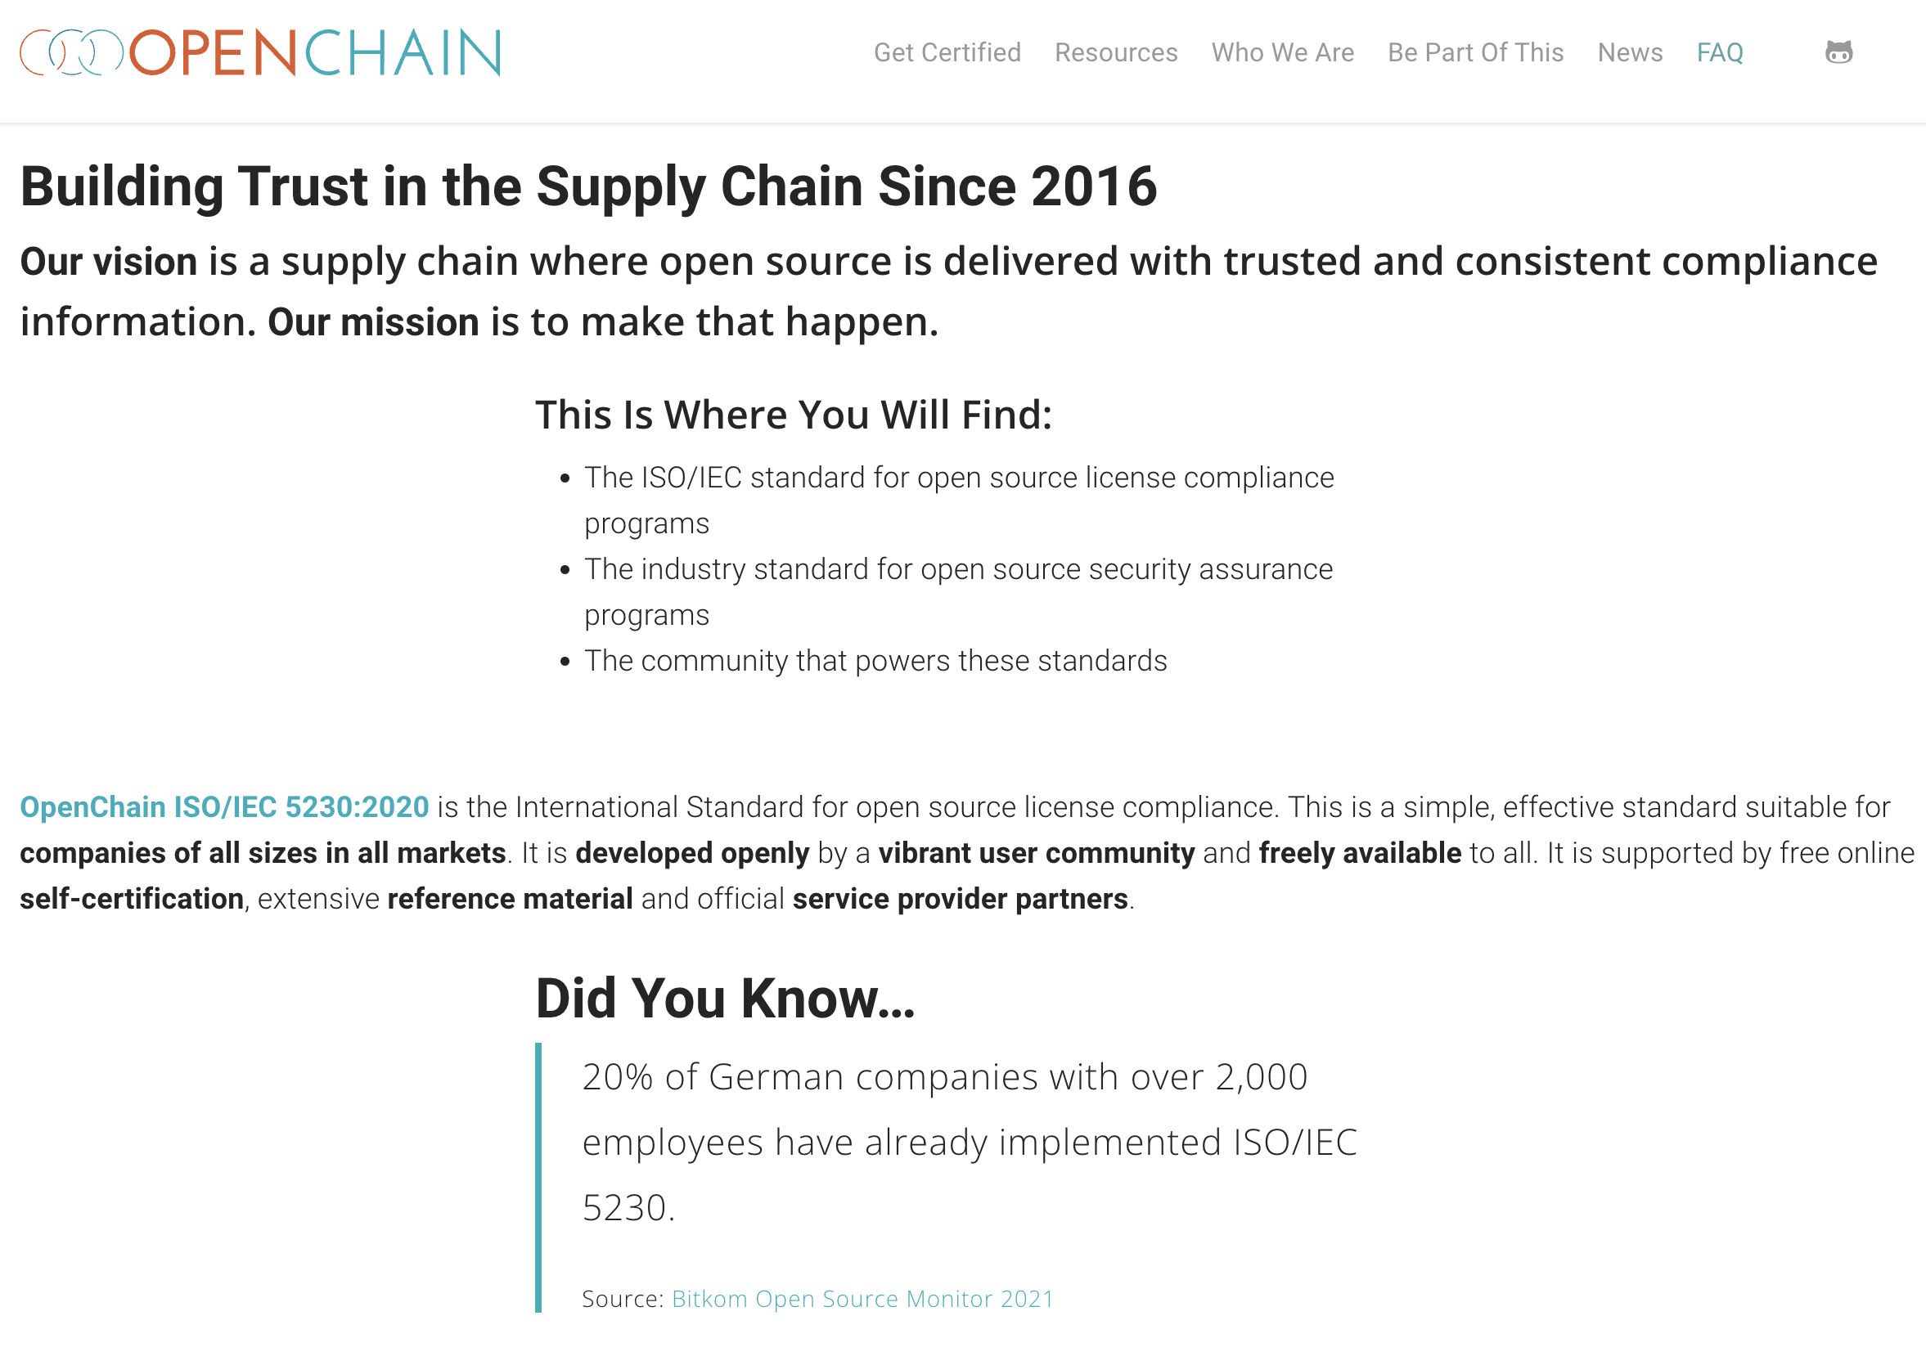
Other Education Work: Website Revamp

Slide 25
Any other business

Slide 26
Close of meeting

Slide 27
See you next time!

