Slide 1
OpenChain Monthly Meeting
2023-02-07

Slide 2
Anti-Trust Policy Notice
Linux Foundation meetings involve participation by industry competitors, and it is the intention of the Linux Foundation to conduct all of its activities in accordance with applicable antitrust and competition laws. It is therefore extremely important that attendees adhere to meeting agendas, and be aware of, and not participate in, any activities that are prohibited under applicable US state, federal or foreign antitrust and competition laws.
Examples of types of actions that are prohibited at Linux Foundation meetings and in connection with Linux Foundation activities are described in the Linux Foundation Antitrust Policy available at http://www.linuxfoundation.org/antitrust-policy. If you have questions about these matters, please contact your company counsel, or if you are a member of the Linux Foundation, feel free to contact Andrew Updegrove of the firm of Gesmer Updegrove LLP, which provides legal counsel to the Linux Foundation.

Slide 3
Regular Agenda
Introductions
Specification news
SBOM news
Work on standards and core material
Any other business
Close of meeting

Slide 4
Specification news

Slide 5


Examples Of Recent News

Slide 6


Security Assurance Specification Adoption

Slide 7
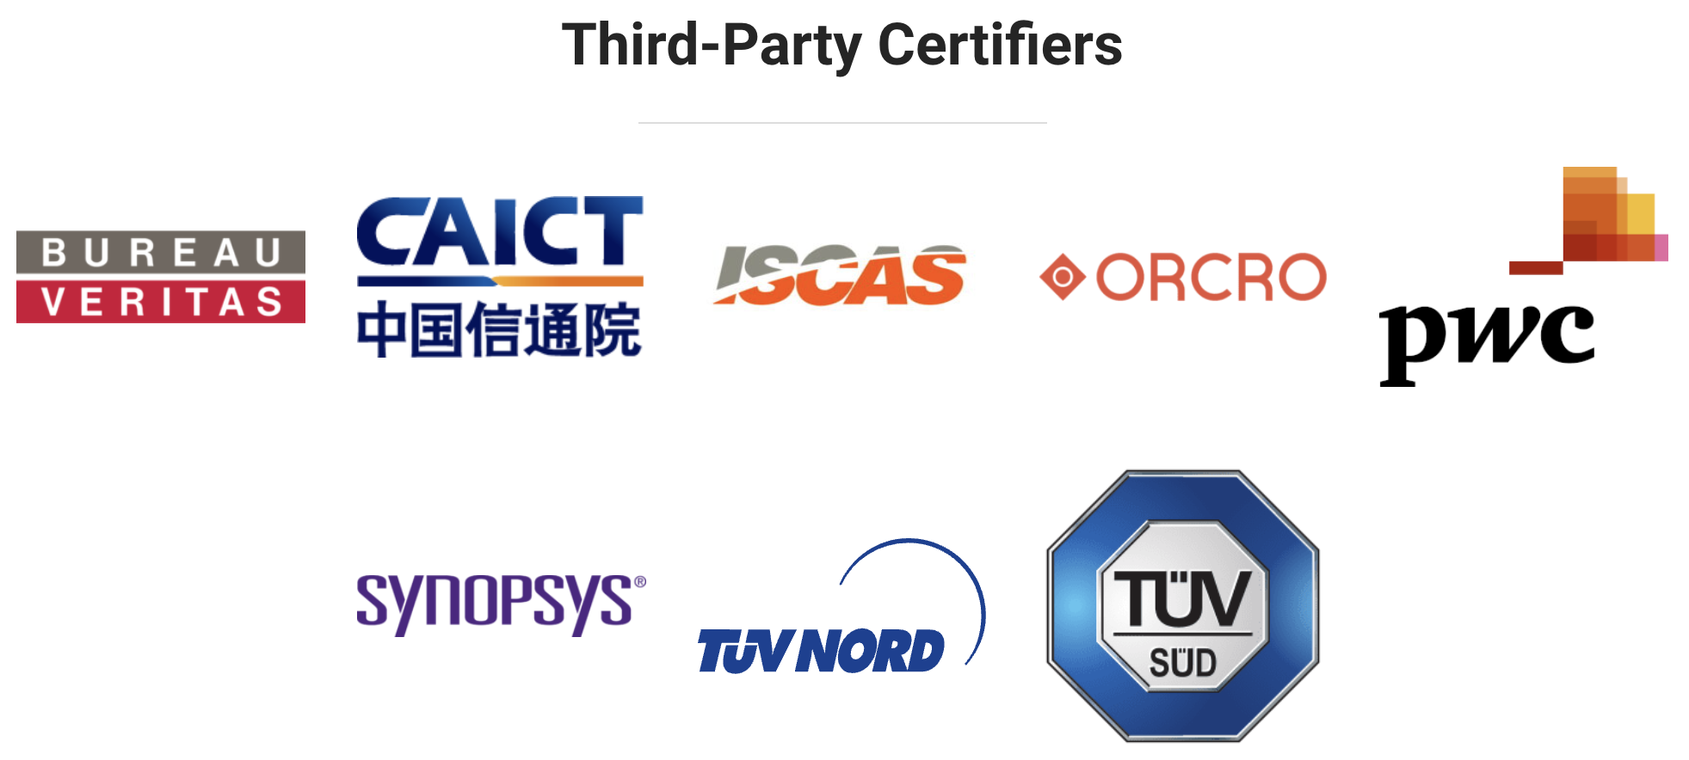
TUV Nord Becomes A Third-Party Certifier
Notes:
We have a growing number of global third party certifiers available.

Slide 8



Update On Free Online Training Courses
LFC193 - 1209 total enrollments (398 digital badges issued) 4.65 out of 5 rating by users
LFC194 - 579 total enrollments (138 digital badges issued) 4.55 out of 5 rating by users
Notes:
We work with LF Training to help make education easier around open source process management.

Slide 9
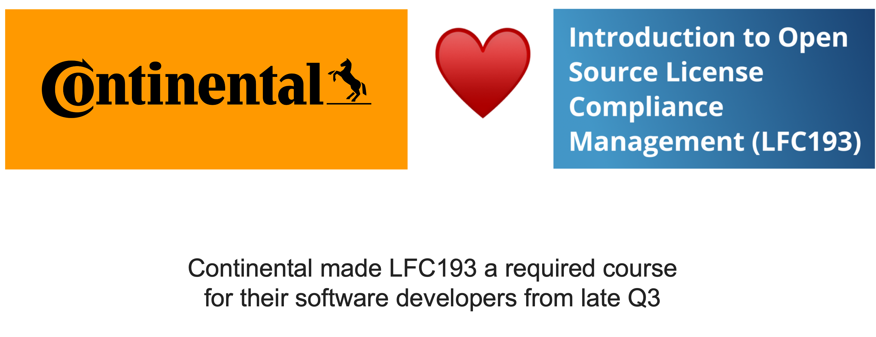
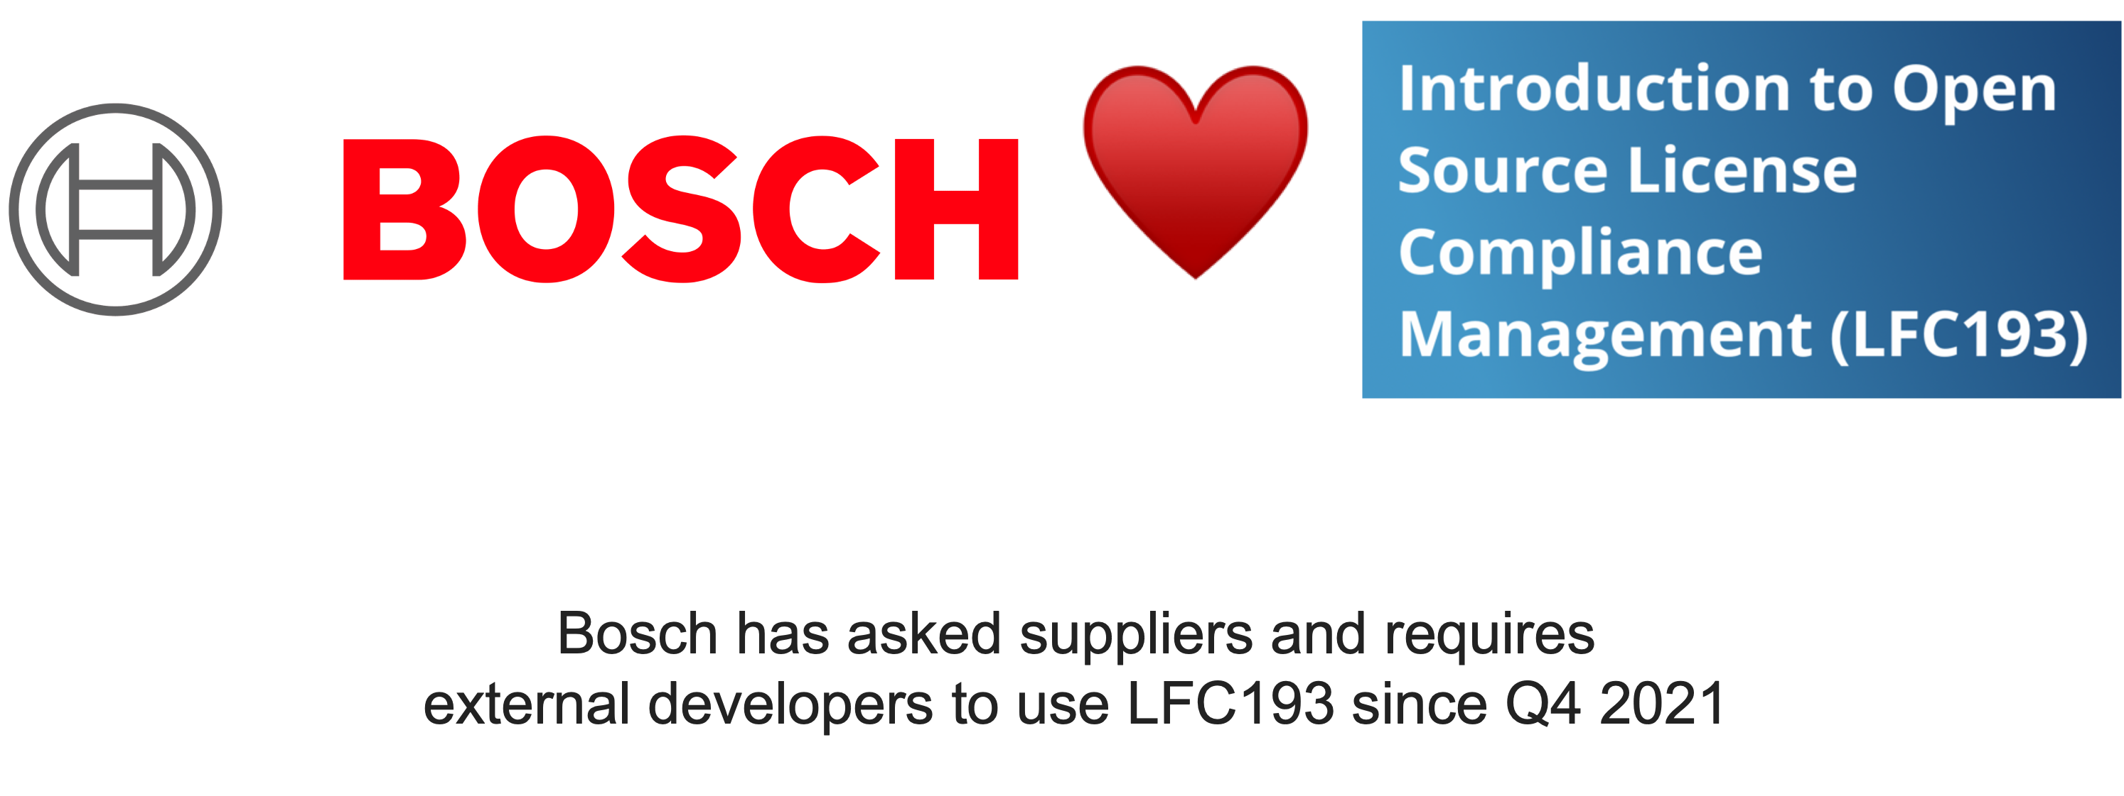
Example Of Market Use
Notes:
These resources make a real difference to companies

Slide 10
Execution Looks Solid

Slide 11
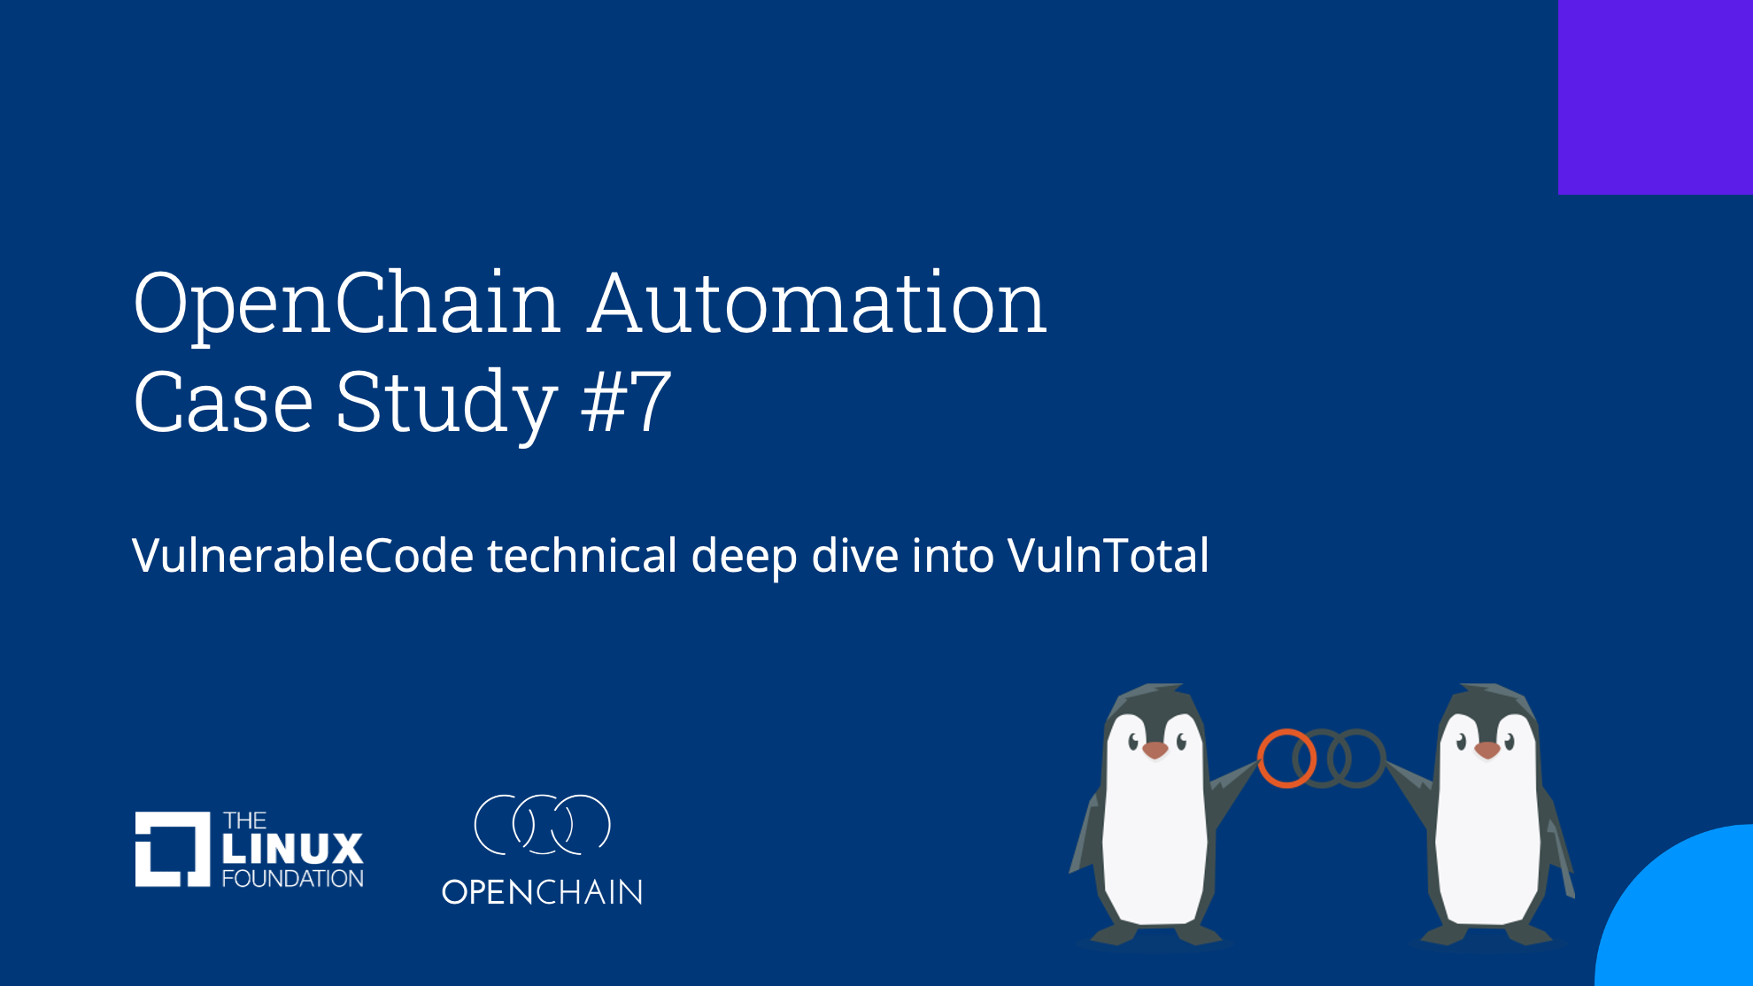
Cool New Webinar
https://www.openchainproject.org/automation/2023/02/07/automation-case-study-7

Slide 12
SBOM news

Slide 13
News from SPDX Project
Successful first ever SBOM devroom at FOSDEM
We had some excellent presentations from FOSSology and SW360, as well as other discussions, like using for SPDX for safety. They will be posted over the next couple of weeks.
Started a good discussion of types of SBOMs
Definitions worked on by group will be published soon by CISA. Link to white paper is: https://docs.google.com/document/d/1PsUhUQ_L-lNymD9p613zP0_MiT1Boag68TP3aiwZ4R8

Slide 14
Work on standards and core material

Slide 15
Revisit Definitions 2.7 - Open Source
Tl;dr: there was a mismatch between licensing and security specs, with security spec having a more limited definition of open source. It seems we will conclude with: our current approach in the licensing ISO standard appears workable for the market situation
The one change should be to harmonize between Licensing and Security to this language:
"software subject to one or more licenses that meet the Open Source Definition published by the Open Source Initiative (see opensource.org/osd) or the Free Software Definition published by the Free Software Foundation (see gnu.org/philosophy/free-sw.html) or similar license"
This would involve adding "or similar license" to the Security Assurance Spec. See: https://github.com/OpenChain-Project/Security-Assurance-Specification/issues/20

Slide 16
CERT #2 - Please add definitions for “remediate” and “mitigate”
Many products contain known vulnerabilities. The important factor is: Has the vulnerability been mitigated or remediated?
Please add definitions for “remediate” and “mitigate”.
2.6 Remediate
Remediation occurs when the vulnerability is eliminated or removed.
2.7 Mitigate
Mitigation occurs when the impact of the vulnerability id decreased without reducing or eliminating the vulnerability.
Renumber the remaining definitions.
This issue is located here on GitHub : https://github.com/OpenChain-Project/Security-Assurance-Specification/issues/22

Slide 17
CERT #3 - Under the Competence category, add requirements
Implement ISO/IEC 29147:2018 and ISO/IEC 30111:2019
Under the Competence category, add these requirements:
Implement a capability for the public to report vulnerabilities; allowing for analysis; and providing mitigation or remediation.
Implement a capability for the secure distribution of software updates.
Provide a timeline for when security patches and security support will end.
This issue is located here on GitHub : https://github.com/OpenChain-Project/Security-Assurance-Specification/issues/23

Slide 18
CERT #4 - Add references to ISO/IEC Standards
Add references to ISO/IEC Standards
ISO/IEC 29147:2018
ISO/IEC 30111:2019
This issue is located here on GitHub : https://github.com/OpenChain-Project/Security-Assurance-Specification/issues/24

Slide 19
Any other business

Slide 20
Close of meeting

Slide 21
See you next time!

