Slide 1
OpenChain Monthly Meeting
2023-03-21

Slide 2
Anti-Trust Policy Notice
Linux Foundation meetings involve participation by industry competitors, and it is the intention of the Linux Foundation to conduct all of its activities in accordance with applicable antitrust and competition laws. It is therefore extremely important that attendees adhere to meeting agendas, and be aware of, and not participate in, any activities that are prohibited under applicable US state, federal or foreign antitrust and competition laws.
Examples of types of actions that are prohibited at Linux Foundation meetings and in connection with Linux Foundation activities are described in the Linux Foundation Antitrust Policy available at http://www.linuxfoundation.org/antitrust-policy. If you have questions about these matters, please contact your company counsel, or if you are a member of the Linux Foundation, feel free to contact Andrew Updegrove of the firm of Gesmer Updegrove LLP, which provides legal counsel to the Linux Foundation.

Slide 3
Regular Agenda
News
Work on standards and core material
Any other business
Close of meeting

Slide 4
Specification news

Slide 5
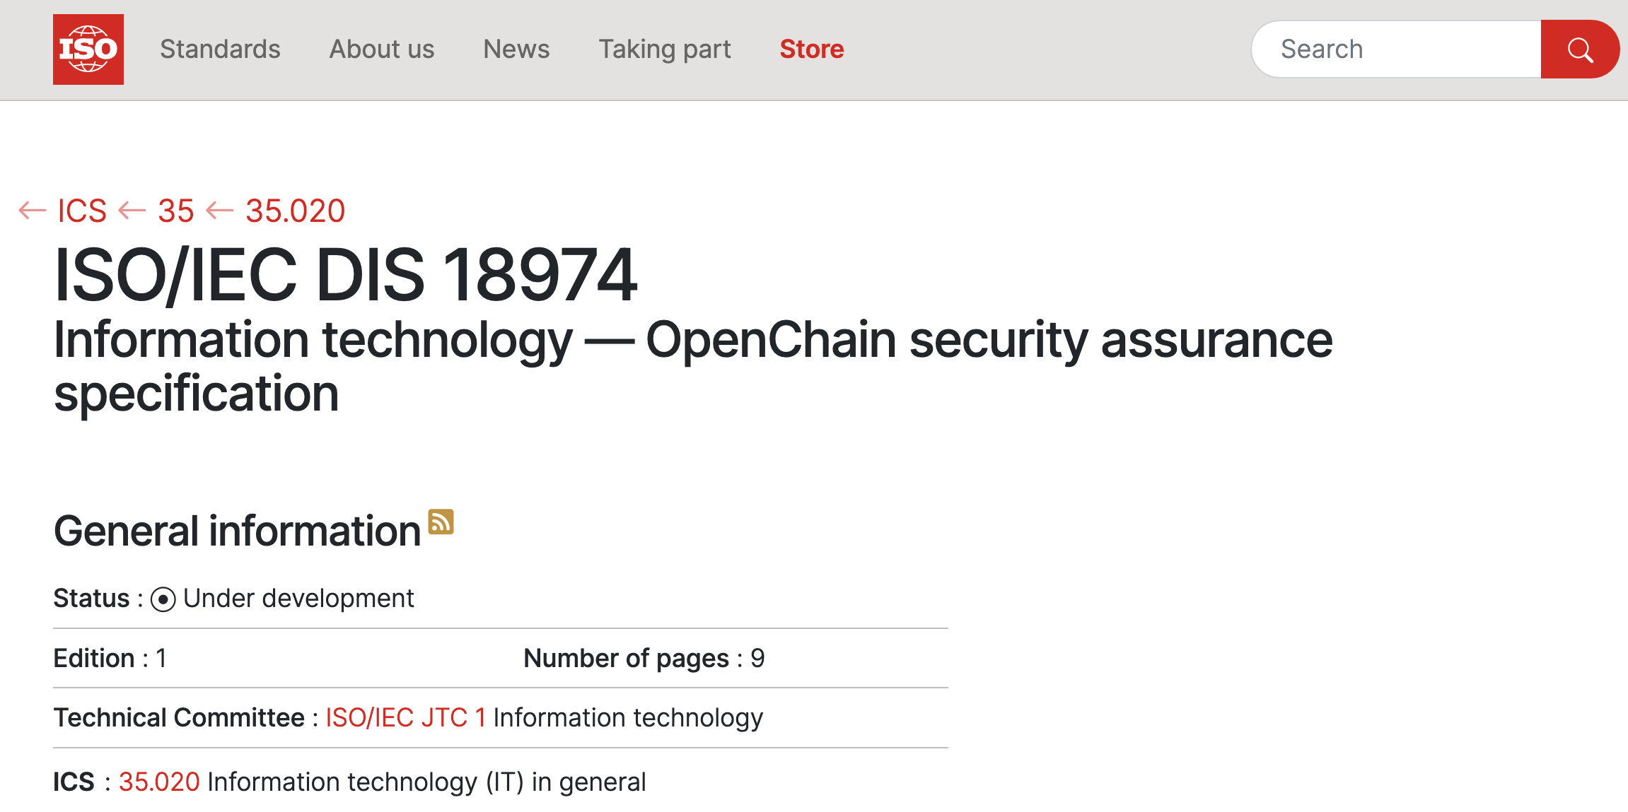
OpenChain News – Overarching Project Stuff

Slide 6
OpenChain News – Overarching Project Stuff
OpenChain @ Wikipedia: https://www.openchainproject.org/news/2023/02/23/openchain-wikipedia
OpenChain Reference Library – Complete Overhaul: https://www.openchainproject.org/news/2023/02/24/openchain-reference-library-complete-overhaul
Improved OpenChain Community Calendar: https://www.openchainproject.org/news/2023/02/27/improved-openchain-community-calendar

Slide 7
OpenChain News – Our Global Events Included…
OpenChain Webinar #48 – GPLv2 Licensing History: https://www.openchainproject.org/news/2023/02/15/webinar-48
Automation Case Study #7 – VulnerableCode technical deep dive into VulnTotal: https://www.openchainproject.org/news/2023/02/07/automation-case-study-7
OpenChain Education Work Group Meeting 2023-02-09: https://www.openchainproject.org/news/2023/02/20/education-wg-2023-02-09

Slide 8
OpenChain News – Conformance and Partners
Yes Security is OpenChain ISO/IEC 5230 Conformant: https://www.openchainproject.org/news/2023/02/16/yes-security-conformance
Panx Project is OpenChain ISO/IEC 5230 Conformant: https://www.openchainproject.org/news/2023/02/13/panx-project-conformance
OSPOCO and Taylor English Join The OpenChain Partner Program: https://www.openchainproject.org/news/2023/02/07/ospoco-and-taylor-english-join-the-openchain-partner-program
TIMETOACT GROUP Offers Open Source Certification Based On ISO/IEC 5230: https://www.openchainproject.org/news/2023/02/08/timetoact-third-party-certification

Slide 9
OpenChain News – Other Activities and Events
OpenChain @ OpenAnolis Standardization SIG Meeting: https://www.openchainproject.org/news/2023/02/24/openchain-openanolis-standardization-sig-meeting
OpenChain Germany OpenChain Germany – LF Training Courses Translation Project: https://www.openchainproject.org/news/2023/02/28/openchain-germany-openchain-germany-lf-training-courses-translation-project-2024-02-24-recording
OpenChain Japan Work Group Meeting #26 (Hybrid #1) – Recording: https://www.openchainproject.org/news/2023/02/27/japan-wg-26
OpenChain Japan: OSPO Subgroup Meeting / TODO Local Meetup: https://www.openchainproject.org/news/2023/02/21/openchain-ospo-subgroup-meeting-todo-local-meetup-2023-02-10-minutes + https://www.openchainproject.org/news/2023/02/21/openchain-ospo-subgroup-meeting-todo-local-meetup-minutes-2023-02-17

Slide 10
OpenChain News – Already In March…
OpenChain Webinar #49 – FOSDEM Recap: https://www.openchainproject.org/news/2023/03/07/webinar-49
OpenChain Export Control Work Group – Third Meeting: https://www.openchainproject.org/news/2023/03/07/openchain-export-control-work-group-third-meeting-2023-03-07-recording
OpenChain Germany – LF Training Courses Translation Project 2024-03-03: https://www.openchainproject.org/news/2023/03/05/openchain-germany-openchain-germany-lf-training-courses-translation-project-2024-03-03-recording
Telco Work Group (Morning and Afternoon 2023-03-02): https://www.openchainproject.org/news/2023/03/07/telco-work-group-morning-2023-03-02 https://www.openchainproject.org/news/2023/03/07/telco-work-group-afternoon-2023-03-02

Slide 11

OpenChain News – Cool Data Point
OpenChain has 10 official third party certifiers around the world:

Slide 12
SBOM news

Slide 13
News from SPDX
Python Libraries: Support for 2.3 & 2.2 available on PyPI as well as in SPDX repo - any bugs, please file issues. Refactoring done, and SPDX 3.0 prototyping in progress.
SPDX Specification: Build, Licensing, & AI branches have been added to the https://github.com/spdx/spdx-3-model repo. Please review and provide feedback.
Security & Dataset profiles to be added as branches soon.
SPDX License List v3.20 released on Feb 17, 2023 - 36 new license/exceptions (22 tagged "used in major distro") - most coming from Fedora

Slide 14
OSPO news

Slide 15
News From TODO Group
The employee Open Source Engagement Working group at TODO announced its 2023 goals and planning: https://todogroup.org/blog/employee-os-engagement-guide/
OSPOlogy Live organizers, including representatives from OpenChain, SPDX, OpenSSF, TODO, ISC, LF Energy, and CHAOSS, gather together and announce updates and new resources for OSPOlogyLive 2023: https://todogroup.org/blog/updates-and-resources-ospologylive2023/
March OSPOlogy Webinar will be a panel discussion on "OSPOs & Transition Paths for Regulated Environments". RSVP is now open: https://community.linuxfoundation.org/events/details/lfhq-todo-group-ospology-presents-ospos-transition-paths-for-regulated-environments/
The OSPO Mindmap has been translated into Chinese

Slide 16
Automation news

Slide 17
OpenChain Automation Work Group Reboot
Discussion on our most recent call:
(1) Consensus that an end-to-end open source toolchain for open source compliance is valuable
(2) Consensus that checking current status of the toolchain and identifying what is needed to complete it is important
(3) Agreement that details like data storage and data sharing schema are an interesting aspect of this (less silos)
(4) Agreement that covering point (2) and perhaps informed by point (3) will allow us to make a blueprint for what types of development and what funding for development should be applied.
Current Suggestion: Let’s start mapping (2) over the next calls. The state of the market will inform decisions over what is needed for the market. Next call is 3rd Wednesday of March at 14:00 UTC.

Slide 18
OpenChain Automation Work Group
Mailing List:
https://groups.io/g/oss-based-compliance-tooling

Slide 19
Work on standards and core material

Slide 20
Last Meeting Recap
On the 2023-03-07 call we addressed the following issues with the Security Assurance Specification 2.0 Draft:
Comments on the Known Vulnerability in the proposed Security Assurance Specification: https://github.com/OpenChain-Project/Security-Assurance-Specification/issues/19
Please add definitions for “remediate” and “mitigate”: https://github.com/OpenChain-Project/Security-Assurance-Specification/issues/22
We adjusted “obtain customer agreement”) as per this issue: https://github.com/OpenChain-Project/Security-Assurance-Specification/issues/27
Under the Competence category, add requirements: https://github.com/OpenChain-Project/Security-Assurance-Specification/issues/23
Add references to ISO/IEC Standards: https://github.com/OpenChain-Project/Security-Assurance-Specification/issues/24
We also opened this new issue:
Add triage entry to specific situations where vulnerability not applicable: https://github.com/OpenChain-Project/Security-Assurance-Specification/issues/29

Slide 21
The Plan For This Meeting
Security:
Add triage entry to specific situations where vulnerability not applicable: https://github.com/OpenChain-Project/Security-Assurance-Specification/issues/29
Comments on the Known Vulnerability in the proposed Security Assurance Specification: https://github.com/OpenChain-Project/Security-Assurance-Specification/issues/19
Add program objectives https://github.com/OpenChain-Project/Security-Assurance-Specification/issues/14
Clarify Stated Purpose (Github) and Scope (specification): https://github.com/OpenChain-Project/Security-Assurance-Specification/issues/28

Slide 22
The Plan For This Meeting
Licensing:
Consider adding definition of 'bill of materials’ https://github.com/OpenChain-Project/License-Compliance-Specification/issues/35
Move "Access" to be part of "Compliance Artifact Delivery” https://github.com/OpenChain-Project/License-Compliance-Specification/issues/53

Slide 23
Need Help To Get Started?
Licensing Specification (3rd Generation Draft):
https://github.com/OpenChain-Project/License-Compliance-Specification/blob/master/Official/en/3.0/openchain-license-compliance-3.0.md
Security Specification (2nd Generation Draft):
https://github.com/OpenChain-Project/Security-Assurance-Specification/blob/main/Security-Assurance-Specification/2.0/en/openchain-security-specification-2.0.md

Slide 24
Any other business

Slide 25
Close of meeting

Slide 26
See you next time!

