Slide 1
OpenChain Monthly Meeting
2023-04-18

Slide 2
Anti-Trust Policy Notice
Linux Foundation meetings involve participation by industry competitors, and it is the intention of the Linux Foundation to conduct all of its activities in accordance with applicable antitrust and competition laws. It is therefore extremely important that attendees adhere to meeting agendas, and be aware of, and not participate in, any activities that are prohibited under applicable US state, federal or foreign antitrust and competition laws.
Examples of types of actions that are prohibited at Linux Foundation meetings and in connection with Linux Foundation activities are described in the Linux Foundation Antitrust Policy available at http://www.linuxfoundation.org/antitrust-policy. If you have questions about these matters, please contact your company counsel, or if you are a member of the Linux Foundation, feel free to contact Andrew Updegrove of the firm of Gesmer Updegrove LLP, which provides legal counsel to the Linux Foundation.

Slide 3
Regular Agenda
News
Work on standards and core material
Any other business
Close of meeting

Slide 4
Specification news

Slide 5

Major ISO/IEC 5230 Announcement
ByteDance, a leading social media company, and the innovator behind TikTok, has announced an OpenChain ISO/IEC 5230 conformant program. Their adoption of the international standard for open source license compliance underlines their commitment to engagement and excellence around open source projects, platforms and solutions.

Slide 6

Major ISO/IEC DIS 18974 Announcement
LG Electronics (LG) now has an OpenChain Security Assurance Specification 1.1 (ISO/IEC DIS 18974) conformant program. This builds on their previous adoption of ISO/IEC 5230, the International Standard for open source license compliance.

Slide 7
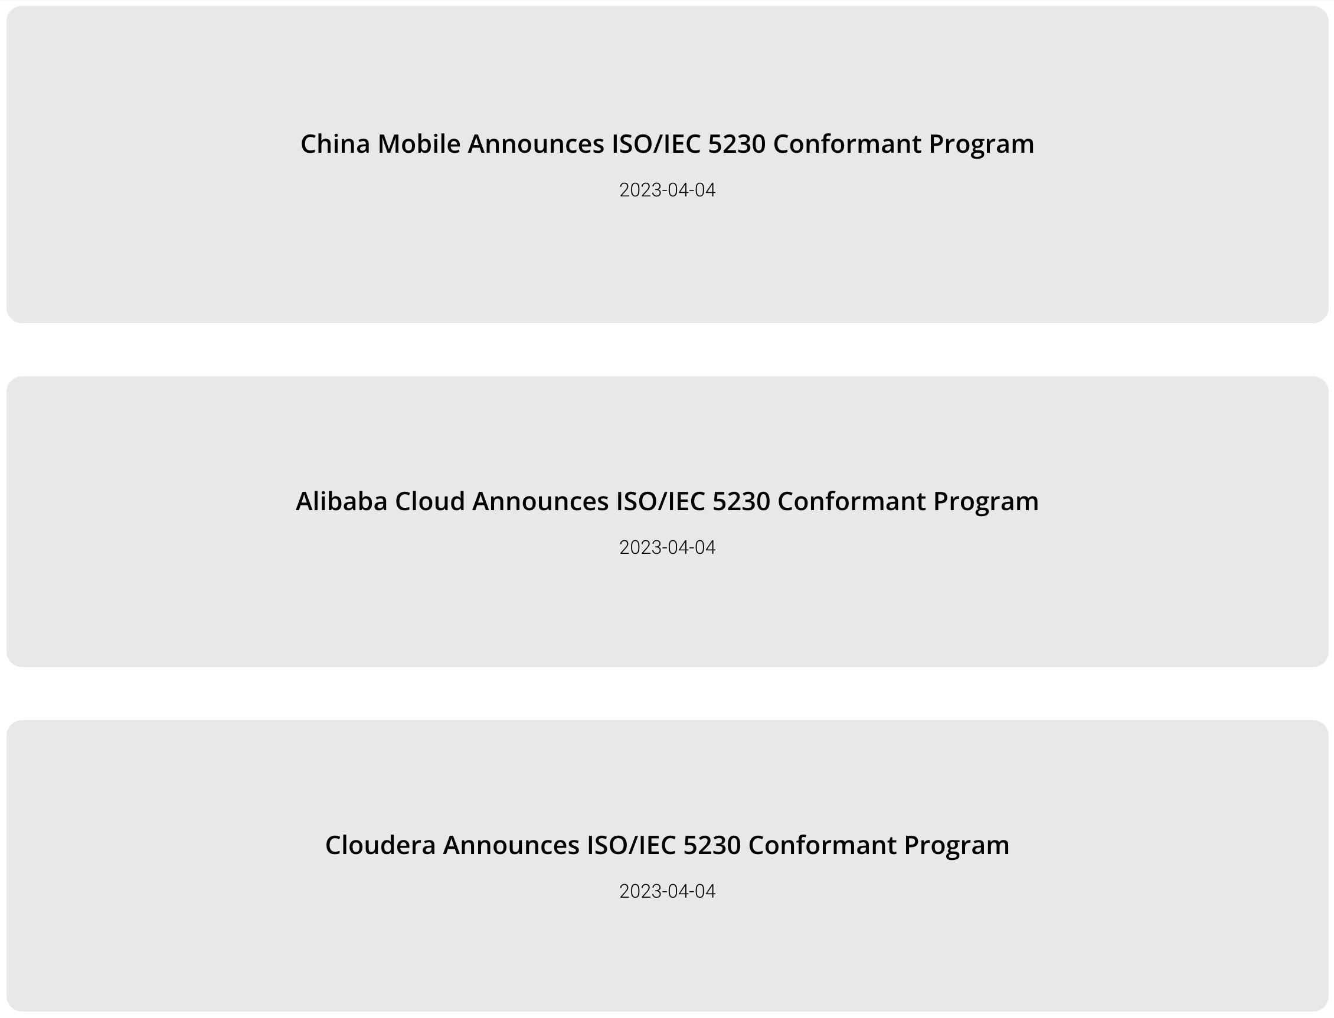



And More Conformance!
https://www.openchainproject.org/news/

Slide 8

We Are Ready To Check The Industry Pulse
https://www.openchainproject.org/news/2023/04/03/openchain-industry-survey-2023

Slide 9
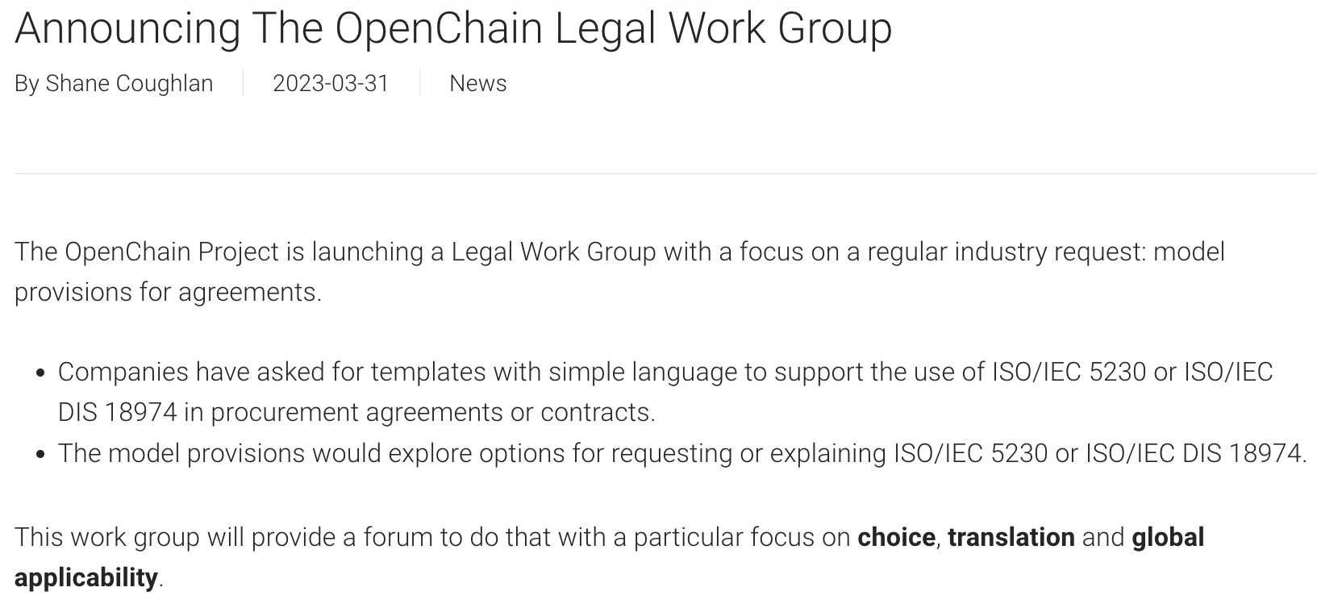
We Are Going To Help Procurement Even More
https://www.openchainproject.org/news/2023/03/31/announcing-the-openchain-legal-work-group

Slide 10
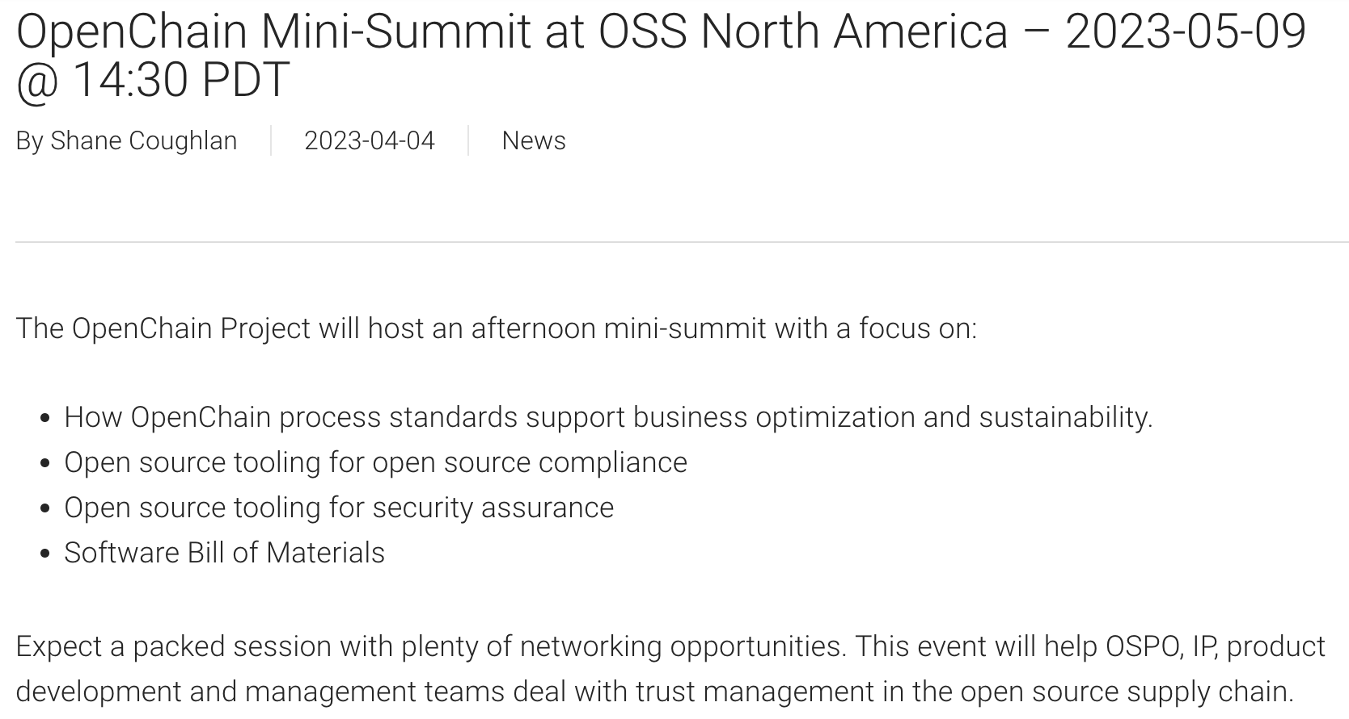
MARK YOUR CALENDARS
https://www.openchainproject.org/news/2023/04/04/mini-summit-oss-na-2023

Slide 11
SBOM news

Slide 12
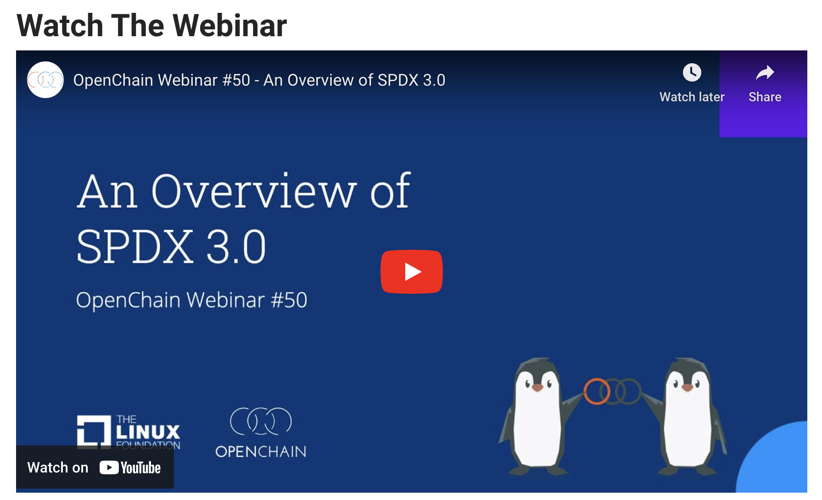
https://www.openchainproject.org/news/2023/03/31/webinar-50

Slide 13
OSPO news

Slide 14
News From TODO Group
New study highlights the business value of OSPOs: Why do organizations create sustain and expand Open Source Program Offices? The report is available in the Linux Foundation research page.
TODO is preparing for the 2023 OSPO survey to study the evolution and status of OSPOs. We're inviting organizations and open source projects to become partners for this upcoming survey, and we'd love to hear from you! To learn more about how to become a partner, please read the announcement in the TODO blog.
TODO is hosting an OSPO BoF + Happy hour meet-up at KubeCon + CloudNativeCon Europe 2023 for OSPO professionals. Join us to network with open source peers involved in Open Source Program Offices and enjoy some appetizers & drinks while taking a break from the action! Seats are limited, so make sure to fill out the form to secure your spot.

Slide 15
Other OSPO News
OSPO Mind Map Chinese and Japanese versions
OSPO Local Community Japan is working on a FAQ for beginners who want to create OSPO
The EU OSOR creates a guide to set up OSPOs in public admins
GitHub has open sourced its own OSPO policies, tools, and guides to help other OSPOs get started

Slide 16
Work on standards and core material

Slide 17
What We Covered In The Last Meeting:
We covered two issues during the 2023-04-04 call: Consider adding definition of ‘bill of materials’ – OUTCOME: ISSUE STILL NEEDS WORK https://github.com/OpenChain-Project/License-Compliance-Specification/issues/35 Move “Access” to be part of “Compliance Artifact Delivery” – OUTCOME: ISSUE CLOSED https://github.com/OpenChain-Project/License-Compliance-Specification/issues/53
For this call the plan is to cover some of the open issues around the potential future update of the OpenChain security specification (ISO/IEC DIS 18974).

Slide 18
What we need to do in security
Security:
Add triage entry to specific situations where vulnerability not applicable: https://github.com/OpenChain-Project/Security-Assurance-Specification/issues/29
Add program objectives https://github.com/OpenChain-Project/Security-Assurance-Specification/issues/14
Clarify Stated Purpose (Github) and Scope (specification): https://github.com/OpenChain-Project/Security-Assurance-Specification/issues/28

Slide 19
Need Help To Get Started?
Licensing Specification (3rd Generation Draft):
https://github.com/OpenChain-Project/License-Compliance-Specification/blob/master/Official/en/3.0/openchain-license-compliance-3.0.md
Security Specification (2nd Generation Draft):
https://github.com/OpenChain-Project/Security-Assurance-Specification/blob/main/Security-Assurance-Specification/2.0/en/openchain-security-specification-2.0.md

Slide 20
Any other business

Slide 21
Close of meeting

Slide 22
See you next time!

