Slide 1
OpenChain Monthly Meeting
2023-05-02

Slide 2
Anti-Trust Policy Notice
Linux Foundation meetings involve participation by industry competitors, and it is the intention of the Linux Foundation to conduct all of its activities in accordance with applicable antitrust and competition laws. It is therefore extremely important that attendees adhere to meeting agendas, and be aware of, and not participate in, any activities that are prohibited under applicable US state, federal or foreign antitrust and competition laws.
Examples of types of actions that are prohibited at Linux Foundation meetings and in connection with Linux Foundation activities are described in the Linux Foundation Antitrust Policy available at http://www.linuxfoundation.org/antitrust-policy. If you have questions about these matters, please contact your company counsel, or if you are a member of the Linux Foundation, feel free to contact Andrew Updegrove of the firm of Gesmer Updegrove LLP, which provides legal counsel to the Linux Foundation.

Slide 3
Regular Agenda
News
Work on standards and core material
Any other business
Close of meeting

Slide 4
News

Slide 5

OpenChain @ Events
https://www.openchainproject.org/news/2023/04/20/openchain-2nd-china-automotive-cyber-security

Slide 6

OpenChain @ Events
https://www.openchainproject.org/news/2023/04/21/openchain-llw-2023

Slide 7
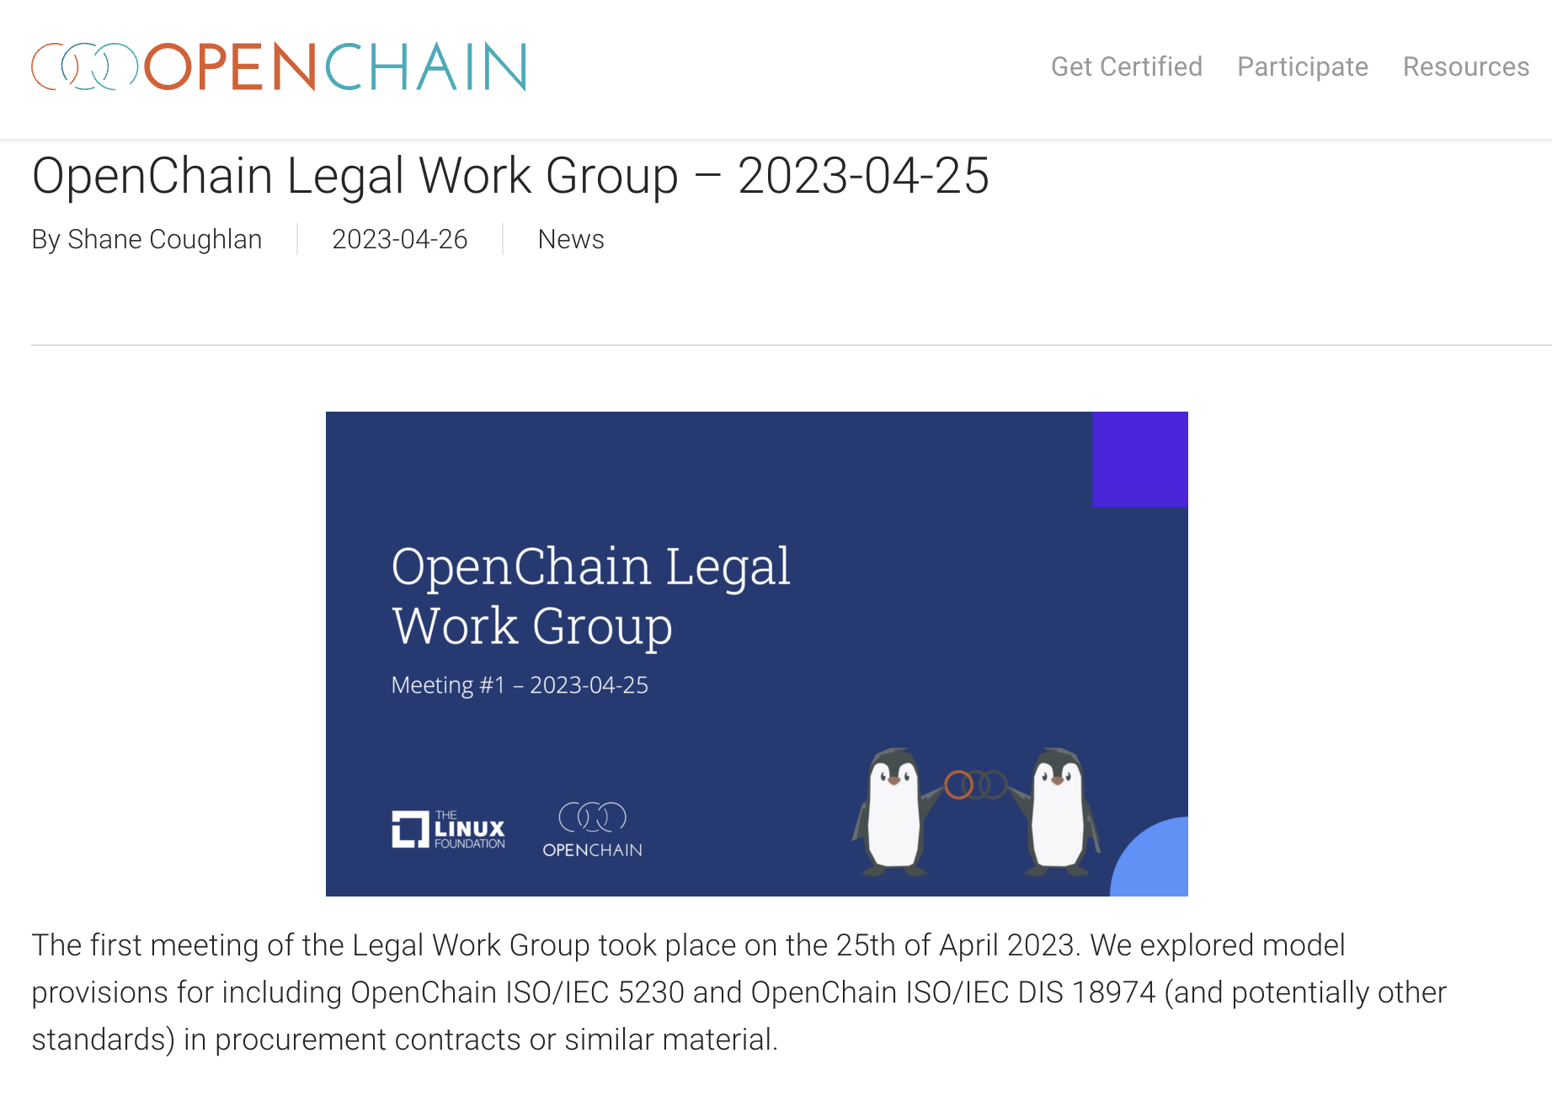
OpenChain Meeting
https://www.openchainproject.org/news/2023/04/26/legal-wg-2023-04-25

Slide 8

OpenChain Webinar
https://www.openchainproject.org/news/2023/04/26/webinar-51

Slide 9
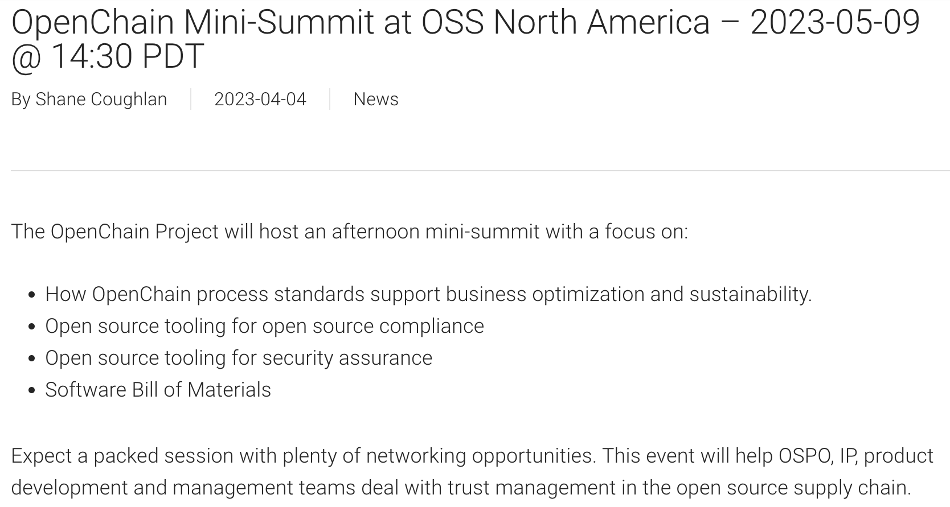
MARK YOUR CALENDARS
https://www.openchainproject.org/news/2023/04/04/mini-summit-oss-na-2023

Slide 10
Work on standards and core material

Slide 11
What We Covered In The Last Meeting:
We covered two issues during the April calls: Consider adding definition of ‘bill of materials’ – OUTCOME: ISSUE STILL NEEDS WORK https://github.com/OpenChain-Project/License-Compliance-Specification/issues/35 Move “Access” to be part of “Compliance Artifact Delivery” – OUTCOME: ISSUE CLOSED https://github.com/OpenChain-Project/License-Compliance-Specification/issues/53
For this call the plan is to cover some of the open issues around the potential future update of the OpenChain security specification (ISO/IEC DIS 18974).

Slide 12
What we need to do in security
Security:
Add triage entry to specific situations where vulnerability not applicable: https://github.com/OpenChain-Project/Security-Assurance-Specification/issues/29
Add program objectives https://github.com/OpenChain-Project/Security-Assurance-Specification/issues/14
Clarify Stated Purpose (Github) and Scope (specification): https://github.com/OpenChain-Project/Security-Assurance-Specification/issues/28

Slide 13
Need Help To Get Started?
Licensing Specification (3rd Generation Draft):
https://github.com/OpenChain-Project/License-Compliance-Specification/blob/master/Official/en/3.0/openchain-license-compliance-3.0.md
Security Specification (2nd Generation Draft):
https://github.com/OpenChain-Project/Security-Assurance-Specification/blob/main/Security-Assurance-Specification/2.0/en/openchain-security-specification-2.0.md

Slide 14
Any other business

Slide 15
Close of meeting

Slide 16
See you next time!

