Slide 1
OpenChain Monthly Meeting
2023-07-11

Slide 2
Anti-Trust Policy Notice
Linux Foundation meetings involve participation by industry competitors, and it is the intention of the Linux Foundation to conduct all of its activities in accordance with applicable antitrust and competition laws. It is therefore extremely important that attendees adhere to meeting agendas, and be aware of, and not participate in, any activities that are prohibited under applicable US state, federal or foreign antitrust and competition laws.
Examples of types of actions that are prohibited at Linux Foundation meetings and in connection with Linux Foundation activities are described in the Linux Foundation Antitrust Policy available at http://www.linuxfoundation.org/antitrust-policy. If you have questions about these matters, please contact your company counsel, or if you are a member of the Linux Foundation, feel free to contact Andrew Updegrove of the firm of Gesmer Updegrove LLP, which provides legal counsel to the Linux Foundation.

Slide 3
Regular Agenda
News
Work on standards and core material
Any other business
Close of meeting

Slide 4
News

Slide 5
ISO/IEC DIS 18974 Passed The ISO Ballot
We expect it to become a formal ISO/IEC standard within 30 days
We expect it to have this ISO/IEC number: ISO/IEC 18974:2023
Conformance is ready: https://www.openchainproject.org/checklist-iso-dis-18974
Companies are already adopting (LG Electronics, BlackBerry, Interneuron)
Conformance to de-facto standards (OpenChain Security Assurance 1.0, 1.1 and ISO/IEC DIS 18974 are also valid for ISO/IEC 18974.

Slide 6
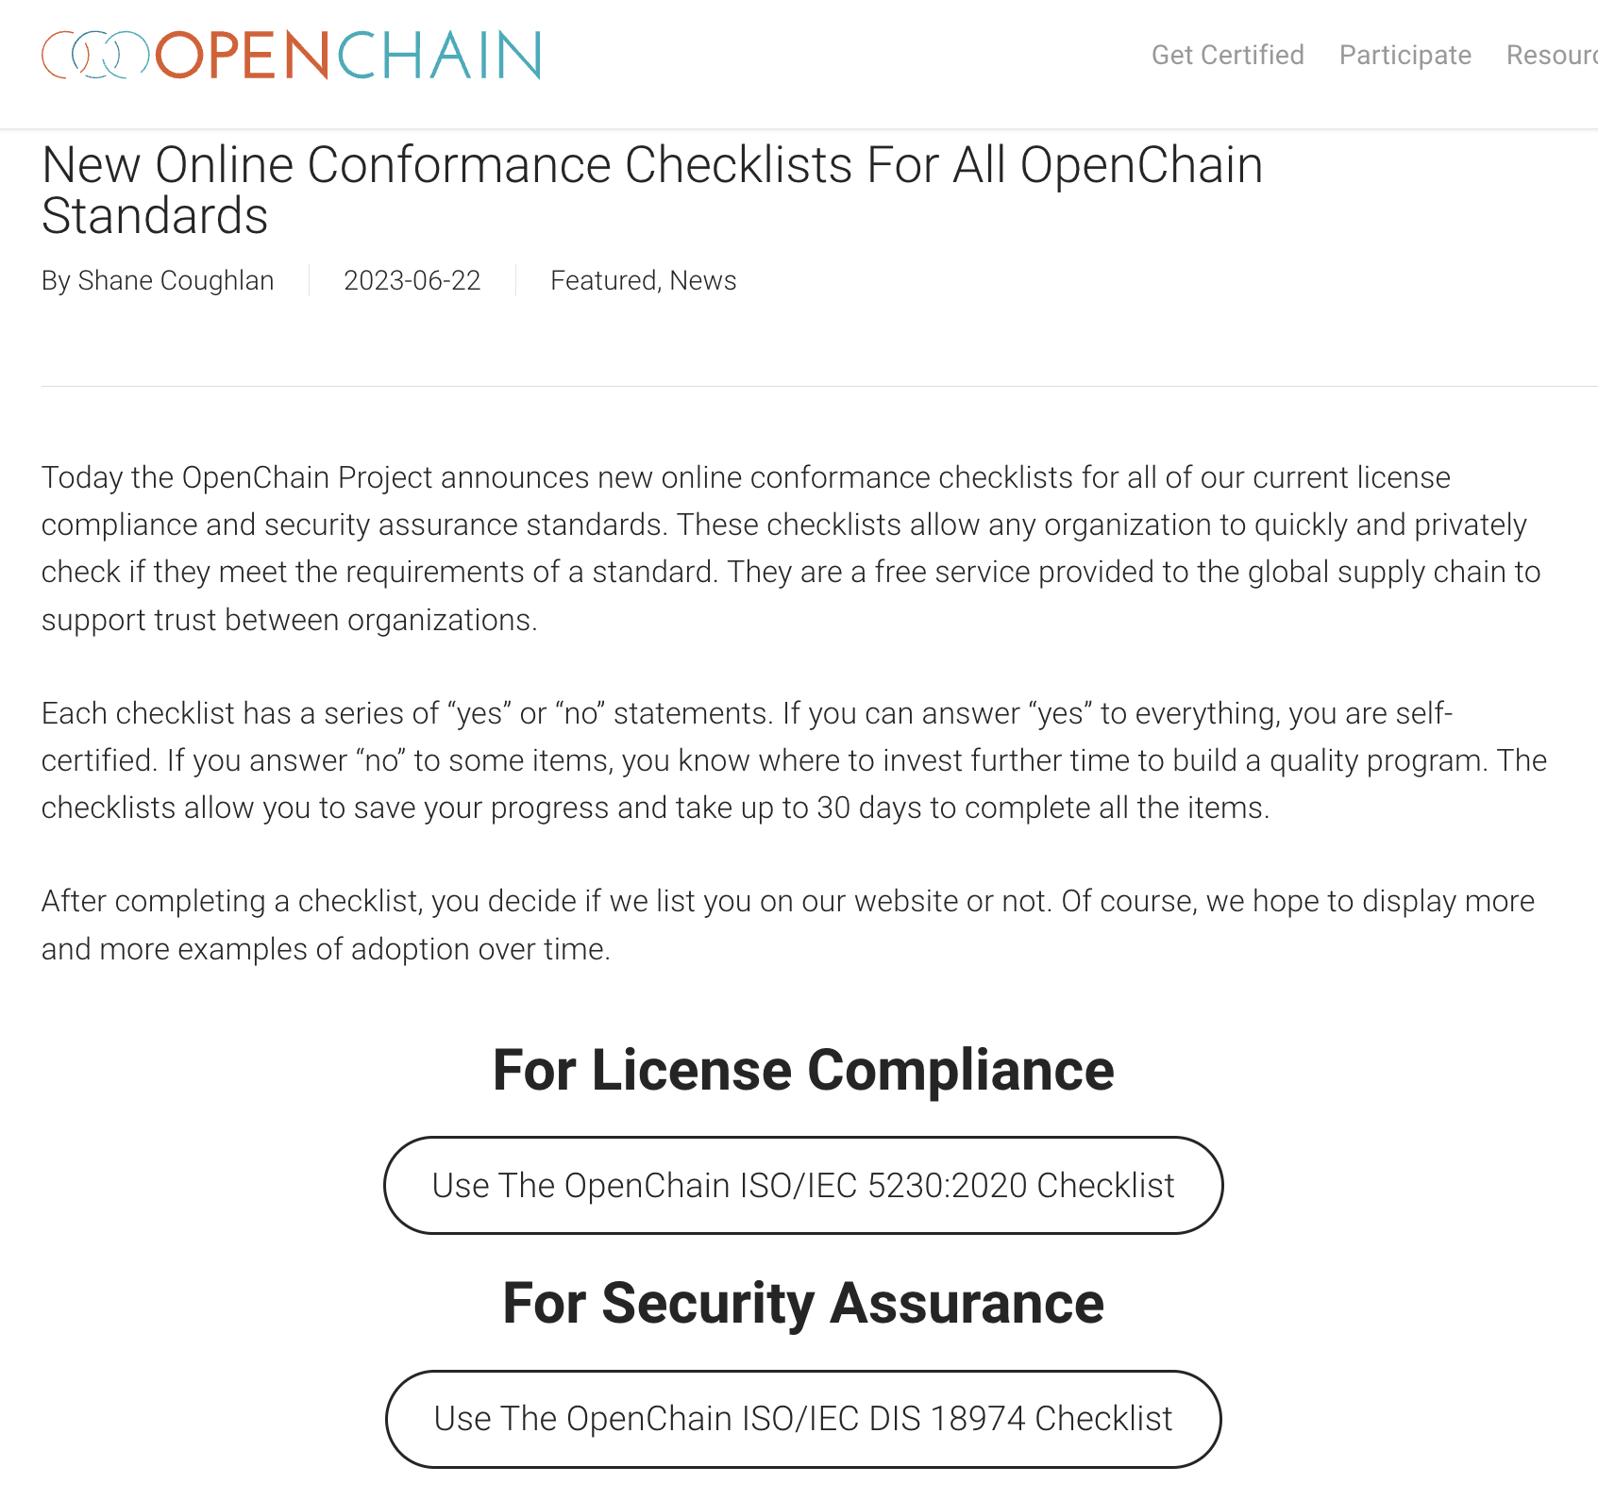
New Conformance Checklists For All Standards
https://www.openchainproject.org/get-started

Slide 7

xFusion is the 100th organization to announce an OpenChain Conformant Program through our website
https://www.openchainproject.org/news/2023/06/27/xfusion

Slide 8

LINE Announces An OpenChain ISO/IEC 5230 Program for Open Source Compliance
https://www.openchainproject.org/featured/2023/07/05/line-iso-iec-5230

Slide 9
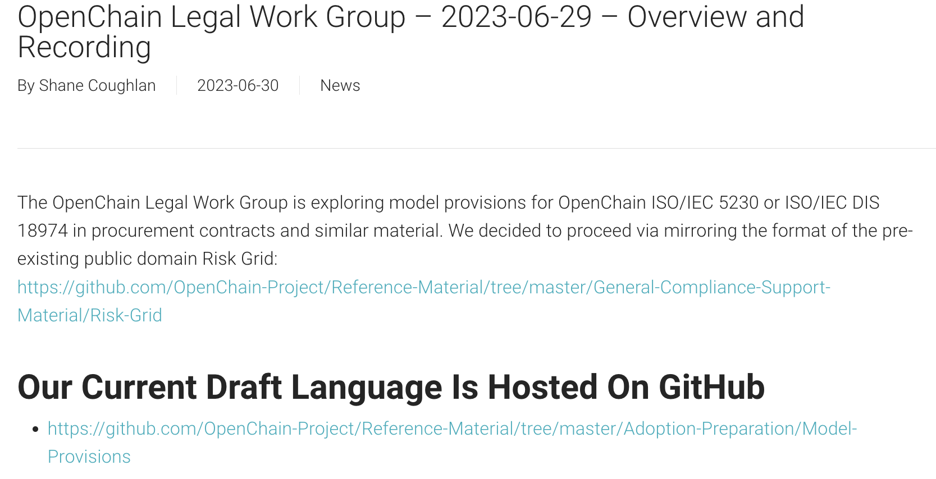
Legal Work Group Has Draft Model Provisions
https://www.openchainproject.org/news/2023/06/30/openchain-legal-work-group-2023-06-29-overview-and-recording

Slide 10
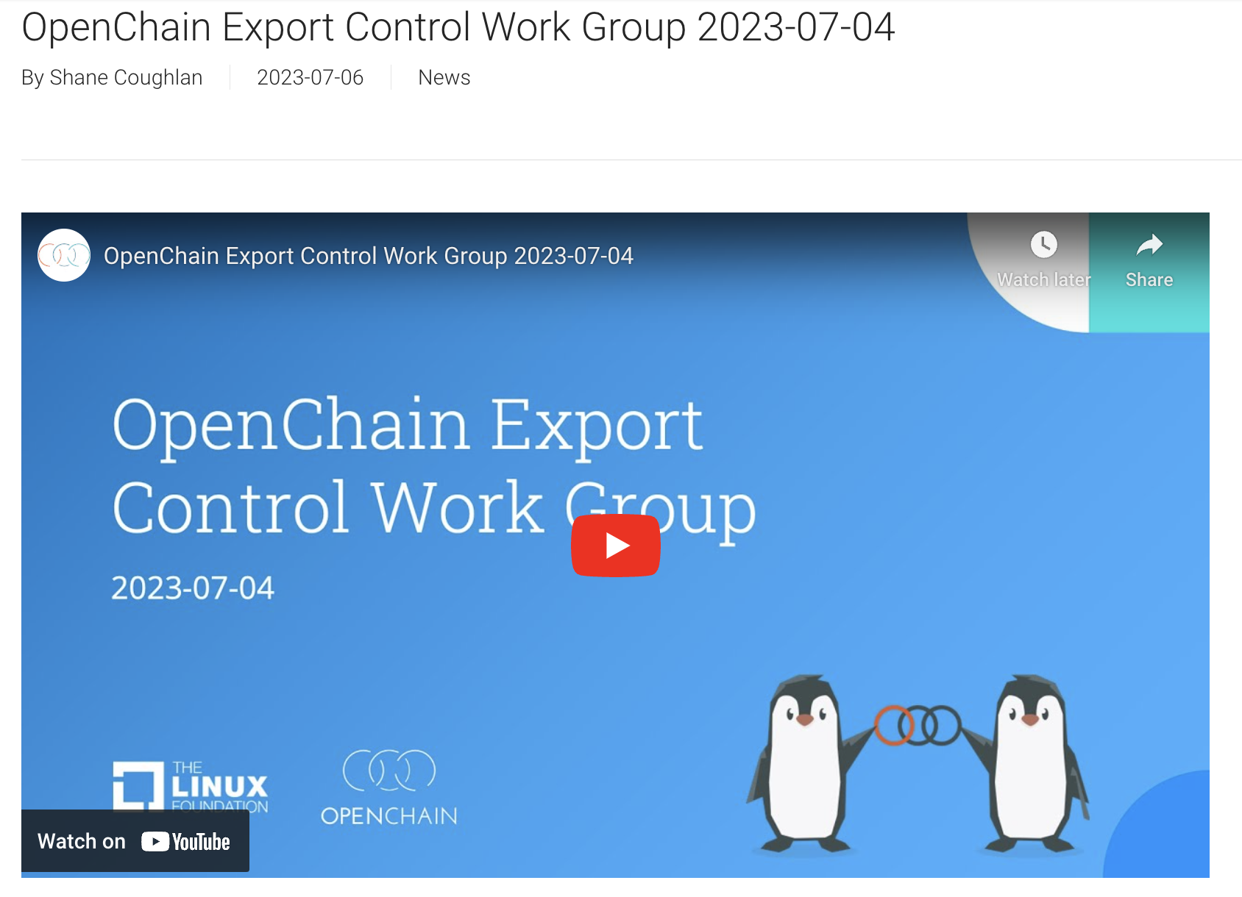
Export Control Work Group Requests Help
https://www.openchainproject.org/news/2023/07/06/openchain-export-control-work-group-2023-07-04

Slide 11

OpenChain Mini-Summit @ OSS NA – Recordings
https://www.openchainproject.org/news/2023/06/30/openchain-mini-summit-oss-na-recording

Slide 12

Automotive Work Group – Major Meeting
https://www.openchainproject.org/news/2023/06/29/automotive-wg-2023-06-14

Slide 13
Work on standards and core material

Slide 14
What We Covered Last Call
Security Specification:
Align “Terms and Definitions” in Section 2 with Licensing Spec 3.0: https://github.com/OpenChain-Project/Security-Assurance-Specification/issues/30
Adjust SBOM definition to align with Licensing Spec 3.0: https://github.com/OpenChain-Project/Security-Assurance-Specification/issues/31
Our outcome was (a) alignment with Licensing Spec 3.0 but (b) several suggestions for improvement.
com/OpenChain-Project/License-Compliance-Specification/issues/35

Slide 15
What Is Scheduled For Today
Licensing Specification:
Review “Terms and Definitions” via open issue in Security Spec 2.0: https://github.com/OpenChain-Project/Security-Assurance-Specification/issues/30 “clarity suggestion at the beginning by Singing and potential flag to check for ISO vs IETF language conflicts by Ninjouji San.”
Improve SBOM definition via open issue in Security Spec 2.0: https://github.com/OpenChain-Project/Security-Assurance-Specification/issues/31 "a “Software Bill of Materials” (SBOM) is a inventory for software, a list of ingredients that make up software components. An example is the (Software Package Data Exchange) SPDX specification created by the Linux Foundation's SPDX Project to exchange bill of materials for a given software package (see spdx.org). This includes various options for different use-cases or minimal SBOMs through the SPDX Lite profile. Regardless of the SBOM specification used, it could usefully include name, version, origin, license, copyright and Known Vulnerabilities in a manner useful to third parties."
Check the next two slides for the current and future draft standards

Slide 16
Current Published Versions of the Standards
Licensing Specification (CURRENT VERSION, 2nd Generation):
https://github.com/OpenChain-Project/License-Compliance-Specification/blob/master/2.1/en/openchainspec-2.1.md
Security Specification (CURRENT VERSION, 1st Generation):
https://github.com/OpenChain-Project/Security-Assurance-Specification/blob/main/Security-Assurance-Specification/1.1/en/openchain-security-specification-1.1.md
These are the current published versions of the standards The drafts we are editing are on the next slide

Slide 17
Draft Future Versions of the Standards
Licensing Specification (3rd Generation Draft):
https://github.com/OpenChain-Project/License-Compliance-Specification/blob/master/Official/en/3.0/openchain-license-compliance-3.0.md
Security Specification (2nd Generation Draft):
https://github.com/OpenChain-Project/Security-Assurance-Specification/blob/main/Security-Assurance-Specification/2.0/en/openchain-security-specification-2.0.md
Here are the drafts we are editing

Slide 18
Any other business

Slide 19
Close of meeting

Slide 20
See you next time!

