Slide 1
OpenChain Monthly Meeting
2023-11-07

Slide 2
Anti-Trust Policy Notice
Linux Foundation meetings involve participation by industry competitors, and it is the intention of the Linux Foundation to conduct all of its activities in accordance with applicable antitrust and competition laws. It is therefore extremely important that attendees adhere to meeting agendas, and be aware of, and not participate in, any activities that are prohibited under applicable US state, federal or foreign antitrust and competition laws.
Examples of types of actions that are prohibited at Linux Foundation meetings and in connection with Linux Foundation activities are described in the Linux Foundation Antitrust Policy available at http://www.linuxfoundation.org/antitrust-policy. If you have questions about these matters, please contact your company counsel, or if you are a member of the Linux Foundation, feel free to contact Andrew Updegrove of the firm of Gesmer Updegrove LLP, which provides legal counsel to the Linux Foundation.

Slide 3
Regular Agenda
News
Work on standards and core material
Any other business
Close of meeting

Slide 4
News

Slide 5
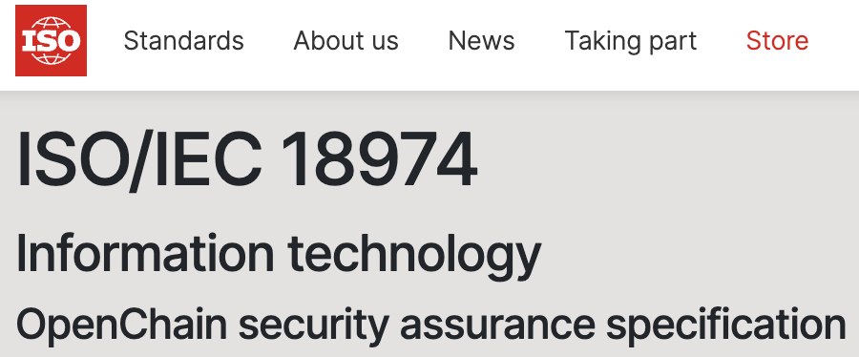
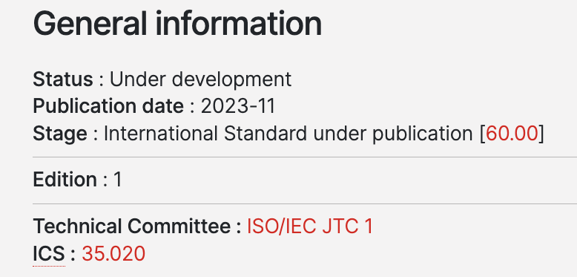
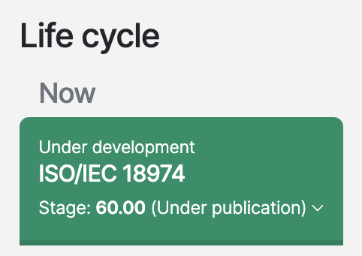
Major Conformance Announcements + ISO
OpenChain ISO/IEC 18974:2023 will be out very, very soon: https://www.iso.org/standard/86450.html
In a few hours we will formally announce that Korea Telecom has adopted ISO/IEC 5230:2020.
Meanwhile, when ISO/IEC 18974 is out, a major Asian bank will announce adoption.

Slide 6
Work on standards and core material

Slide 7
What Happens Next
We are working on the proposals for:
OpenChain License Compliance 3.0 (ISO/IEC 5230:2020 next gen)
OpenChain Security Assurance 2.0 (ISO/IEC 18974:2023 next gen)
OpenChain Contribution Process Management 1.0 (name TBD)
OpenChain SBOM Quality Specification 1.0 (discussion is still underway in Telco about next steps)
At least some of these items will go before the OpenChain Steering Committee in early December for review.
The Steering Committee will provide formal guidance on where to go next.

Slide 8
Current Versions of OpenChain Standards
Licensing Specification (CURRENT VERSION, 2nd Generation):
https://github.com/OpenChain-Project/License-Compliance-Specification/blob/master/2.1/en/openchainspec-2.1.md
Security Specification (CURRENT VERSION, 1st Generation):
https://github.com/OpenChain-Project/Security-Assurance-Specification/blob/main/Security-Assurance-Specification/1.1/en/openchain-security-specification-1.1.md

Slide 9
Draft Future Versions of Licensing / Security
Licensing Specification (3rd Generation Draft):
https://github.com/OpenChain-Project/License-Compliance-Specification/blob/master/Official/en/3.0/openchain-license-compliance-3.0.md
Security Specification (2nd Generation Draft):
https://github.com/OpenChain-Project/Security-Assurance-Specification/blob/main/Security-Assurance-Specification/2.0/en/openchain-security-specification-2.0.md

Slide 10
Proposed OpenChain Contribution Specification
First GitHub Issue: https://github.com/OpenChain-Project/Contribution-Process-Specification/issues/1
Kick-Off Call: https://www.openchainproject.org/news/2023/08/23/contribution-spec-kick-off
Issues to Review: https://github.com/OpenChain-Project/Contribution-Process-Specification/issues

Slide 11
Next Steps: Licensing / Security
Open Issues
Both the next generation License Compliance specification and the next generation Security Assurance specification have pre-existing open issues for review:
Licensing: https://github.com/OpenChain-Project/License-Compliance-Specification/issues/
Security: https://github.com/OpenChain-Project/Security-Assurance-Specification/issues/
We have very little time before the Steering Committee meets (two calls). It is proposed that we (a) assess whether the current drafts are ready to go before the Steering Committee in early December and (b) whether any open issues should be closed before that.

Slide 12
Next Steps: Contribution
Open Issues:
https://github.com/OpenChain-Project/Contribution-Process-Specification/issues
Draft (not ready): https://github.com/OpenChain-Project/Contribution-Process-Specification/blob/main/1.0/en/1.0.md
We have very little time before the Steering Committee meets (two calls). It is proposed that we (a) assess whether the current draft can be brought into a form that is ready to go before the Steering Committee in early December or (b) whether community work should continue here before going before the Steering Committee in Q1 2024 or later.

Slide 13
Next Steps: SBOM Quality
Open Issues:
https://github.com/OpenChain-Project/Telco-WG/issues
Draft: https://github.com/OpenChain-Project/Telco-WG/blob/main/OpenChain%20Telco%20SBOM%20Specification.md
We have very little time before the Steering Committee meets (two calls). The Telco Work Group has moved from a “ready for specification work group to review” back into a discussion cycle about whether the SBOM Quality item may better fit in the SPDX Project. It would appear that – pending their decision – the SBOM Quality proposal is not ready for review by the Steering Committee in December.
Mailing list with Telco discussion: https://lists.openchainproject.org/g/telco/messages

Slide 14
Any other business

Slide 15
Close of meeting

Slide 16
See you next time!

