Slide 1
OpenChain Monthly Meeting
2024-01-09

Slide 2
Anti-Trust Policy Notice
Linux Foundation meetings involve participation by industry competitors, and it is the intention of the Linux Foundation to conduct all of its activities in accordance with applicable antitrust and competition laws. It is therefore extremely important that attendees adhere to meeting agendas, and be aware of, and not participate in, any activities that are prohibited under applicable US state, federal or foreign antitrust and competition laws.
Examples of types of actions that are prohibited at Linux Foundation meetings and in connection with Linux Foundation activities are described in the Linux Foundation Antitrust Policy available at http://www.linuxfoundation.org/antitrust-policy. If you have questions about these matters, please contact your company counsel, or if you are a member of the Linux Foundation, feel free to contact Andrew Updegrove of the firm of Gesmer Updegrove LLP, which provides legal counsel to the Linux Foundation.

Slide 3
Regular Agenda
News
Work on standards and core material
Any other business
Close of meeting

Slide 4
News

Slide 5

ISO/IEC 18974:2023 has been Published
Self—Certification and third-party certification resources: https://www.openchainproject.org/get-started

Slide 6
The 2023 Annual Report and Goals for 2024
The OpenChain Project in 2023 – Annual Report: https://www.openchainproject.org/news/2024/01/03/the-openchain-project-in-2023-annual-report
The OpenChain Project in 2024 – Where We Go Next: https://www.openchainproject.org/featured/2024/01/05/the-openchain-project-in-2024-where-we-go-next

Slide 7
Coming Soon: AI Study Group
Planning call last month: https://www.openchainproject.org/news/2023/12/20/ai-study-group-planning-call-2023-12-13
Kick-off call coming soon – 2023-01-23 @ 16:00 GMT (UK Time): https://www.openchainproject.org/news/2024/01/09/openchain-ai-study-group-kick-off-call
Mailing list: https://lists.openchainproject.org/g/ai

Slide 8
Specification Election – This Month
The OpenChain Specification Work Group Election nomination period will open tomorrow, 10th of January.
- You can nominate yourself by sending an email to the specification@ mailing list.
- You can nominate someone else by sending an email to the specification@ mailing list
(but please make sure they are ok with it first).
Once our nominations are received, we will have a voting period between the 17th and 24th of January 2024.
Learn more about the details of the election:
https://lists.openchainproject.org/g/specification/topic/openchain_specification_work/103615290?p=,,,20,0,0,0::recentpostdate/sticky,,,20,2,0,103615290,previd%3D1704777598034963580,nextid%3D1693908296119927309&previd=1704777598034963580&nextid=1693908296119927309
Everyone needs to nominate to be included in the election, including existing chairs. :)
Please note: for 2023 we had a special situation with two chairs of the OpenChain Specification Work Group due to our new security specification joining the ISO process. In 2024, we will return to the normal project practice of having one chair per work group.

Slide 9
Education Chair Election – This Month
The OpenChain Education Work Group Election nomination period will open tomorrow, 10th of January.
- You can nominate yourself by sending an email to the education@ mailing list.
- You can nominate someone else by sending an email to the education@ mailing list
(but please make sure they are ok with it first).
Once our nominations are received, we will have a voting period between the 17th and 24th of January 2024.
Learn more about the details of the election:
https://lists.openchainproject.org/g/education/topic/openchain_education_work/103615329?p=,,,20,0,0,0::recentpostdate/sticky,,,20,2,0,103615329,previd%3D1704777732893623504,nextid%3D1688460021141254373&previd=1704777732893623504&nextid=1688460021141254373
Everyone needs to nominate to be included in the election, including the existing chair. :)

Slide 10
Work on standards and core material

Slide 11
Our Status
We were working on the proposals for:
OpenChain License Compliance 3.0 (ISO/IEC 5230:2020 next gen)
OpenChain Security Assurance 2.0 (ISO/IEC 18974:2023 next gen)
OpenChain Contribution Process Management 1.0 (name TBD)
OpenChain SBOM Quality Specification 1.0 (discussion is still underway in Telco about next steps)
The propoals for ISO 5230 and ISO 18974 went before the OpenChain Steering Committee in early December for review. The other proposals were not regarded as ready yet.
The Steering Committee provided formal guidance on where to go next.

Slide 12
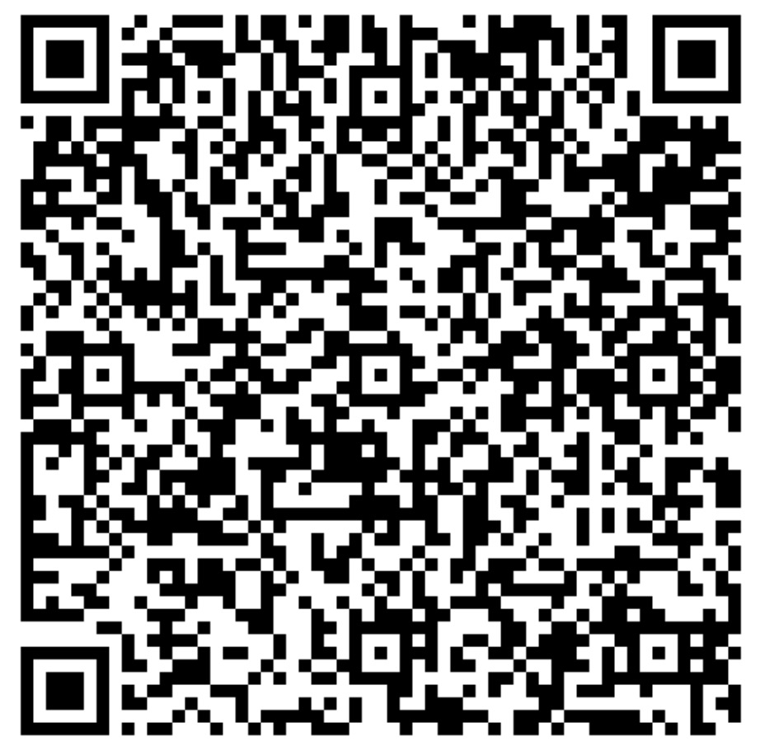
The Current and Draft Versions
Licensing Specification (CURRENT VERSION, 2nd Generation):
https://github.com/OpenChain-Project/License-Compliance-Specification/blob/master/2.1/en/openchainspec-2.1.md
Licensing Specification (3rd Generation Draft):
https://github.com/OpenChain-Project/License-Compliance-Specification/blob/master/Official/en/3.0/openchain-license-compliance-3.0.md
QR code is for the 3rd Generation Draft:

Slide 13
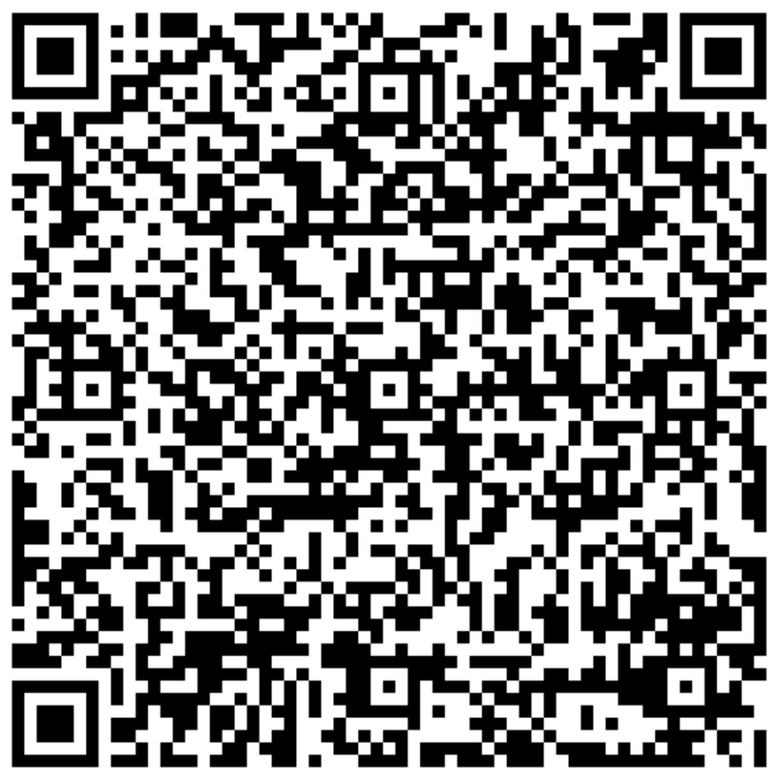
The Current and Draft Versions
Security Specification (CURRENT VERSION, 1st Generation):
https://github.com/OpenChain-Project/Security-Assurance-Specification/blob/main/Security-Assurance-Specification/1.1/en/openchain-security-specification-1.1.md
Security Specification (2nd Generation Draft):
https://github.com/OpenChain-Project/Security-Assurance-Specification/blob/main/Security-Assurance-Specification/2.0/en/openchain-security-specification-2.0.md
QR code is for the 2nd Generation Draft:

Slide 14
Steering Committee Conclusions
In December 2023 the OpenChain Steering Committee reviewed the community work related to proposed updates to ISO/IEC 5230 and ISO/IEC 18974 and provided guidance that: • The community-developed update proposals seem reasonable • We will extend our Public Comment and Freeze Periods significantly to ensure the supply chain has time to consider the proposed changes • The Public Comment period will change from 30 days to 6 months • The Freeze Period will change from 14 days to 3 months • This will be communicated in an update to FAQ and to our Specification Work Team. • In principle, it is suggested that we target updates to our ISO standards once every five years • This would suggest the update for ISO/IEC 5230 is likely to be ready for 2025 • ISO/IEC 18974 may be updated sooner due to a rapidly-moving market, but not at a speed that would hinder adoption of the existing and newly published version

Slide 15
Next Steps
We communicate the new public comment period (Shane as GM task)
We continue reviewing comments and ideas for the specifications during this period
We communicate progress to the Steering Committee in Mid-2024.

Slide 16
Any other business

Slide 17
Close of meeting

Slide 18
See you next time!

