Slide 1
OpenChain Monthly North America / Europe Meeting
2024-03-19

Slide 2
Anti-Trust Policy Notice
Linux Foundation meetings involve participation by industry competitors, and it is the intention of the Linux Foundation to conduct all of its activities in accordance with applicable antitrust and competition laws. It is therefore extremely important that attendees adhere to meeting agendas, and be aware of, and not participate in, any activities that are prohibited under applicable US state, federal or foreign antitrust and competition laws.
Examples of types of actions that are prohibited at Linux Foundation meetings and in connection with Linux Foundation activities are described in the Linux Foundation Antitrust Policy available at http://www.linuxfoundation.org/antitrust-policy. If you have questions about these matters, please contact your company counsel, or if you are a member of the Linux Foundation, feel free to contact Andrew Updegrove of the firm of Gesmer Updegrove LLP, which provides legal counsel to the Linux Foundation.

Slide 3
Regular Agenda
News
Work on standards and core material
Work on reference and supporting material
Any other business
Close of meeting

Slide 4
News

Slide 5
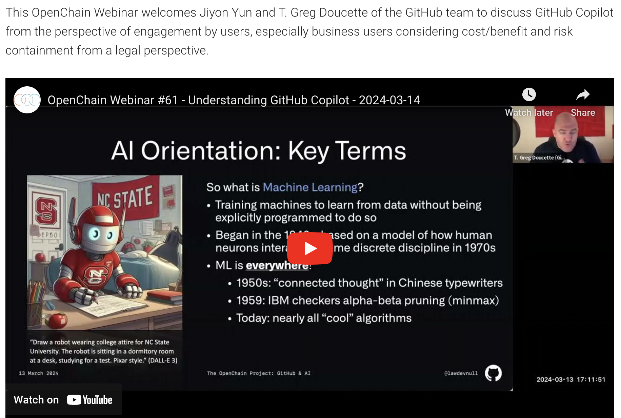
Webinar: Understanding GitHub Copilot
https://www.openchainproject.org/webinar/2024/03/14/webinar-understanding-github-copilot

Slide 6
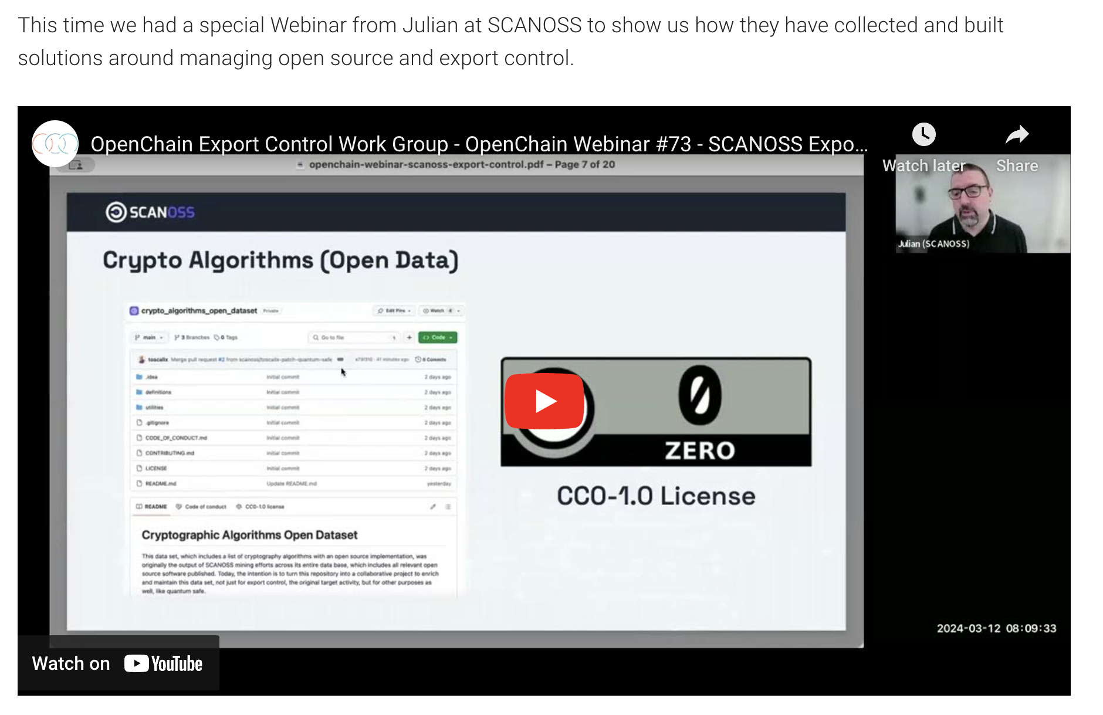
Webinar: SCANOSS Export Control
https://www.openchainproject.org/partner-webinar/2024/03/12/webinar-scanoss-export-control

Slide 7
OpenChain AI Study Group
OpenChain AI Study Group Call (Europe and Asia) – 2024-03-14 – Full Recording
https://www.openchainproject.org/news/2024/03/15/openchain-ai-study-group-call-europe-and-asia-2024-03-14
Outcomes of the Special OpenChain AI Workshop – 2024-03-06
https://www.openchainproject.org/news/2024/03/13/outcomes-ai-workshop-2024-03-06

Slide 8
OpenChain Deep Dive – Supply Chain Best Practices in China using ISO 5230 and ISO 18974
We held a special workshop in Shinagawa on March 18th for Japanese companies using open source. This workshop focused on case studies about open source business process management in China. The starting point was ISO 5230 and ISO 18974 from upstream project to commercial ecosystem.
https://www.openchainproject.org/featured/2024/03/05/openchain-deep-dive-openeuler-ecosystem
Recording coming soon.

Slide 9

First South Korean Certifier
KOSYAS is the first Official Third-Party Certifier in South Korea
https://www.openchainproject.org/news/2024/03/13/kosyas-is-the-first-official-third-party-certifier-in-south-korea

Slide 10
Project Meetings This Week (all times UTC)
Monday 18th March:
– OpenChain Deep Dive – Case Study of Establishing and Maintaining Supply Chain Best Practices Across a Complete Operating System Ecosystem – openEuler @ 00:00 UTC
– OpenChain Webinar: Universal CVSS Calculator @ 09:00 UTC
Tuesday 19th March:
– OpenChain Monthly North America / Asia Call @ 01:00 UTC
Wednesday 20th March:
– OpenChain Automation Work Group Meeting (European Afternoon) @ 16:00 UTC
You can check out all our international meetings and get instructions on adding our calendar to your client here: https://www.openchainproject.org/participate

Slide 11
Work on standards and core material

Slide 12
OpenChain North America / Europe Call
Full Recording:
https://www.openchainproject.org/news/2024/03/08/openchain-monthly-north-america-and-europe-call-2024-03-05-full-recording
Issues:
https://github.com/OpenChain-Project/License-Compliance-Specification/issues/38#issuecomment-1979180160
https://github.com/OpenChain-Project/License-Compliance-Specification/issues/40#issuecomment-1979247325
https://github.com/OpenChain-Project/License-Compliance-Specification/issues/33#issuecomment-1352912391
Commit:
https://github.com/OpenChain-Project/License-Compliance-Specification/commit/a95b510897f4a640e091b354540ec50d08f96e0e#commitcomment-139403069

Slide 13
The ISO Standards – All The Open Issues
See Next Two Slides For Status And Next Steps
Security:
https://github.com/OpenChain-Project/Security-Assurance-Specification/issues
Licensing:
https://github.com/OpenChain-Project/License-Compliance-Specification/issues

Slide 14
Today: We Will Look At These Issues In Security
[Improvement] ZA/NM05 - Proposed rewording for 3.1.5 https://github.com/OpenChain-Project/Security-Assurance-Specification/issues/18
[Improvement] Add triage entry to specific situations where vulnerability not appliable https://github.com/OpenChain-Project/Security-Assurance-Specification/issues/29
[New Material] What is a quality or complete SBOM for licensing or security use cases? https://github.com/OpenChain-Project/Security-Assurance-Specification/issues/32

Slide 15
Work on reference and supporting material

Slide 16
OpenChain Education Study Group
OpenChain Education Work Group Meeting – 2024-03-05 – Full Recording
https://www.openchainproject.org/news/2024/03/07/openchain-education-work-group-meeting-2024-03-05-full-recording

Slide 17
OpenChain Education Work Group - Overview
We have been working on the Supplier Education Leaflet:
https://github.com/OpenChain-Project/Reference-Material/blob/master/Education-For-Suppliers/ISO-5230-2020-Supplier-Education-Leaflet/Official/MarkDown/en/supply-chain-education-leaflet-version-2.md
All topics also discussed on our dedicated education mailing list: https://lists.openchainproject.org/g/education

Slide 18
Any other business

Slide 19
Close of meeting

Slide 20
See you next time!

