Slide 1
OpenChain Monthly North America / Europe Meeting
2024-06-04

Slide 2
Anti-Trust Policy Notice
Linux Foundation meetings involve participation by industry competitors, and it is the intention of the Linux Foundation to conduct all of its activities in accordance with applicable antitrust and competition laws. It is therefore extremely important that attendees adhere to meeting agendas, and be aware of, and not participate in, any activities that are prohibited under applicable US state, federal or foreign antitrust and competition laws.
Examples of types of actions that are prohibited at Linux Foundation meetings and in connection with Linux Foundation activities are described in the Linux Foundation Antitrust Policy available at http://www.linuxfoundation.org/antitrust-policy. If you have questions about these matters, please contact your company counsel, or if you are a member of the Linux Foundation, feel free to contact Andrew Updegrove of the firm of Gesmer Updegrove LLP, which provides legal counsel to the Linux Foundation.

Slide 3
Regular Agenda
News
Work on standards and core material
Work on reference and supporting material
Any other business
Close of meeting

Slide 4
News

Slide 5
Project Meetings This Week (all times UTC)
Tuesday 4th June:
– OpenChain AI Study Group – Monthly Workshop for North America and Europe @ 14:00 UTC
– OpenChain Monthly Call – North America / Europe @ 16:00 UTC
Wednesday 5th June:
– OpenChain Automation Work Group Meeting (European Morning) @ 08:00 UTC
– OpenChain Education Work Group Meeting @ 16:00 UTC
Thursday 6th June:
– OpenChain Telco Work Group Call (European Morning) @ 07:00 UTC
– OpenChain Telco Work Group Call (European Afternoon) @ 14:00 UTC
You can check out all our international meetings and get instructions on adding our calendar to your client here:
https://www.openchainproject.org/participate

Slide 6
OpenChain AI Study Group – Monthly Recap for North America and Asia – 2024-05-09 – Full Recording
This call focused on recapping the main AI Study Group workshop from the 7th of May. It covered a lot of ground, including new contributions from participants like Fujitsu, and an overview of the latest new about the OSI Open Source AI Definition from their Executive Director. https://openchainproject.org/news/2024/05/15/openchain-ai-study-group-call-asia-sync-call-2024-05-09-full-recording

Slide 7
OpenChain Supply Chain Security & Compliance Workshop in Shenzhen – May 31st 2024
On the 31st of May there was a workshop at the Hilton Shenzhen Shekou Nanhai (蛇口希尔顿南海酒店) in Shenzhen by Huawei, SecTrend and OpenChain Project on the topic of supply chain security and compliance. The core of the workshop was discussing these questions in the context of OpenChain ISO/IEC 5230 and OpenChain ISO/IEC 18974. https://openchainproject.org/news/2024/05/22/supply-chain-security-compliance-may-2024

Slide 8
OpenChain @ International Open Source Trends For Industries – Building The OpenSource Ecosystem In Taiwan – 2024-06-04
The OpenChain Project keynoted a special workshop held in collaboration with the Open Culture Foundation (OCF) in Taiwan on the topic of international open source trends for industries. https://openchainproject.org/news/2024/06/04/openchain-international-open-source-trends-for-industries-building-the-opensource-ecosystem-in-taiwan-2024-06-04

Slide 9
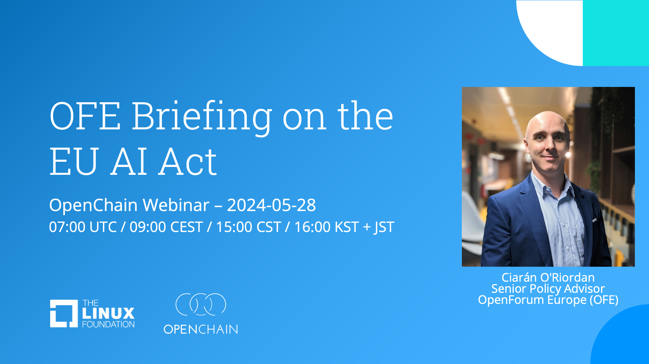
OpenChain Webinars
https://openchainproject.org/featured/2024/05/30/webinar-eu-ai-act

Slide 10
Work on standards and core material

Slide 11
The ISO Standards – All The Open Issues
See Next Slide For Status And Next Steps
Security: https://github.com/OpenChain-Project/Security-Assurance-Specification/issues
Licensing: https://github.com/OpenChain-Project/License-Compliance-Specification/issues

Slide 12
Last OpenChain North America / Asia Call
Full Recording:
https://openchainproject.org/news/2024/05/28/openchain-monthly-north-america-asia-call-2024-05-21-full-recording
Issues Raised and Closed:
License Compliance Review Verification Material For Training – next iteration #38 https://github.com/OpenChain-Project/License-Compliance-Specification/issues/38
Issues Raised and Not Closed:
Security Assurance Review [Improvement] Expand definitions section for (1) Secure Software Development to include Secure Programming Techniques and (2) Security Testing to include Static and Dynamic #36 https://github.com/OpenChain-Project/Security-Assurance-Specification/issues/36

Slide 13
Items Scheduled For This Call
Security Assurance Review
[Improvement] Expand definitions section for (1) Secure Software Development to include Secure Programming Techniques and (2) Security Testing to include Static and Dynamic #36 https://github.com/OpenChain-Project/Security-Assurance-Specification/issues/36
License Compliance Review
[Improvement] Review Cycle Potentially Needs Adjustment #71 https://github.com/OpenChain-Project/License-Compliance-Specification/issues/71

Slide 14
Work on reference and supporting material

Slide 15
OpenChain Education Work Group – Monthly Meeting
On 2024-05-01 we held our regular meeting of the OpenChain Education Work Group. As part of the outreach activities of the OpenChain Project, it focuses on help to make it easier to understand and adopt OpenChain ISO/IEC 5230:2020 for license compliance and OpenChain ISO/IEC 18974:2023 for security assurance. Discussion ranges from handouts to education leaflets to training slides to case studies and guides. Editing is normally done on GitHub. You can review the full recording here: https://openchainproject.org/news/2024/05/07/openchain-education-work-group-monthly-meeting-2024-05-01

Slide 16
Any other business

Slide 17
Close of meeting

Slide 18
See you next time!

