Slide 1
OpenChain Monthly North America / Asia Meeting
2024-06-18

Slide 2
Anti-Trust Policy Notice
Linux Foundation meetings involve participation by industry competitors, and it is the intention of the Linux Foundation to conduct all of its activities in accordance with applicable antitrust and competition laws. It is therefore extremely important that attendees adhere to meeting agendas, and be aware of, and not participate in, any activities that are prohibited under applicable US state, federal or foreign antitrust and competition laws.
Examples of types of actions that are prohibited at Linux Foundation meetings and in connection with Linux Foundation activities are described in the Linux Foundation Antitrust Policy available at http://www.linuxfoundation.org/antitrust-policy. If you have questions about these matters, please contact your company counsel, or if you are a member of the Linux Foundation, feel free to contact Andrew Updegrove of the firm of Gesmer Updegrove LLP, which provides legal counsel to the Linux Foundation.

Slide 3
Regular Agenda
News
Work on standards and core material
Work on reference and supporting material
Any other business
Close of meeting

Slide 4
News

Slide 5
Project Meetings This Week (all times UTC)
Monday 17th June:
–Webinar: Open Source Diligence - From Risk Assessment to Post-Close Integration @ 07:00 UTC
Tuesday 18th June:
– OpenChain OpenChain Monthly North America / Asia Call @ 01:00 UTC
Wednesday 19th June:
– OpenChain Automation Work Group Meeting (European Afternoon) @ 14:00 UTC
You can check out all our international meetings and get instructions on adding our calendar to your client here:
https://www.openchainproject.org/participate

Slide 6
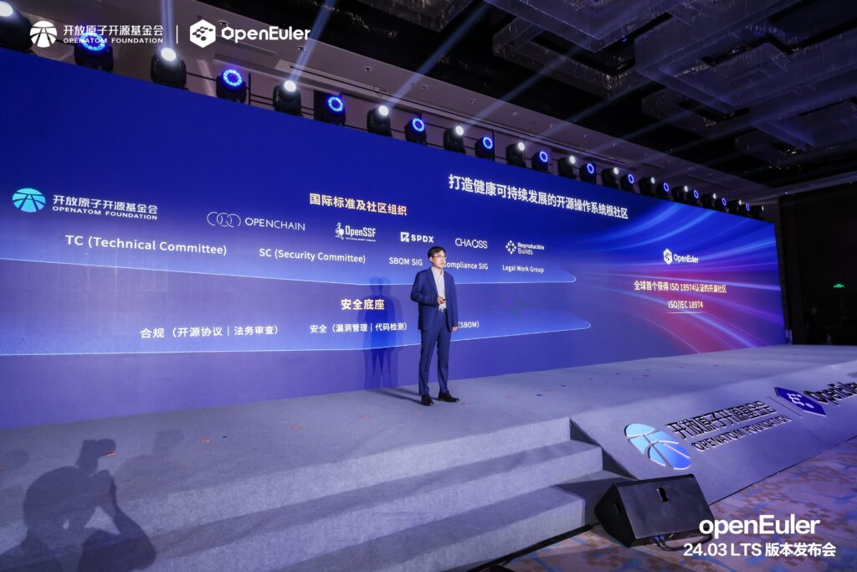
openEuler Adoption of OpenChain ISO/IEC 18974
Adoption:
https://openchainproject.org/news/2024/06/06/openeuler-adoption-iso-18974
Case Study:
https://openchainproject.org/news/2024/06/06/openeuler-iso-18974-case-study

Slide 7

OpenChain @ OSS Europe
Open Source and IP Departments: Risk Containment and Portfolio Management
https://openchainproject.org/news/2024/06/13/openchain-oss-europe-ip
Creating Standards – From Writing a Spec to Obtaining ISO Status
https://openchainproject.org/news/2024/06/13/openchain-oss-europe-standards

Slide 8

https://openchainproject.org/news/2024/06/13/webinar-eu-pld

Slide 9
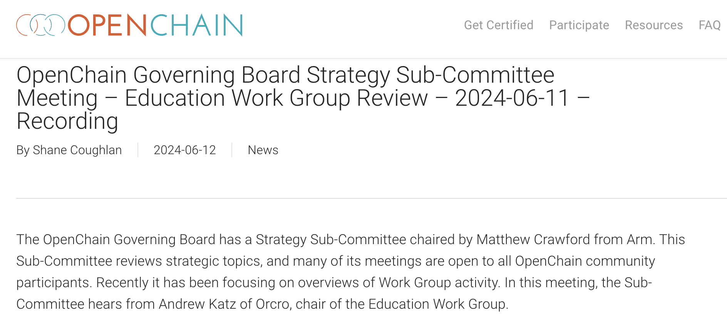
https://openchainproject.org/news/2024/06/12/openchain-governing-board-strategy-sub-committee-meeting-education-work-group-review-2024-06-11-recording

Slide 10
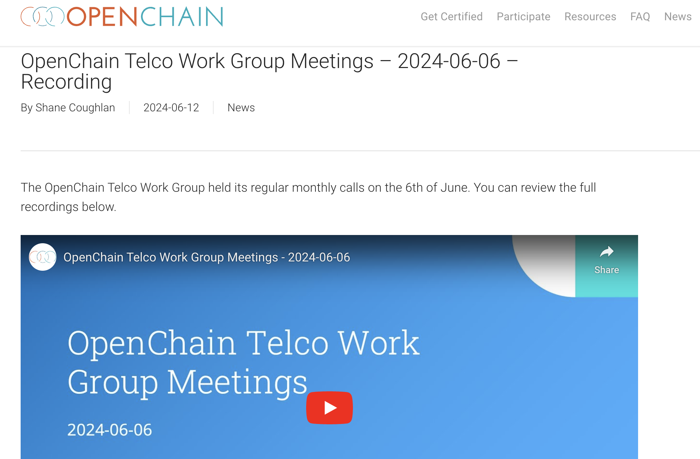
https://openchainproject.org/news/2024/06/12/openchain-telco-work-group-meetings-2024-06-06-recording

Slide 11
Work on standards and core material

Slide 12
The ISO Standards – All The Open Issues
See Next Slide For Status And Next Steps
Security: https://github.com/OpenChain-Project/Security-Assurance-Specification/issues
Licensing: https://github.com/OpenChain-Project/License-Compliance-Specification/issues

Slide 13
Last OpenChain North America / Europe Call
Full Recording:
https://openchainproject.org/news/2024/06/12/openchain-monthly-north-america-and-europe-call-2024-06-05-recording
The following issues were closed during this call:
Security Assurance Review [Improvement] Expand definitions section for (1) Secure Software Development to include Secure Programming Techniques and (2) Security Testing to include Static and Dynamic #36 https://github.com/OpenChain-Project/Security-Assurance-Specification/issues/36
License Compliance Review [Improvement] Review Cycle Potentially Needs Adjustment #71 https://github.com/OpenChain-Project/License-Compliance-Specification/issues/71

Slide 14
Items Scheduled For This Call
Moving to the Public Comment Period for both specification drafts
This is a six month period to solicit and review public comments on the drafts so far. As per our FAQ, this starts “nine months before our target completion date. This runs for 6 months and only accepts minor updates such as typos or grammar corrections that do not change the requirements of the content. We do not accept any material changes during this period. All other feedback and recommendations are queue for consideration during the next version release cycle.” https://openchainproject.org/resources/faq#specification-development-questions
Check open issues for both specs to confirm: (linked on slide 12)

Slide 15
Work on reference and supporting material

Slide 16
OpenChain Education Work Group – Monthly Meeting
On 2024-05-01 we held our regular meeting of the OpenChain Education Work Group. As part of the outreach activities of the OpenChain Project, it focuses on help to make it easier to understand and adopt OpenChain ISO/IEC 5230:2020 for license compliance and OpenChain ISO/IEC 18974:2023 for security assurance. Discussion ranges from handouts to education leaflets to training slides to case studies and guides. Editing is normally done on GitHub. You can review the full recording here: https://openchainproject.org/news/2024/05/07/openchain-education-work-group-monthly-meeting-2024-05-01

Slide 17
Any other business

Slide 18
Close of meeting

Slide 19
See you next time!

