Slide 1
OpenChain Monthly North America / Asia Meeting
2024-07-16

Slide 2
Anti-Trust Policy Notice
Linux Foundation meetings involve participation by industry competitors, and it is the intention of the Linux Foundation to conduct all of its activities in accordance with applicable antitrust and competition laws. It is therefore extremely important that attendees adhere to meeting agendas, and be aware of, and not participate in, any activities that are prohibited under applicable US state, federal or foreign antitrust and competition laws.
Examples of types of actions that are prohibited at Linux Foundation meetings and in connection with Linux Foundation activities are described in the Linux Foundation Antitrust Policy available at http://www.linuxfoundation.org/antitrust-policy. If you have questions about these matters, please contact your company counsel, or if you are a member of the Linux Foundation, feel free to contact Andrew Updegrove of the firm of Gesmer Updegrove LLP, which provides legal counsel to the Linux Foundation.

Slide 3
Regular Agenda
News
Work on standards and core material
Work on reference and supporting material
Any other business
Close of meeting

Slide 4
News

Slide 5
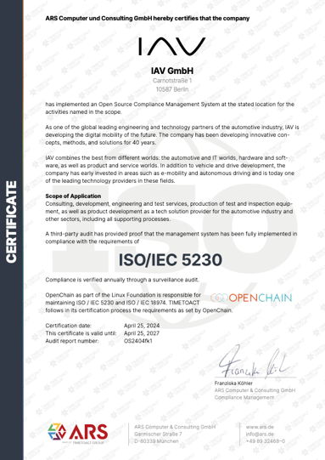

IAV ISO/IEC 5230 Conformance
https://openchainproject.org/featured/2024/07/09/iav-iso-iec-52302020

Slide 6

AI Study Group
https://openchainproject.org/news/2024/07/03/openchain-ai-study-group-monthly-workshop-for-north-america-and-europe-2024-07-02-recording

Slide 7

https://zoom-lfx.platform.linuxfoundation.org/meeting/98327905457?password=a5544a1a-f24a-41fc-83eb-b1cb4ac9820c

Slide 8
Work on standards and core material

Slide 9
The ISO Standards – All The Open Issues
See Next Slide For Status And Next Steps
Security: https://github.com/OpenChain-Project/Security-Assurance-Specification/issues
Licensing: https://github.com/OpenChain-Project/License-Compliance-Specification/issues

Slide 10
Last OpenChain North America / Europe Call
Full Recording:
https://openchainproject.org/news/2024/07/03/openchain-project-monthly-north-america-and-europe-call-july-full-recording
Discussed the details of the public comment period. This was a chance for everyone to ask questions.

Slide 11
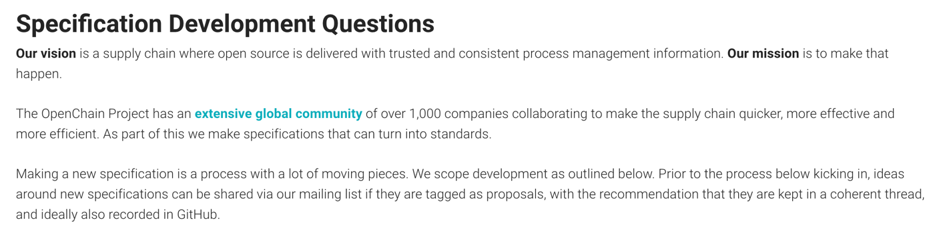
Specification Development Process #1
As per our FAQ: https://openchainproject.org/resources/faq#specification-development-questions

Slide 12
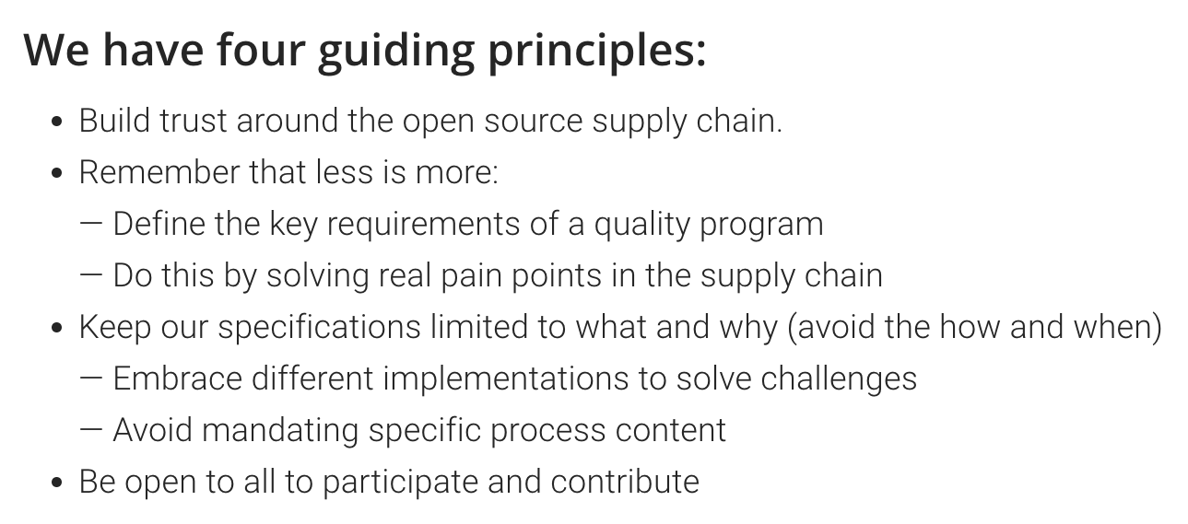
Specification Development Process #2

Slide 13
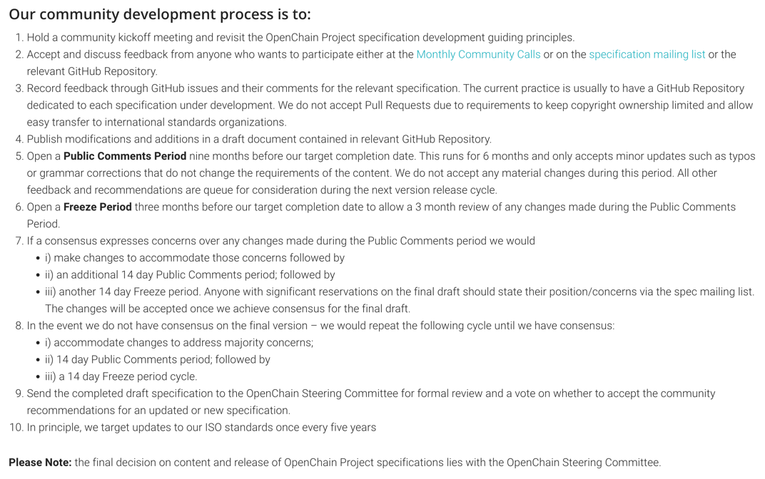
Specification Development Process #3

Slide 14

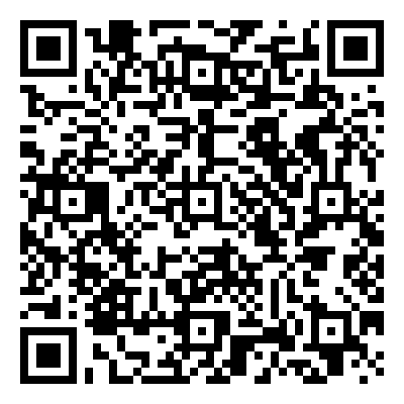
Starting 2024-06-19 ~ Ending 2024-12-19
The OpenChain Project has announced the beginning of its six month Public Comment Period for proposed draft updates to the open source license compliance (ISO/IEC 5230:2020) and open source security assurance (ISO/IEC 18974:2023) specifications.
As per our specification development process outlined in the project FAQ, this Public Comment Period will run for six months, and it will be followed by a three month Freeze Period.

Slide 15
Review of suggested changes to ISO/IEC 5230:2020
Current ISO standard:
https://github.com/OpenChain-Project/License-Compliance-Specification/blob/master/ISO-5230-2020/en/ISO-5230-2020.md
Current Next Generation Draft (pre-public comments period):
https://github.com/OpenChain-Project/License-Compliance-Specification/blob/master/3.0/en/openchain-license-compliance-3.0.md
All open issues have been closed by the Specification Work Group
https://github.com/OpenChain-Project/License-Compliance-Specification/issues?q=is%3Aissue+is%3Aclosed
Next:
Six month public comment period launched 19th June 2024 as per our specification development process:
https://openchainproject.org/resources/faq#specification-development-questions
This will be followed by a Three Month freeze period

Slide 16
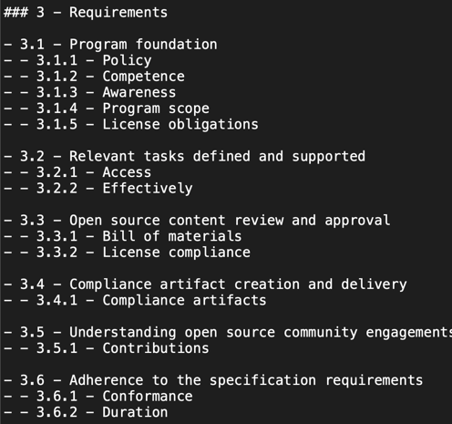
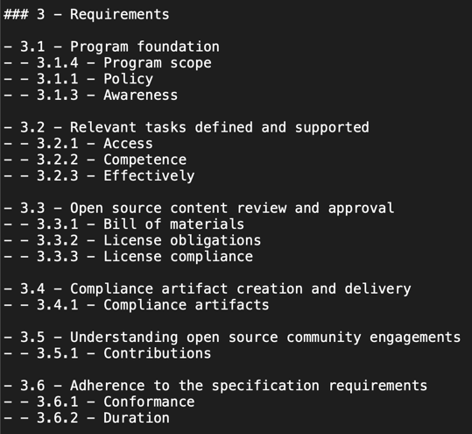
Example Suggestion for ISO/IEC 5230:2020

Slide 17
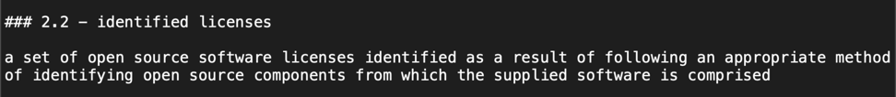
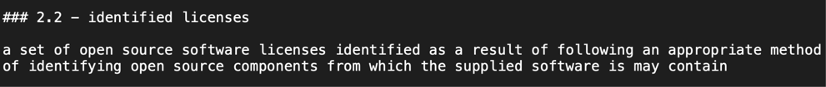
Example Suggestion for ISO/IEC 5230:2020
Example of the type of error the public comment period is for

Slide 18
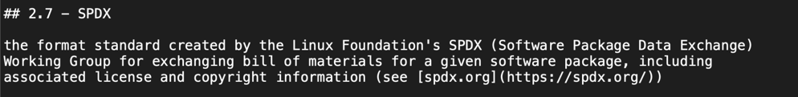
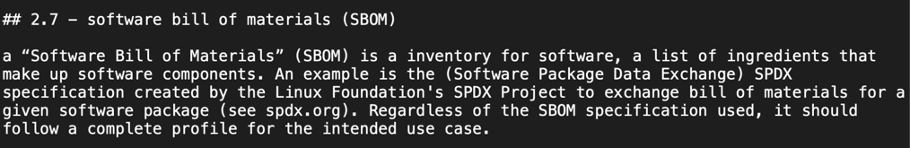
Example Suggestion for ISO/IEC 5230:2020

Slide 19
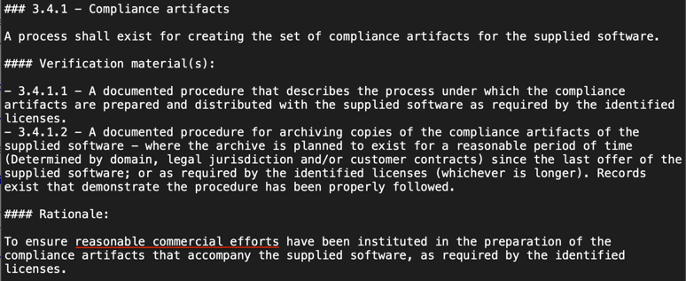
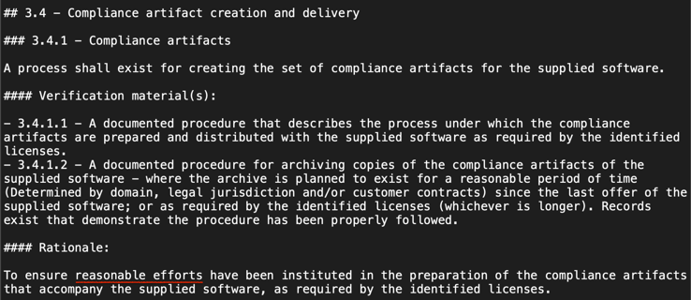
Example Suggestion for ISO/IEC 5230:2020

Slide 20
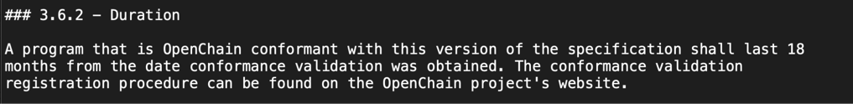
Example Suggestion for ISO/IEC 5230:2020

Slide 21
Review of suggested changes to ISO/IEC 18974:2023
Current ISO standard:
https://github.com/OpenChain-Project/Security-Assurance-Specification/blob/main/Security-Assurance-Specification/ISO-18974/en/ISO-18974.md
Current Next Generation Draft (pre-public comments period):
https://github.com/OpenChain-Project/Security-Assurance-Specification/blob/main/Security-Assurance-Specification/2.0/en/openchain-security-specification-2.0.md
All open issues have been closed by the Specification Work Group
https://github.com/OpenChain-Project/Security-Assurance-Specification/issues?q=is%3Aissue+is%3Aclosed
Next:
Six month public comment period launched 19th June 2024 as per our specification development process:
https://openchainproject.org/resources/faq#specification-development-questions
This will be followed by a Three Month freeze period

Slide 22
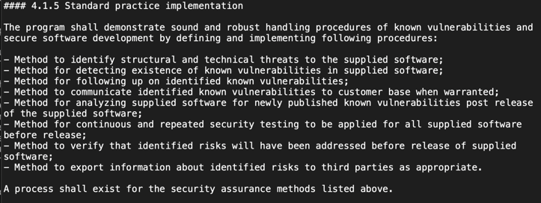
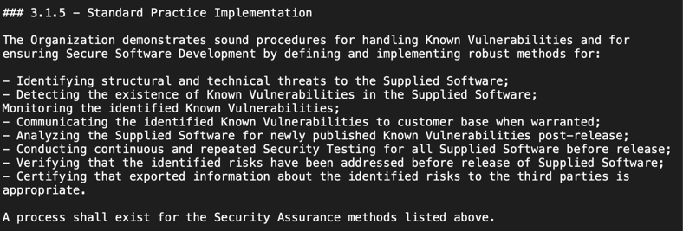
Example Suggestion for ISO/IEC 18974:2023

Slide 23
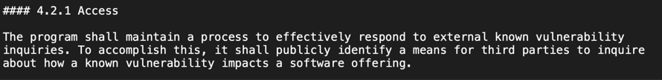
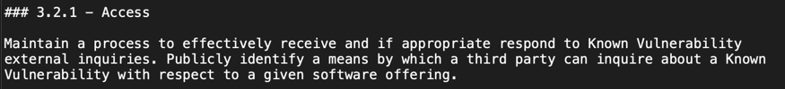
Example Suggestion for ISO/IEC 18974:2023

Slide 24
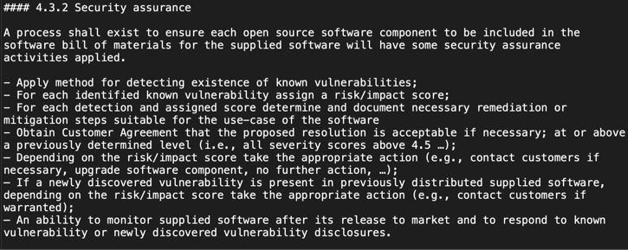
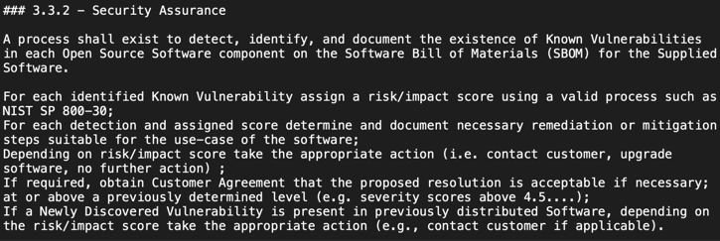
Example Suggestion for ISO/IEC 18974:2023

Slide 25
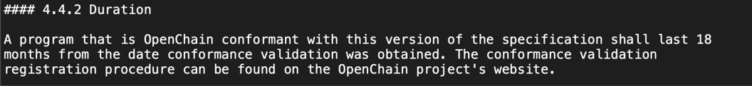
Example Suggestion for ISO/IEC 18974:2023

Slide 26
Questions?

Slide 27
Work on reference and supporting material

Slide 28
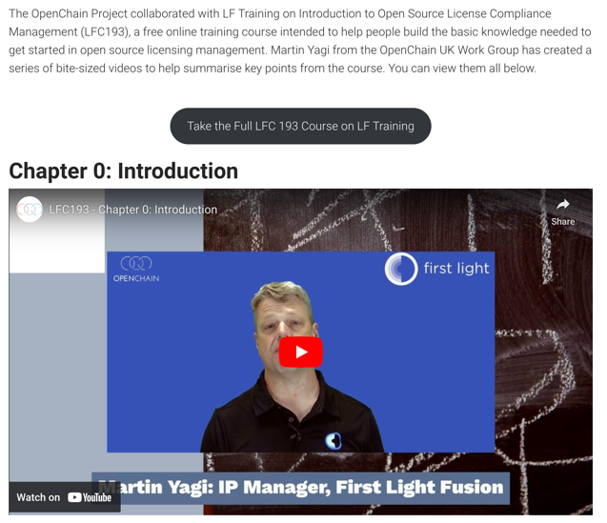
Introduction to Open Source License Compliance Management (LFC193) – The Bite-Sized Videos
https://openchainproject.org/news/2024/07/07/lfc193-bite-sized-videos

Slide 29
Any other business

Slide 30
Close of meeting

Slide 31
See you next time!

