Slide 1
OpenChain Monthly North America / Europe Meeting
2024-09-03

Slide 2
Anti-Trust Policy Notice
Linux Foundation meetings involve participation by industry competitors, and it is the intention of the Linux Foundation to conduct all of its activities in accordance with applicable antitrust and competition laws. It is therefore extremely important that attendees adhere to meeting agendas, and be aware of, and not participate in, any activities that are prohibited under applicable US state, federal or foreign antitrust and competition laws.
Examples of types of actions that are prohibited at Linux Foundation meetings and in connection with Linux Foundation activities are described in the Linux Foundation Antitrust Policy available at http://www.linuxfoundation.org/antitrust-policy. If you have questions about these matters, please contact your company counsel, or if you are a member of the Linux Foundation, feel free to contact Andrew Updegrove of the firm of Gesmer Updegrove LLP, which provides legal counsel to the Linux Foundation.

Slide 3
Recent News Highlights

Slide 4

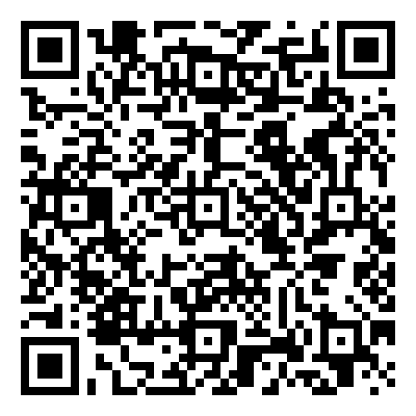
Starting 2024-06-19 ~ Ending 2024-012-19
The OpenChain Project has announced the beginning of its six month Public Comment Period for proposed draft updates to the open source license compliance (ISO/IEC 5230:2020) and open source security assurance (ISO/IEC 18974:2023) specifications.
As per our specification development process outlined in the project FAQ, this Public Comment Period will run for six months, and it will be followed by a three month Freeze Period.

Slide 5

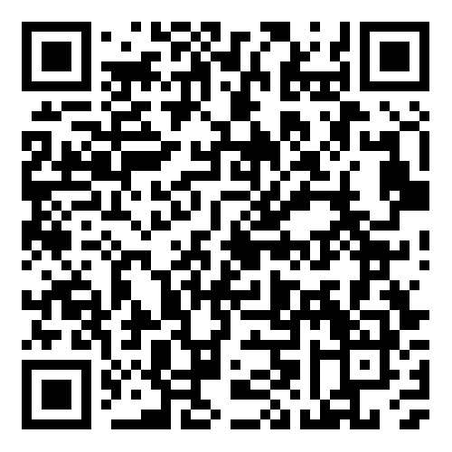
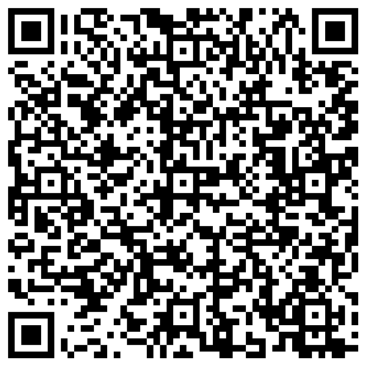
IAV Adopts ISO/IEC 5230 + Case Study Released
News
Case Study

Slide 6

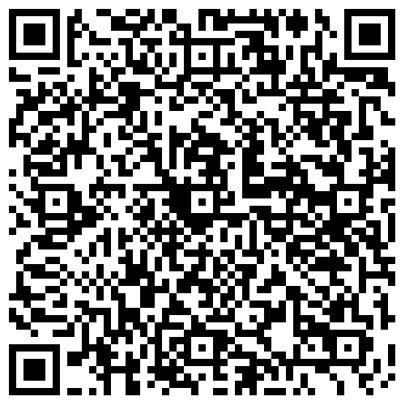
dSpace Announces Adoption of ISO/IEC 5230

Slide 7

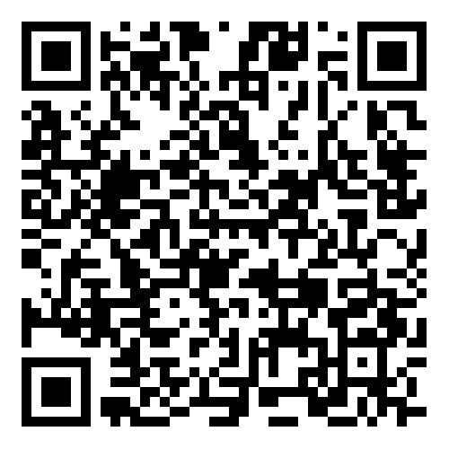
Samsung SDS Adoption of ISO/IEC 18974

Slide 8
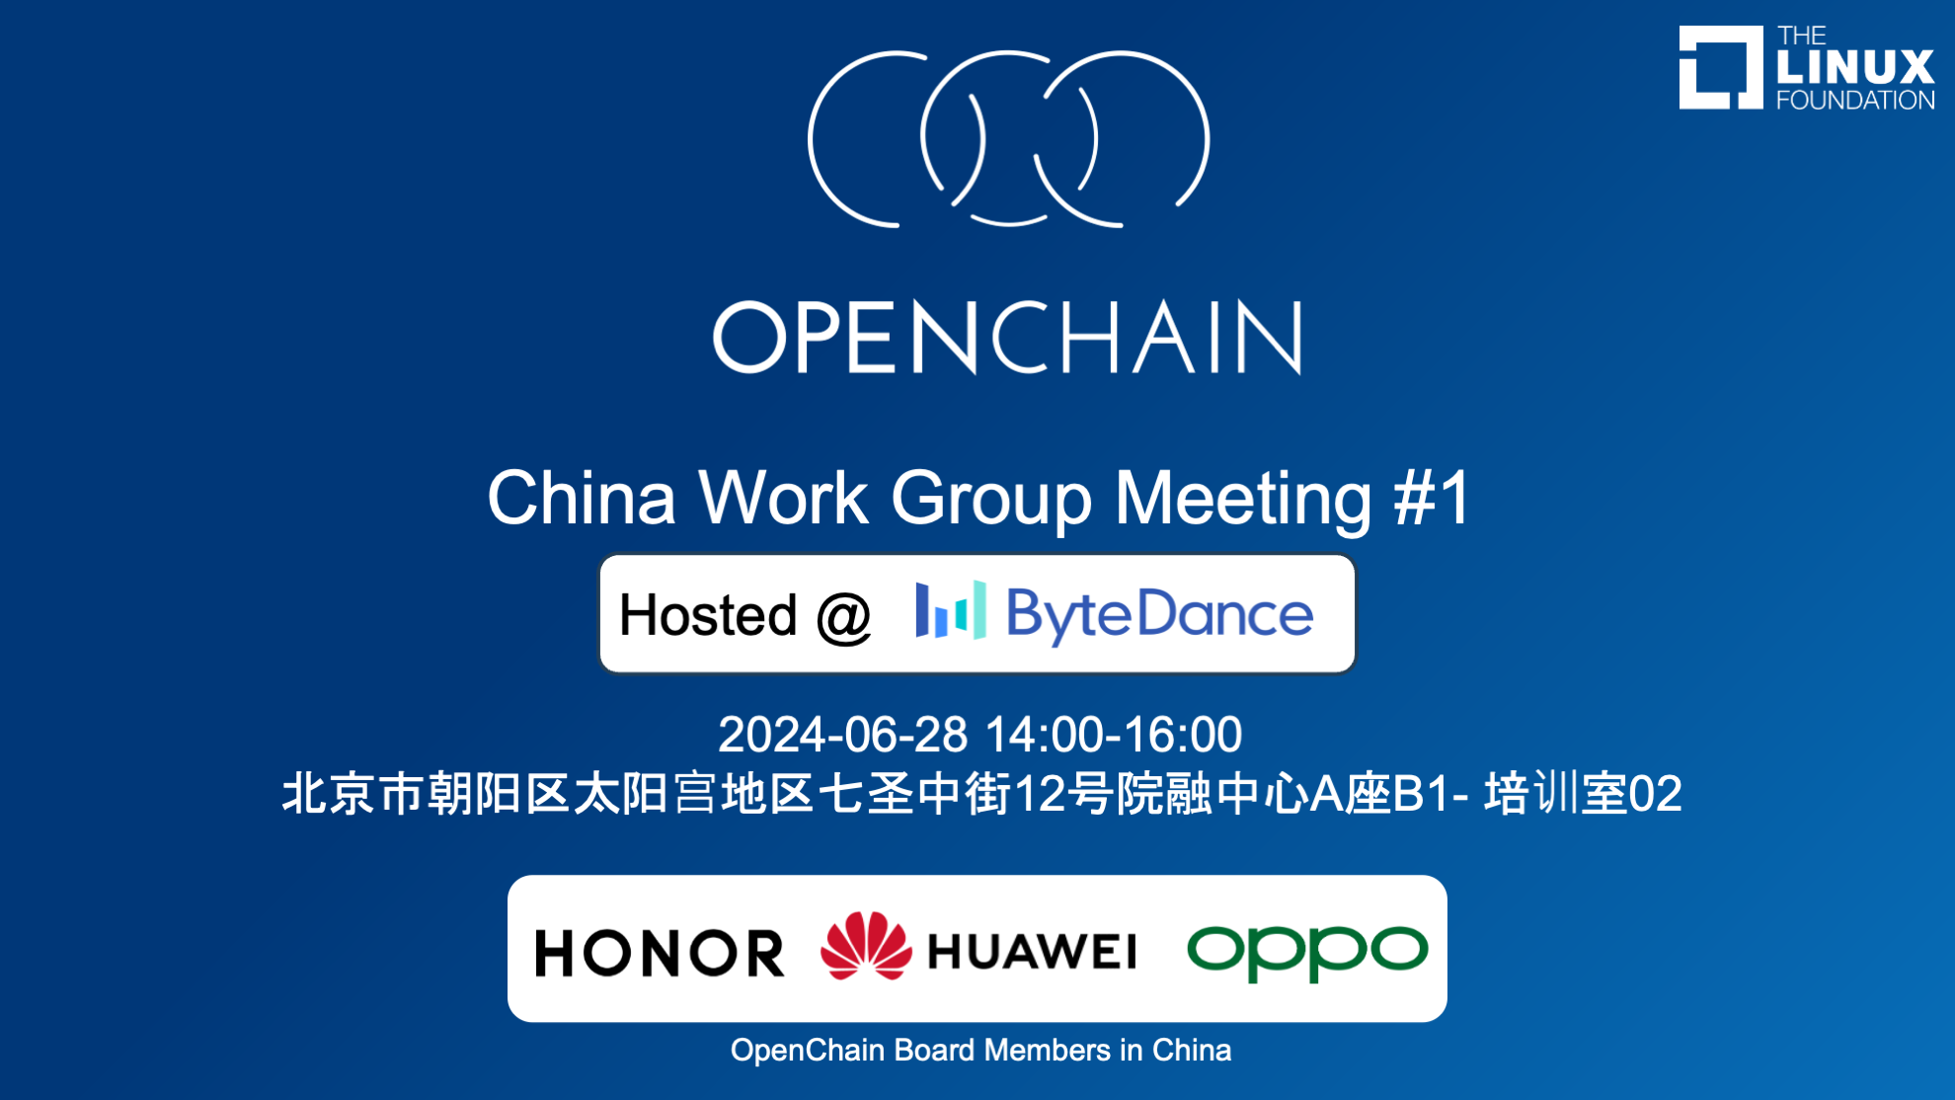
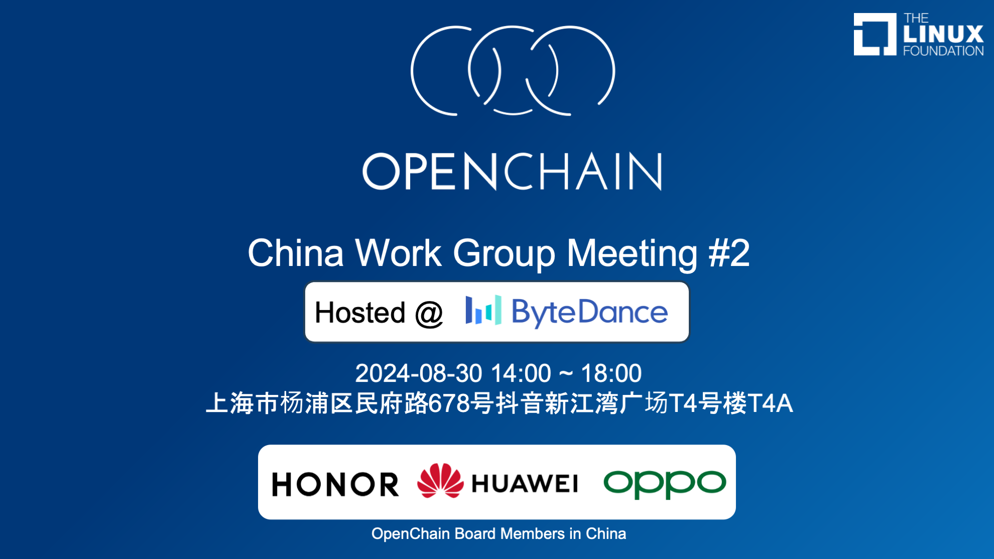
Switched to Regular Meetings in China

Slide 9


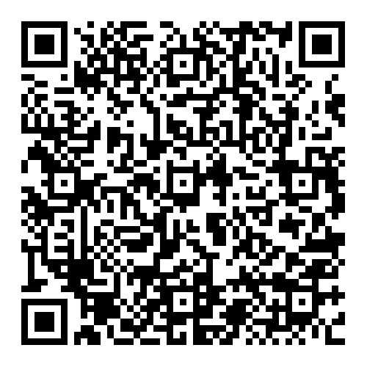
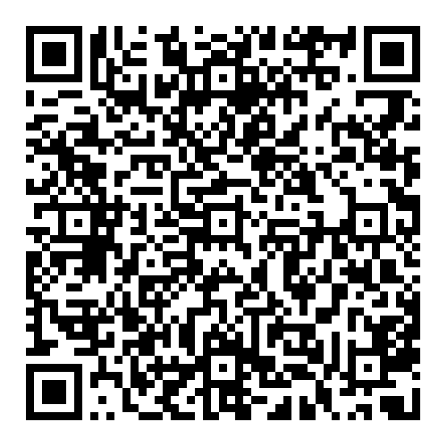
New in July

Slide 10

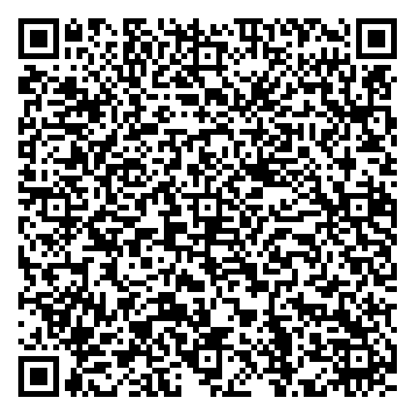
Webinar + Case Study
OpenChain ISO/IEC 5230 at endjin + Further Research on OpenChain ISO/IEC 18974

Slide 11

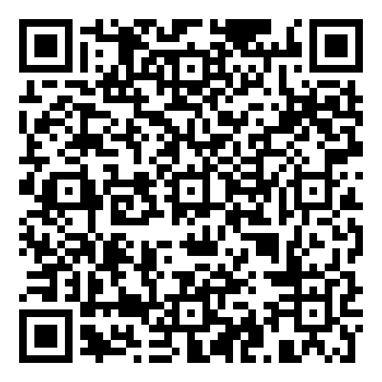
Coming in September: Automotive Workshop

Slide 12

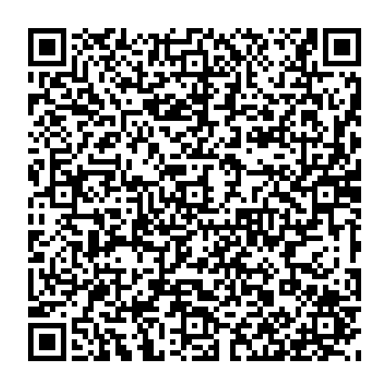
Coming in October: Open Compliance Summit
Call for Papers ends on August 7th

Slide 13

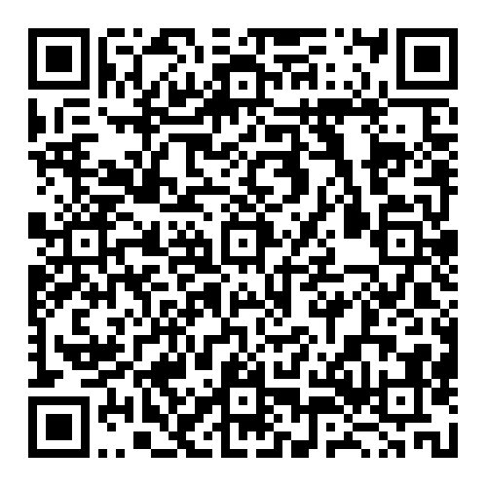
Coming in October: CC-0 Maturity Model

Slide 14
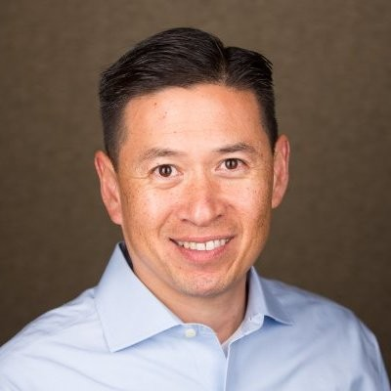

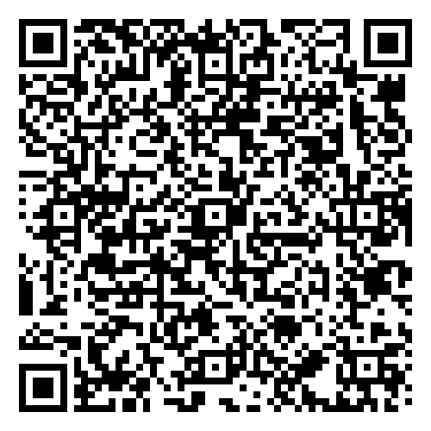
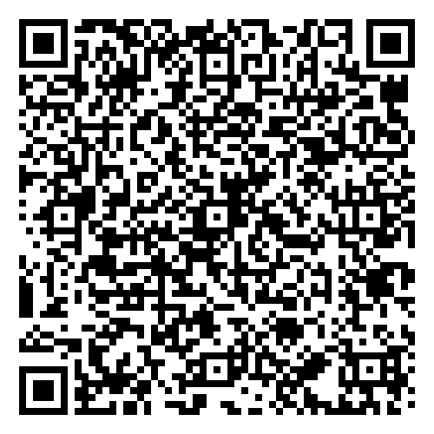
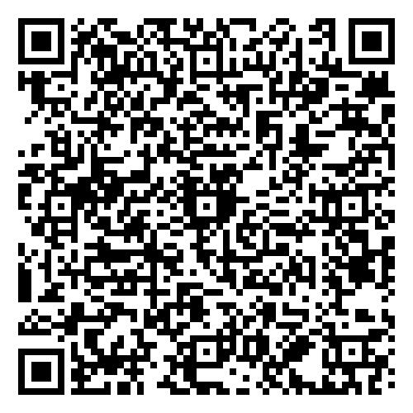
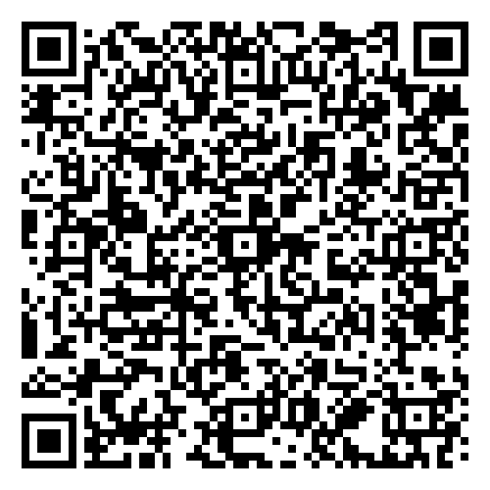
AI Study Group
Workshops are held once a month discussing AI Compliance in the supply chain co-chaired by Matthew Crawford from Arm and David Marr from Qualcomm. They focus on identifying shared concerns across industries. We are considering a guide about using AI BOM in the trusted supply chain.
April
May
June
July

Slide 15
Work on standards and core material

Slide 16
The ISO Standards – All The Open Issues
See Next Slide For Status And Next Steps
The public comment for proposed updates to ISO 5230 and ISO 18974 continues. On this call, we will check out some of the comments about typos, language clarity and so on. There are various pull requests (submissions) on GitHub.
ISO 5230: https://github.com/OpenChain-Project/License-Compliance-Specification/pulls
ISO 18974: https://github.com/OpenChain-Project/Security-Assurance-Specification/pulls
We aim close and merge or reject all open pull requests on this call.

Slide 17
Work on reference and supporting material

Slide 18
Education Work Group Meeting Tomorrow
From Andrew: “In preparation for tomorrow’s meeting, here’s the link to the current version of the Capability Maturity Model overview:
https://docs.google.com/spreadsheets/d/1CAOD7PjNXXlnW-dkmfC9Bsb94mVyt0AdoRIqV-H3HE4/edit?usp=sharing
I’d also like to thank Martin Yagi for his excellent work on creating MarkDown versions of the explainers. You can see them here:
https://github.com/OpenChain-Project/Reference-Material/pull/86/commits/2688b23c609d0360ff60d89edb6f335e6b9b2965
Click on “load diff” to see his versions. It would be great to go through a few of these, and approve them for publication where possible.
Looking forward to seeing you tomorrow!”
Dial-in details are on the OpenChain project calendar: https://openchainproject.org/participate

Slide 19
Any other business

Slide 20
Close of meeting

Slide 21
See you next time!

