Slide 1
OpenChain Monthly North America / Europe Meeting
2024-10-01

Slide 2
Anti-Trust Policy Notice
Linux Foundation meetings involve participation by industry competitors, and it is the intention of the Linux Foundation to conduct all of its activities in accordance with applicable antitrust and competition laws. It is therefore extremely important that attendees adhere to meeting agendas, and be aware of, and not participate in, any activities that are prohibited under applicable US state, federal or foreign antitrust and competition laws.
Examples of types of actions that are prohibited at Linux Foundation meetings and in connection with Linux Foundation activities are described in the Linux Foundation Antitrust Policy available at http://www.linuxfoundation.org/antitrust-policy. If you have questions about these matters, please contact your company counsel, or if you are a member of the Linux Foundation, feel free to contact Andrew Updegrove of the firm of Gesmer Updegrove LLP, which provides legal counsel to the Linux Foundation.

Slide 3
Recent News Highlights

Slide 4

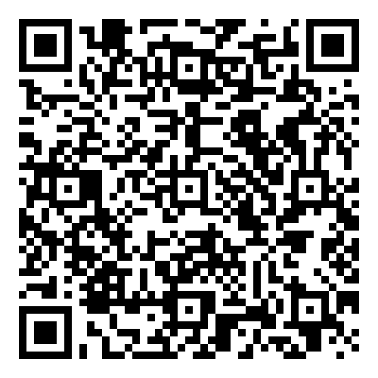
Starting 2024-06-19 ~ Ending 2024-012-19
The OpenChain Project has announced the beginning of its six month Public Comment Period for proposed draft updates to the open source license compliance (ISO/IEC 5230:2020) and open source security assurance (ISO/IEC 18974:2023) specifications.
As per our specification development process outlined in the project FAQ, this Public Comment Period will run for six months, and it will be followed by a three month Freeze Period.

Slide 5

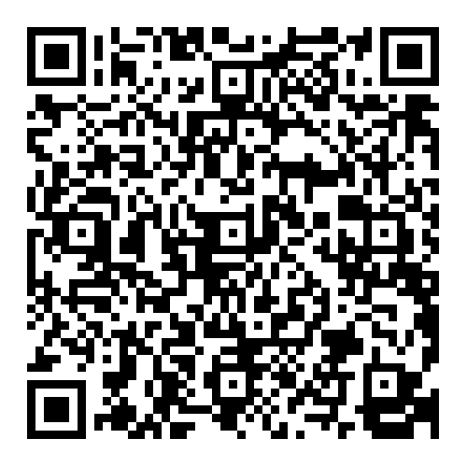
Nokia Announces ISO/IEC 5230 Adoption

Slide 6

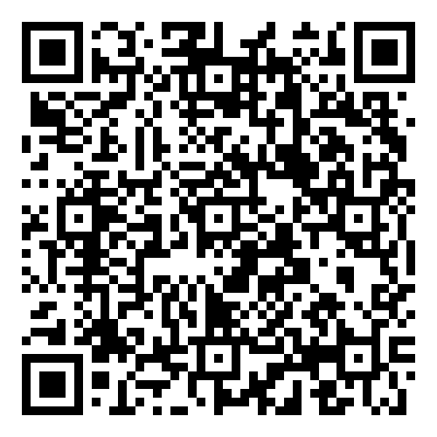
OpenHarmony Announces ISO/IEC 5230 Adoption

Slide 7

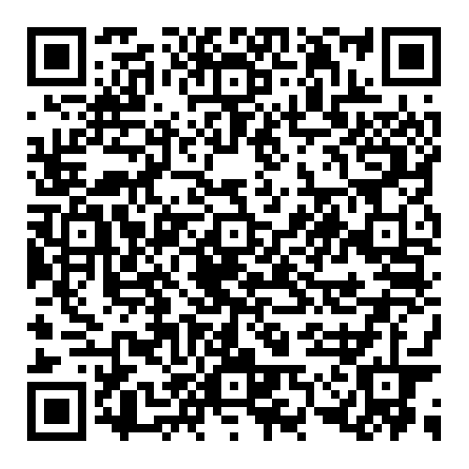
SBOM Study Group Recording

Slide 8
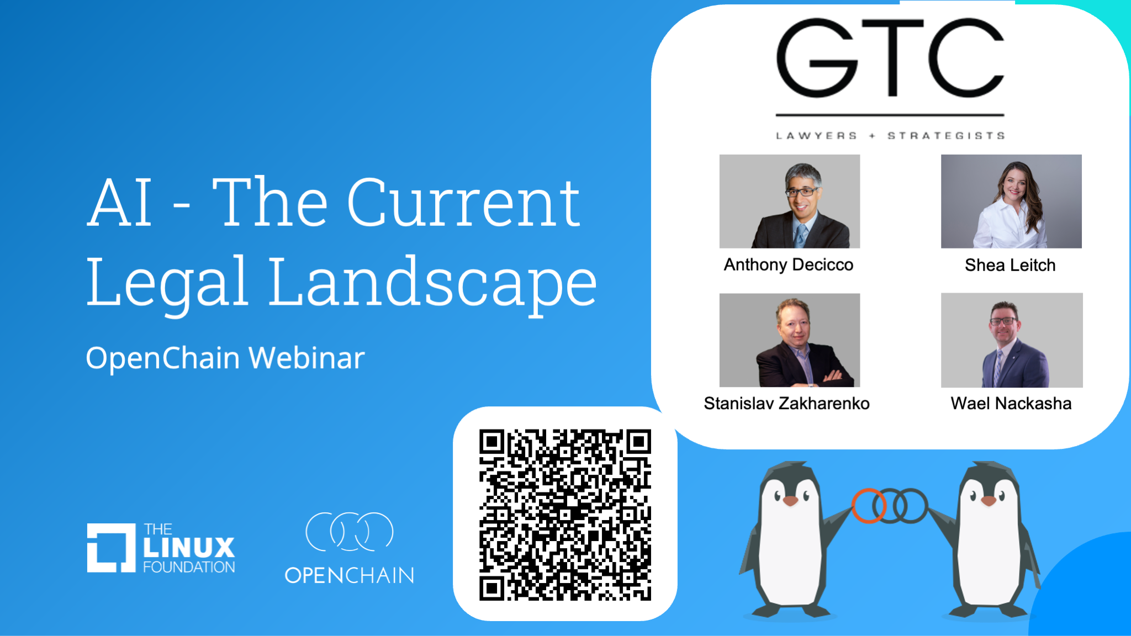
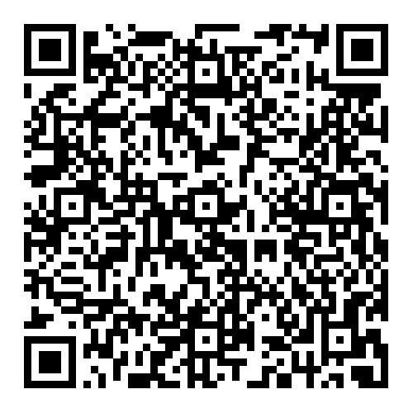
AI Legal Landscape Webinar Recording

Slide 9

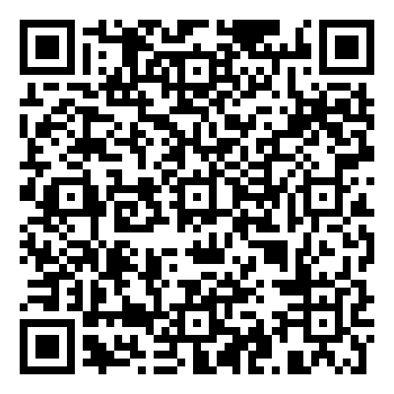
Automotive Work Group – Stuttgart – Outcomes

Slide 10
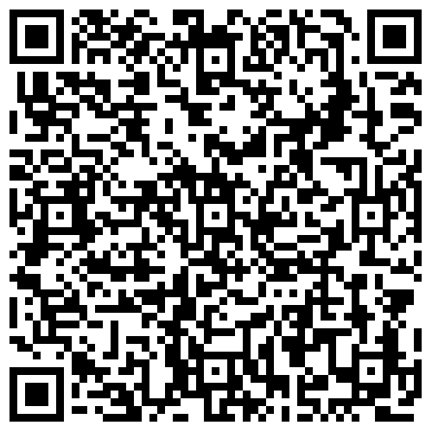
Nokia Contributes Validator for Telco SBOM Guide

Slide 11

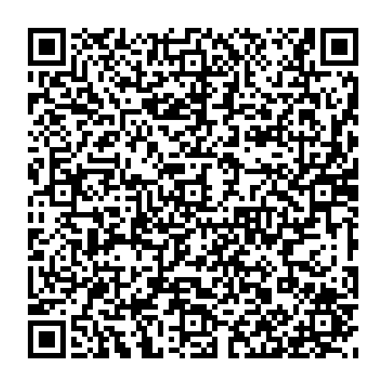
Coming in October: Open Compliance Summit
Call for Papers ends on August 7th

Slide 12
Work on standards and core material

Slide 13
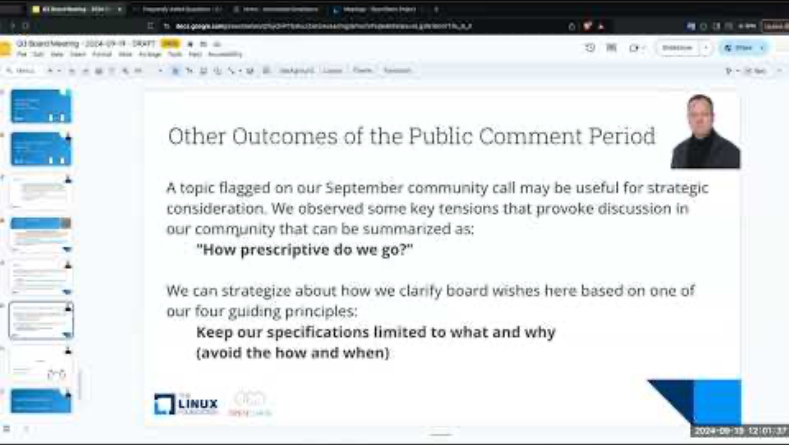
Steering Committee Meeting – 2024-09-19

Slide 14
The ISO Standards – All The Open Issues
Note: as of today, 2024-10-01, there are no open issues. More may come.
The public comment for proposed updates to ISO 5230 and ISO 18974 continues. Our job is to check out some of the comments about typos, language clarity and so on. We collect feedback into pull requests (submissions) on GitHub.
ISO 5230: https://github.com/OpenChain-Project/License-Compliance-Specification/pulls
ISO 18974: https://github.com/OpenChain-Project/Security-Assurance-Specification/pulls
We aim close and merge or reject all open pull requests before the end of the public comment period.

Slide 15
ISO/IEC 5230 Open Items for Review - NONE
From the last meeting:
Update openchain-license-compliance-3.0.md #76 opened 28 days ago
Improved 2.7 #75 opened 28 days
Update openchain-license-compliance-3.0.md #74 opened 28 days ago
Terms and definitions sub-headings to same level openchain-license-co…#66 opened on May 15, 2023
Check out the details of the last meeting: https://openchainproject.org/news/2024/09/12/openchain-monthly-north-america-europe-meeting-2024-09-03-full-recording
1

Slide 16
ISO/IEC 18974 Open Items for Review - NONE
From the last meeting:
Update openchain-security-specification-2.0.md #37 opened 28 days ago
Check out the details of the last meeting: https://openchainproject.org/news/2024/09/12/openchain-monthly-north-america-europe-meeting-2024-09-03-full-recording

Slide 17
Work on reference and supporting material

Slide 18
Education Work Group Meeting on 2024-10-02
From Andrew: “The wording for the explainers is close to being finalized…Hopefully we can approve these in the meeting [this] week.
We’re also close to a release candidate on the Capability Model. Thanks to fantastic work and feedback from people like Sascha and David from Deloitte, Martin and Jari, and Stephen and Alex here at Orcro, the matrix is now populated, and we’re confident it will be ready to launch in October as well.”
Dial-in details are on the OpenChain project calendar: https://openchainproject.org/participate

Slide 19
Any other business

Slide 20
Close of meeting

Slide 21
See you next time!

