Slide 1
OpenChain Monthly North America / Europe Meeting
2024-11-05

Slide 2
Anti-Trust Policy Notice
Linux Foundation meetings involve participation by industry competitors, and it is the intention of the Linux Foundation to conduct all of its activities in accordance with applicable antitrust and competition laws. It is therefore extremely important that attendees adhere to meeting agendas, and be aware of, and not participate in, any activities that are prohibited under applicable US state, federal or foreign antitrust and competition laws.
Examples of types of actions that are prohibited at Linux Foundation meetings and in connection with Linux Foundation activities are described in the Linux Foundation Antitrust Policy available at http://www.linuxfoundation.org/antitrust-policy. If you have questions about these matters, please contact your company counsel, or if you are a member of the Linux Foundation, feel free to contact Andrew Updegrove of the firm of Gesmer Updegrove LLP, which provides legal counsel to the Linux Foundation.

Slide 3
Recent News Highlights

Slide 4

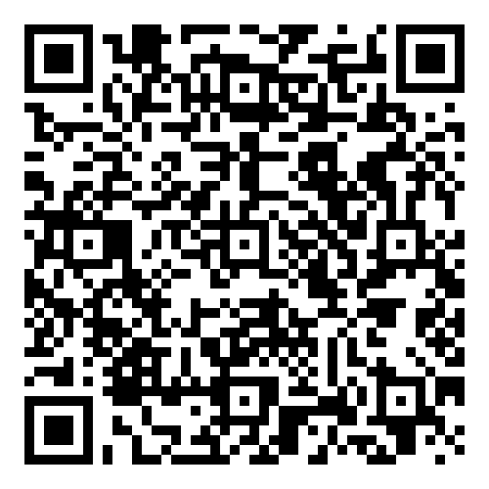
Starting 2024-06-19 ~ Ending 2024-012-19
The OpenChain Project has announced the beginning of its six month Public Comment Period for proposed draft updates to the open source license compliance (ISO/IEC 5230:2020) and open source security assurance (ISO/IEC 18974:2023) specifications.
As per our specification development process outlined in the project FAQ, this Public Comment Period will run for six months, and it will be followed by a three month Freeze Period.

Slide 5

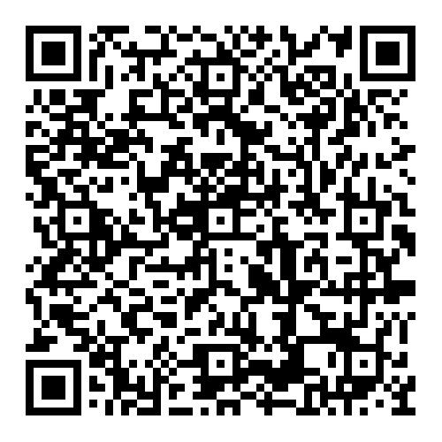
Osaka NDS Adoption of ISO/IEC 5230

Slide 6

Public ISO/IEC 5230 Progress To Date

Slide 7
Data Point:
31% of large German companies use or plan to adopt OpenChain ISO/IEC 5230
Source PwC: https://tinyurl.com/openchain-germany-31

Slide 8

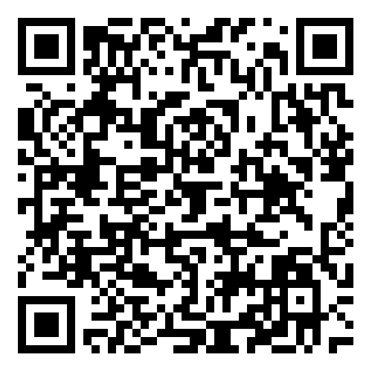
Korea Telecom Adoption of ISO/IEC 18974

Slide 9

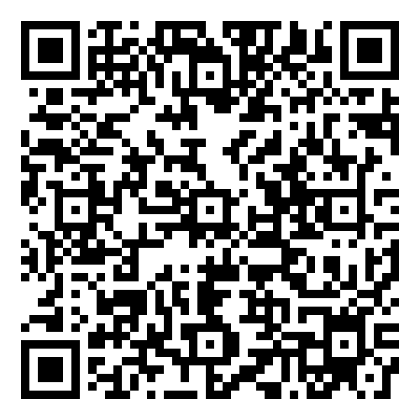
Honda Adoption of ISO/IEC 18974

Slide 10

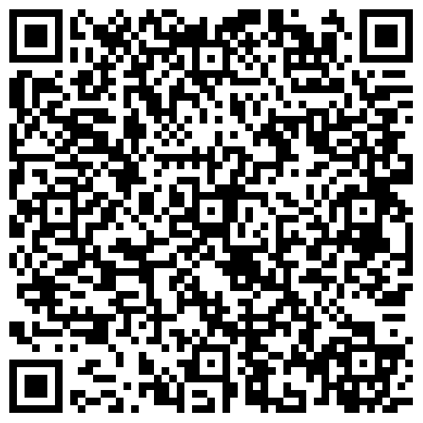
Fujitsu Adoption of ISO/IEC 18974

Slide 11
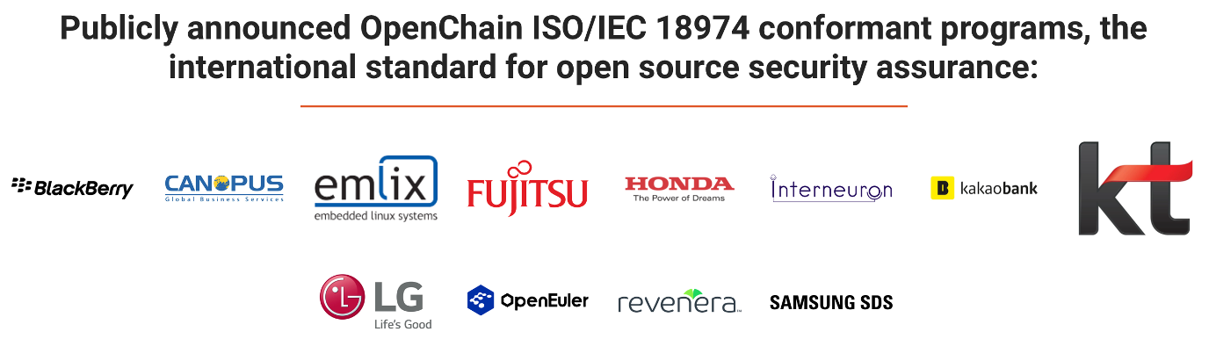
Public ISO/IEC 18974 Progress To Date

Slide 12

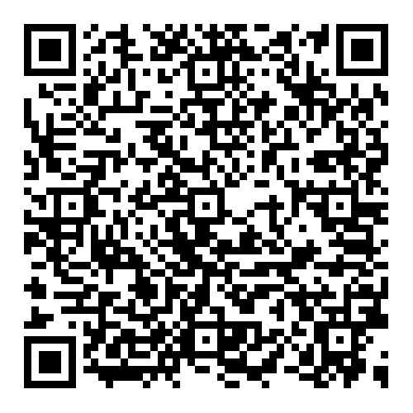
SBOM Study Group Recording

Slide 13

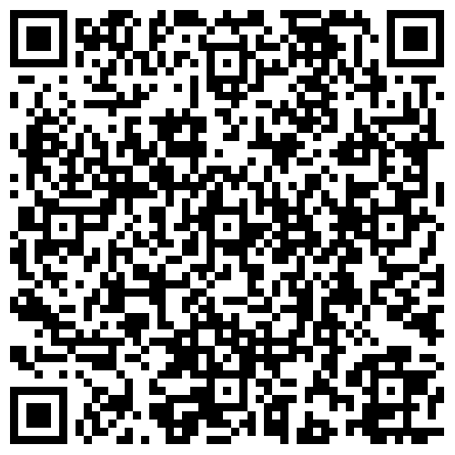
AI Study Group Recording

Slide 14
Work on standards and core material

Slide 15
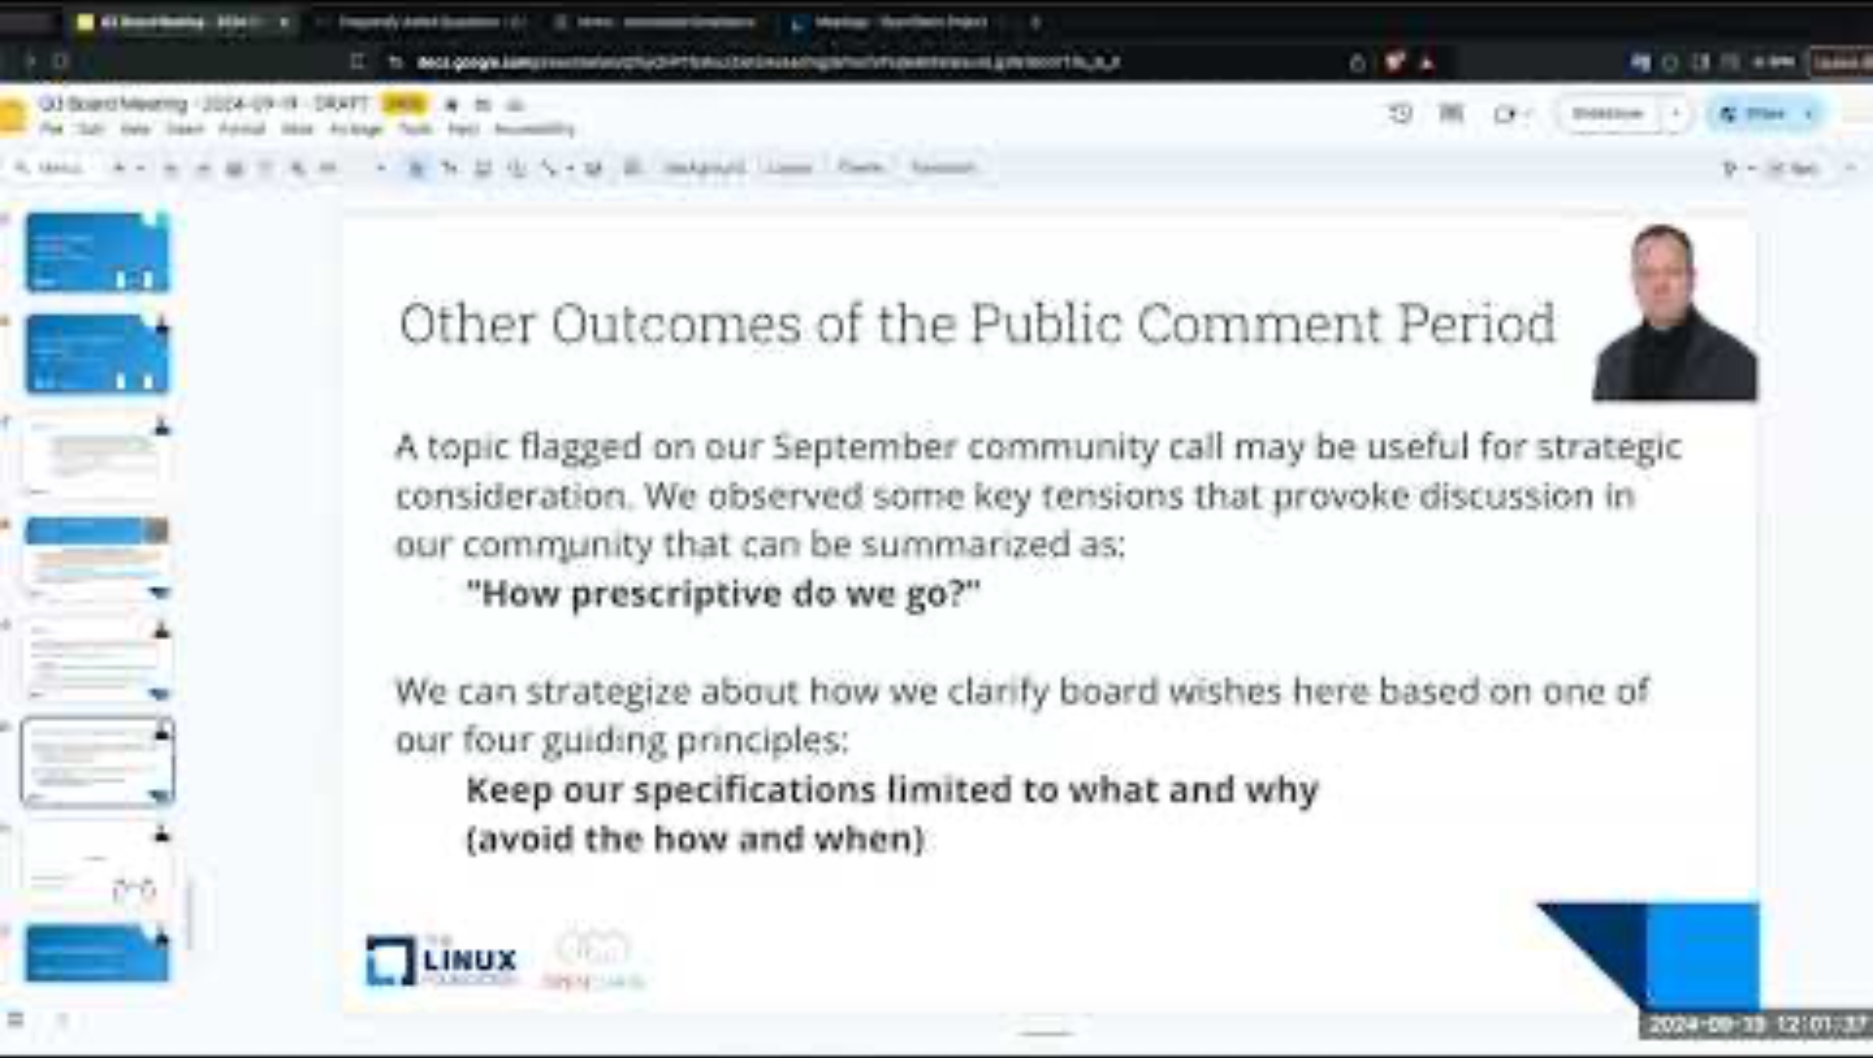
Steering Committee Meeting – 2024-09-19

Slide 16
The ISO Standards – All The Open Issues
Note: as of today, 2024-11-05, there are 3 open issues
The public comment for proposed updates to ISO 5230 and ISO 18974 continues. Our job is to check out some of the comments about typos, language clarity and so on. We collect feedback into pull requests (submissions) on GitHub.
ISO 5230: https://github.com/OpenChain-Project/License-Compliance-Specification/pulls
ISO 18974: https://github.com/OpenChain-Project/Security-Assurance-Specification/pulls
We aim close and merge or reject all open pull requests before the end of the public comment period.

Slide 17
ISO/IEC 5230 Recently Closed
From September / October:
Update openchain-license-compliance-3.0.md #76
Improved 2.7 #75
Update openchain-license-compliance-3.0.md #74
Terms and definitions sub-headings to same level openchain-license-co…#66
Check out the details of the last meeting where issues were closed: https://openchainproject.org/news/2024/09/12/openchain-monthly-north-america-europe-meeting-2024-09-03-full-recording
1

Slide 18
ISO/IEC 5230 Open Items for Review - 1
Originally raised in September:
[Improvement] Adjust wording in Definition Section 2.2 from using "identify" to "examine" - License Compliance 3.0 Draft #77

Slide 19
ISO/IEC 18974 Recently Closed
From September / October :
Update openchain-security-specification-2.0.md #37
Check out the details of the last meeting where issues were closed: https://openchainproject.org/news/2024/09/12/openchain-monthly-north-america-europe-meeting-2024-09-03-full-recording

Slide 20
ISO/IEC 18974 Open Items for Review - 2
[Bug] Minor Editing Error - missing Section Description Text #39
[Improvement] Addressing changes in other projects / standards naming conventions - Security Assurance 2.0 Draft #38

Slide 21
Work on reference and supporting material

Slide 22
Education Work Group Meeting on 2024-10-02
The OpenChain Education Work Group has been working on developing a simplified capability model to assess a company’s capability in open source licence compliance against ISO 5230:2020.
You can find the current working version of the model here:
https://docs.google.com/spreadsheets/d/1CAOD7PjNXXlnW-dkmfC9Bsb94mVyt0AdoRIqV-H3HE4/edit?usp=sharing
Alternatively, you can find a static download of the model here: https://cloud2.orcro.co.uk/index.php/s/t9AWWXKZWbZt8nH

Slide 23
Any other business

Slide 24
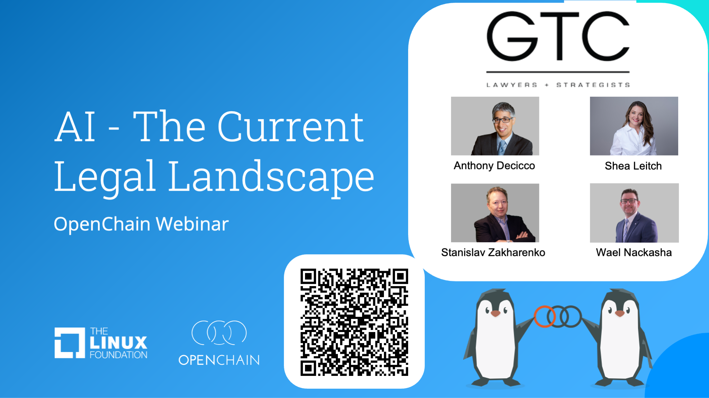
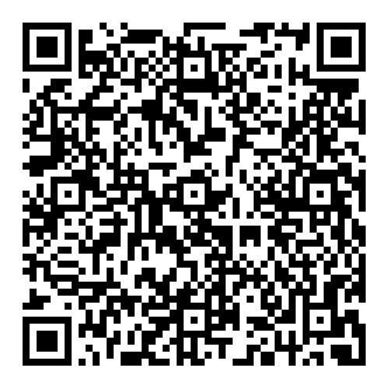
AI Legal Landscape Webinar Recording

Slide 25

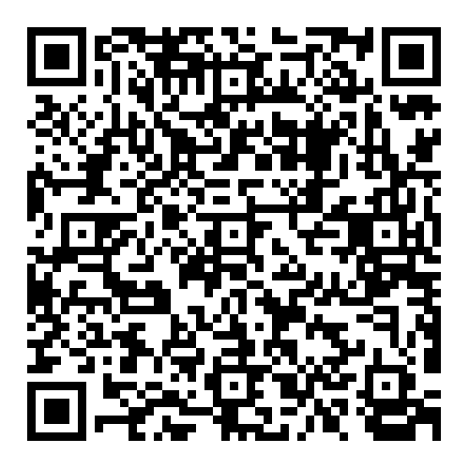
AI Data and the Supply Chain Webinar Recording

Slide 26
Update on AI Study Group?

Slide 27
Close of meeting

Slide 28
See you next time!

