Slide 1
OpenChain Monthly Meeting
Europe and Asia - 2025-03-19

Slide 2
Anti-Trust Policy Notice
Linux Foundation meetings involve participation by industry competitors, and it is the intention of the Linux Foundation to conduct all of its activities in accordance with applicable antitrust and competition laws. It is therefore extremely important that attendees adhere to meeting agendas, and be aware of, and not participate in, any activities that are prohibited under applicable US state, federal or foreign antitrust and competition laws.
Examples of types of actions that are prohibited at Linux Foundation meetings and in connection with Linux Foundation activities are described in the Linux Foundation Antitrust Policy available at http://www.linuxfoundation.org/antitrust-policy. If you have questions about these matters, please contact your company counsel, or if you are a member of the Linux Foundation, feel free to contact Andrew Updegrove of the firm of Gesmer Updegrove LLP, which provides legal counsel to the Linux Foundation.

Slide 3
Agenda
Recap of North America / Europe call
The end of the freeze period for proposed updates to ISO/IEC 5230 and ISO/IEC 18974
A call for questions or suggestions to raise at the Board strategy meeting on 17th March in Napa
The initial market reaction to our organization maturity modeling (capability model)
A major event coming soon and a major tooling capability model being update by the Tooling Work Group
Comments or suggestions about whether OpenChain should explore introducing new standards in the future
Update on the recent Governing Board Strategy Sub-Committee Meeting
Ana briefs us on what TODO Group is doing!

Slide 4
Freeze Period

Slide 5
The Freeze Period For Proposed ISO/IEC Updates
The Freeze Period ends on March 20th.
At this juncture, the proposed updates to ISO/IEC 5230 and ISO/IEC 18974 will be handed off to the OpenChain Steering Committee
The next formal meeting of the OpenChain Steering Committee is scheduled for June 25th
This is when you can expect a decision regarding next steps

Slide 6
Board Strategy Session - 17/3

Slide 7
OpenChain Board Strategy Sub-Committee
Meeting between 13:00 and 16:00 PDT in Napa during the LF Member Summit
The board will discuss the topic of “future standards”
This is a brainstorming session and will consider “what ifs”
Two examples are:
“What if the forthcoming AI BOM Compliance Guide becomes a market solution?”
“What if we release a cross-industry, cross-format version of the Telco SBOM Quality Guide and it becomes popular?”
Do you have topics you would like the board to discuss at this meeting?

Slide 8
Maturity / Capability Model

Slide 9
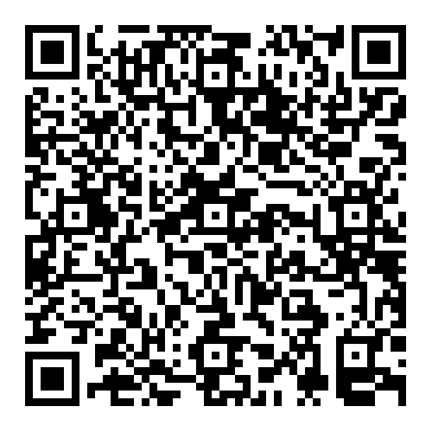
Our Capability Model Is Working Well
The model can be found here:
https://openchainproject.org/news/2025/01/31/the-openchain-capability-model-reaches-general-release
It is leading to discussion about how maturity can be measured for topics outside ISO/IEC 5230.
We will probably explore two things next:
ISO/IEC 18974
Collaboration with the CHAOSS Project around metrics

Slide 10
Tooling Meeting – April 7-9

Slide 11

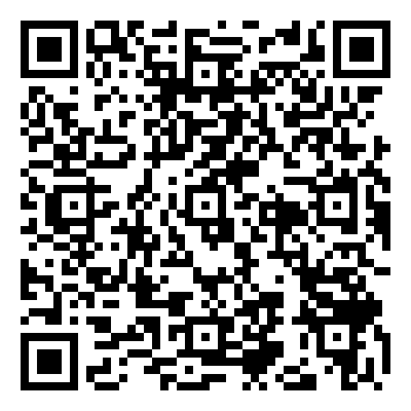
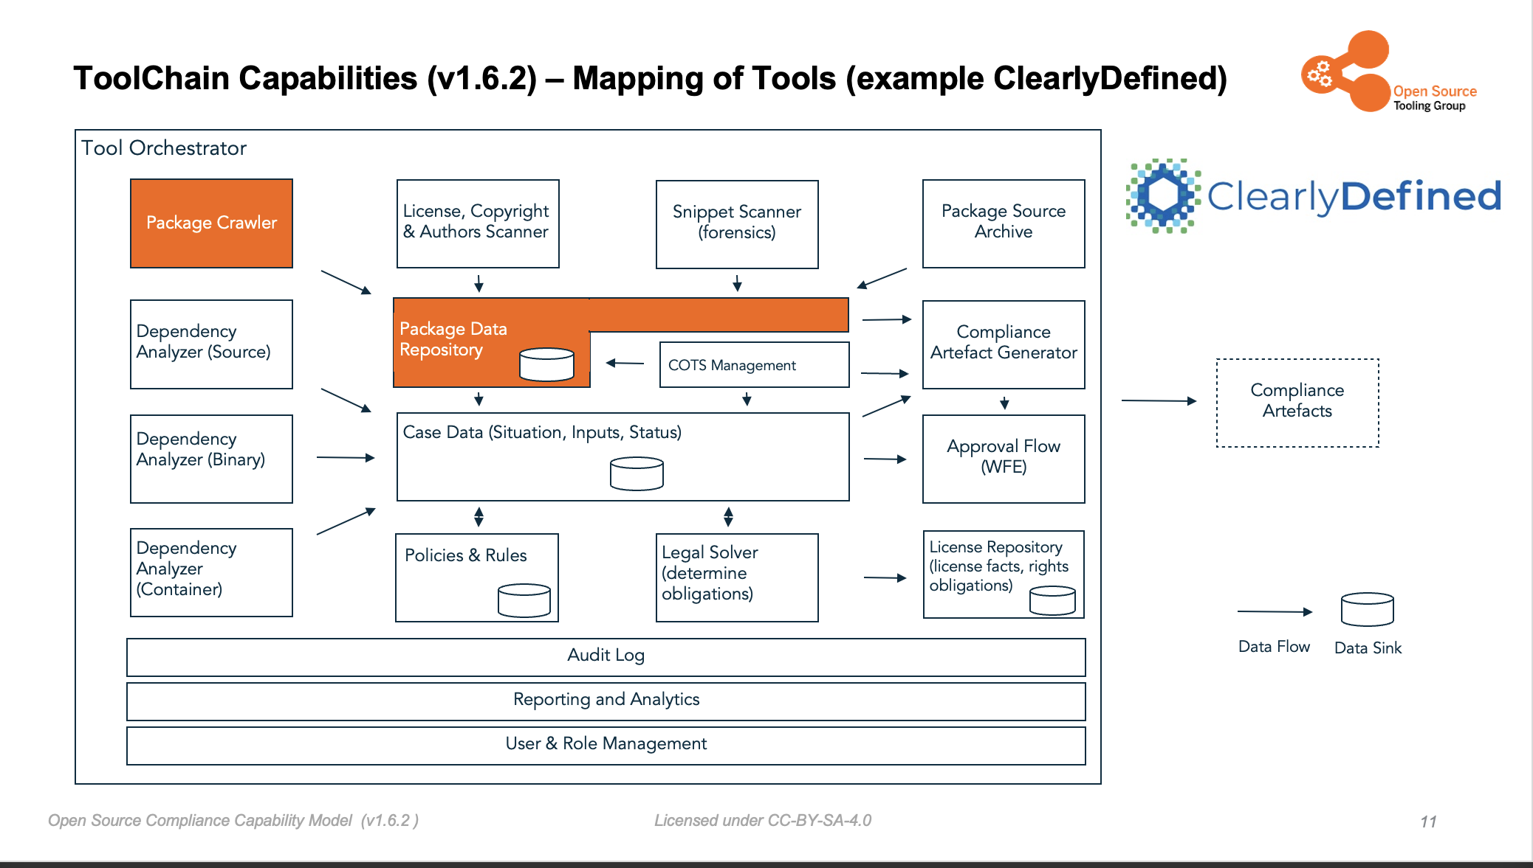
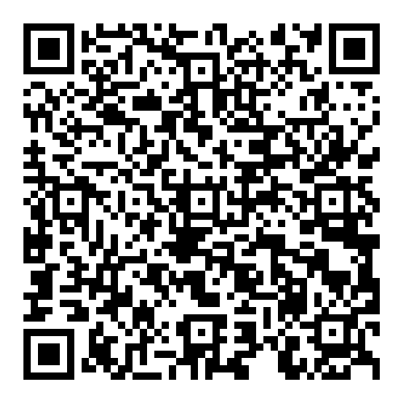
Tooling Work Group Doing A Lot
Event in Stuttgart April 7th to 9th:
Tooling Capability Model:

Slide 12
Future Standards?

Slide 13
What Are Your Thoughts On Expanding?
We have two sister standards for open source process management – compliance matters (Licensing and Security)
Should we explore more?

Slide 14
Board Strategy Meeting

Slide 15
Basically We Talked About:
We have two sister standards for open source compliance process management (Licensing and Security)
Should we explore more?
After all, we are about to release an AI BOM Compliance Guide, we already released a Telco SBOM Quality Guide, and we may release a Cross-Industry SBOM Quality Guide
And our security standard started as a guide
The board will consider guidance on (1) when a guide solves the identified challenge effectively, and (2) when it is appropriate to consider turning a guide into a specification.

Slide 16

And Now Ana from TODO!

Slide 17
Any other business

Slide 18
Close of meeting

Slide 19
See you next time!

