Slide 1
OpenChain Monthly Meeting: Spec, Education + More
North America / Europe - 2025-11-19 @ 08:30 UTC

Slide 2
Anti-Trust Policy Notice
Linux Foundation meetings involve participation by industry competitors, and it is the intention of the Linux Foundation to conduct all of its activities in accordance with applicable antitrust and competition laws. It is therefore extremely important that attendees adhere to meeting agendas, and be aware of, and not participate in, any activities that are prohibited under applicable US state, federal or foreign antitrust and competition laws.
Examples of types of actions that are prohibited at Linux Foundation meetings and in connection with Linux Foundation activities are described in the Linux Foundation Antitrust Policy available at http://www.linuxfoundation.org/antitrust-policy. If you have questions about these matters, please contact your company counsel, or if you are a member of the Linux Foundation, feel free to contact Andrew Updegrove of the firm of Gesmer Updegrove LLP, which provides legal counsel to the Linux Foundation.

Slide 3
Agenda
OpenChain Project News
Specification Work Group – Next steps in developing our ISO standards
Education Work Group – Continued work on training material
Any Other Business?

Slide 4
OpenChain Project News

Slide 5
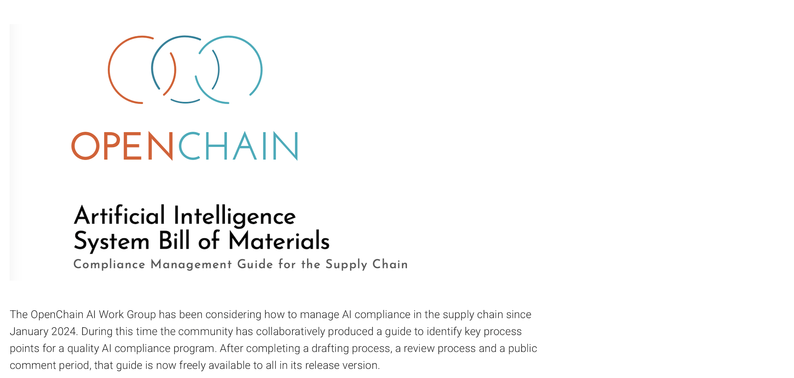
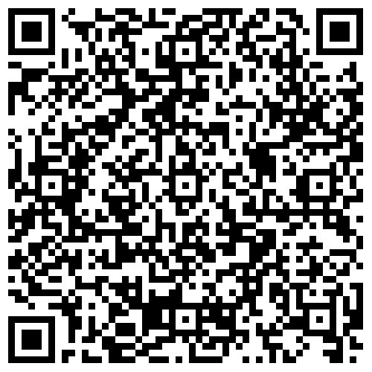
Main News Item:
https://openchainproject.org/news/2025/10/20/welcoming-the-openchain-ai-system-bill-of-materials-compliance-guide

Slide 6






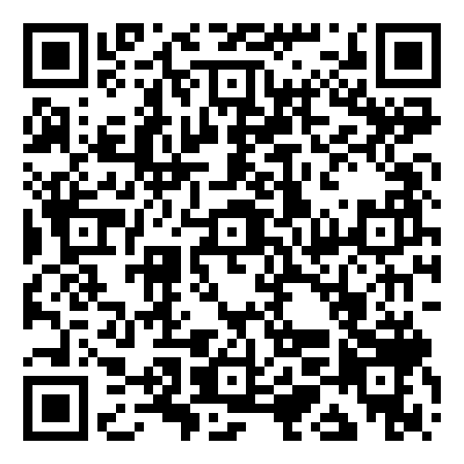
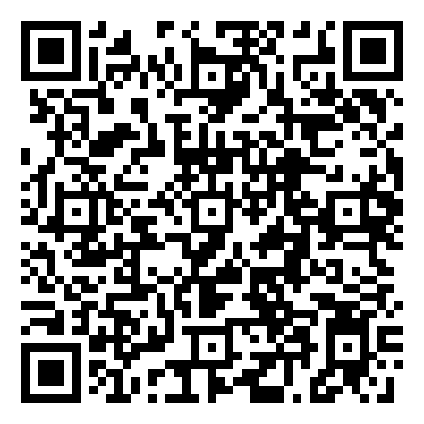

Other Key Project News
Conformance (ISO/IEC 5230):
New partners: New webinars & briefings:
Containers
CRA
Containers: https://openchainproject.org/news/2025/11/07/webinar-containers-and-compliance
CRA: https://openchainproject.org/news/2025/10/29/openchain-meridian-22-meeting-1

Slide 7
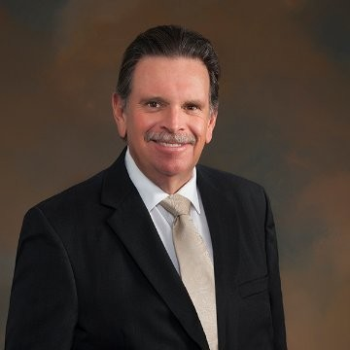
Specification Work Group

Slide 8
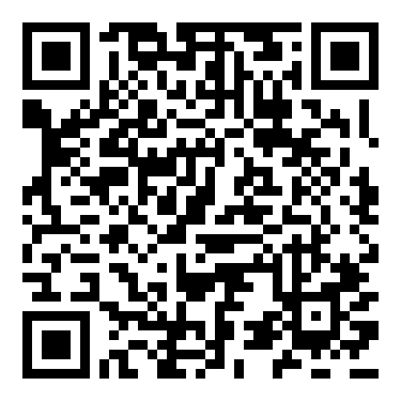
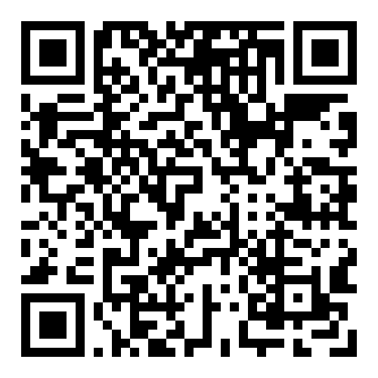
Sister Standards - Processes for Programs
ISO/IEC 5230 (License Compliance)
ISO/IEC 18974 (Security Assurance)
Flexible program size
Covering:
Inbound processes
Internal processes
Outbound processes
Standards about process points
Not about process content
https://bit.ly/3JUnEh8
http://bit.ly/4mbmOd8

Slide 9
Further Development of the Specs
On the last call we discussed adjusting our ISO standards for the CRA, and the consensus was that we should try to avoid regional customization, but seek to find commonalities in requirements around the world.
In practical terms, what does this mean? What types of edits or additions may we need to make between now and December 2026?

Slide 10
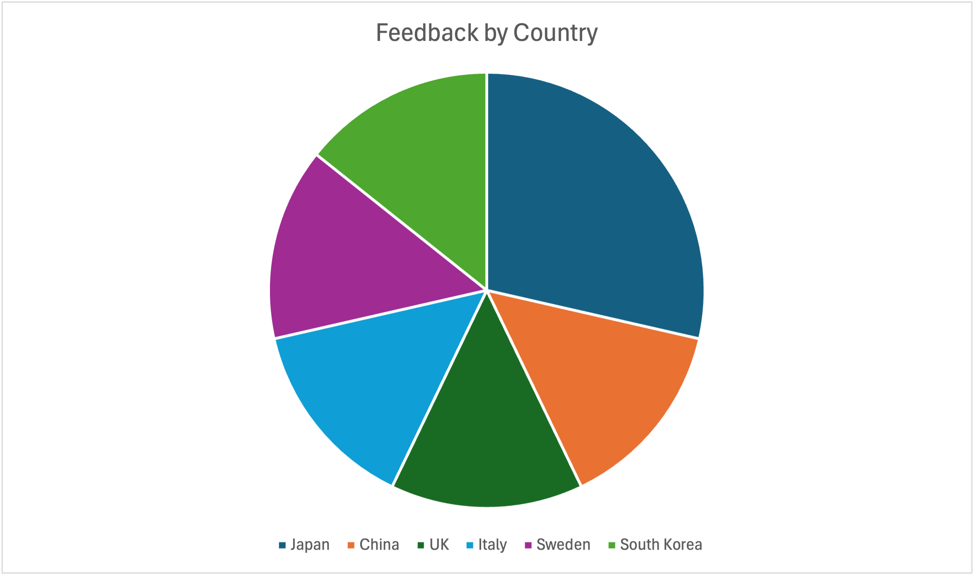
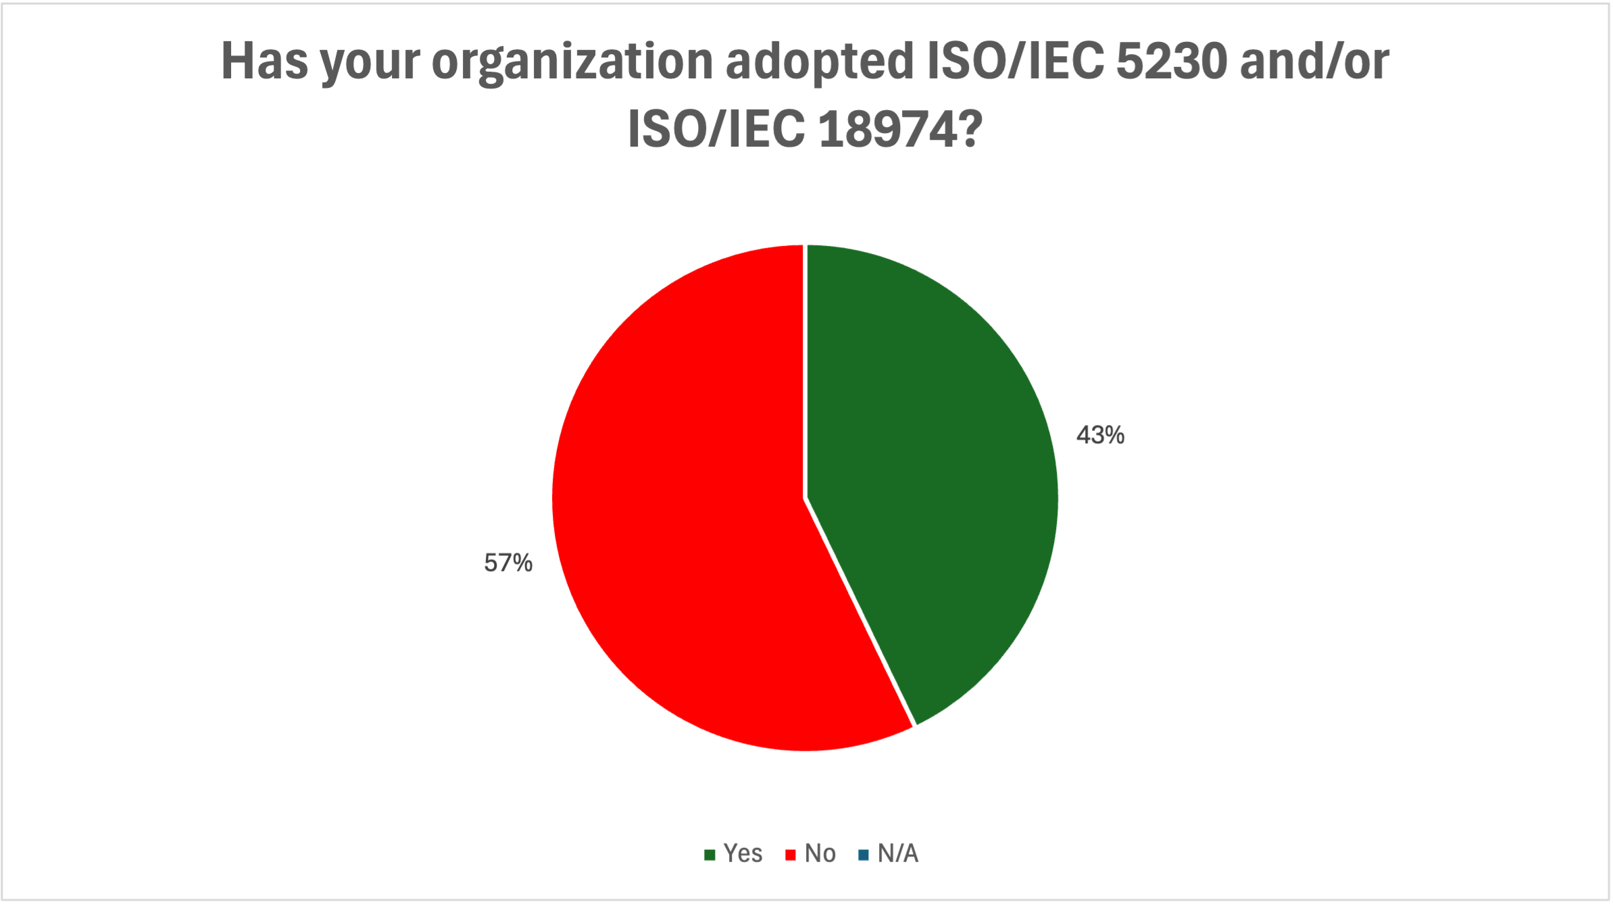
Outcomes of Recent Survey 1/2
Limited responses (7) but wide geographic coverage. Interestingly, most responders are not yet adaptors, indicating they are in examination phase:

Slide 11
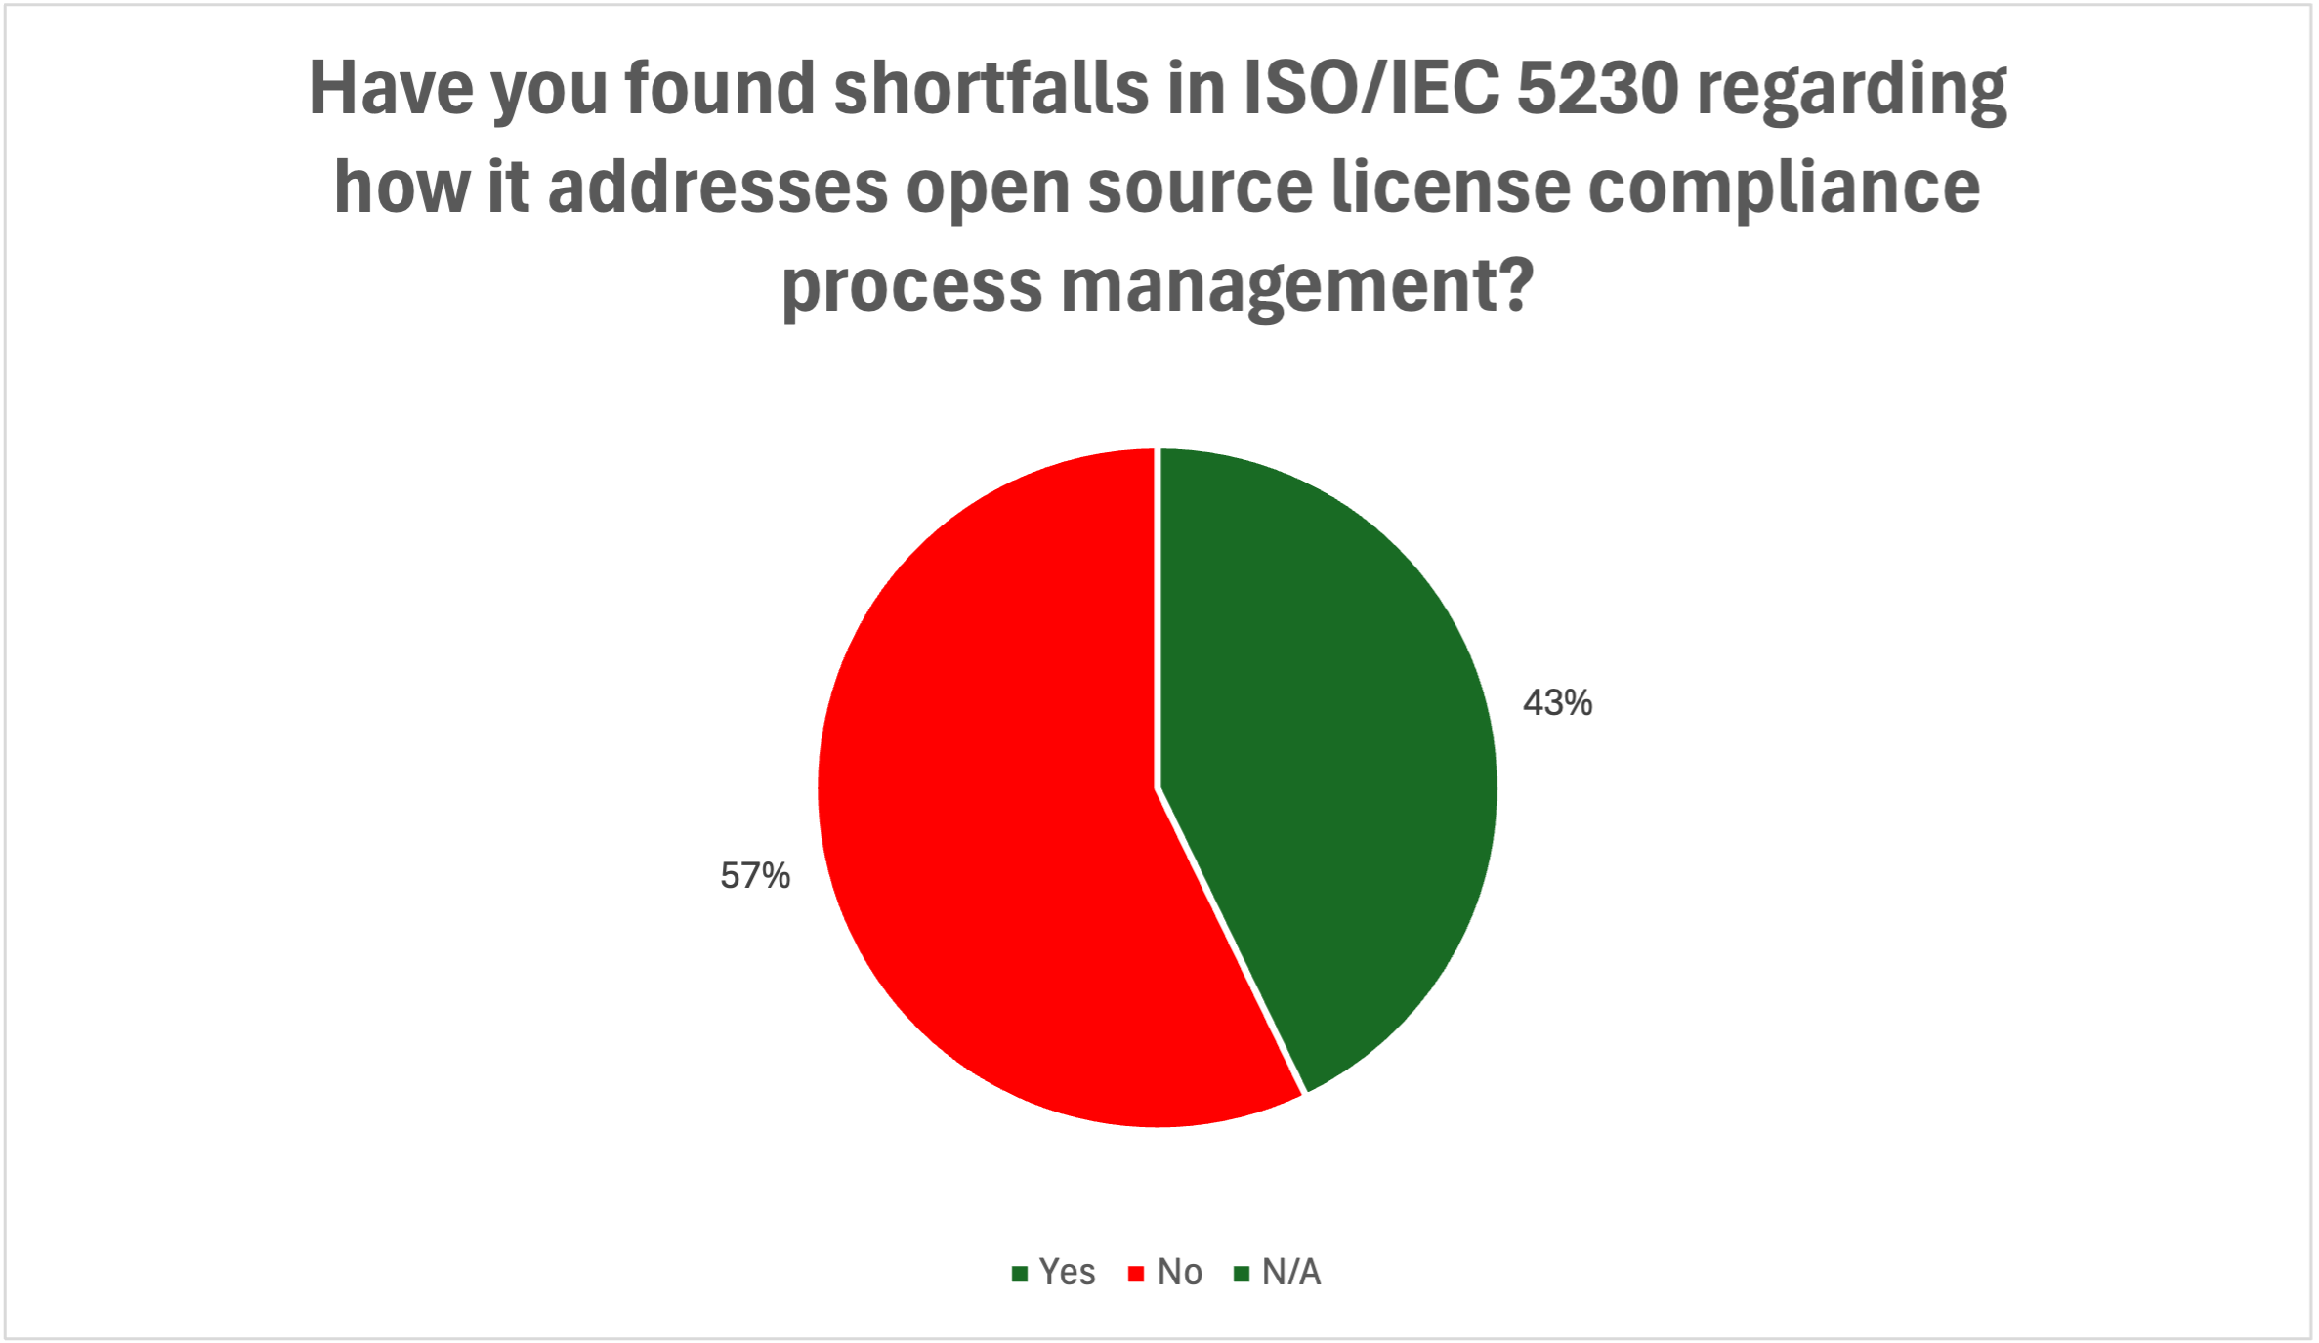
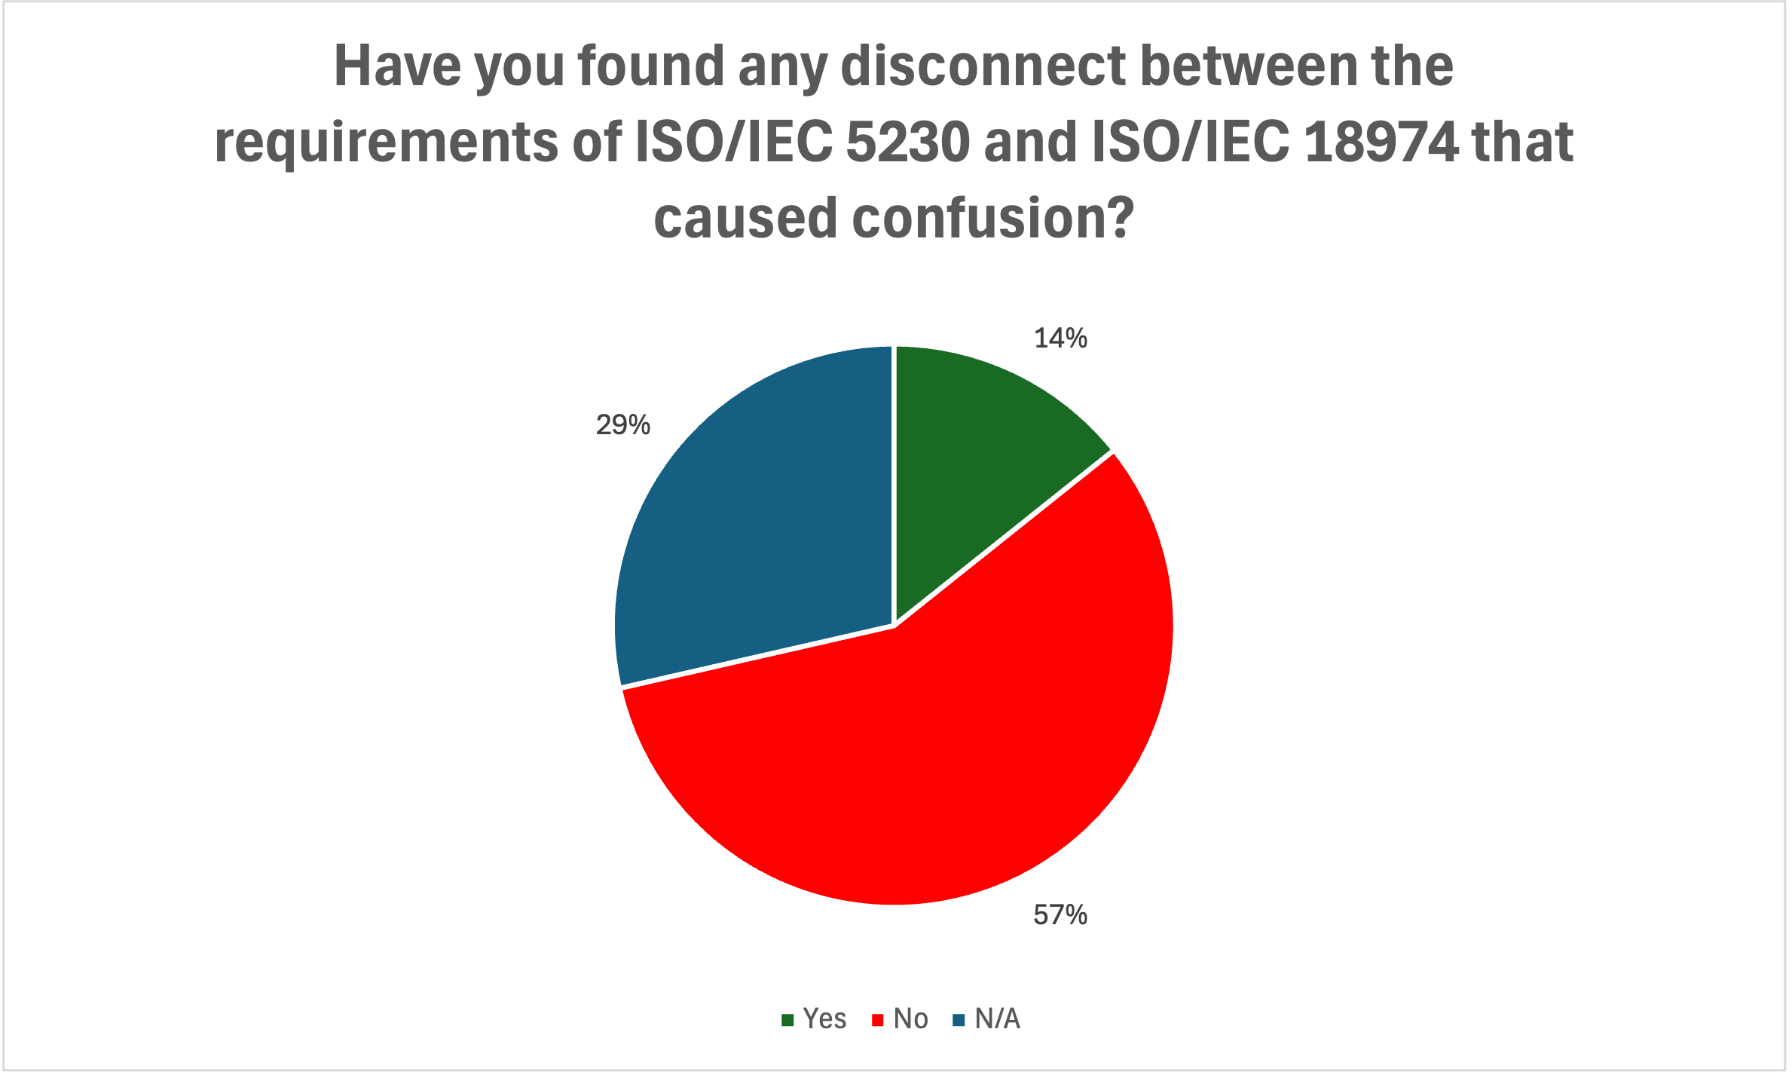
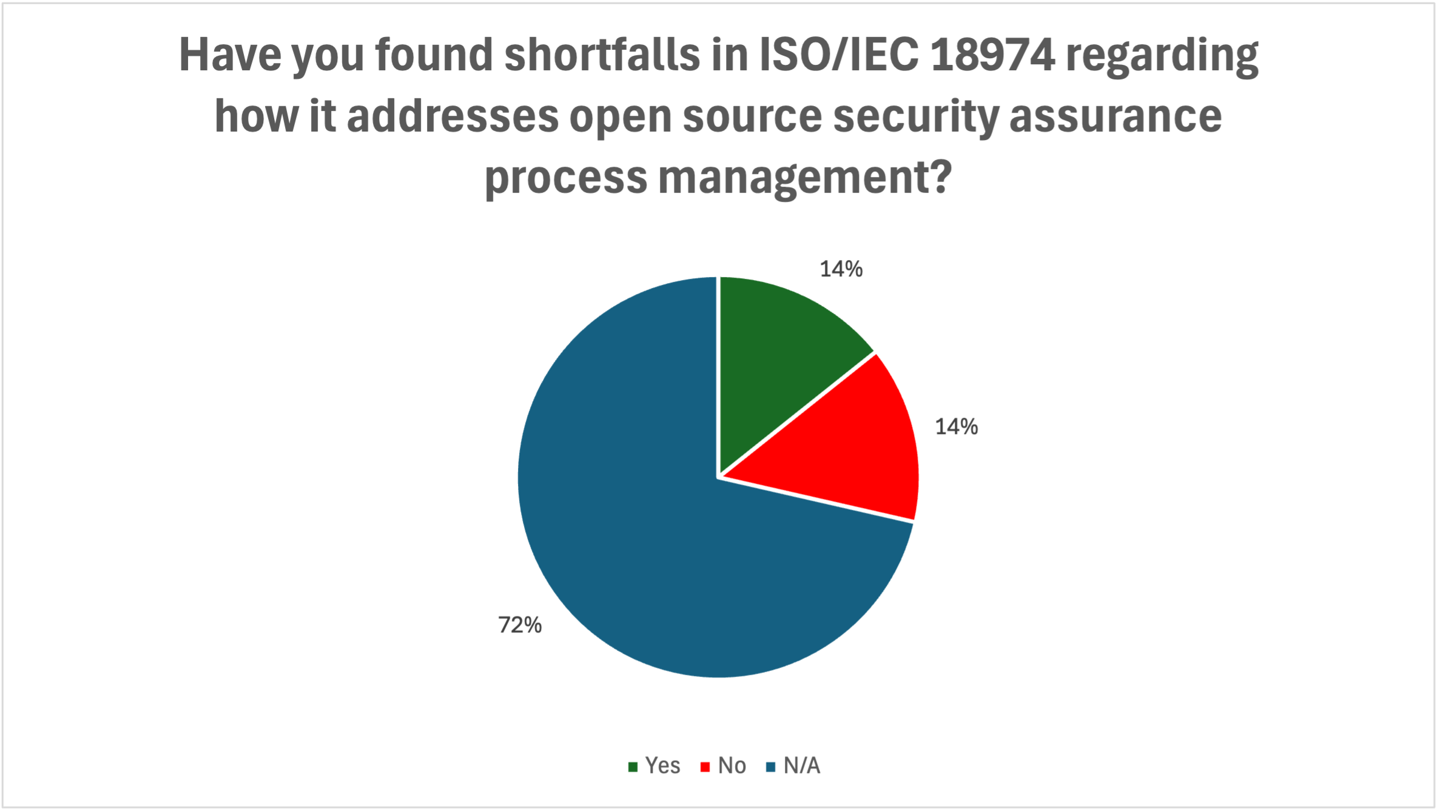
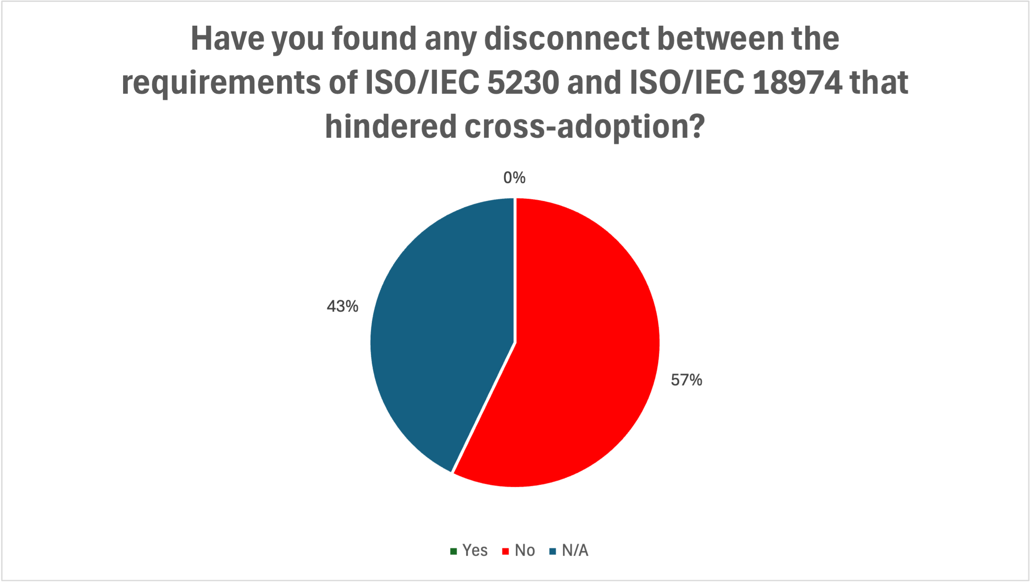
Outcomes of Recent Survey 2/2
Yes
No
N/A

Slide 12

Education Work Group

Slide 13
Update and Next Steps – Training Material
Martin has been working on the education material, with a focus on the Quiz questions at the end of each section.
It is suggested that we take a walk through the current LFC 193 course and discuss opinions / ideas for next steps.
After the walk-through, if everyone is happy with the current content, we can ask LF Training to update the course.

Slide 14
Any other business?

Slide 15
Close of meeting

Slide 16
See you next time!

