Slide 1
OpenChain Monthly Meeting: Spec, Education + More
North America / Europe - 2025-12-10 @ 16:30 UTC UK; 10:30 CT US

Slide 2
Anti-Trust Policy Notice
Linux Foundation meetings involve participation by industry competitors, and it is the intention of the Linux Foundation to conduct all of its activities in accordance with applicable antitrust and competition laws. It is therefore extremely important that attendees adhere to meeting agendas, and be aware of, and not participate in, any activities that are prohibited under applicable US state, federal or foreign antitrust and competition laws.
Examples of types of actions that are prohibited at Linux Foundation meetings and in connection with Linux Foundation activities are described in the Linux Foundation Antitrust Policy available at http://www.linuxfoundation.org/antitrust-policy. If you have questions about these matters, please contact your company counsel, or if you are a member of the Linux Foundation, feel free to contact Andrew Updegrove of the firm of Gesmer Updegrove LLP, which provides legal counsel to the Linux Foundation.

Slide 3
Agenda
OpenChain Project News
Specification Work Group – Next steps in developing our ISO standards
Education Work Group – Continued work on training material
Any Other Business?

Slide 4
OpenChain Project News

Slide 5
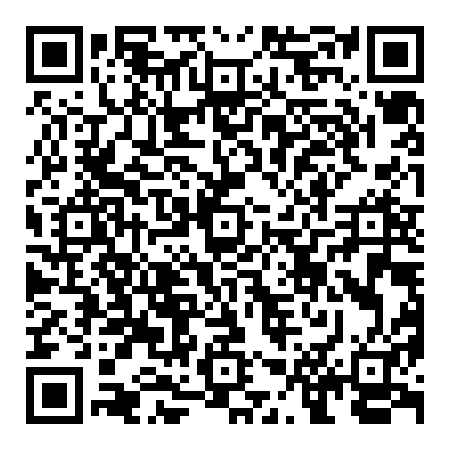
Main News Item:
Our OpenChain General Manager Shane Coughlan is moving on in a planned management rotation within the Linux Foundation.
We will miss him as his presence and leadership was largely instrumental to our work and will continue to shape our endeavours as we continue to improve the OpenChain portfolio of products.
You can read more about this rotation here: https://tinyurl.com/5692jxaa

Slide 6
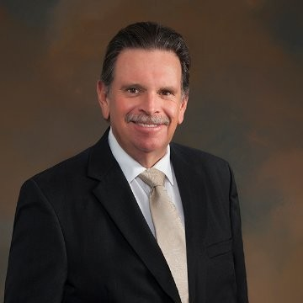
Specification Work Group

Slide 7


Sister Standards - Processes for Programs
ISO/IEC 5230 (License Compliance)
ISO/IEC 18974 (Security Assurance)
Flexible program size
Covering:
Inbound processes
Internal processes
Outbound processes
Standards about process points
Not about process content
https://bit.ly/3JUnEh8
http://bit.ly/4mbmOd8

Slide 8
Further Development of the Specs
On the last call we discussed adjusting our ISO standards for the CRA, and the consensus was that we should try to avoid regional customization.
The specification team should seek to find commonalities in requirements and remain open to some regional tailoring.
Tailoring is acceptable as it does cause the software users in regions receiving the software to be in violation and unable to remain compliant.
What types of edits or additions may we need to make between now and December 2026?
Looking at the charts from an academic perspective the survey was inconclusive and not useful to informing us on needed improvement areas to concentrate on. {Simple questions seemed to have yielded simple responses with no clear linkage to the supposed disconnects.}
We need to get more people from the communities participating in these meeting and contributing.

Slide 9
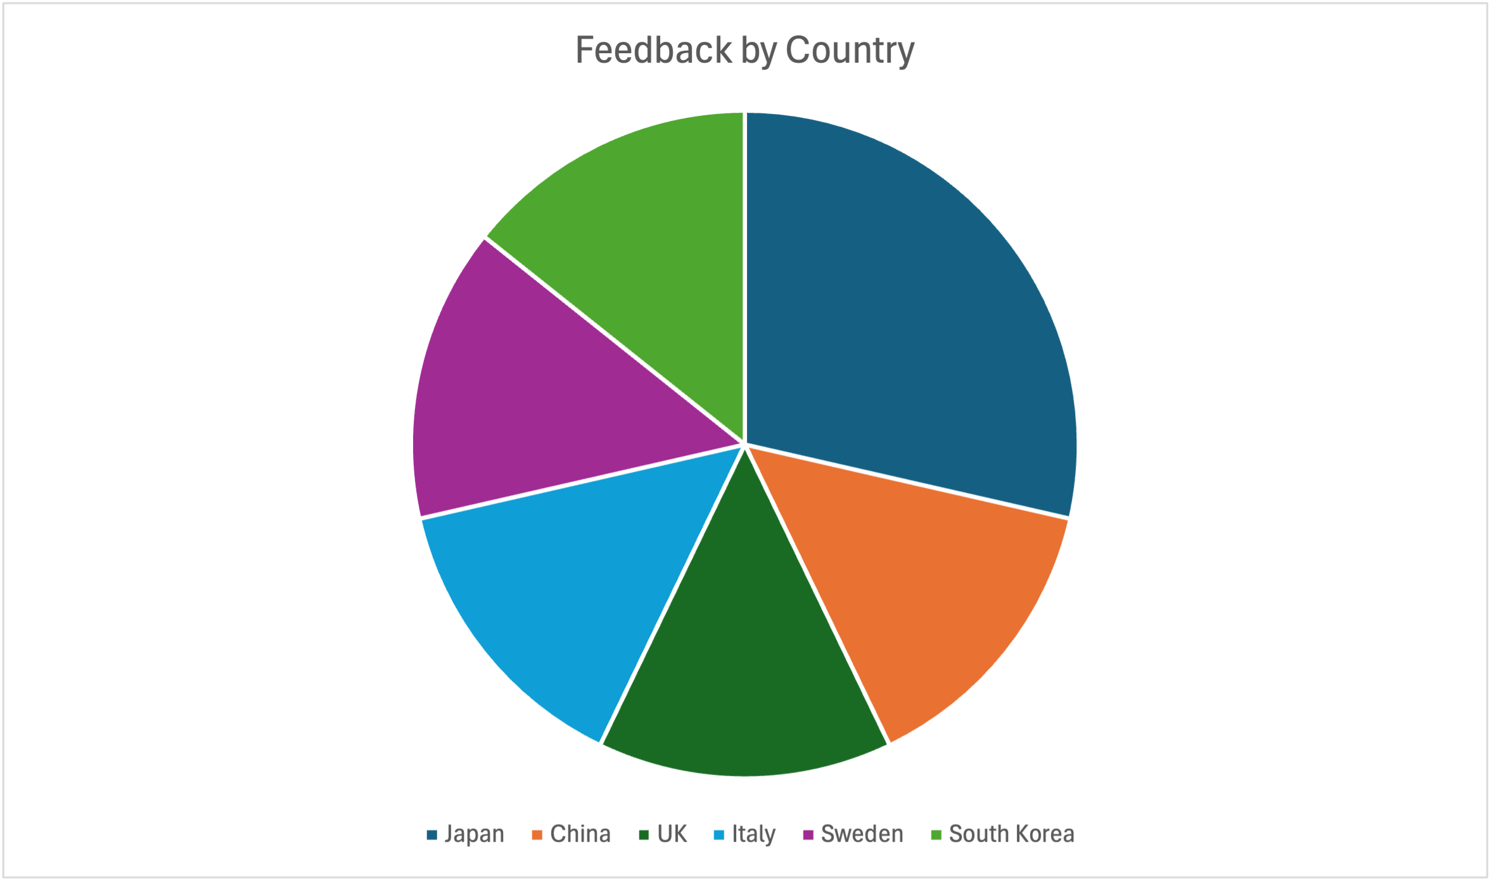
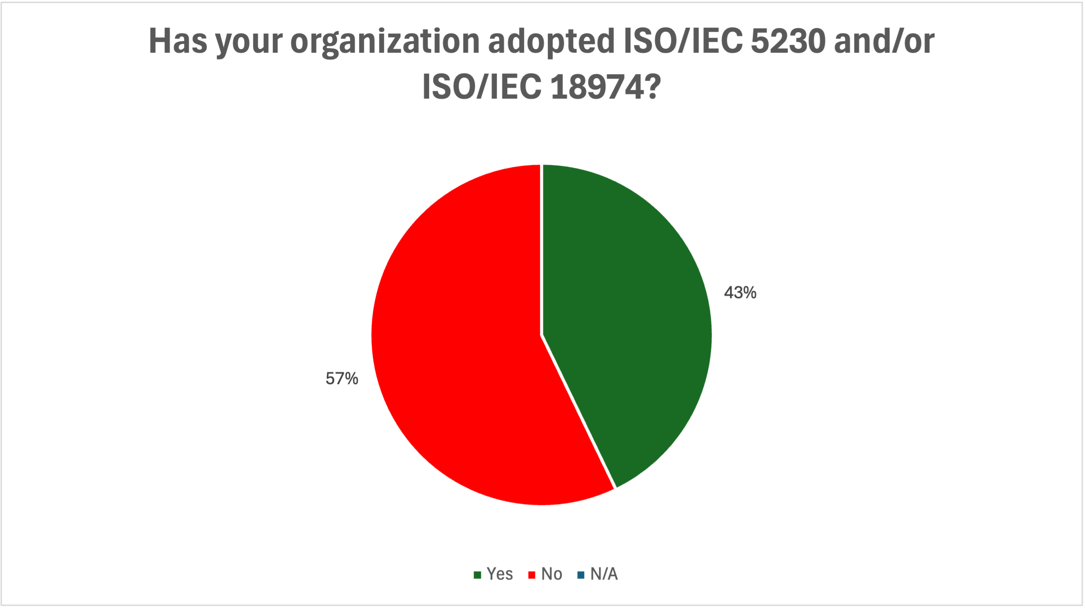
Outcomes of Recent Survey 1/2
Limited responses (7) but wide geographic coverage. Interestingly, most responders are not yet adaptors, indicating they are in examination phase:

Slide 10
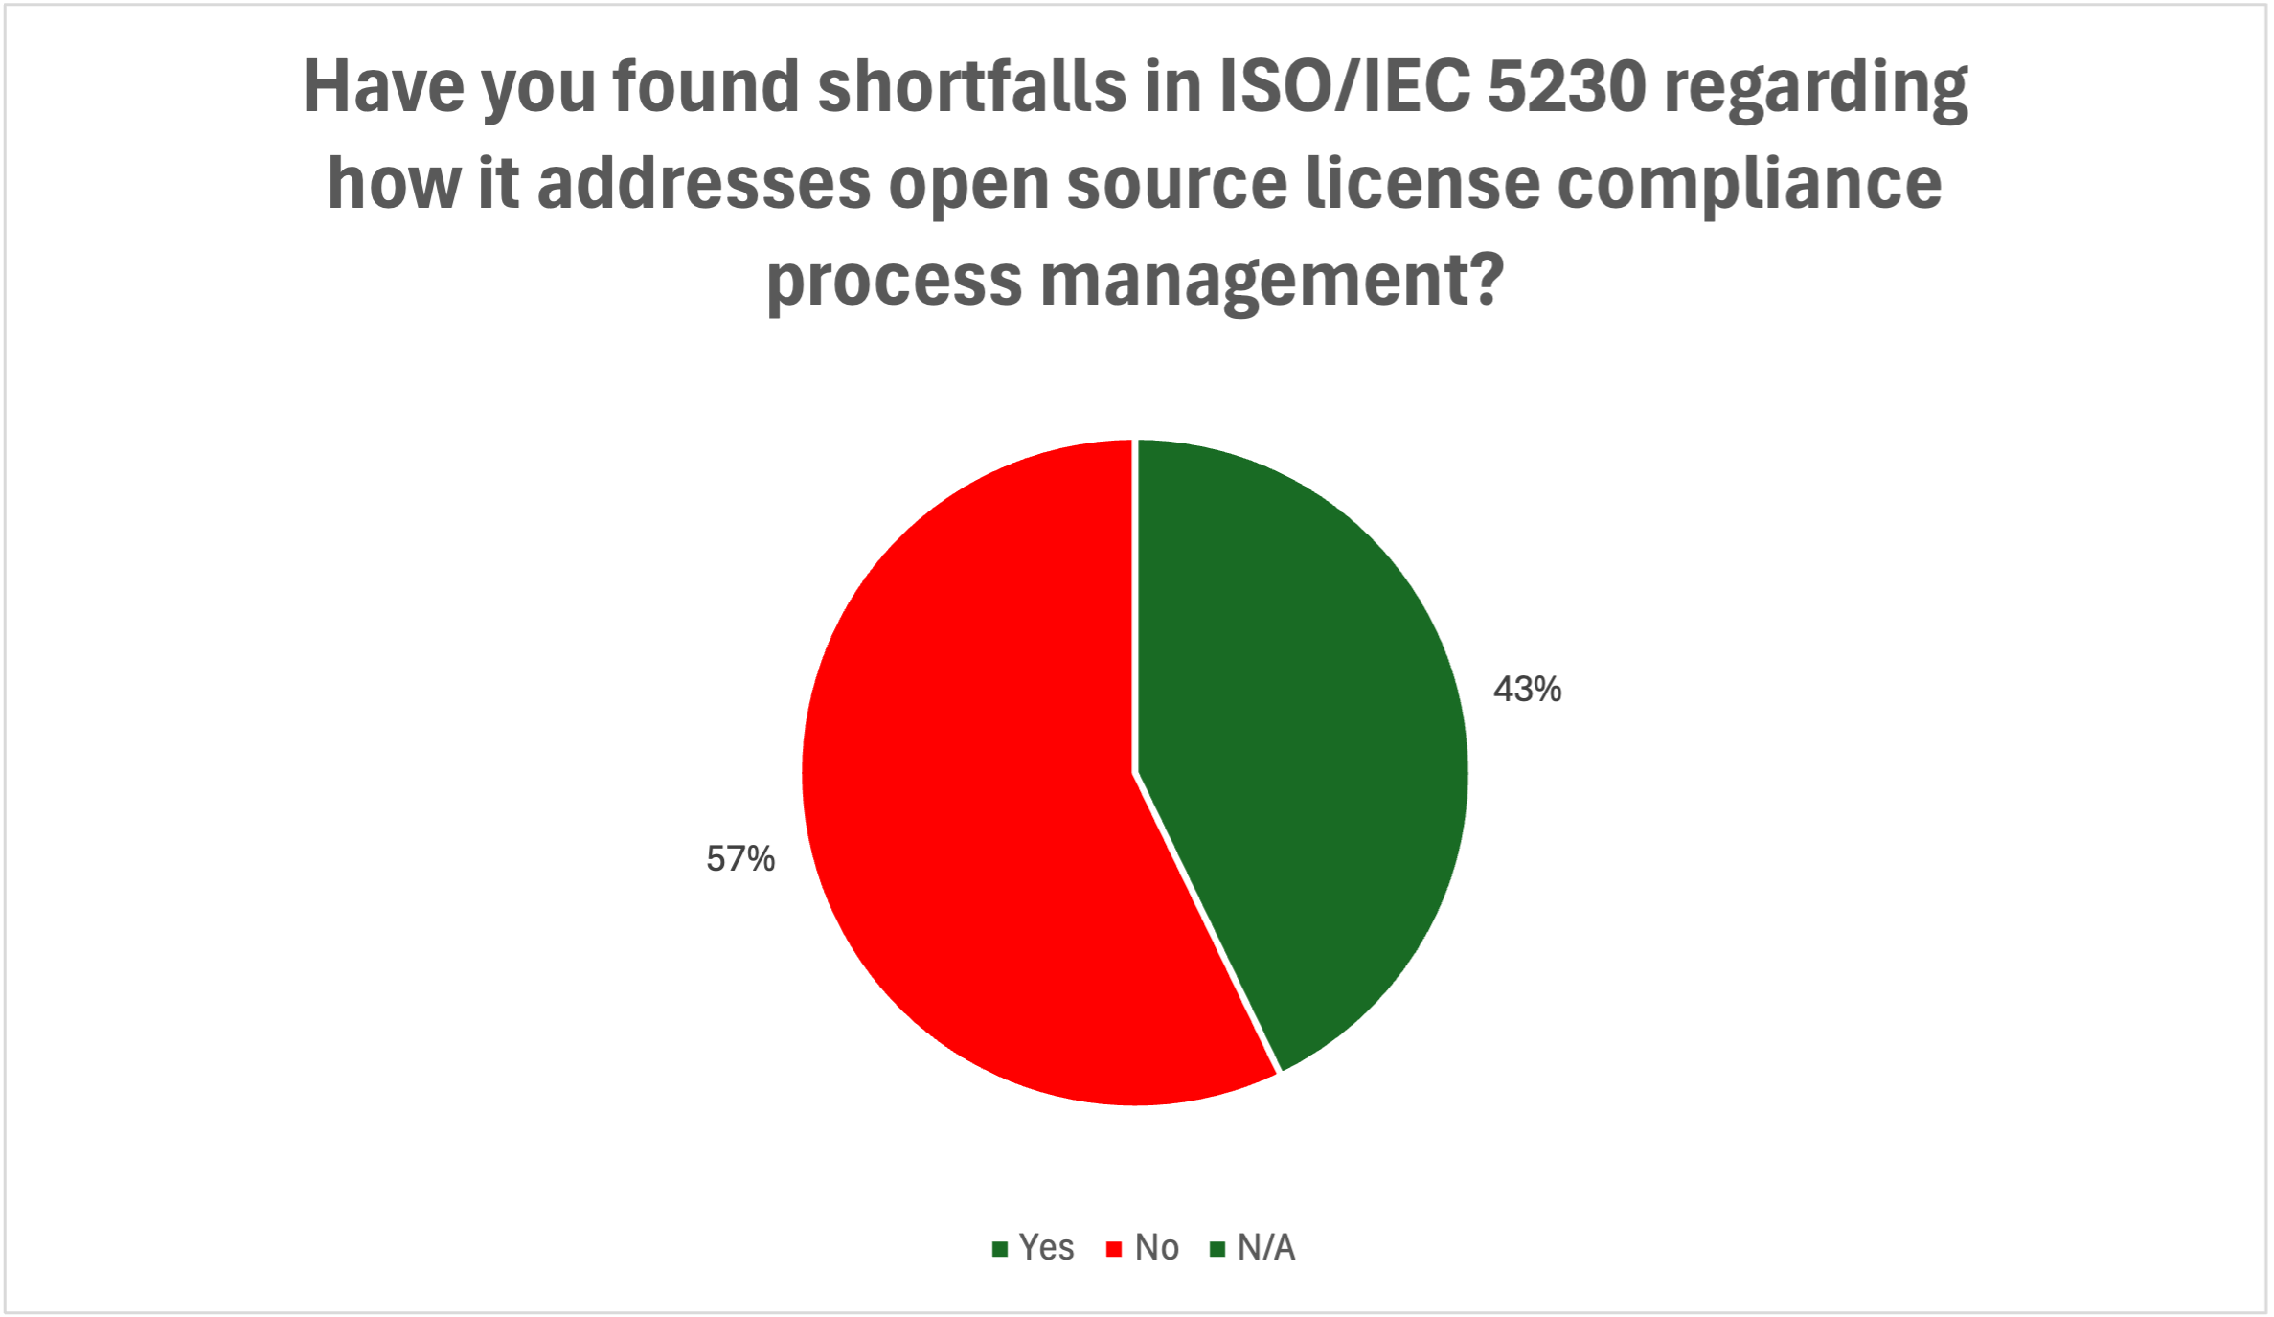
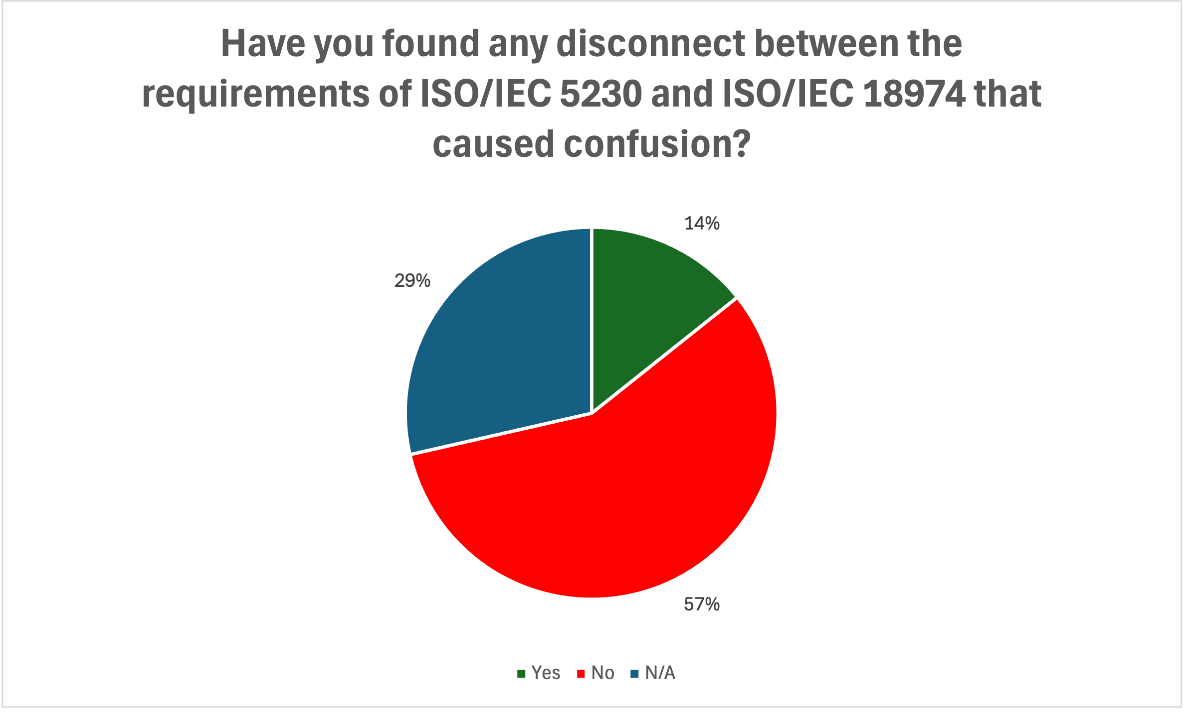
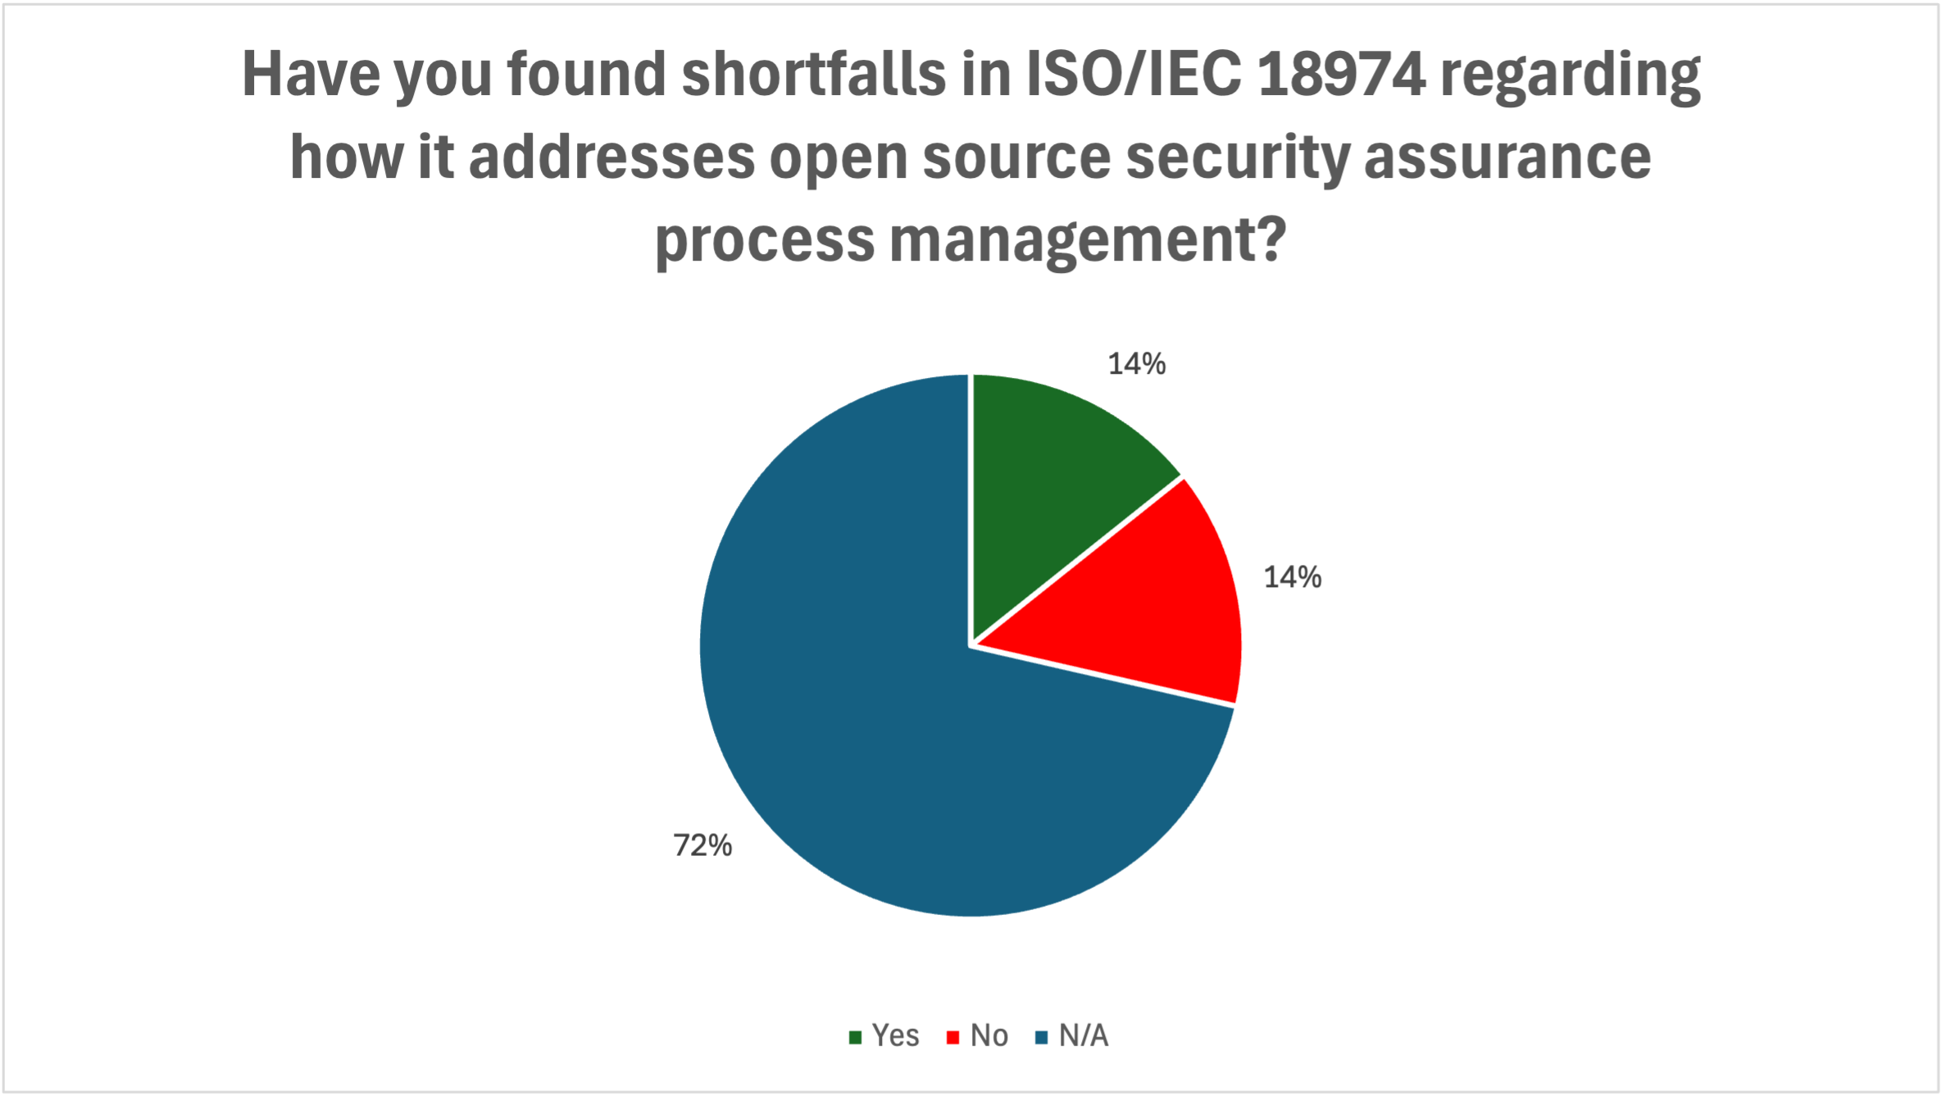
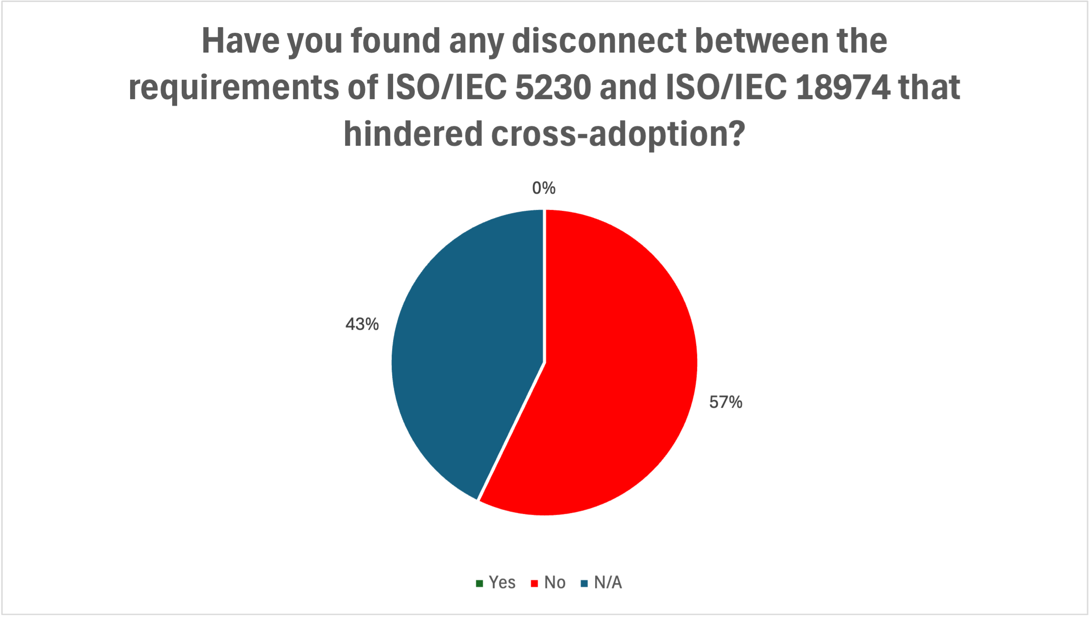
Outcomes of Recent Survey 2/2
Yes
No
N/A

Slide 11

Education Work Group

Slide 12

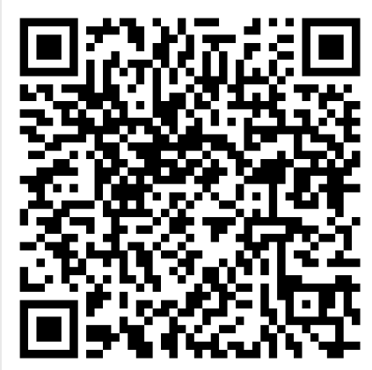
Update and Next Steps – Training Material
LFC193 Course
Candidate .md version on github
https://github.com/OpenChain-Project/Reference-Material/blob/master/OpenChain-Training/en/Online-Training-Courses/LFC193%20Course%20Content/Introduction%20to%20Open%20Source%20License%20Compliance%20Management%20(LFC193).md
Add a GenAI note??
https://github.com/OpenChain-Project/Reference-Material/issues/130
Linux Foundation Training resource allocated from Jan ‘26
Notes:
Reference-Material/OpenChain-Training/en/Online-Training-Courses/LFC193 Course Content/Introduction to Open Source License Compliance Management (LFC193).md at master · OpenChain-Project/Reference-Material
https://github.com/OpenChain-Project/Reference-Material/issues/130

Slide 13
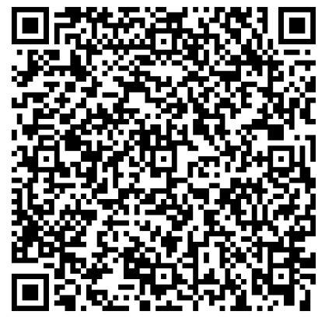
Update and Next Steps – Training Material
LFC194 Course
https://github.com/OpenChain-Project/Reference-Material/tree/master/OpenChain-Training/en/Online-Training-Courses/LFC194%20Course%20Content
Target completion date for end Q1 to pass to Linux Foundation Training
Review of existing comments and proposed changes
Notes:
https://github.com/OpenChain-Project/Reference-Material/tree/master/OpenChain-Training/en/Online-Training-Courses/LFC194%20Course%20Content

Slide 14
Any other business?

Slide 15
Meetings:
Our schedule remains the same for December: NA / Europe on second week, Europe / Asia on third week December. It is here: https://openchainproject.org/participate
From January 2026 we will move to a new schedule:
OpenChain Monthly Specification and Education Call (North America / Europe) on the 14th January @ 16:30 UTC
OpenChain Monthly Education Call (Europe / Asia) on the 21st January @ 08:30 UTC
OpenChain Monthly Specification Call (North America / Asia) on the 21st January @ 23:30 UTC

Slide 16
Close of meeting

Slide 17
See you next time!

