Slide 1


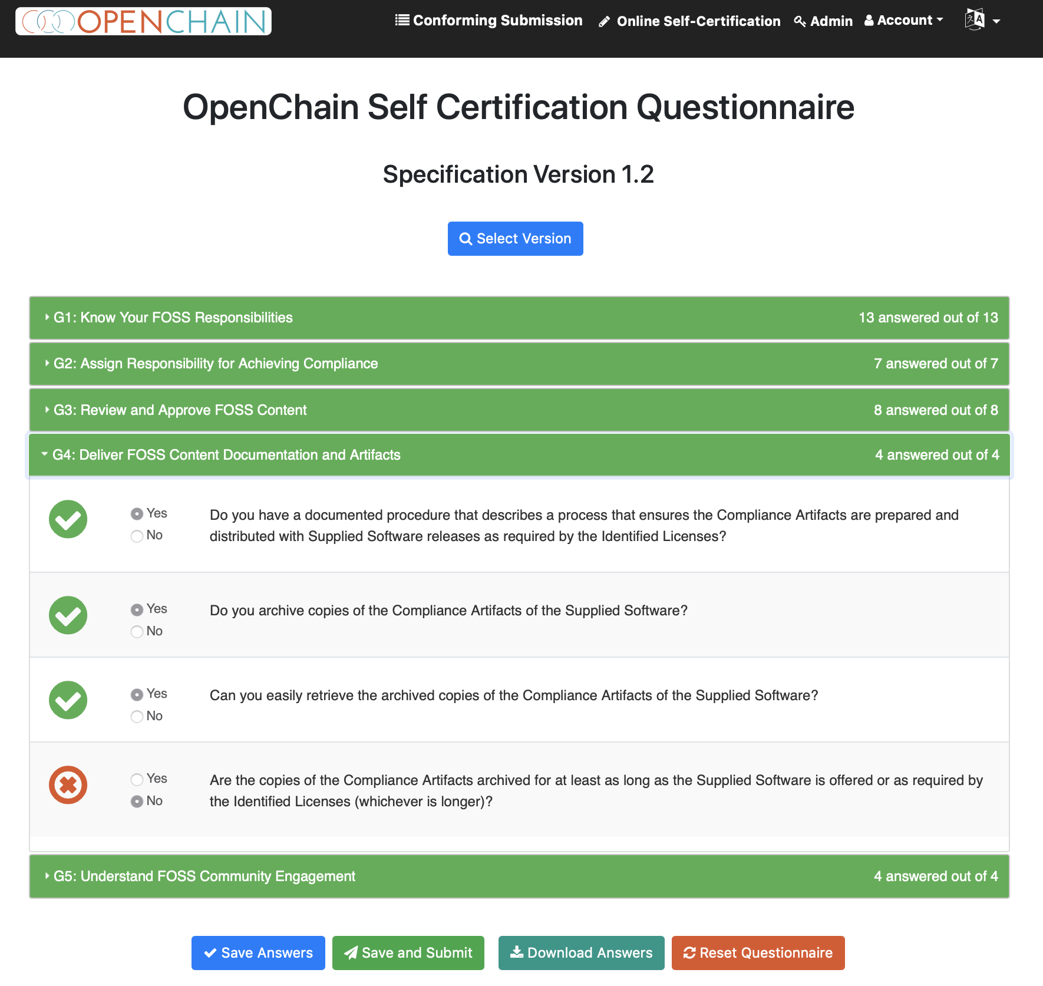
The OpenChain Project defines the key requirements for a quality compliance program.
It is a simple, effective standard for organizations of all sizes in all markets. It is openly developed and freely available to all.
The OpenChain Project is supported by extensive reference material, free online self-certification and a vibrant community.
Learn more: www.openchainproject.org

