Slide 1
Here is a pictorial representation of the SBOM management process that was described and commented on 5/23.
I would appreciate your advice and comments.
OSPO
Establishment of rules and guidelines for the SBOM management process from parts procurement to product shipment
Control of the SBOM management process, handling and improvement of abnormalities
Consideration of improvement and efficiency of the SBOM management process
Consideration, evaluation, procurement, and introduction of tools necessary for the SBOM management process
Ordered parts
SBOM
Ordered parts
SBOM
Procurement Department
Design Department
Development Department
Quality management
Departments
Shipping Department
Product
SBOM
OSS
SBOM
SBOM Ordering/Receiving Management of Ordered Parts
(Ensure that SBOMs are requested and received at the time of ordering; ensure that SBOMs are received at VUP, etc.)
SBOM content management for ordered parts
(Component vulnerability management/handling/reporting to component manufacturer when it becomes apparent, etc.)
Product SBOM creation management
(Responsible for SBOM creation, FIX the OSS version at the time of development and create the SBOM for the product to be delivered, etc.)
SBOM quality control of products
(Check for defects in attachments and violations of company guidelines)
Product SBOM management
(Product SBM delivery management, version management of delivered product SBOMs, ensuring delivery of SBOMs during product VUP, etc.)
(upstream)
Parts Manufacturer
Repository
(Downstream)
Destination/Customer

Slide 2
5/23 of chat memos (excluding speaker information)
You mentioned that it doesn't make money, but based on the information you shared on Slack, I think Japan needs to do OSS activities to the extent that they make money.
I have the impression that community activities tend to be more difficult to explain when the main body of OSPO-like activities is the profit center.
  I think there are various factors.
Since the stage of a company (including group companies) varies depending on the business, it is difficult to put it down to "cross-group activities."
It happens very rarely. >"Think about it in OSPO."
Is OSPO in charge of SBOM management? I thought the answer might be confusing because the question could imply "Is OSPO responsible for the SBOM?" ...
This is exactly the situation that is being discussed in our company, and we don't have the resources to deal with it individually, so we would like to have OSPO as a contact point for SBOM for the whole company.
  We are considering how to handle the inquiries we receive.
I think (development) people expect someone else to do it. We need to sort out roles and responsibilities.
"Creating" and "submitting" SBOMs is a developer's responsibility, and I agree with the developer side, but if there is a guide for automating it in CI/CD, I would be happy if it is implemented. (Like GitHub)
I think the OSPO in my previous job was not responsible for managing SBOMs.
However, their role was to manage "best practices" and "platforms" related to OSPO and including SBOMs.
  (Not managing SBOMs themselves)
If there is a department like PSIRT (Security department? or Procurement?), I think that department should be in charge of SBOMs rather than OSPO.
When automating, the requirements for SBOMs used in an organization should be normalized. In this sense, I think that the SBOM guide of TelcoWG is useful for my industry. I think OSPO should take the lead (but there is no consensus within our company OSPO team).
Replying to "If there is a division like PSIRT (Security department? or Procurement?), it would be better for SBO than OSPO ...":
Why? Can you elaborate on that?

Slide 3
7/11
As OSPO matures, it will become an organization that leads the discussion by demonstrating its insight on OSS-related responses.
Chat notes:
The procurement department only checks the formal appearance, but if another department (such as the security department) uses it to manage vulnerabilities, it should be included in this flow.
Check to see if there are any blanks.
The function of OSPO varies a lot even in the same industry. Examples of four companies in the automotive industry can be found in AGL Publications here.
  https://lf-automotivelinux.atlassian.net/wiki/spaces/OSPO/pages/397082627/Publications#OSS-%26-OSPO-Promotion-Slides-for-Automotive-Companies
  It's called "Showcase."
In the table above, you can see that SBOM management corresponds to Compliance, but it varies between "Leading" and "Support."
Procurement, ordering and development are actually the same person...
"The SBOM is different from the BOM we know." Problem?
Isn't there a nuance that OSPO is involved because they know from experience that "If you don't get involved early and control it to some extent, it will go in a weird direction and you'll have a hard time later." ...?
Isn't it correct to say that it is not important to reach out to other departments, but if it is necessary for the items (SBOM) that increase the value of OSS to be operated correctly, they are leading?
Sorry, I am not participating in the current discussion. From my point of view, I think there is such an ideal different world.

Slide 4
8/22
The role of OSPO is to ensure that the organization adapts and adapts to changes caused by OSS. Therefore, there is also a view that the need for OSPO to be involved in security will disappear once the corresponding departments are formed and functioning.
Will OSPO expand its activities beyond OSS? ➡ YES
  Program Office = Open Collaboration Program Office for open activities in the sense that changes from the outside and activities from the outside are well related
It is each division (each department) that acts proactively, and OSPO supports them.
  OSPO is responsible for company-wide collaboration and proactive initiatives.
  Developing and defending core engineers? That is the role of OSPO.
OSPO's activity costs are linked to its performance.
  Being connected to the open world is the foundation of OSPO activities, so we need to maintain certain activities.
  We should think of it as an investment, and it is not good to limit it according to performance. If we do not continue, there will be no growth.
  If we can gain understanding that OSS activities are closely related to our business and show results, we will be stable.

Slide 5
8/22
Among the various items handled by OSPO, are there any items that are important to the business or the company itself in terms of business or governance that should be transferred to a separate organization? If so, it might be a good idea to consider what items could be transferred.
  I think it would be good to transfer items that are directly useful to the business to that division.
  The things that can only be done by OSPO are things that the division has not yet considered and that are necessary in the future.
    Securing a certain number of engineers and human resources who can handle OSS and maintaining that culture.
  I think it would be good if OSPO's OSS strategy consideration and promotion function is integrated into the company-wide management strategy.

Slide 6
9/19
The understanding of OSS is often "blind men and an elephant."^{[LINK1]}
  (Comment) "Blind men and an elephant" has different lessons from country to country, so we need to be careful when using it in global explanations.

Slide 7
9/19
What is an OSPO?
A group that works to ensure that corporate activities adapt and adapt to changes caused by OSS
The state of adaptation and adaptation varies from company to company, resulting in different OSPO activities (Your OSPO is not My OSPO)

Slide 8
9/19
The "desired state" may differ depending on the position within the company.
  Management is concerned with risk measures, R & D is concerned with innovation acceleration, product development is concerned with efficient compliance, and OSPO is concerned with management strategies including OSS and community action collaboration strategies.
  This may be due to a lack of consensus on OSS.
  (Comment) Bridging these differences may be the role (definition) of OSPO.

Slide 9
9/19
OSPO activities differ depending on how OSPO is started.
  Until around 2020, volunteers who felt that OSPO was essential to the development and survival of a company started OSPO as a grassroots activity and gradually gained recognition as an official activity. (Bottom Up OSPO)
  In recent years, the recognition that OSPO is necessary has spread to the industry, and there are cases where OSPO is started as a management decision. (Top Down OSPO)
    (Comment) Does this actually happen? I'd like to know some examples.
  Bottom Up OSPO tends to aim for OSS strategy, while Top Down OSPO tends to aim for what management aims for.
    If management sees OSS as a risk, governance will come first and OSS contributions will come second.
    In the end, does it depend on whether management understands how the OSS community works and how the company should work within it?
    I think it makes a big difference whether the software side is creating a big technology stream or just dealing with specific customers.

Slide 10
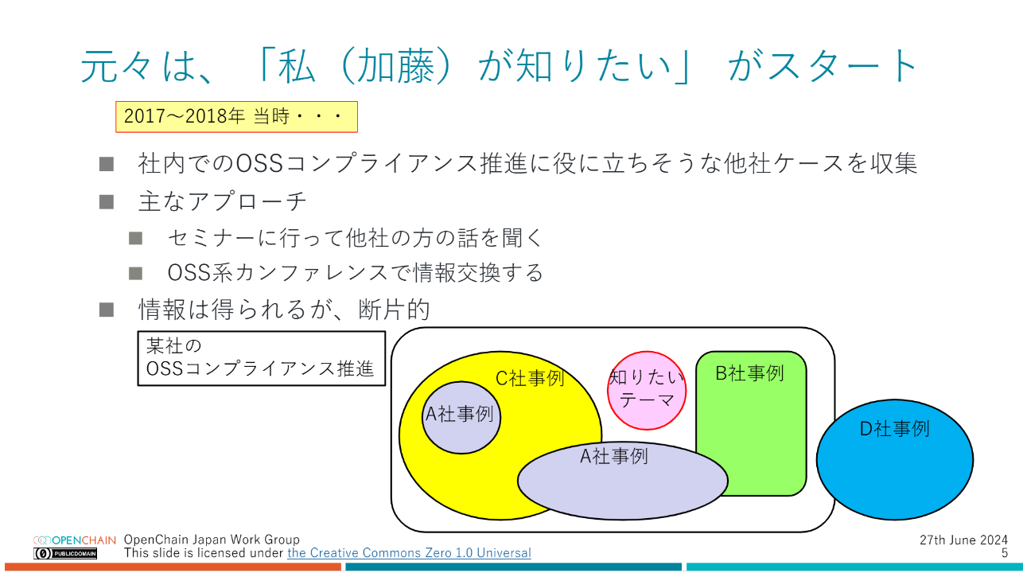
9/19
The situation described above is one of the reasons why OSPO activities do not proceed easily.
Wouldn't it be good to have guidelines (?) for each industry? Wouldn't it be nice to have)?
  A collection of practices (?)? )
Are OSPOs somewhat similar for each type of business activity?
When setting up an OSPO, information that other companies in the same industry have OSPOs would be useful for internal persuasion ➡ Can we gather information?
  This was the beginning of the Lightning Talk at the OpenChain meeting

