Slide 1
Our understandings about SPDX history
From overview figures in SPDX specification
OpenChain JWG SBOM SG

Slide 2
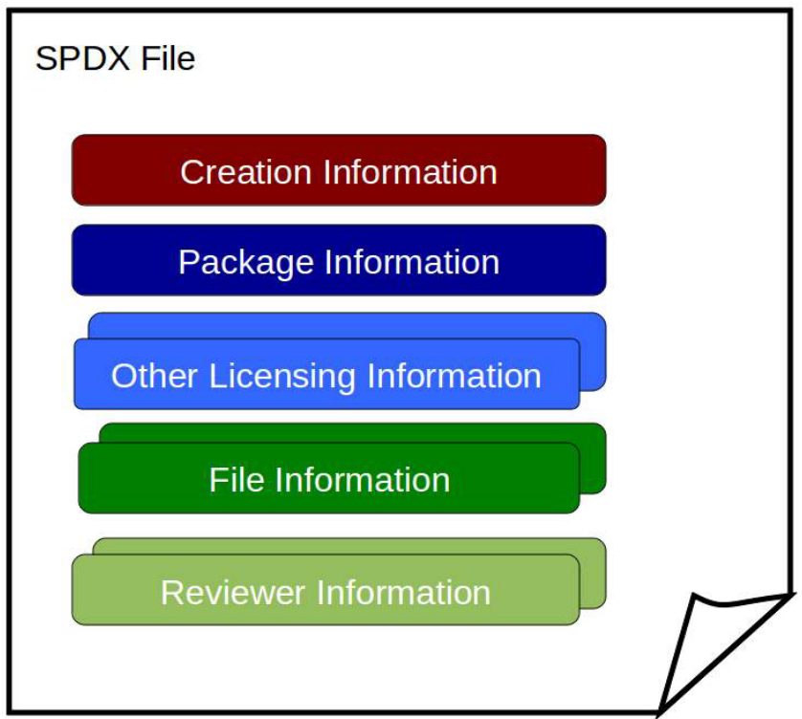

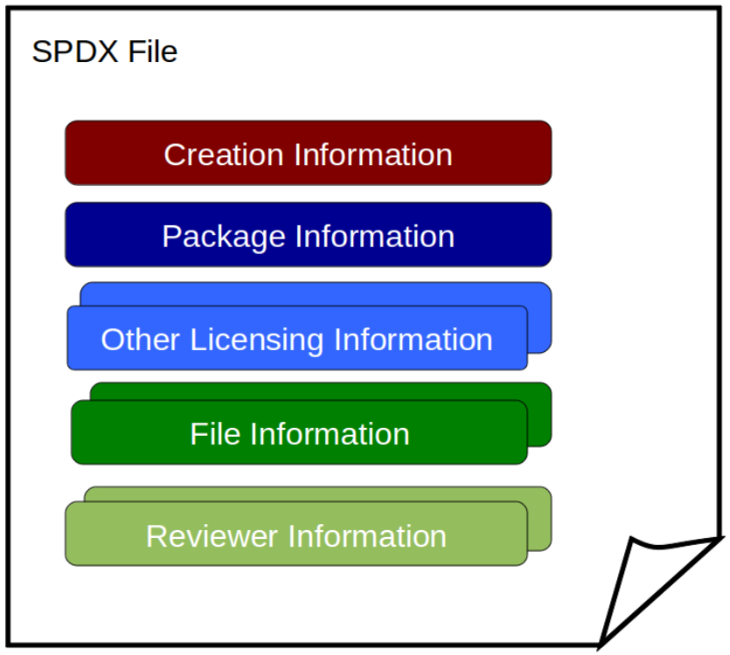
from v1.0 to v1.2
v1.0
v1.1
v1.2

Slide 3
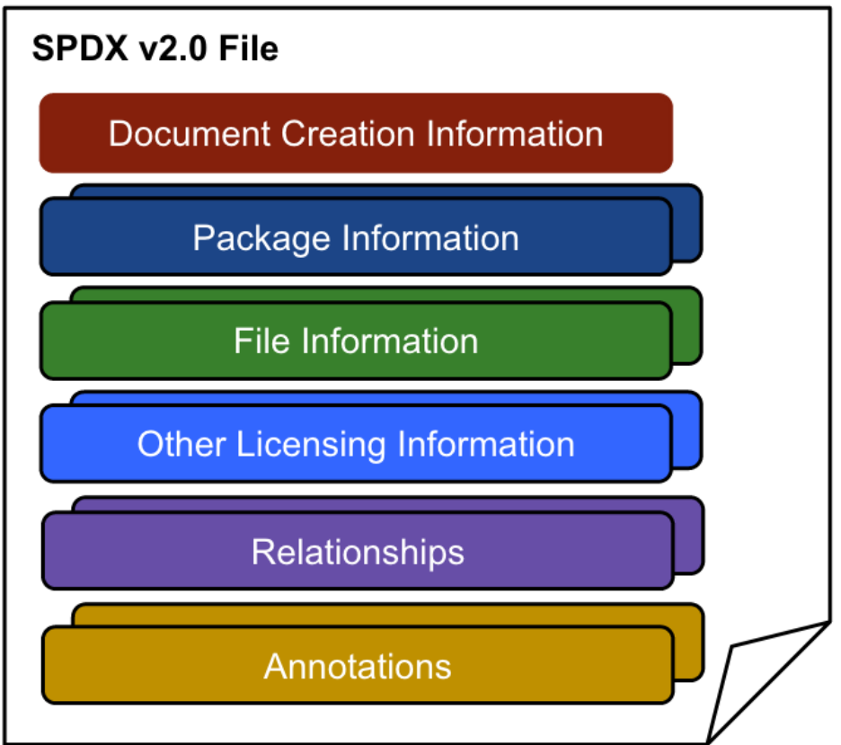
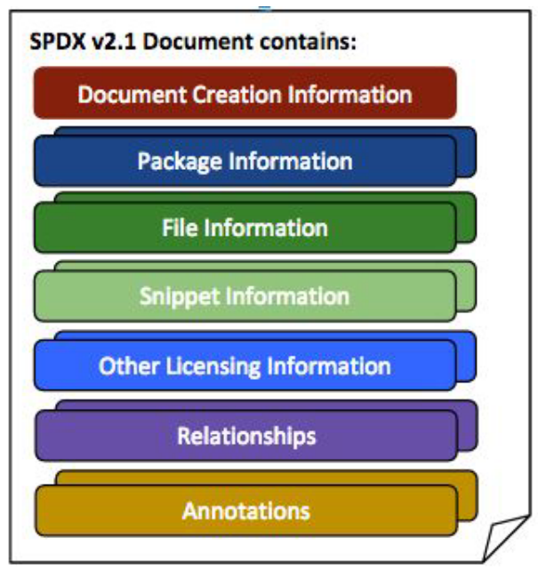
from v1.2 to v2.1
V1.2(re-presented)

Slide 4
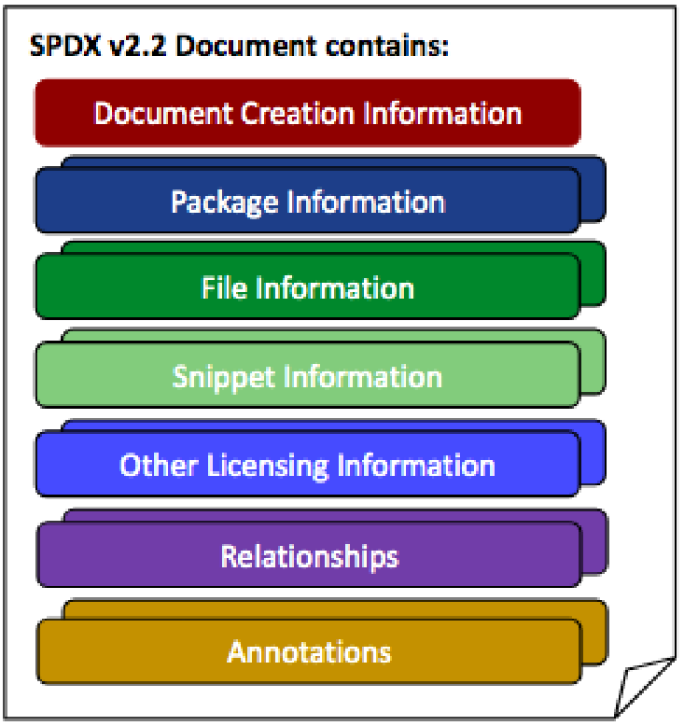
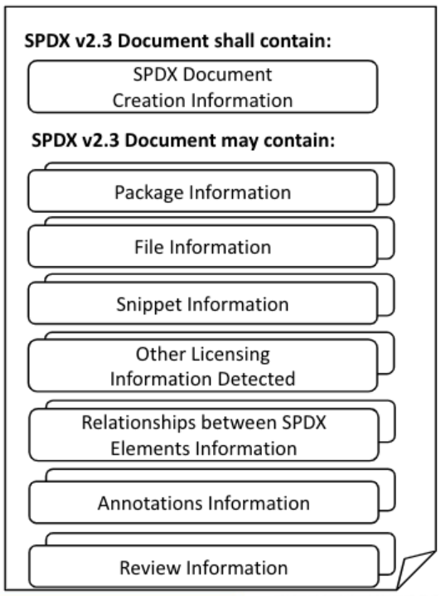
from v2.1 to v2.3
f
(re-presented)

Slide 5
A little more detail

Slide 6
from v1.0 to v1.2
v1.0
v1.1
v1.2
There is no change as a figure.

Slide 7
from v1.2 to v2.0
Multiple “Package info”s are allowed
“Relationships” appear
“Reviewer Info” disappear
“Annotations” appear

Slide 8
from v2.0 to v2.1
“Snippet Info” appear

Slide 9
from v2.1 to v2.2
There is no change as a figure.

Slide 10
from v2.2 to v2.3
(The way to draw the figure has changed.)
“Review Info” appear. (But it says “deprecated in 2.0”, so it seems the same as “Reviewer info” in 1.x and this seems to be intentinally illustrated this time.）

Slide 11
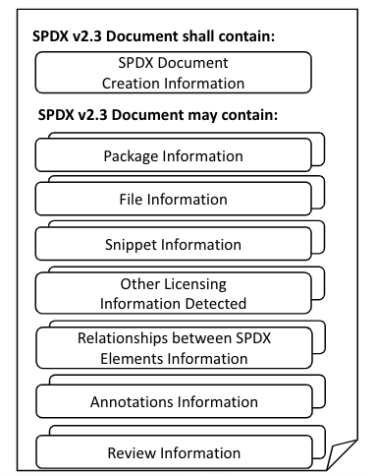
Changes from v2.3 to v3.0
v2.3
v3.0
Profile Core
Profile Software
Profile Licensing
Profile Security
Profile Build
Profile Usage
Profile AI
Profile Service

Slide 12
Changes from v2.3 to v3.0(detail)
v2.3
v3.0
Profile Core
Profile Software
Profile Licensing
Profile Security
Profile Build
Profile Usage
Profile AI
Profile Service
deprecated

Slide 13
Changes from v2.3 to v3.0 (Package Information）
v2.3
v3.0
Package Information
Profile Core
7.1 Package name field
7.2 Package SPDX identifier field
7.3 Package version field
Profile Software
7.21 External reference field
7.22 External reference comment field
Profile Licensing
7.4 Package file name field
7.5 Package supplier field
7.6 Package originator field
7.7 Package download location field
7.8 Files analyzed field
7.9 Package verification code field
7.10 Package checksum field
7.11 Package home page field
7.12 Source information field
7.18 Package summary description field
7.19 Package detailed description field
7.20 Package comment field
Profile Security
Profile Build
Profile Usage
7.25 Release Date
7.26 Built Date
7.27 Valid Until Date
Profile AI
7.13 Concluded license field
7.14 All licenses information from files field
7.15 Declared license field
7.16 Comments on license field
7.17 Copyright text field
Profile Service
7.23 Package attribution text field
7.24 Primary Package Purpose field

Slide 14
References
https://spdx.dev/specifications/

