Slide 1
Activity Report of
Planning Subgroup
（Sep.–Oct. /2018）
Hiroyuki Fukuchi

Slide 2
Part-I
Activity Report

Slide 3
Overview
Member
  Nomura, Imada, Endo, Abe, Nozue, Ueda, Yamaoka, Kobota
  Ohuchi, Harada, Asaba, Watanabe, Koizumi, Kato
  Fukuchi(reporter)
Outcome
  F2F meeting： Oct. 1st (@Toyota), Oct. 16th (@Sony), Oct. 24th (@Hitachi)
  Discussion about the direction of our activity
  Case study of business workflow (automotive, CE, IT )
  Building universal business workflow model
  Planning of all member meeting

Slide 4
Organizing ideas from the view point of
Inside Framework（Spec, Curriculum, Conformance) and Outside Framework.
Ideas Discussed
Inside Framework
Idea
★Building Guideline for Specification
Prioritizing item by Industry, Company size etc.
Specification
★Making education materials for each role in the OSS process
Procurement
Developer FAQ
Release Engineer
Management
Sales/Marketing Leaflet
Community Role Understanding the ecosystem？
仕様変更を先取り
Curriculum Teamとの分担必要
Curriculum
Conformance
Case Study (specific idea has not been proposed yet)
Outside Framework
★Organizing and analyzing case studies
★Considering usage of SPDX in supply chains

Slide 5
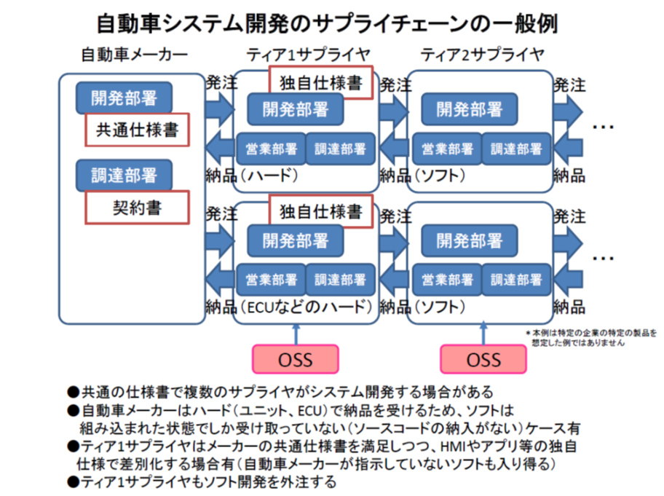
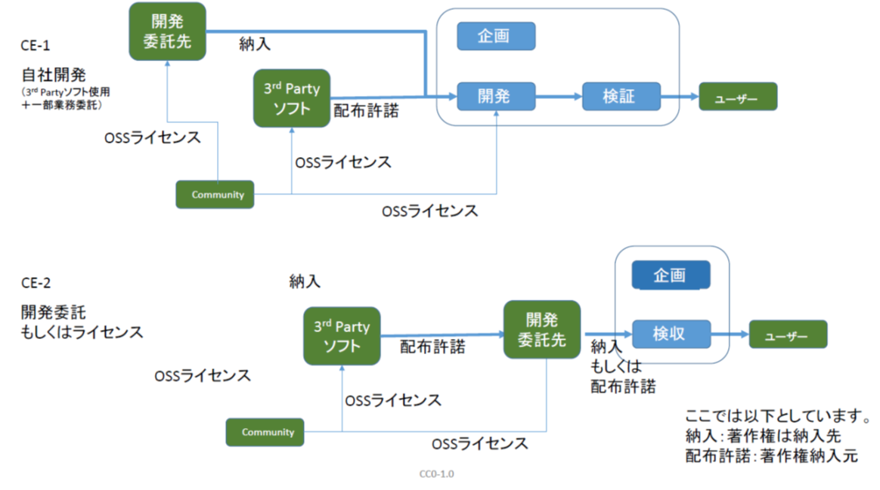
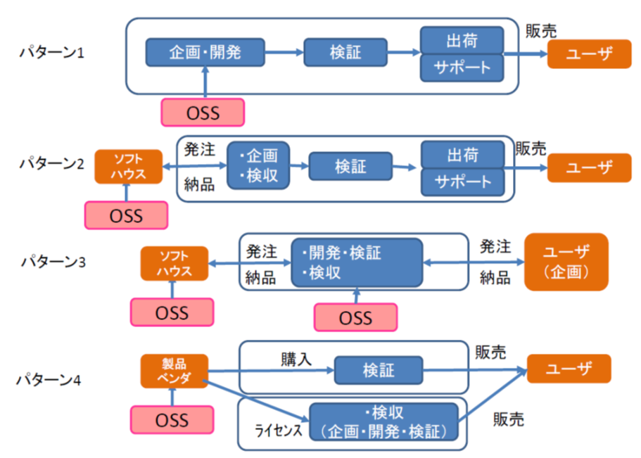
Case Study of Business Workflow
Materials are shared on GitHub
https://github.com/OpenChain-Project/Onboarding-JWG/tree/master/CaseStudy/BusinessFlow

Slide 6
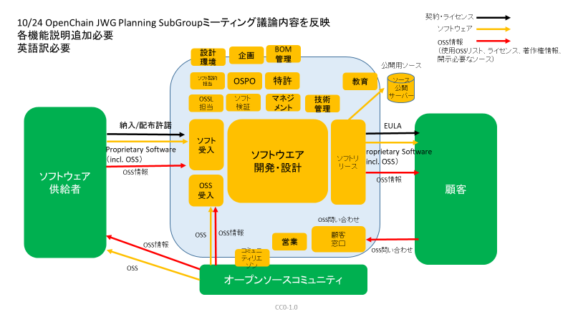
Universal Business Workflow Model

Slide 7
Applying Universal Model
Applying universal model to specific businesses

Slide 8
Part-II
New Activities

Slide 9
Proposed Items：
License Information
usage of SPDX
simple /standard version
items for exchange
background explanation
sample of format
procedure of making formatted data
tooling
Experiment of Exchange
Potentially Building Guidelines
for the Exchange of License Information
Exchanging license information between companies may be out of scope of OpenChain but is useful for the market
Software Supplier
Software Recipient
Process
Process
Open Source
License Information
OpenChain Specification
OpenChain Specification

Slide 10
Call for Proposal No.1 “license information between companies”
Call for Proposal for ideas for “exchanging license information between companies”
We would like to start the subgroup activity dedicated to this theme.
If you have proposals or comments, please contact with H.Fukuchi.
You can join the subgroup without a proposal, please contact with H.Fukuchi.
Before 10th Nov., we want to start the subgroup for preparing the first draft
at the 7th meeting(Dec. 4th). (The subgroup will continue after the meeting.)
Suggested items to be proposed：
License information
Usage of SPDX
simple /standard version
items for exchange
background explanation
sample of format
procedure of making formatted data
tooling
experiment of exchanging

Slide 11
Call for Proposal No.2 “Education for each roles”
Call for Proposal for ideas for “education for each roles”
We would like to start the subgroup activity dedicated to this theme.
If you have proposals or comments, please contact with H.Fukuchi.
You can join the subgroup even without a proposal, please contact with H.Fukuch i.
Before 10th Nov., we want to start the subgroup for preparing the first draft
at the 7th meeting(Dec. 4th). (The subgroup will continue after the meeting.)
Suggested items to be proposed：
definition of roles
education material for each roles (Inbound, Outbound, Management, legal, IP, sales, etc.)
disclosing an education material used in a company
selecting roles
collaboration with Curriculum work team

Slide 12
Organizing ideas from the view point of
Inside Framework（Spec, Curriculum, Conformance) and Outside Framework.
Ideas Discussed
Inside Framework
Idea
★Building Guideline for Specification
Prioritizing item by Industry, Company size etc.
Specification
★Making education materials for each roles in OSS process
Procurement
Developer FAQ
Release engineer
Management
Sales/Marketing Leaflet
Community Role Understanding the ecosystem？
仕様変更を先取り
Curriculum Teamとの分担必要
Curriculum
Conformance
Case Study (specific idea has not been proposed yet)
Outside Framework
★Organizing and analyzing case studies
★Considering usage of SPDX in supply chains
★Building guidelines for exchanging license information between companies

Slide 13
Proposed Milestones
2018年 10月 | 2019年 1月 | 2019年 4月 | 2019年 7月 | 2019年 10月
Japan WG
meeting
第6回
東芝
第7回
TuvSud
第8回
三菱電機
第9回
デンソーテン
Conference
OSS EU
Open Compliance Summit
Leadership Summit
OSS Japan
OSS NA
OSS EU
OpenChain
Steering
Committee
Business Workflow
Guideline for Exchanging
Education Material

