Slide 1


OpenChain Korea Meeting #9 – March 11th 2021

Slide 2
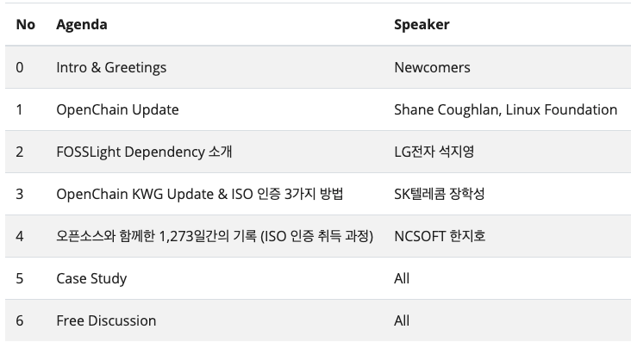
Agenda

Slide 3

Welcoming Newcomers

