Slide 1



Title
OpenChain Webinar
Sub-Title

Slide 2
Anti-Trust Policy Notice
Linux Foundation meetings involve participation by industry competitors, and it is the intention of the Linux Foundation to conduct all of its activities in accordance with applicable antitrust and competition laws. It is therefore extremely important that attendees adhere to meeting agendas, and be aware of, and not participate in, any activities that are prohibited under applicable US state, federal or foreign antitrust and competition laws.
Examples of types of actions that are prohibited at Linux Foundation meetings and in connection with Linux Foundation activities are described in the Linux Foundation Antitrust Policy available at http://www.linuxfoundation.org/antitrust-policy. If you have questions about these matters, please contact your company counsel, or if you are a member of the Linux Foundation, feel free to contact Andrew Updegrove of the firm of Gesmer Updegrove LLP, which provides legal counsel to the Linux Foundation.

Slide 3
Example Slides After This

Slide 4


Unlocking Potential
OpenChain Webinar
Case Study on ZF’s ISO 5230 third-party certification with TIMETOACT

Slide 5
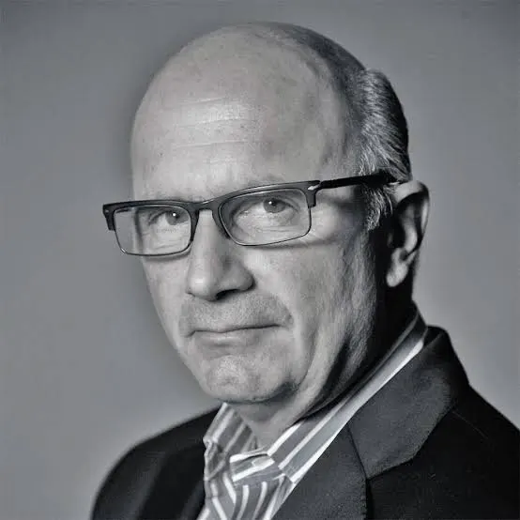

OIN - A Conversation About the Journey So Far and Preview of OIN 2.0
Featuring Keith Bergelt, CEO of OIN and Shane Coughlan, GM of OpenChain
OpenChain Webinar

Slide 6
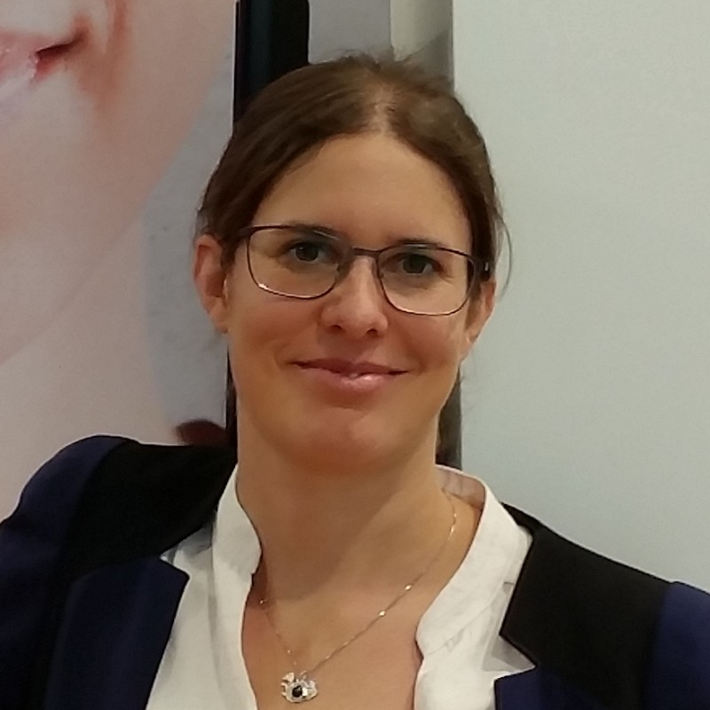
Compliant containers with the OSADL Base Image
OpenChain Webinar
Caren Kresse
OSADL-Vorstandsmitglied

Slide 7
Today We Will Have…

Slide 8
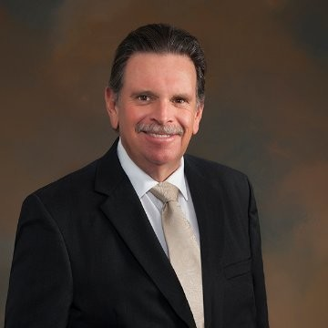


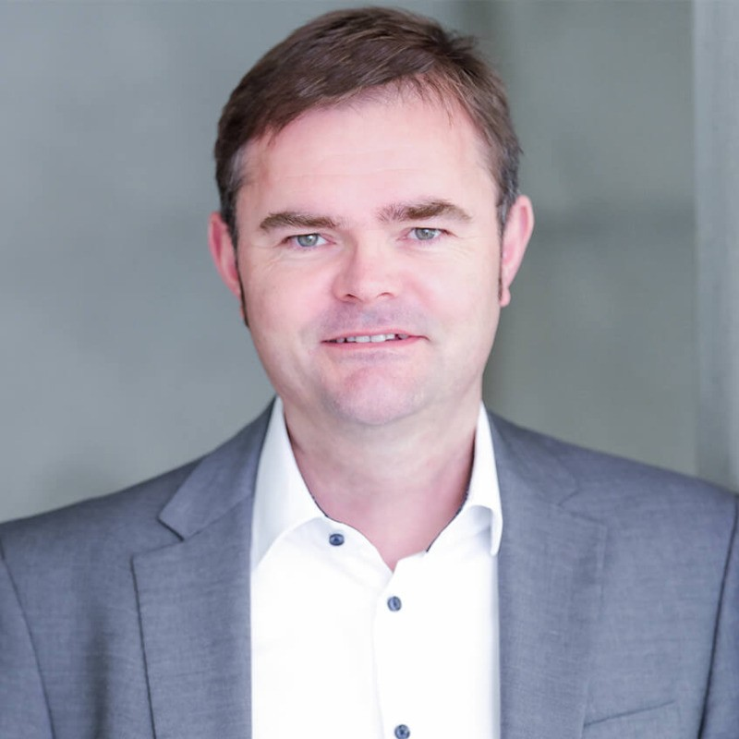
Our Panelists
Chris Wood
Caren Kresse
Heather Meeker
Mary Hardy
Till Jaeger

Slide 9
Discussion Point #1
Question from Chris to the Panel:
"I have a concern about Package Manager Transparency: The current products of several key package managers do not contain sufficient information to achieve true license compliance as many only reveal the top-level license. More often than not they fail to provide the necessary information (source code and SBOMs) for a comprehensive license assessment. Increased transparency and standardization in this area are crucial. What are your thoughts?”

Slide 10
Discussion Point #2
Question from Chris to the Panel:
"Moving on to the second question, another cause for concern lies with the design limitations of License Scanners: While license scanners are improving, many still lack the capability to deeply analyze binaries, resulting in incomplete and therefore inaccurate license compliance reports. The development of more robust and sophisticated scanning technologies is essential to address this gap. What are your thoughts?”

Slide 11
Discussion Point #3
Question from Chris to the Panel:
“I would assert that there is a need for improved developer awareness of container license and copyright information to help the community to achieve a comprehensive container license compliance process is necessary to achieve a shift in developer practices. What are your thoughts?"

Slide 12
Next Phase: Overall Context Revisted
Each panelist is invited to share their key thoughts about containers and compliance

Slide 13
Audience Questions Welcome
Starting question from Chris to the panelists:
What does the future hold for containers and compliance?

